Slide 1


The Language of Security
Exploring Practical Applications of LLMs in Cyber Security
Jesse van der Zweep

Slide 2
Table of contents
01
02
How to think about LLMs
Demos
03
04
Challenges and opportunities
Q&A

Slide 3

01
How to think about LLMs

Slide 4
They predict the next word
I hope this email finds you well. I am writing to
Given this context

Slide 5
They predict the next word
I hope this email finds you well. I am writing to extend
Given this context
Predict the next word

Slide 6
They predict the next word
…
offer
discuss
I hope this email finds you well. I am writing to extend
share
request
express
…

Slide 7
They can interpolate

Slide 8
?
They can interpolate

Slide 9
They can interpolate

Slide 10
They can interpolate

Slide 11
They can interpolate

Slide 12
But not extrapolate

Slide 13
But not extrapolate

Slide 14

LLM interpolation
Poetry
CVE data

Slide 15
LLM interpolation
Poetry
?
CVE data

Slide 16
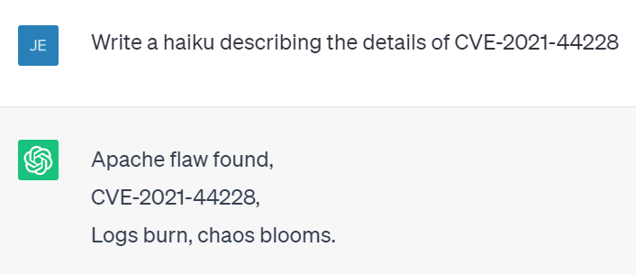
Source CVE description

Slide 17
LLM extrapolation
Data after 2021
All training data

Slide 18
LLM extrapolation
Data after 2021
?
All training data

Slide 19
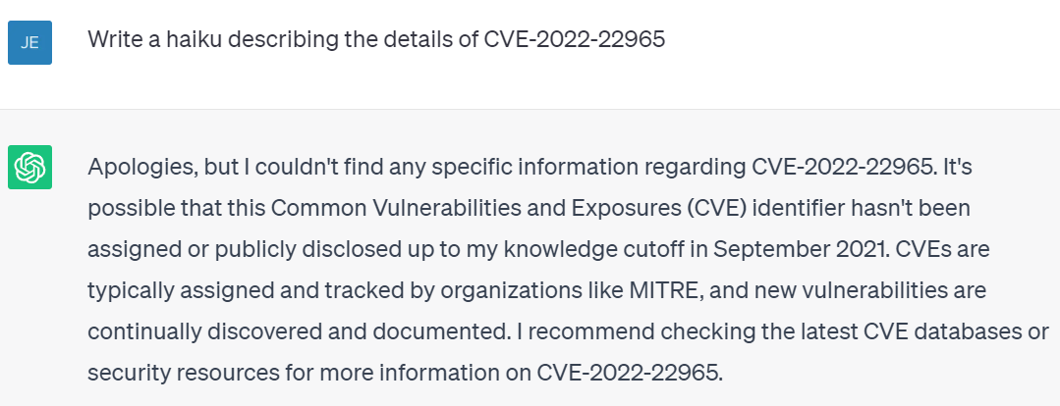
Source CVE description

Slide 20
LLMs generate text that sounds right.

Slide 21
LLMs generate text that sounds right.
Not text that is right.

Slide 22
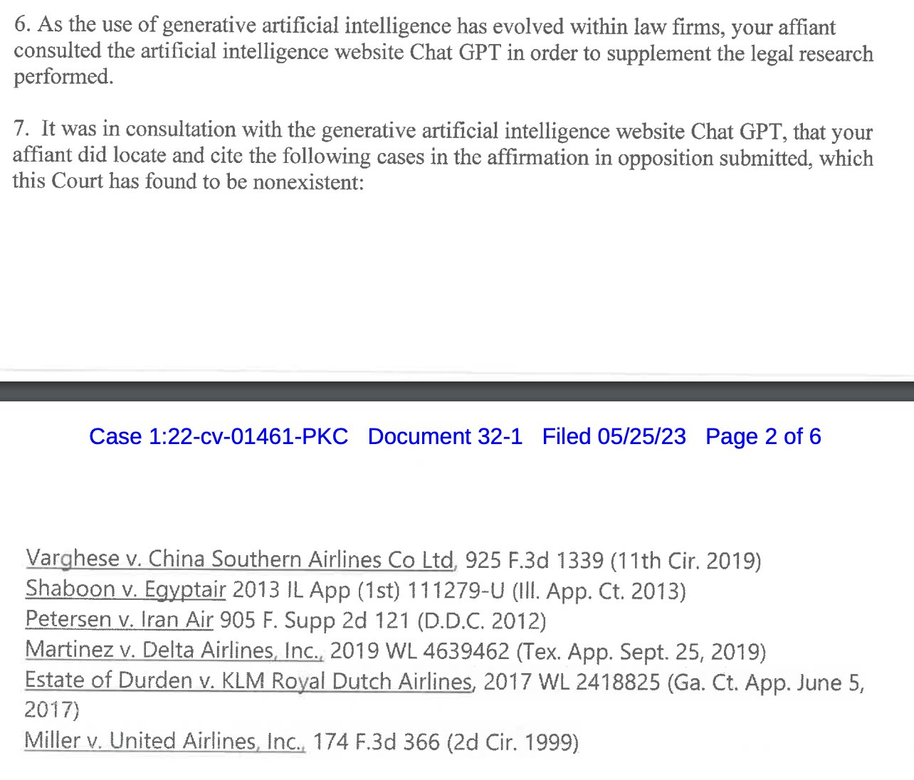
Schwartz says he was “unaware of the possibility that ChatGPT’s content could be false.”
Source

Slide 23

02
Demo use cases

Slide 24
2.1 Code understanding

Slide 25
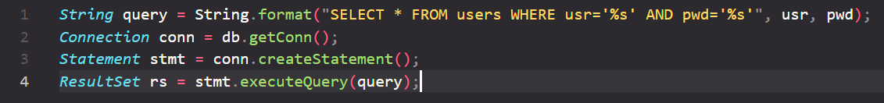
Code understanding

Slide 26
Code understanding
Is there a security flaw in this code?

Slide 27
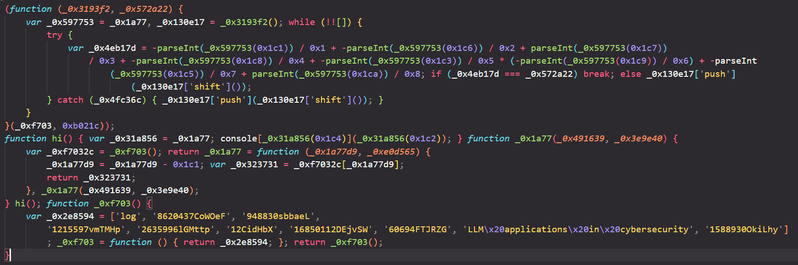
Code understanding

Slide 28
Code understanding
What does this code do?

Slide 29
2.2 Text transformation

Slide 30
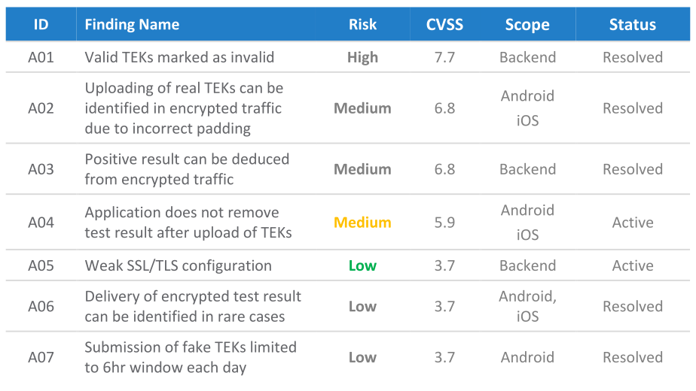
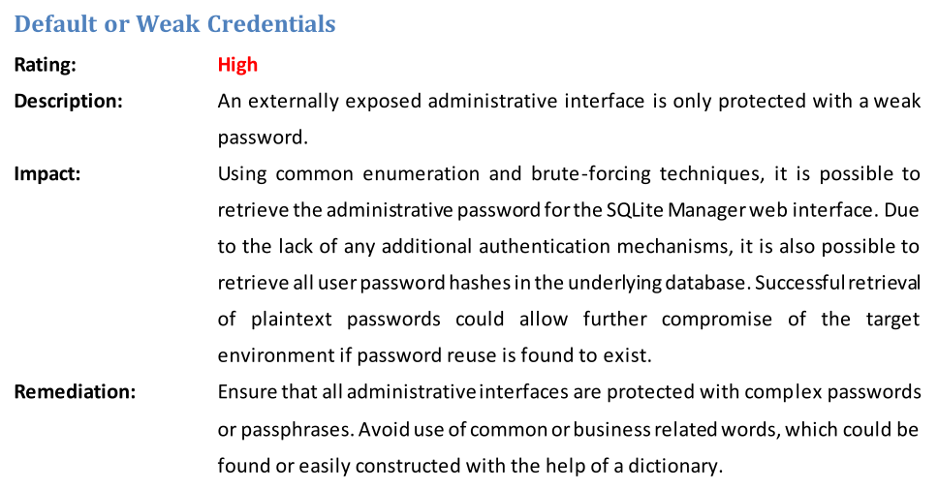
Text extraction and processing
Report 1
Report 2

Slide 31
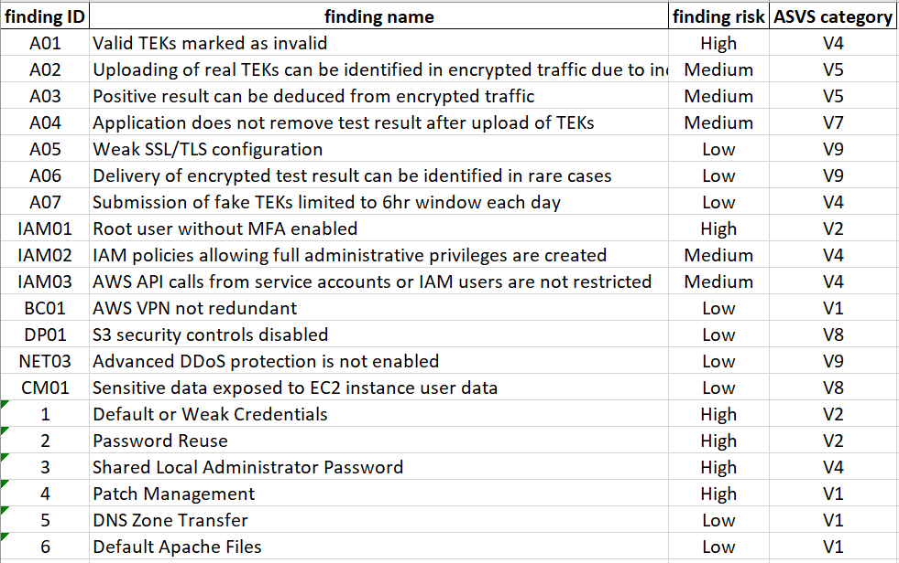
Text extraction and processing
Report 1
Report 2
Unified representation

Slide 32
2.3 Question answering

Slide 33

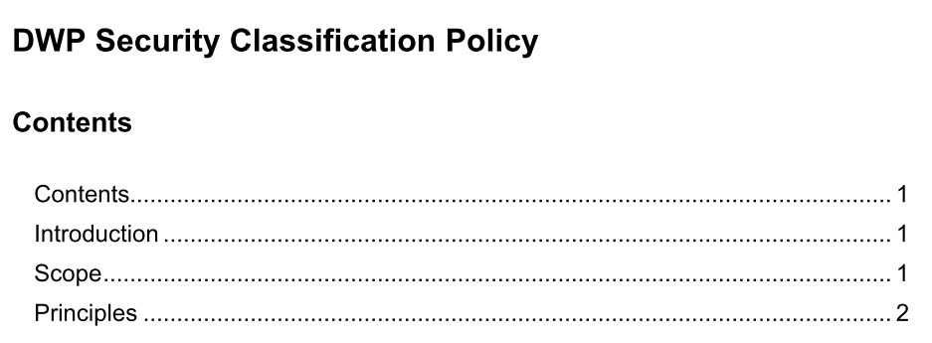
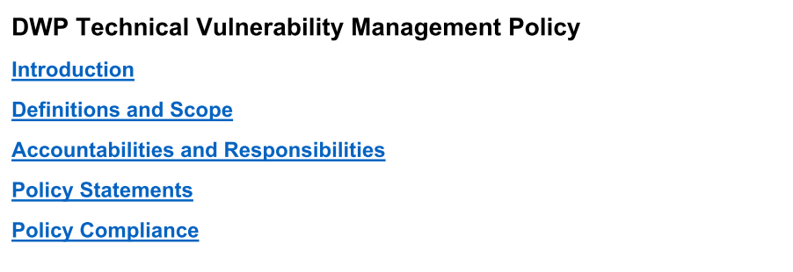
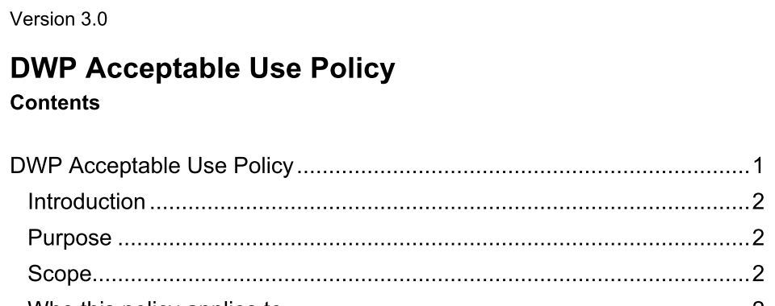
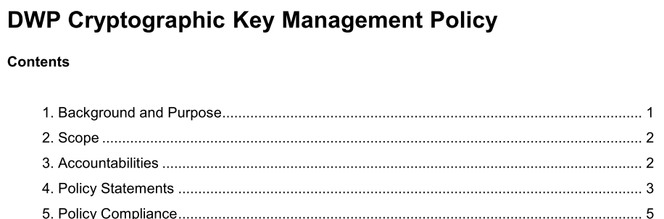
Question answering over documents
Security policy documents

Slide 34
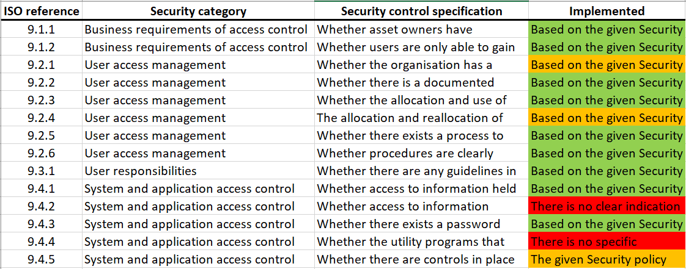
Question answering over documents
Security audit
Security policy documents

Slide 35
2.4 Threat hunting

Slide 36
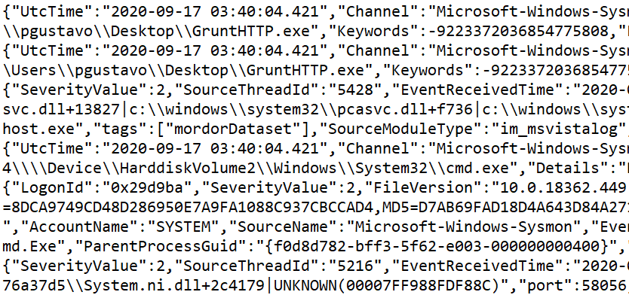
Threat hunting assistants
Help write filters searching for specific adversary tactics and techniques
Summarize chronological log activity in natural language
Decide whether there are indications of malicious activity
Raw log files

Slide 37

03
Challenges and opportunities

Slide 38
Challenges

Slide 39
Challenges
We can’t use the OpenAI API

Slide 40
Challenges
We can’t use the OpenAI API
It’s a UX problem, not an ML problem

Slide 41
Challenges
We can’t use the OpenAI API
It’s a UX problem, not an ML problem
The tools you build need to be LLM agnostic

Slide 42
Challenges
We can’t use the OpenAI API
It’s a UX problem, not an ML problem
The tools you build need to be LLM agnostic
You need solid data relevant to your use-case

Slide 43
Opportunities

Slide 44
Opportunities
The threshold for using ML has never been this low

Slide 45
Opportunities
The threshold for using ML has never been this low
The opportunities for saving time/costs are immense

Slide 46
Opportunities
The threshold for using ML has never been this low
The opportunities for saving time/costs are immense
Data privacy-friendly models/APIs will soon follow are already here

Slide 47
Opportunities
The threshold for using ML has never been this low
The opportunities for saving time/costs are immense
Data privacy-friendly models/APIs will soon follow are already here
Open source is a viable option

Slide 48

04
Questions

Slide 49
Thank you
for listening
Jesse van der Zweep
Reach me at Jesse@vanderzweep.be

