Slide 1
Algorithm Design and Applications 算法设计与应用基础

Slide 2
Grading Scheme
Homework assignments: 20%
Midterm examination: 20%
Final examination: 60%

Slide 3
Main Topics
Algorithms with Numbers & Primality
Divide & Conquer: Sorting & Medians
Graph: Decomposition, Paths
Greedy Algorithms
Dynamic Programming
Backtracking
Linear Programming & Reductions
NP-Completeness (NPC) & Coping with NPC

Slide 4
Why study algorithm and performance?
Algorithms help us to understand scalability.
Performance often draws the line between what is feasible and what is impossible.
Algorithmic mathematics provides a language for talking about program behavior.
The lessons of program performance generalize to other computing resource.
Speed is fun.
Notes:
Scalability：可量测性

Slide 5
The divide-and-conquer strategy
Breaking it into subproblems that are themselves smaller instances of the same type of problem.
Recursively solving these subproblems.
Appropriately combining their answers.

Slide 6
Quicksort
Efficient sorting algorithm
--Proposed by C.A.R. Hoare in 1962
--Divide-and-Conquer algorithm
--Sorts “in place” (like insertion sort, but not like merge sort)
--Very practical (with tuning)
--Can be viewed as a randomized Las Vegas algorithm
--Worst-case running time: Θ(n²)
--Expected running time: Θ(nlogn)
--Constant hidden in Θ(nlogn) are small.

Slide 7
Greedy Method
For many optimization problems, a greedy algorithm always makes the choice that looks best at every step. That is, it makes local optimal solution in the hope that this choice will lead to a globally optimal one.
I make the shortest path to the target at each step. Sometime I win, sometime I lose.

Slide 8
When Greedy Algorithm Works?
How can one tell if a greedy algorithm will solve a particular optimization problem? There is no way in general. If we can demonstrate the following properties, then it is probable to use greedy algorithm:
Greedy-choice property
Optimal substructure (the same with that of dynamic programming)

Slide 9
Optimization Problems
A design technique, like divide-and-conquer.
Works bottom-up rather than top-down.
Useful for optimization problems.
Four-step method:
1. Characterize the structure of the optimal solution.
2. Recursively define the value of the optimal solution.
3. Compute the value of the solution in a bottom-up fashion.
4. Construct the optimal solution using the computed information.

Slide 10
Back-Tracking Paradigm
A design technique, like divide-and-conquer.
Useful for optimization problems and finding feasible solutions.
Solution to a problem is defined as an n-tuple:
(x₁, x₂, …, x_{n}), where x_{i} is taken from a finite set
S_{i} . Generally, we need to
* finding a (or all) vector(s) that satisfy a specific
criterion function P(x₁, x₂, …, x_{n}).
* finding a vector which maximize (or minimize)
a specific objective function P(x₁, x₂, …, x_{n}).

Slide 11
Back-Tracking——General Method
Constraints
Explicit constraints:
constrain values of each component x_{i} ;
All tuples that satisfy explicit constraints
make up a possible solution space.
Implicit constraints:
* inter-components constraints;
* Implicit constraints identify those satisfying the
criterion function in the solution space.

Slide 12
Linear Programming
In a linear programming problem we are given a set of variables, and we want to assign real values to them so as to
satisfy a set of linear equations and/or linear inequalities involving these variables, and
maximize or minimize a given linear objective function.

Slide 13
LP formulation
Objective function
Constraints
max x₁ + 6x₂
x₁ ≤ 200
x₂ ≤ 300
x₁ + x₂ ≤ 400
x₁ , x₂ ≥ 0
A linear equation in x₁ and x₂ defines a line in the two-dimensional (2D) plane, and a linear inequality designates a half-space, the region on one side of the line.
Thus the set of all feasible solutions of this linear program, that is, the points (x₁ , x₂) which satisfy all constraints, is the intersection of five half-spaces.
It is a convex polygon.

Slide 14
The optimal solution
We want to find the point in this polygon at which the objective function – the profit – is maximized.
The points with a profit of c dollars lie on the line x₁ + 6x₂ = c, which has a slope of -1/6.
As c increases, this “profit line” moves parallel to itself, up and to the right. Since the goal is to maximize c , we must move the line as far up as possible, while still touching the feasible region.
The optimum solution will be the very last feasible point that the profit line sees and must therefore be a vertex of the polygon.

Slide 15
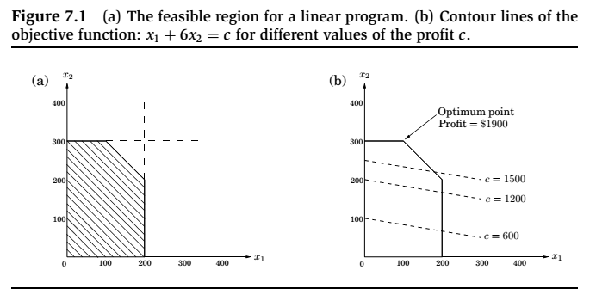
Thus the set of all feasible solutions of this linear program, that is, the points (x₁ , x₂) which satisfy all constraints, is the intersection of five half-spaces. It is a convex polygon.

Slide 16
The optimal solution (cont’d)
It is a general rule of linear programs that the optimum is achieved at a vertex of the feasible region.
The only exceptions are cases in which there is no optimum; this can happen in two ways:
The linear program is infeasible; that is, the constraints are so tight that it is impossible to satisfy all of them. For instance,
x ≤ 1, x ≥ 2.
The constraints are so loose that the feasible region is unbounded, and it is possible to achieve arbitrarily high objective values. For instance,
max x₁ + x₂, x₁ , x₂ ≥ 0

Slide 17
Solving linear programs
Linear programs (LPs) can be solved by the simplex method, devised by George Dantzig in 1947.
This algorithm starts at a vertex, and repeatedly looks for an adjacent vertex (connected by an edge of the feasible region) of better objective value.
In this way it does hill-climbing on the vertices of the polygon, walking from neighbor to neighbor so as to steadily increase profit along the way.

Slide 18
Solving linear programs, cont.
Upon reaching a vertex that has no better neighbor, simplex declares it to be optimal and halts.
Why does this local test imply global optimality? By simple geometry – think of the profit line passing through this vertex. Since all the vertex’s neighbors lie below the line, the rest of the feasible polygon must also lie below this line.

Slide 19
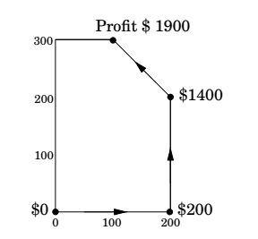

Slide 20
NP-complete problems

Slide 21
Hard problems, easy problems
Hard problems (NP-complete) | Easy problems (in P)
3sat | 2sat, Hornsat
Traveling salesman problem | Minimums panning tree
Longest path | Shortest path
3D matching | Bipartite matching
knapsack | Unary knapsack
Independent set | Independent set on trees
Integer linear programming | Linear programming
Rudrata path | Euler path
Balanced cut | Minimum cut

Slide 22
Why P and NP?
P: Polynomial time
NP: Nondeterministic Polynomial time

Slide 23
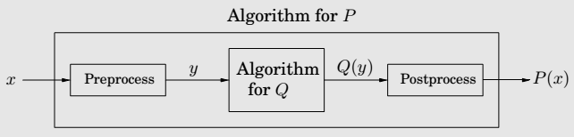
Reduction

Slide 24
Reductions, again
Even if we believe P = NP, what about the specific problems
on the left side of the table?
On the basis of what evidence do we believe that these particular problems have no efficient algorithm?
Such evidence is provided by reductions, which translate one search problem into another.
We will show that the problems on the left side of the table are all, in some sense, exactly the same problem, the hardest search problems in NP.
If even one of them has a polynomial time algorithm,
then every problem in NP has a polynomial time algorithm.

Slide 25
Reduction between search problems
A reduction from search problem A to search problem B is a polynomial time algorithm f that transforms any instance I of A into an instance f (I) of B, together with another polynomial time algorithm h that maps any solution S of f (I) back into a solution h(S) of I.
If f (I) has no solution, then neither does I.
These two translation procedures f and h imply that any algorithm for B can be converted into an algorithm for A by bracketing it between f and h.

Slide 26
NP-completeness
Definition
A search problem is NP-complete if all other search problems reduce to it.
Remark
It is not clear a priori that NP-complete problems exist at all.

Slide 27
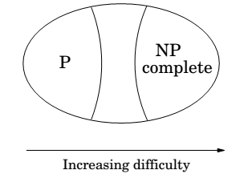

Slide 28
The two ways to use reductions
Assume there is a reduction from a problem A to a problem B.
A → B.
If we can solve B efficiently, then we can also solve A efficiently. If we know A is hard, then B must be hard too.
Reductions also have the convenient property
that they compose.
If A → B and B → C, then A → C.

Slide 29
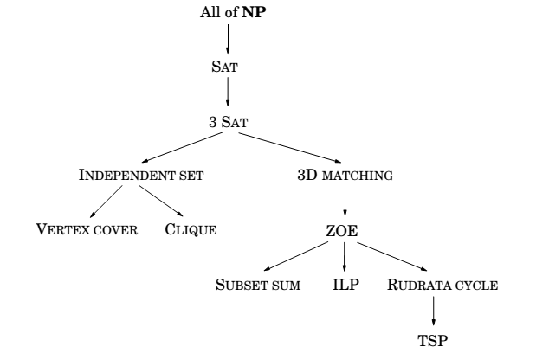
Reductions between Search Problems

Slide 30
Good luck!

