Slide 1
Examples of Greedy Algorithms
Scheduling
  Activity Selection
  Minimizing time in system
  Deadline scheduling
Graph Algorithms
  Minimum Spanning Trees
  Dijkstra’s (shortest path) Algorithm
Other Heuristics
  Huffman coding
  Coloring a graph
  Traveling Salesman Problem
  Set-covering
  Subset-sum problem

Slide 2
Greedy Method
For many optimization problems, Dynamic Programming (we are going to cover) is overkill. A greedy algorithm always makes the choice that looks best at every step. That is, it makes local optimal solution in the hope that this choice will lead to a globally optimal one.
  I make the shortest path to the target at each step. Sometime I win, sometime I lose.

Slide 3
When Greedy Algorithm Works?
How can one tell if a greedy algorithm will solve a particular optimization problem? There is no way in general. If we can demonstrate the following properties, then it is probable to use greedy algorithm:
  Greedy-choice property
  Optimal substructure (the same with that of dynamic programming)

Slide 4
Elements of Greedy Strategy
Greedy-choice property: a global optimal solution can be arrived at by making local optimal (greedy) choice
  Greedy strategy progresses in a “top-down” (instead of bottom up in dynamic programming), iteratively reducing each given problem to a smaller one
Optimal substructure: if an optimal solution to the problem contains within it optimal solutions to subproblems
  Be able to demonstrate that if optimal solution A with s₁, then the set A’ = A - {s₁} is an optimal solution to a smaller problem w/o s₁.

Slide 5
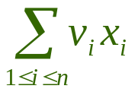
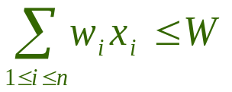
Knapsack Problem
Two variants of a classical optimization problem.
  0-1 knapsack problem
    0-1 knapsack problem: A thief robs a store and finds n items, with item i being worth $v_{i} and having weight w_{i} pounds, The thief can carry at most W ∈ N in his knapsack but he wants to take as valuable a load as possible. Which item should he take?
    i.e., is maximized and s.t.
  Fractional knapsack problem
    The setup is the same, but the thief can take fractions of items.

Slide 6
Optimal Substructure
Both knapsack problems exhibit the optimal substructure property:
  For 0-1 knapsack problem, if we remove item j from this load, the remaining load must be at most valuable items weighing at most W-w_{j} from n -1 items.
  For fractional one, if we remove a weight w of one item j from the optimal load, then the remaining load must be the most valuable load weighing at most W -w that the thief can take from the n-1 original items plus w_{j} –w pounds of item j.

Slide 7

Fractional Knapsack
There are 5 items that have a value and weight list below, the knapsack can contain at most 100 Lbs.
Method 1 choose the least weight first
  Total Weight = 10 + 20 + 30 + 40 = 100
  Total Value = 20 + 30 + 65 + 40 = 155
Method 2 choose the most expensive first
  Total Weight = 30 + 50 + 20 = 100
  Total Value = 65 + 60 + 20 = 145
Method 3 choose the most value/ weight per unit first
  Total Weight = 30 + 10 + 20 + 40 = 100
  Total Value = 65 + 20 + 30 + 48 = 163
What can you draw?

Slide 8
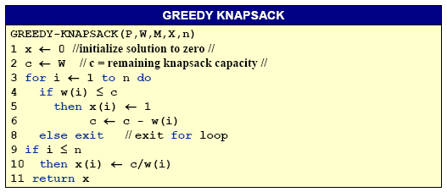
Greedy for Fractional Knapsack
p, w,W, x, n
p(1:n) and w(1:n) contain the values and weights respectively of the n items ordered so that p(i)/w(i) ≥ p(i+1)/w(i+1). W is the knapsack size and x(1:n) is the solution vector.

Slide 9
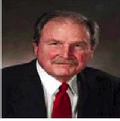
Huffman codes
Data Compression via Huffman Coding
  Motivation
    Limited network bandwidth.
    Limited disk space.
  Human codes are used for data compression.
    Reducing time to transmit large files, and
    Reducing the space required to store them on disk or tape.
  Huffman codes are a widely used and very effective technique for compressing data, savings of 20% to 90% are typical, depending on the characteristics of the data.

Slide 10
Huffman codes
Problem
  Suppose that you have a file of 100K characters. To keep the example simple, suppose that each character is one of the 6 letters from a through f. Since we have just 6 characters, we need just 3 bits to represent a character, so the file requires 300K bits to store. Can we do better?
  Suppose that we have more information about the file:
    the frequency which each character appears.
Solution
  The idea is that we will use a variable length code instead of a fixed length code (3 bits for each character), with fewer bits to store the common characters, and more bits to store the rare characters.

Slide 11

Example of Data Compression
For example, suppose that the characters appear with the following frequencies, and following codes:
Then the variable-length coded version will take not 300K bits but 45∗1 + 13∗3 + 12∗3 + 16∗3 + 9∗4 + 5∗4 = 224K bits to store, a 25% saving. In fact this is the optimal way to encode the 6 characters present, as we shall see.

Slide 12
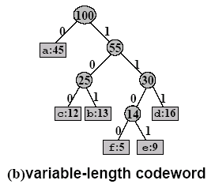
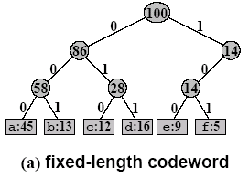
Characteristic of Optimal Code
  Represented as a binary tree whose leaves are the given characters.
  In an optimal code each non-leaf node has two children.

Slide 13
Prefix-free Code
In a Prefix code¹ no codeword is a prefix of another code word.
  Easy encoding and decoding.
To encode, we need only concatenate the codes of consecutive characters in the message.
  The string 110001001101 parses uniquely as 1100-0-100-1101, which decodes to FACE.
To decode, we have to decide where each code begins and ends.
  Easy, since, no codes share a prefix.
1 “prefix-free codes” would be a better name, but the term “prefix codes” is standard in the literature

Slide 14


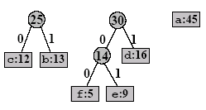

Example of Huffman codes

Slide 15
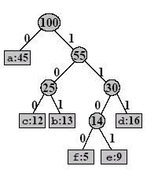
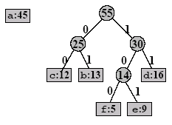
Example of Huffman codes
(cont.)
Notes:
霍夫曼树是带权路径长度(WPL:Weighted Path Length)最小的二叉树

Slide 16
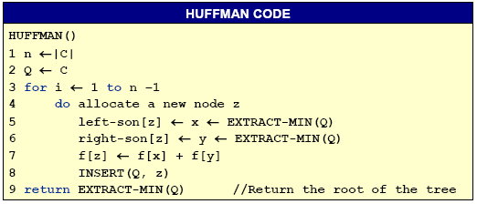
Algorithm of Huffman Coding
The greedy algorithm for computing the optimal Huffman coding tree T is as follows.
  It starts with a forest of one-node trees representing each c ∈C, and merges them in a greedy style, using a priority queue Q, sorted by the smallest frequency:

