Slide 1
BIGMART SALES PREDICTION SYSTEM
Here is where your presentation begins

Slide 2
CONTENTS
Objective | 3
Problem Statement | 4
Proposed Solution | 5
Technology | 6
Design | 7
Implementation | 8
Conclusion | 9

Slide 3


TABLE OF CONTENTS
01
Objective
02
Problem Statement
03
Proposed Solution
04
Technology
Design
Implementation

Slide 4
01
OBJECTIVE
The objective of this framework is to predict the future sales from given data of the previous year's using Machine Learning Techniques.
Another objective is to conclude the best model which is more efficient and gives fast and accurate result.
To find out key factors that can increase their sales and what changes could be made to the product or store's characteristics.

Slide 5
Problem Statement
Nowadays, shopping malls and Big Marts keep track of individual item sales data in order to forecast future client demand and adjust inventory management.
In a data warehouse, these data stores hold a significant amount of consumer information and particular item details. By mining the data store from the data warehouse, more anomalies and common patterns can be discovered.

Slide 6
Proposed Solution
The proposed system gives most effective predictive analytics solution for sales forecasting, it predict the future sale and demand of the products available in the mart.
Furthermore, the system extends its functionalities by predicting the sales of outlet based on the trained datasets.

Slide 7
Technology
Python
Font end – HTML, CSS
Back end – Flask
Deployment – Heruko

Slide 8
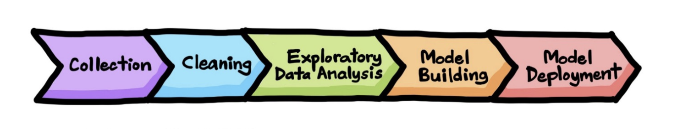
Project Development Stage

Slide 9
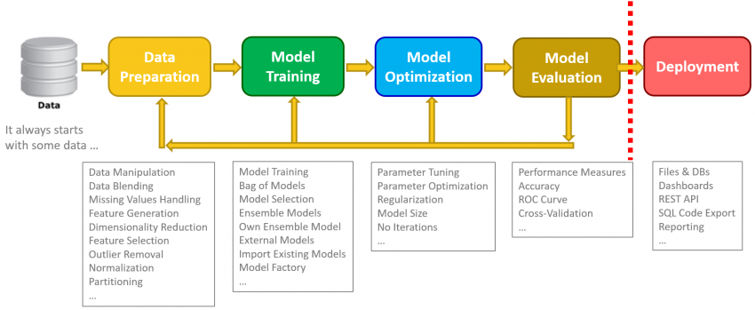
Project Development Stage

