Slide 1
CAPSTONE PROJECT
DATA SCIENCE PROJECT
Presented By:
Jessica Ravindran - ACTech – Industrial Biotechnology

Slide 2
OUTLINE
Problem Statement
Proposed System/Solution
System Development Approach
Algorithm & Deployment
Result
Conclusion
Future Scope
References

Slide 3
PROBLEM STATEMENT
Python Program for Flight Ticket Reservation System

Slide 4
PROPOSED SOLUTION
To develop a Python program for flight ticket booking, you'll need to design and implement a system that handles various aspects such as flight schedules, seat availability, user authentication, booking transactions, and more. Below are proposed solutions covering key functionalities and considerations for building a flight ticket booking program in Python:
1.⁠ ⁠Object-Oriented Design (OOD): Use classes and objects to model entities like Flight, Ticket, User, and Booking. This facilitates a structured approach to representing flight system components.
2.⁠ ⁠User Authentication and Management: Implement user authentication functionalities to allow users to create accounts, log in, and manage their profiles.

Slide 5
3.⁠ ⁠Flight and Seat Management Solution: Manage flight schedules, seat availability, and bookings within the booking system.
4.⁠ ⁠Booking Transactions: Implement logic to handle booking transactions, including seat reservations and ticket issuance.
5.⁠ ⁠Data Persistence and Storage: Implement data storage using file handling or databases (e.g., SQLite, PostgreSQL) to persist flight schedules, user information, and booking records.

Slide 6
SYSTEM APPROACH
1. User Interface:
Frontend Interface: Users interact with the system through a graphical user interface (GUI) or command-line interface (CLI).
Input Validation: Validate user inputs to ensure correctness and prevent invalid data entry.
2. Data Management:
Flight Data:
Maintain a database or data structure to store information about flights, including flight number, name, available seats, departure time, and possibly other attributes like class, fare, etc.
Store this data in a format that allows for efficient retrieval and modification.
Bookings Data:
Store information about bookings, including booking ID, flight number, number of seats booked, and passenger details (name, age, contact).
Each booking should be linked to a specific flight and have a unique identifier.

Slide 7
Functionalities:
Display Available Flights:
Retrieve information about available flights and display them to the user.
Include details like flight number, name, available seats, departure time, etc.
Book Tickets:
Allow users to book tickets for a selected flight.
Collect necessary details like flight number, number of seats, passenger information.
Update the available seats for the selected flight after booking.
Cancel Tickets:
Enable users to cancel their booked tickets by providing the booking ID.
Update the available seats for the respective flight after cancellation.
View Booking Details:
Allow users to view details of their booked tickets by providing the booking ID.
Display booking details including flight number, number of seats booked, passenger details, etc.

Slide 8
4. Business Logic:​
Validation:​
Validate user inputs to ensure they are within acceptable ranges and formats.​
Check for seat availability before booking.​
Handle edge cases and error conditions gracefully.​
Concurrency Control:​
Implement measures to handle concurrent access to the same data, preventing race conditions and ensuring data integrity.​
Use locks or other synchronization mechanisms if necessary.
5. Security:
User Authentication:
Implement user authentication to ensure only authorized users can access certain functionalities (e.g., booking, cancellation).
Protect sensitive data like user passwords using encryption.
Data Privacy:
Ensure that passenger details are stored securely and access is restricted to authorized personnel only.

Slide 9
6. Administration:​
Admin Interface:​
Provide an interface for administrators to manage flights, bookings, and user accounts.​
Allow admins to add/remove flights, modify seat availability, view booking history, etc.
7. Error Handling and Logging:
Error Handling:
Handle errors gracefully and provide informative error messages to users.
Log errors and exceptions for debugging and monitoring purposes.

Slide 10
ALGORITHM & DEPLOYMENT
Algorithm:
1. Initialization:
Initialize the FlightReservationSystem class.
Initialize flight data and booking data (either from a file/database or hardcoded).
2. Display Menu:
Display a menu with options: Display Flights, Book Ticket, Cancel Ticket, View Booking Details, and Exit.
3. Display Flights:
Iterate through the flight data and display flight details (flight number, name, departure time, and available seats).

Slide 11
4. Book Ticket:​
Prompt the user to enter the flight number, number of seats, and passenger details.​
Check if the flight exists and if there are enough available seats.​
If valid, decrement the available seats, generate a booking ID, and store booking details.​
Display a success message with the booking ID.
5. Cancel Ticket:
Prompt the user to enter the booking ID to cancel.
Check if the booking ID exists.
If valid, increment the available seats, remove the booking from the booking data.
Display a success message.

Slide 12
6. View Booking Details:
Prompt the user to enter the booking ID.
Display the details of the booking if the ID exists.
7. Exit:
Exit the program.

Slide 13
Deployment:
1. Local Deployment:
Run Locally: Run the Python program on a local machine.
Installation: Ensure Python is installed. Execute the program in a Python IDE or command line.
Advantages: Simple setup, suitable for development and testing.
Disadvantages: Not accessible remotely, requires installation on each machine.
2. Web Application:
Web Framework: Use Python web frameworks like Flask or Django.
Deployment Platform: Deploy the web application on platforms like Heroku, AWS, or DigitalOcean.
Advantages: Accessible from any device with an internet connection, scalable, and easier maintenance.
Disadvantages: More complex setup, requires web development skills.

Slide 14
3. Cloud Deployment:
Serverless Computing: Utilize serverless platforms like AWS Lambda or Google Cloud Functions.
Containerization: Use Docker containers and deploy on container orchestration platforms like Kubernetes.
Advantages: Scalable, cost-effective, and managed infrastructure.
Disadvantages: Learning curve for setting up serverless or containerized environments.
4. Desktop Application:
GUI Framework: Use Python GUI frameworks like Tkinter, PyQt, or wxPython.
Deployment: Package the application using tools like PyInstaller or cx_Freeze.
Advantages: No need for internet connection, easy distribution.
Disadvantages: Platform-dependent, less accessible than web applications.

Slide 15
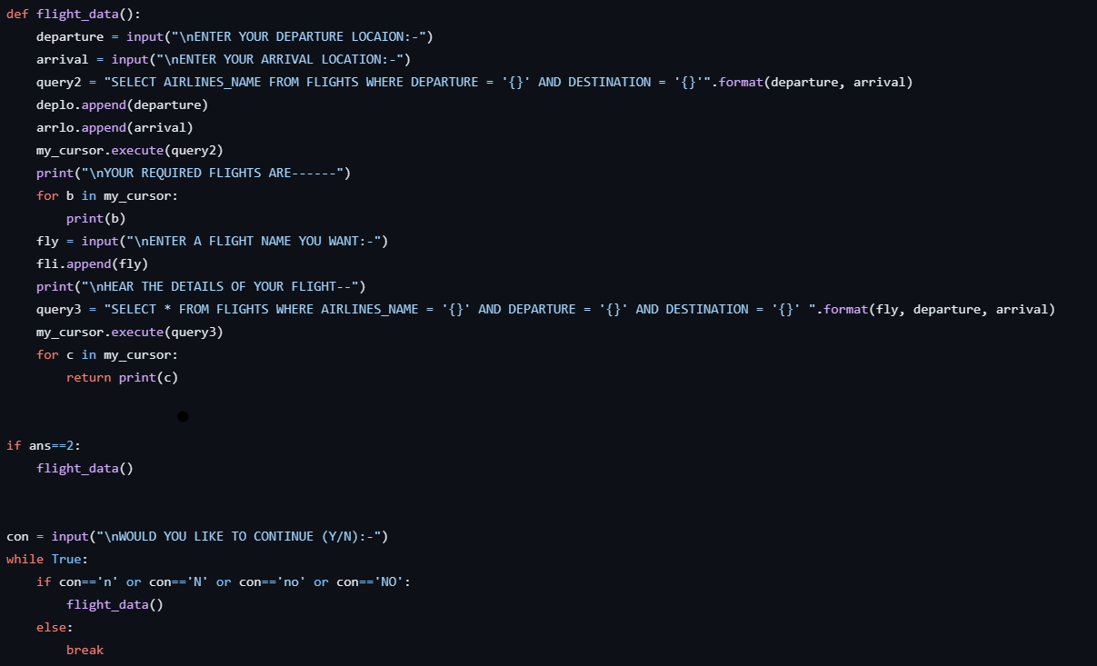
RESULT

Slide 16
CONCLUSION
The Flight Reservation System is a crucial system that facilitates the booking and management of flight tickets. In this system, we have designed a Python program to handle basic functionalities like booking tickets, canceling tickets, and viewing flight details.
Key Points:
Functionality: Users can view available flights, book tickets for a specific flight, cancel booked tickets, and view booking details.
Data Management: Flight data and booking data are stored using dictionaries and lists.
User Interface: The system provides a simple menu-driven interface for users to interact with.

Slide 17
4. Error Handling: Input validation and error messages are provided to ensure smooth user experience.
5. System Design: The system is designed with clear components: user interface, data management, functionality, error handling, and control flow.
6. Optional Features: The system can be extended with features like user authentication, admin interface, and data persistence.

Slide 18
FUTURE SCOPE
Mobile Ticketing and NFC Technology
AI-Powered Customer Service
Dynamic Pricing and Revenue Management
4. Predictive Maintenance
5. Biometric Identification and Security
6. Integration with Public Transport
7. Augmented Reality (AR) for Navigation

Slide 19
THANK YOU

