Slide 1
Agenda
History
What is Wireless ?
IEEE 802.11 Standard
Basic Terminology
IEEE 802.11 architecture
Types Of WLAN Networks
Data Rates
IEEE 802.11 architectural services
Frame Types
Scanning Procedure
Authentication Procedure
Association / Re-association Procedure
Power Management In BSS

Slide 2
History
WiFi is used to “describe the underlying technology of wireless local area networks (WLAN) based on the IEEE 802.11 specifications
IEEE 802.11 “denotes a set of Wireless LAN/WLAN standards developed by working group 11 of the IEEE LAN/MAN Standards Committee (IEEE 802)”

Slide 3
Wireless?
A wireless LAN or WLAN is a wireless local area network that uses radio waves as its carrier.
The last link with the users is wireless, to give a network connection to all users in a building or campus.
The backbone network usually uses cables.

Slide 4
MAC(Medium Access Control)
What is WiFi MAC Protocol?
It is the underlying technology of wireless local area networks (WLAN) based on the IEEE 802.11 specifications that provides the data link layer of the Ethernet LAN system.
Who came up with WiFi MAC Protocol?
The IEEE Task Groups and created the IEEE 802.11 or IEEE 802.11x Committee, however IEEE only sets specifications. WiFi Alliance runs the certification program.

Slide 5
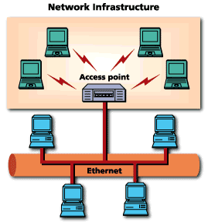
Common Topologies
The wireless LAN connects to a wired LAN
There is a need of an access point that bridges wireless LAN traffic into the wired LAN.
The access point (AP) can also act as a repeater for wireless nodes, effectively doubling the maximum possible distance between nodes.

Slide 6
How are WLANs Different?
They use specialized physical and data link protocols
They integrate into existing networks through access points which provide a bridging function
They let you stay connected as you roam from one coverage area to another
They have unique security considerations
They have specific interoperability requirements
They require different hardware
They offer performance that differs from wired LANs.

Slide 7
Physical and Data Link Layers
Physical Layer:
The wireless NIC takes frames of data from the link layer, scrambles the data in a predetermined way, then uses the modified data stream to modulate a radio carrier signal.
Data Link Layer:
Uses Carriers-Sense-Multiple-Access with Collision Avoidance (CSMA/CA).

Slide 8
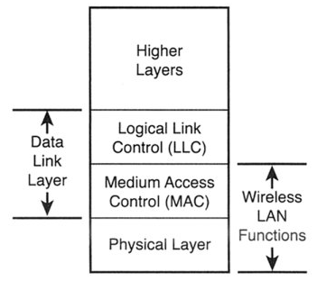
A TCP/IP packet in 802.11

Slide 9
A TCP/IP packet in 802.11
TPC/IP send data packet
Control
header
LLC constructs PDU by adding a control header
SAP (service access point)
MAC frame with new control fields
MAC lines up packets using carrier sense multiple access (CSMA)
PHY layer transmits packet
using a modulation method
(DSSS, OFDM, IR, FHSS)
Traffic to the
target BSS / ESS
*BDU: protocol data unit

Slide 10
IEEE 802.11 Standard
PHY/MAC standard for wireless LANs
First standardized in 1997
Meet great success starting in 1999
Several working groups
IEEE 802.11a: high speed extension to the 5GHz band
802.11b/g: high speed extension to the 2.4GHz band
802.11e: Quality of service (QoS) enhancement (still active)
802.11i: Security enhancement
802.11s: Mesh-networking support
802.11k,802.11h

Slide 11
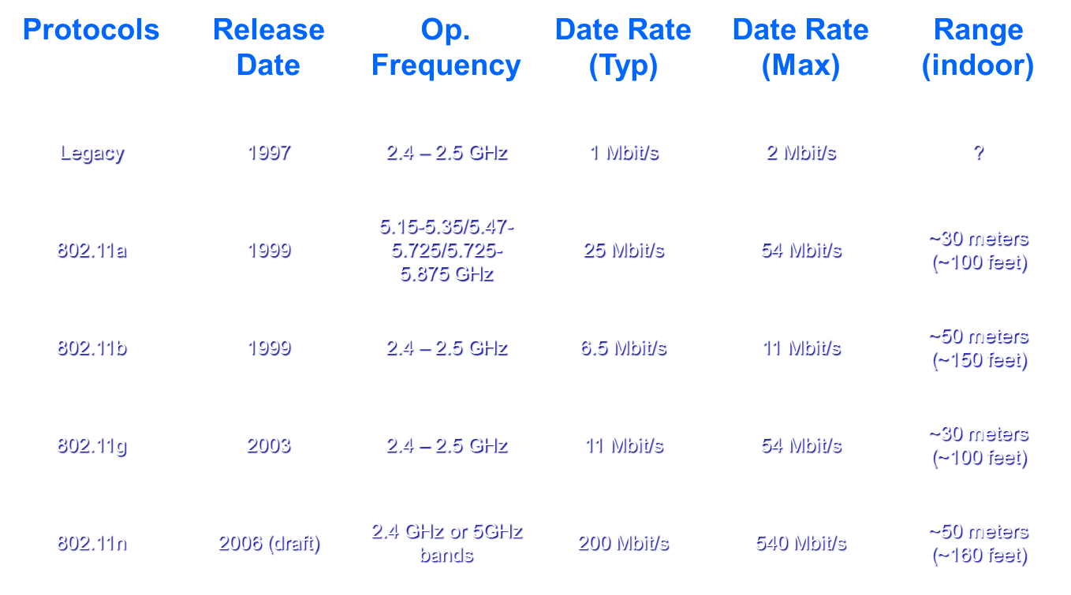
Protocols

Slide 12
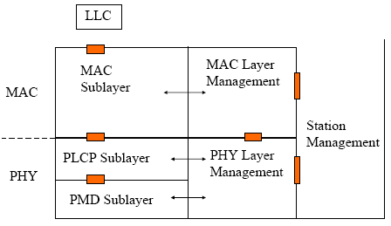
802.11 Protocol Entities

Slide 13
Basic Terminology
Access Point:
It is an entity that has station functionality and provides access to the distribution services, via WM for the associated stations. In simple term AP acts as bridge between the Ethernet and WM.
Station:
Any device that contains an IEEE 802.11 conformant MAC and PHY layer interface to the Wireless Medium. For example a laptop with a WLAN adapter becomes / forms a station.
Authentication:
The service used to establish the identity of one station as a member of the set of stations authorized to associate with another station.

Slide 14
Basic Terminology
Association:
The service used to establish access point/station (AP/STA) mapping and enable STA invocation of the distribution system services (DSSs).
Reassociation:
The service that enables an established association [between access point (AP) and station (STA)] to be transferred from one AP to another (or the same) AP.
Disassociation:
The service that removes an existing association.
Basic service set (BSS):
A set of stations controlled by a single coordination function.

Slide 15
Basic Terminology
Basic Service Area (BSA):
The conceptual / logical area within which all the members of BSS may communicate with each other
Basic Service Set (BSS) basic rate set:
Also known as basic rates. Set of data transfer rates that all the stations in a BSS will be capable of using to receive frames from the WM. In case of Infrastructure network AP will announce these basic rates set in Beacons and Probe Response packets. In case of IBSS network the creator will announce the basic rate set in same Beacons and Probe Response packets. Usually Management and Control frames will be transmitted using one of the supported basic rate set,
Extended Rate Set (ERS):
Set of data transfer rates supported by the station beyond the basic rate set. Stations make use of extended rate set for transferring data frames at highest possible rate.

Slide 16
Basic Terminology
Extended Service Set (ESS):
Set of one or more interconnected BSSs and integrated LANs that appears as single BSS to the LLC layer at any station associated with one of those BSSs.
Independent Basic Service Set (IBSS):
A BSS that forms a self contained network and in which there is no access to the distribution system is available. In simple terms a network formed between two stations form an IBSS network where there is no access to the Ethernet medium. The station which creates IBSS network is called as Creator and the station which joins the existing IBSS network is called as Joiner.
Distribution System (DS):
A system used to interconnect a set of BSSs and integrated LAN to create ESS

Slide 17
Basic Terminology
Deauthentication:
The service that voids an existing authentication relationship.
Extended service area (ESA):
The conceptual area within which members of an extended service set (ESS) may communicate. An ESA is larger than or equal to a basic service area (BSA) and may involve several basic service sets (BSSs) in overlapping, disjointed, or both configurations.
medium access control (MAC) service data unit (MSDU):
Information that is delivered as a unit between MAC service access points (SAPs).

Slide 18
Basic Terminology
Medium access control (MAC) protocol data unit (MPDU):
The unit of data exchanged between two peer MAC entities using the services of the physical layer (PHY).
Medium access control (MAC) management protocol data unit (MMPDU):
The unit of data exchanged between two peer MAC entities to implement the MAC management protocol.
Network allocation vector (NAV):
An indicator, maintained by each station, of time periods when transmission onto the wireless medium (WM) will not be initiated by the station whether

Slide 19
Basic Terminology
Distribution System Medium (DSM):
The medium or set of media used by the DS for the communication between the APs and Portals of an ESS.
Distribution System Services (DSS):
The set of services provided by the DS. These services are used for the delivery of MSDU between the two stations in an ESS, between two APs in an ESS, between two stations within a BSS and between AP and portals in an ESS
Distribution system services are:
Association / Re-association / Disassociation
Distribution / Integration

Slide 20
Basic Terminology
Distributed Coordination Function (DCF):
A coordination function that runs in all the stations within a BSS whenever the network is in operation. DCF is responsible for acquiring the channel for data transaction by the stations in a BSS. The DCF function helps in avoiding the packet collisions on WM.
point coordination function (PCF):
A class of possible coordination functions in which the coordination function logic is active in only one station in a basic service set (BSS) at any given time that the network is in operation.
portal:
The logical point at which medium access control (MAC) service data units (MSDUs) from a non-IEEE 802.11 local area network (LAN) enter the distribution system (DS) of an extended service set (ESS).

Slide 21
IEEE 802.11 architecture

Slide 22
802.11 LAN architecture
wireless host communicates with base station
base station = access point (AP)
Basic Service Set (BSS) (aka “cell”) in infrastructure mode contains:
wireless hosts
access point (AP): base station
ad hoc mode: hosts only
Internet
hub, switch
or router
AP
BSS 1
AP
BSS 2

Slide 23
Different Types WLAN Networks
WLAN Network can be any one of the following two forms
Infrastructure / BSS Network
AP, mobile station and integrated LAN forms infrastructure network.

Slide 24
Different Types WLAN Networks
IBSS(ad-hoc)

Slide 25
Data Rates
The data rates supported by 802.11b standard
1, 2, 5.5 and 11Mbps
The data rates supported by 802.11g standard
1, 2 ,5.5, 11, 6, 9, 12, 18, 24, 36, 48 and 54
The data rates supported by 802.11a standard
6, 12 and 24Mbps are mandatory and
9, 18, 36, 48 and 54Mbps are optional
AP and IBSS creators announce set of Basic rates and supported rates in the Beacons and Probe Response packets. Station announces supported rate information in Probe Request and (Re)Association packets

Slide 26
IEEE 802.11 architectural services
The complete set of IEEE 802.11 architectural services are as follows:
a) Authentication
b) Association
c) Deauthentication
d) Disassociation
e) Distribution
f) Integration
g) Privacy
h) Reassociation
i) MSDU delivery
These services are supported by using one or more MAC frame types (Management / Control / Data messages)

Slide 27
IEEE 802.11 architectural services
This set of services is divided into two groups: those that are part of every STA, and those that are part of a DS.
Station Services (SS):
The SS is present in every IEEE 802.11 station (including APs, as APs include station functionality). The SSis specified for use by MAC sublayer entities. All conformant stations provide SS.
The SS is as follows:
a) Authentication
b) Deauthentication
c) Privacy
d) MSDU delivery

Slide 28
IEEE 802.11 architectural services
Distribution system service (DSS)
The service provided by the DS is known as the distribution system service
The DSSs are as follows:
a) Association
b) Disassociation
c) Distribution
d) Integration
e) Reassociation

Slide 29
Distribution system service (DSS)
Distribution Service (DS):
This service is invoked by the station whenever station wants to send or receive the data packet via distribution system media
Integration Service:
The integration service is invoked by the distribution system when MSDU
has to be delivered from DSM media to the integrated LAN portal and visa
Versa
Association Service:
To deliver the message within a DS, the distribution service needs to know which AP to access for given 802.11station.The station is allowed to send the data message via an AP only if it is associated with the AP. This act of becoming associated with the AP invokes association service. Association procedure provides AP to station mapping. The DS comes to know which AP it has to access for delivering MSDU to the station by this unique station to AP mapping

Slide 30
Reassociation Service:
Reassociation service is invoked to move current association from one AP to another AP. This keeps the DS informed of the current mapping between the AP and station as station moves from one BSS area to another BSS area
Association and reassociation services are invoked by the mobile station
Disassociation Service:
The disassociation service is invoked when existing association is to be terminated. The disassociation service can be invoked by either AP or mobile station. Disassociation is a notification, not a request. Disassociation cannot be refused by either party to the association. STAs shall attempt to disassociate whenever they leave a network.

Slide 31
Station Services
Authentication Service:
IEEE 802.11 provides the ability to control LAN access via the authentication service. This service is usedby all stations to establish their identity to stations with which they will communicate.
If a mutually acceptable level of authentication has not been established between two stations, an association shall not be established.
IEEE 802.11 provides link-level authentication between IEEE 802.11 STAs i.e. up to MAC level. This use of authentication is independent of any authentication process that may be used in higher levels of a network protocol stack.)
IEEE 802.11 authentication are
Open System Authentication
Shared Key Authentication

Slide 32
Station Services
Deauthentication Service:
The deauthentication service is invoked whenever an existing authentication is to be terminated. In an ESS, since authentication is a prerequisite for association, the act of deauthentication shall cause the station to be disassociated. The deauthentication service may be invoked by either authenticated party (non-AP STA or AP). Deauthentication is not a request; it is a notification. Deauthentication shall not be refused by either party. When an AP sends a deauthentication notice to an associated STA, the association shall also be terminated.
Privacy Service:
IEEE 802.11provides the ability to encrypt the contents of messages using optional WEP algorithm. This functionality is provided by the privacy service. Note that privacy may only be invoked for data frames and some Authentication Management frames.

Slide 33
Relationships between services
A STA keeps two state variables for each STA with which direct communication via the WM is needed:
Authentication state: The values are unauthenticated and authenticated.
Association state: The values are unassociated and associated.
These two variables create three local states for each remote STA:
State 1:unauthenticated, unassociated.
State 2:Authenticated, not associated.
State 3:Authenticated and associated.

Slide 34
Frame Types
Frames are classified into 3 different categories
Control Frames
Management Frames
Data Frames
Control Frames:
Control frames assist in the delivery of IEEE 802.11 Data frames and Management frames. They administer access to the wireless medium like use of RTS/CTS frames
Management Frames:
Management frames helps in implementing 802.11 defined functions / services.
Data Frames:
Data frames carry higher level / layer data in the frame body.

Slide 35
Relationships
The relationships between these station state variables and the services

Slide 36
Relationships between services
Class 1 frames (permitted from within States 1, 2, and 3):
1) Control frames
Request to send (RTS)
Clear to send (CTS)
Acknowledgment (ACK)
Contention-Free (CF)-End+ACK
CF-End
2) Management frames
Probe request/response
Beacon
Authentication: Successful authentication enables a station to exchange Class 2 frames. Unsuccessful authentication leaves the STA in State 1.Deauthentication: Deauthentication notification when in State 2 or State 3 changes the STA’s state to State 1. The STA shall become authenticated again prior to sending Class 2 frames.
Announcement traffic indication message (ATIM)
3) Data frames
Data: Data frames with frame control (FC) bits “To DS” and “From DS” both false.

Slide 37
Class 2
Class 2 frames (if and only if authenticated; allowed from within States 2 and 3 only):
1) Management frames:
Association request/response
— Successful association enables Class 3 frames.
— Unsuccessful association leaves STA in State 2.
Reassociation request/response
— Successful reassociation enables Class 3 frames.
— Unsuccessful reassociation leaves the STA in state 2 (with respect to the STA that was sent the reassociation message). Reassociation frames shall only be sent if the
sending STA is already associated in the same ESS.
Disassociation
— Disassociation notification when in State 3 changes a Station’s state to State
2. This station shall become associated again if it wishes to utilize the DS. If STA A receives a Class 2 frame with a unicast address in the Address 1 field from STA B that is not authenticated with STA A, STA A shall send a deauthentication frame to STA B.

Slide 38
Class 3
Class 3 frames (if and only if associated; allowed only from within State 3):
1) Data frames
Data subtypes:
Data frames allowed. That is, either the “To DS” or “From DS” FC bits may be set to true to utilize DSSs.
2) Management frames
Deauthentication:
Deauthentication notification when in State 3 implies disassociation as
well, changing the STA’s state from 3 to 1. The station shall become authenticated again prior to another association.
3) Control frames
PS-Poll

Slide 39
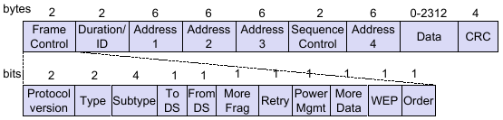
MAC Frame

Slide 40
Scanning Procedure
The station comes to existence of the surrounding WLAN networks by scanning procedure
Two types of scanning are there
Active Scanning
Passive Scanning
Active Scanning:
The station sends probe request packet on each channel and collects information about the existing surrounding WLAN networks from the probe response packets.
Passive Scanning:
The station collects information about the existing networks by listening beacons on all the channels.

Slide 41
802.11: passive/active scanning
BBS 1
BBS 2
BBS 1
BBS 2
AP 1
AP 2
AP 1
1
AP 2
1
1
2
2
2
3
3
4
H1
H1
Passive Scanning:
beacon frames sent from APs
association Request frame sent: H1 to selected AP
association Response frame sent: H1 to selected AP
Active Scanning:
Probe Request frame broadcast from H1
Probes response frame sent from APs
Association Request frame sent: H1 to selected AP
Association Response frame sent: H1 to selected AP

Slide 42
Authentication Process
IEEE 802.11 defines two different MAC layer authentication
Open System Authentication
Shared Key Authentication
These authentication mechanisms are defined with respect to infrastructure network only.
Preauthentication:
Preauthentication is typically done by a STA while it is already associated with an AP. If the authentication is left until reassociation time, this may impact the speed with which a STA can reassociate between APs, limiting BSS-transition mobility performance.

Slide 43
Authentication Process

Slide 44
Authentication Process
Shared Key Authentication Process

Slide 45
Authentication Process

Slide 46
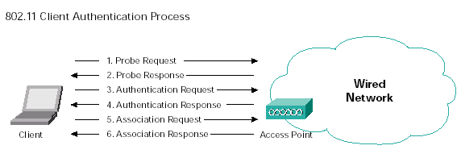
Association / Re-association Procedure
The association / re-association process involves

Slide 47
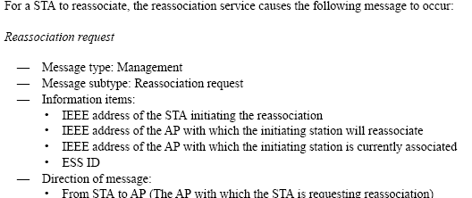
Association / Re-assocaition Procedure
Association / Re-assocaition Procedure

Slide 48
Association / Re-assocaition Procedure

Slide 49
Power Management In Infrastructure Networks
A station can remain in one the following two modes
Active mode
Doze mode / Sleep mode
It is the responsibility of the station to indicate to the AP about it’s power state i.e. stations has to inform to the AP if it is changing it’s power state from active state to doze state or visa-versa.
Station make use of power bit in control flag of PS-Poll / 802.11 Null data frame to indicate it’s power status to the AP.
PM bit = 0 station is in active mode
PM bit = 1 station is in sleep mode

Slide 50
Power Management In Infrastructure Networks
AP has two different mechanisms for delivering buffered Unicast, Multicast and Broadcast packets
Unicast frame buffering and delivery using TIM
Beacons coming from the AP contains TIM information. The TIM gives the buffered packets information to the stations. It is the responsibility of the station to wake up on every listen interval to hear the buffered frames information from the AP.
-- Delivering multicast and broadcast frames using DTIM
It is the responsibility of the station to wake up on every DTIM frame to receive broadcast and multicast frames. The beacon with DTIM count = 0 forms a DTIM frame.

Slide 51
Bridging between wire and wireless
brctl addbr br0
brctl addif br0 eth0
brctl addif wireless interface name
ifconfig wireless interface name up
Ifconfig Ethernet interface name up

