Slide 1
Plant phenotyping and quantitative genetics
@JinliangYang
Agronomy and Horticulture

Slide 2
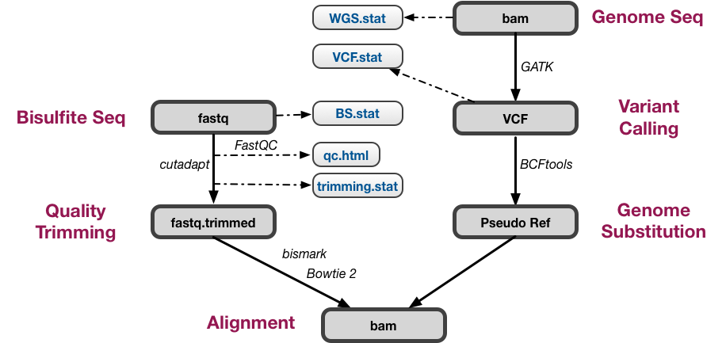
Overall goals: High throughput phenotyping to facilitate genome-enabled selection
Phenotyping data analysis
2018 yield trial (done)
2019 yield trial (processing)
Genotyping data analysis
Download from NCBI
Data cleaning, quality checking and mapping (Done)
SNP calling (working)
Newly generated data
Sample preparation (working)
Genotyping and phenotyping analysis
Not started yet
Genomic data processing pipeline

Slide 3
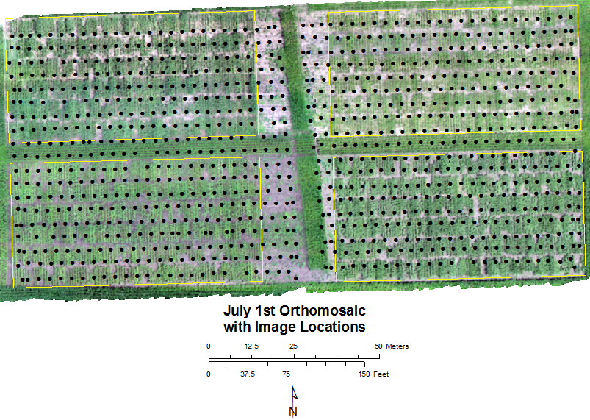
Georectified and stitched images
There are 971 images shot between 11:09 and 11:51 AM
Four quadrants each with 6 rows and 96 subplots
Note difference in contrast

Slide 4
To Do List
Need to figure out the SNP calling procedure
Finalize the phenotyping data extraction pipeline
Other plans:
Any questions you have not related to your research
Course questions
Any upcoming vacations

