Slide 1
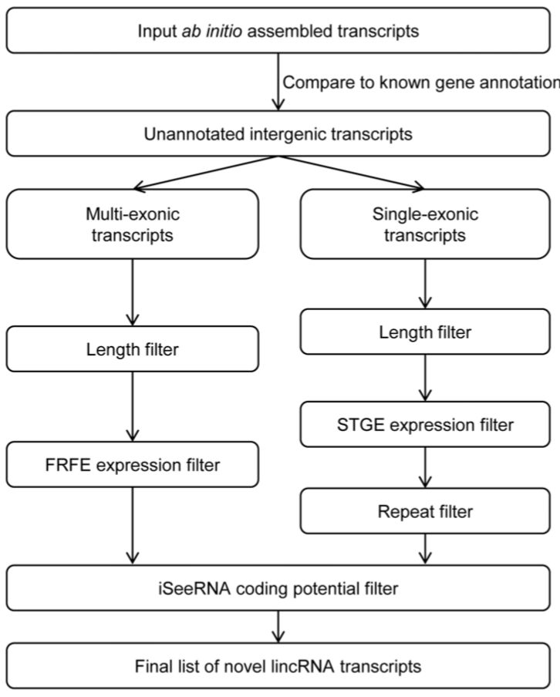
de novo lncRNA pipeline
Ctrl ~80M PE
siTCF21 ~75M PE
Cufflinks ab initio
>200
200, 10000
475996 transcripts
412150 transcripts
0.05,0.95
>=0.5
<0.05
Sebnif
>=0.9
15862 lncRNA
14759 lncRNA

Slide 2
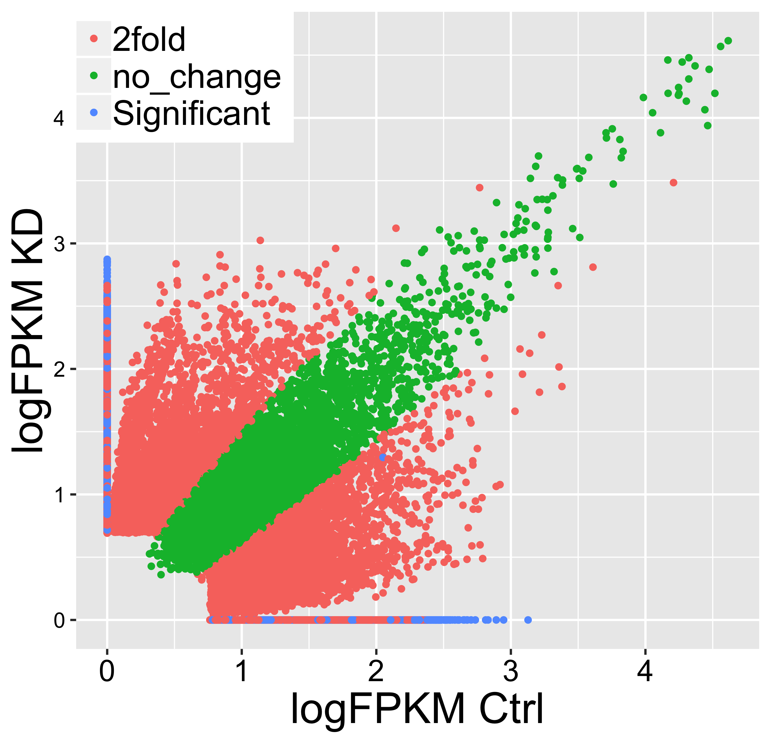
15862 lncRNA
14759 lncRNA
Cuffmerge
24384 merged transcript
Cuffdiff
2457 Significant
14074
>2 fold change

Slide 3
Switch to gmm model
Ctrl:
8513 lncRNA
siTCF21:
6545 lncRNA
13627 merged transcript

Slide 4

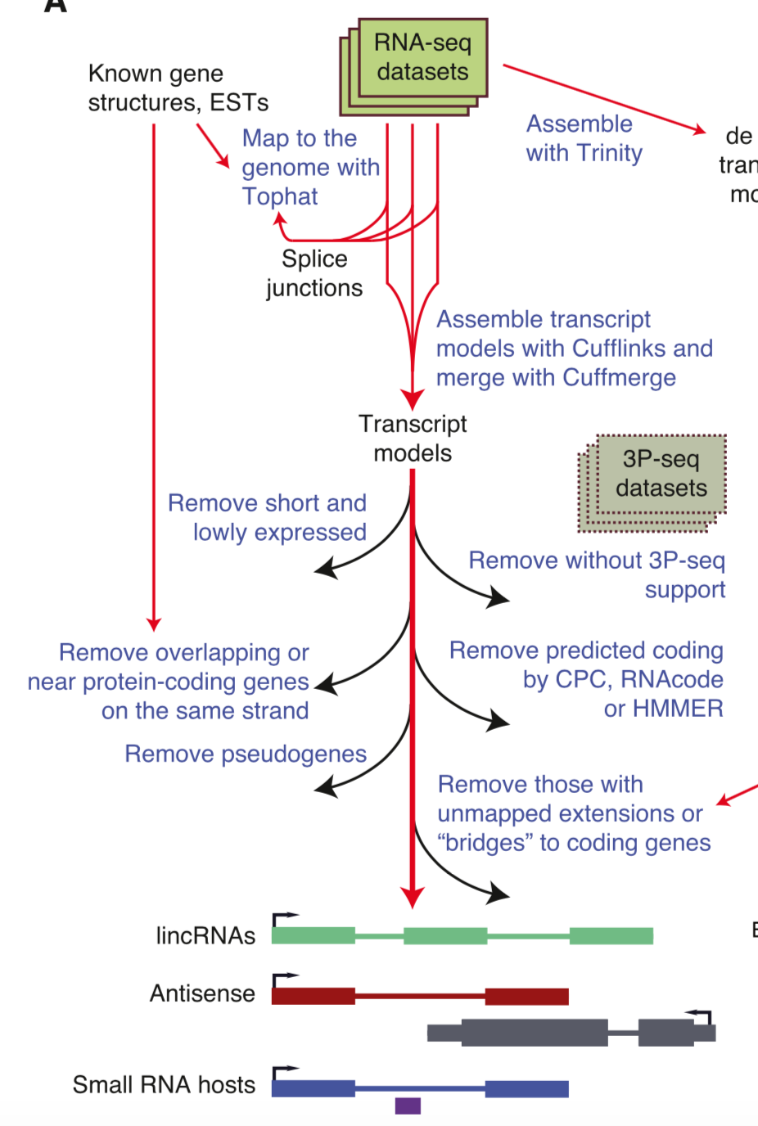
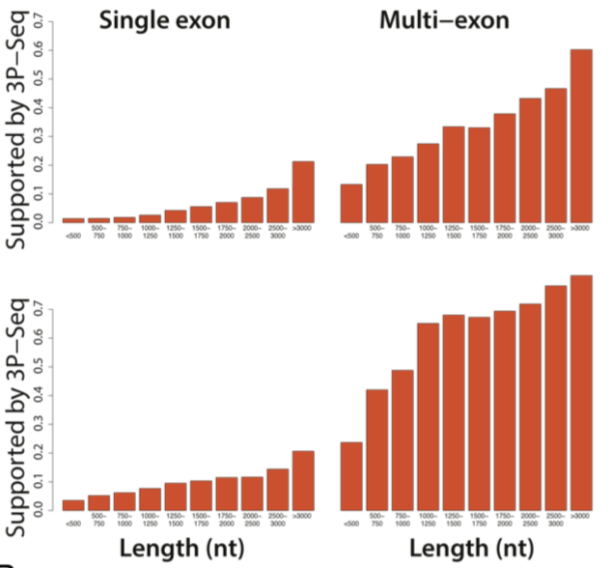
PLAR pipeline
160M Reads
HISAT2 ~1-2h
Stringtie ~1h
cuffdiff ~3h
FPKM>0.1, >200bp multi-exon
FPKM>5, >2kb single-exon
Filter1 ~10min
>500bp/50% overlap
E<0.001
Filter2 (CPC/HMMER) ~3h
Filter3 ~10min
Total<10h
Hezroni, Cell reports 2015

Slide 7
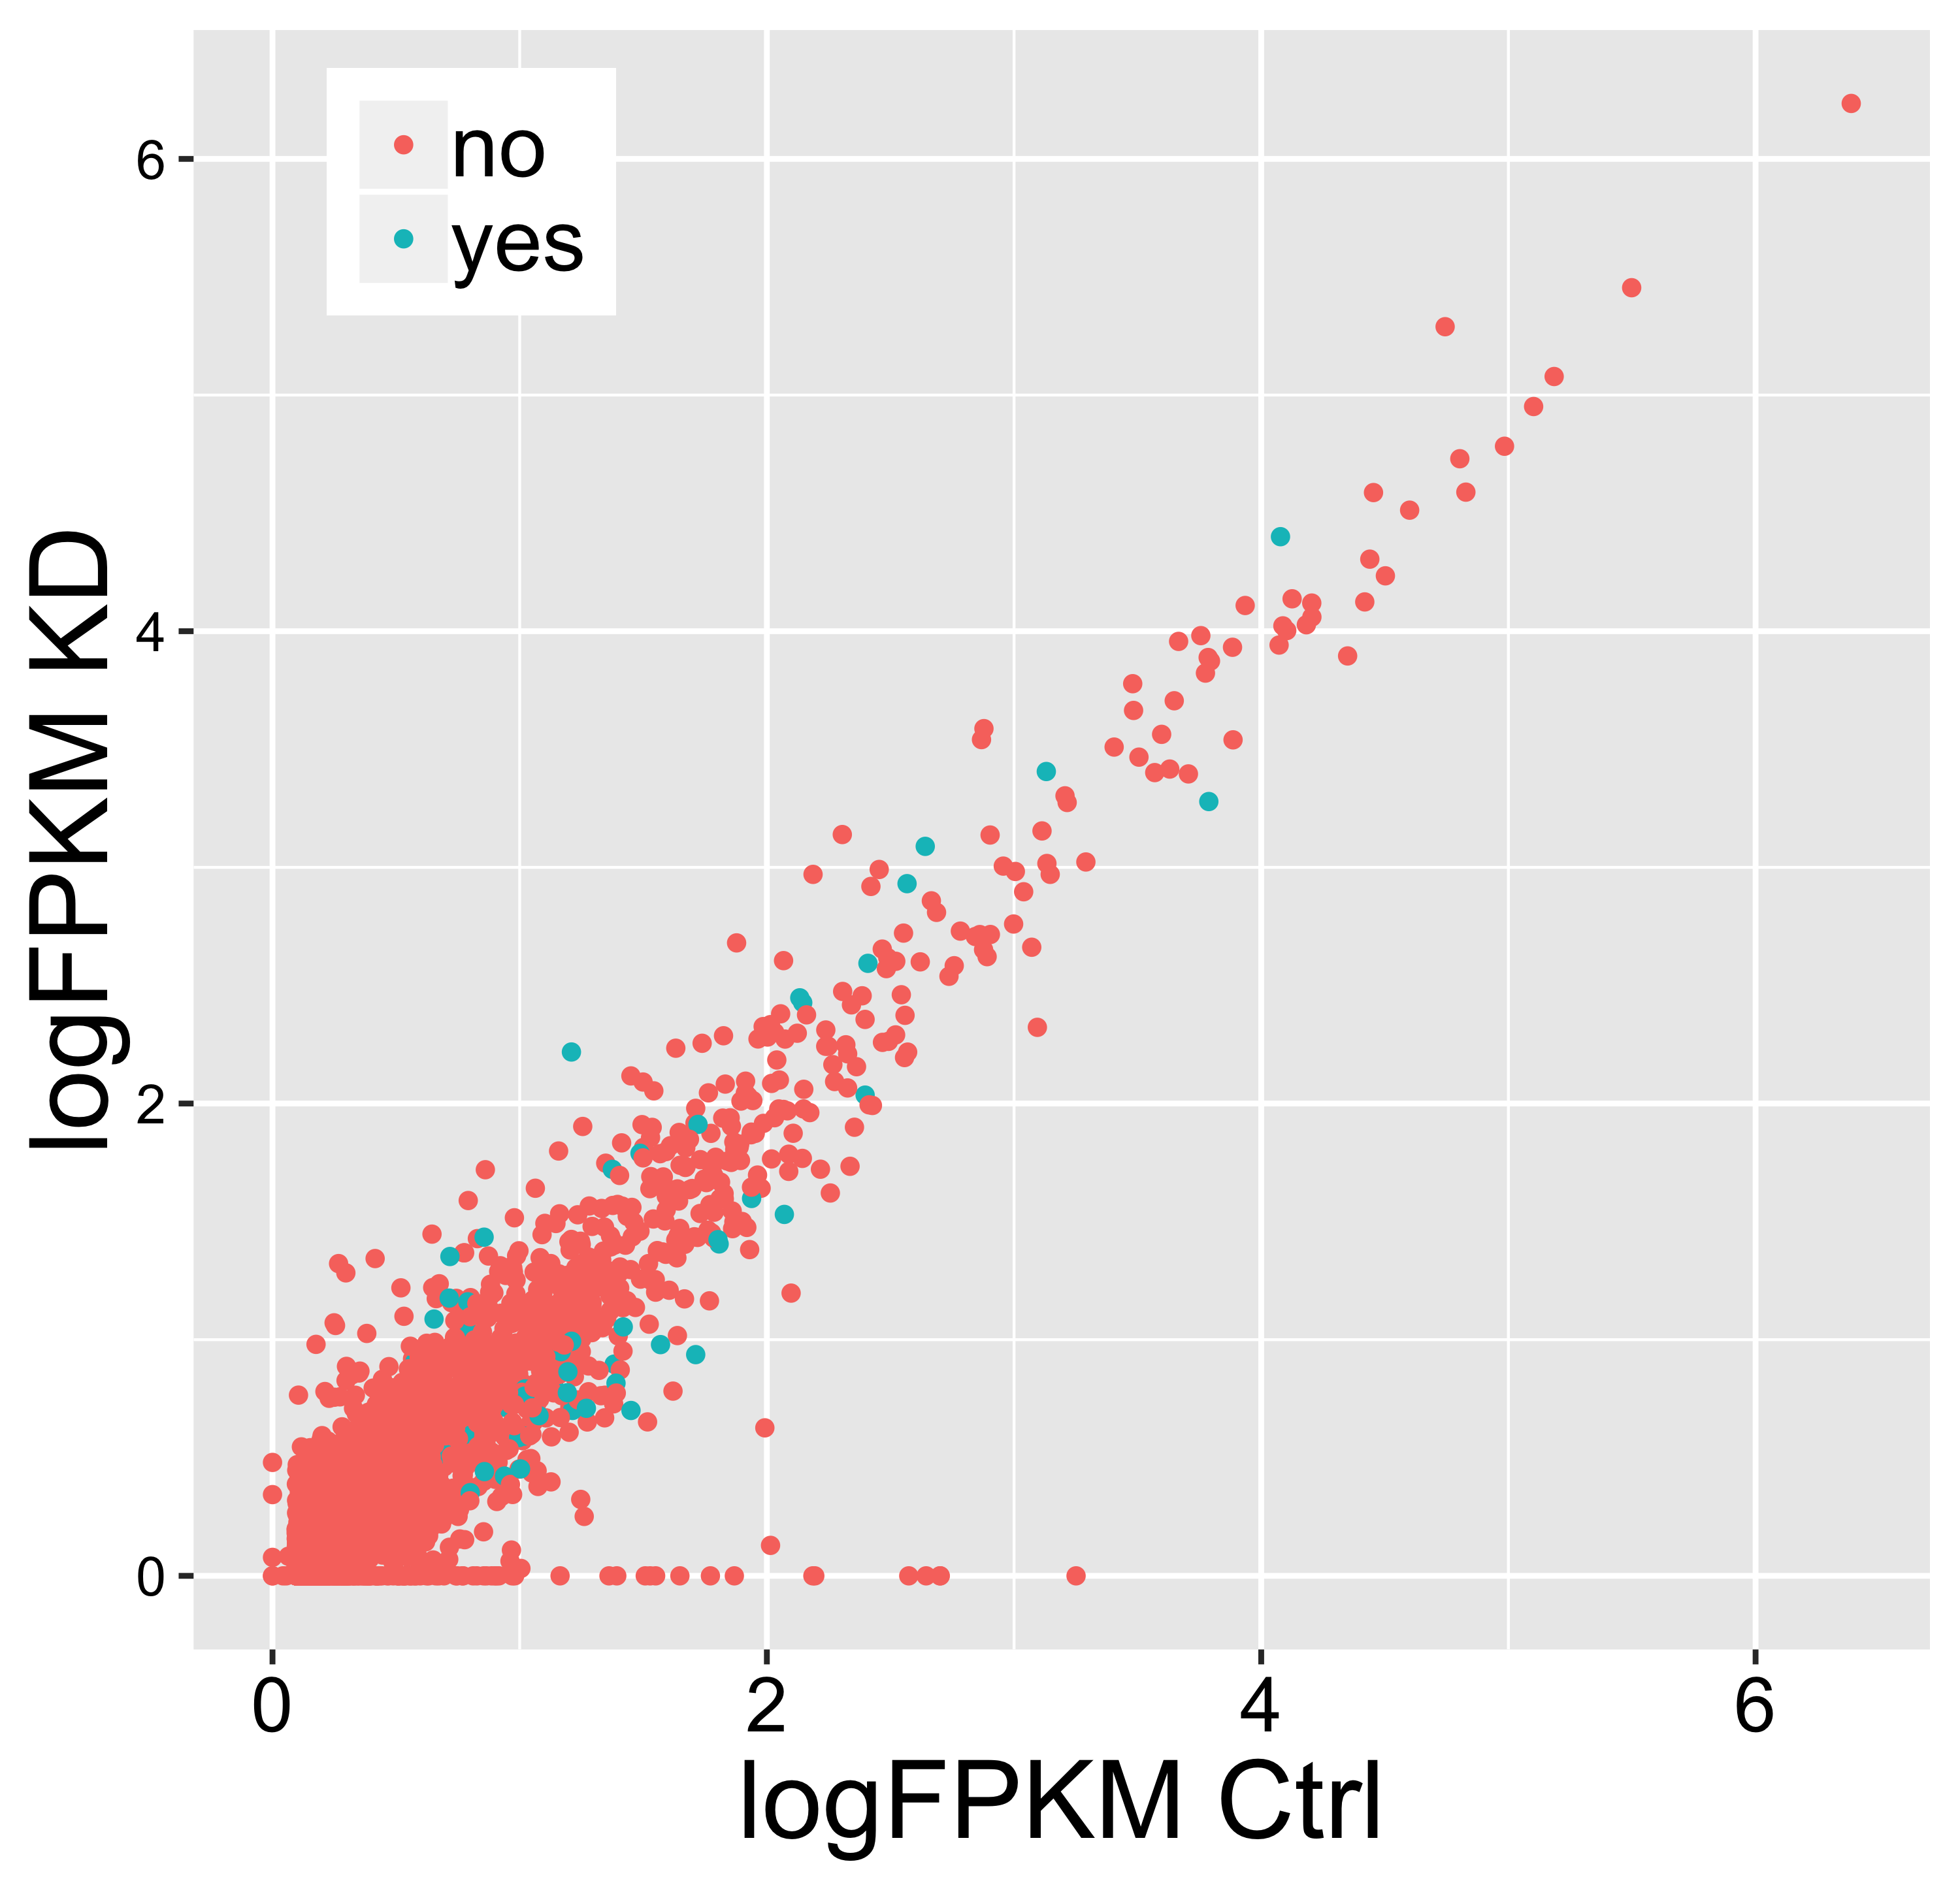
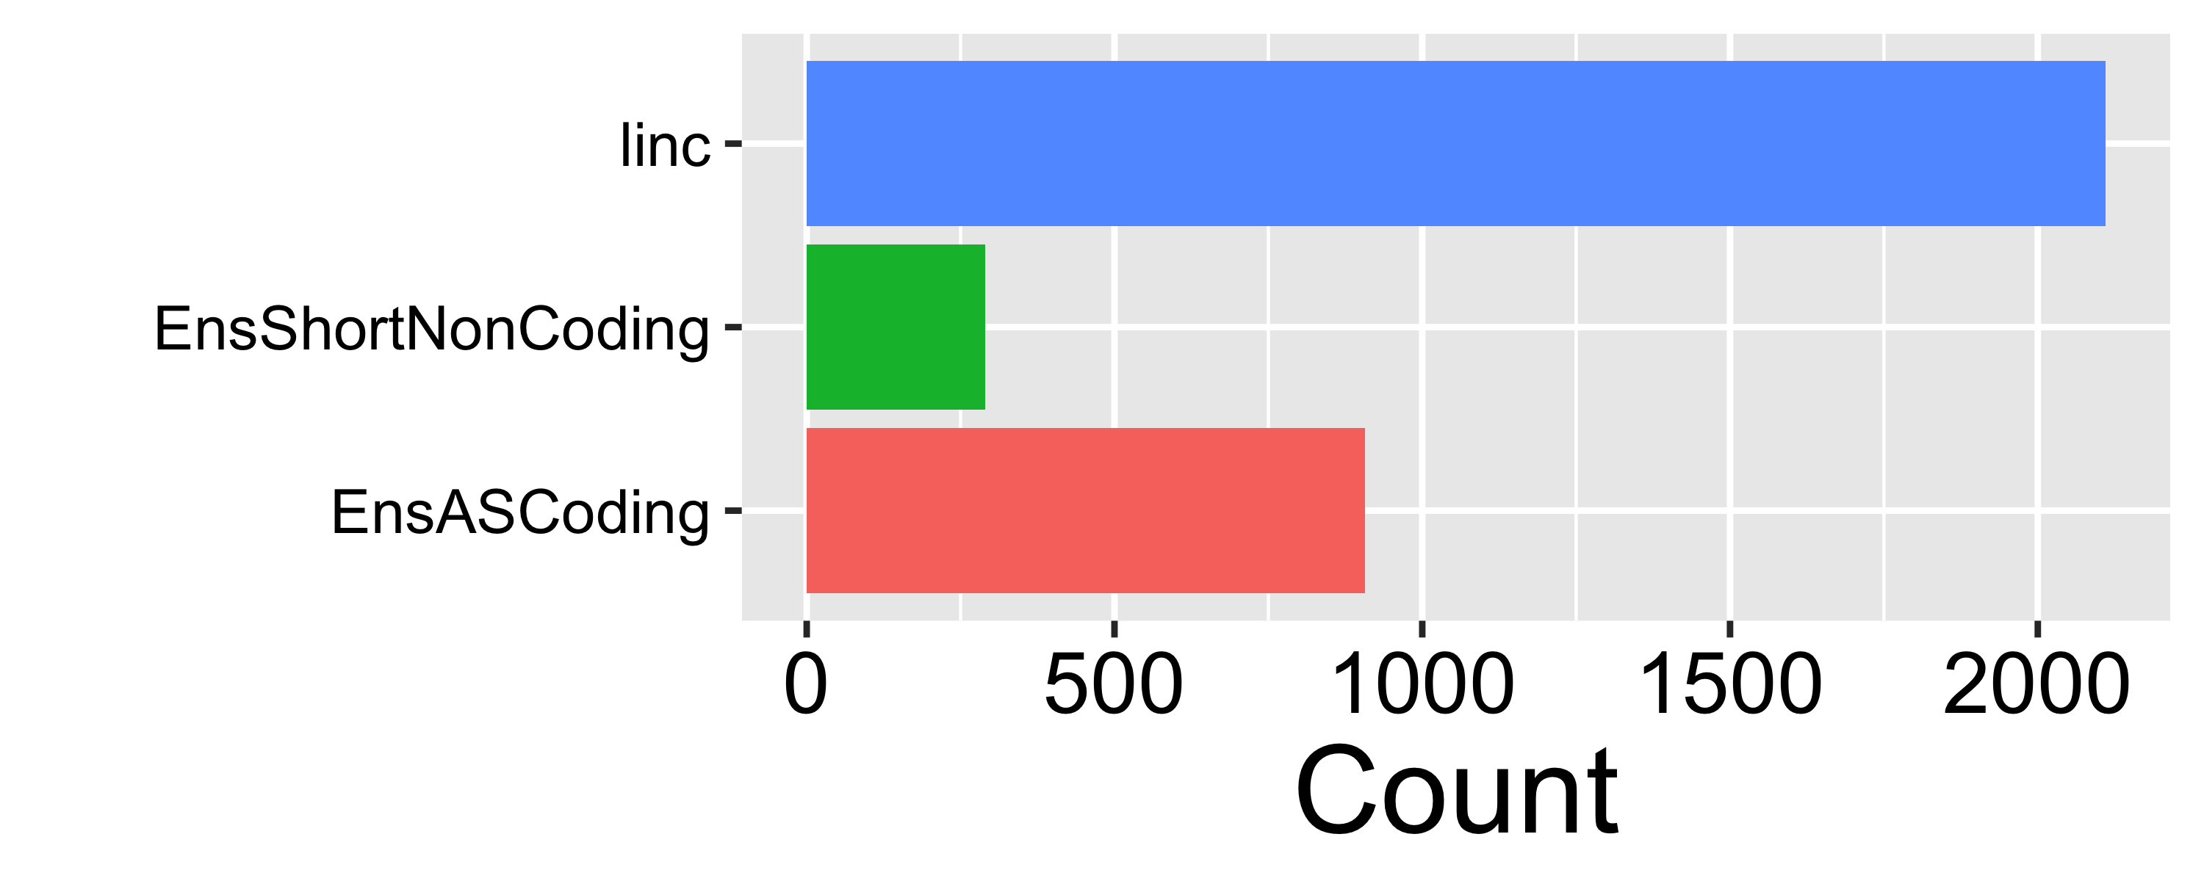
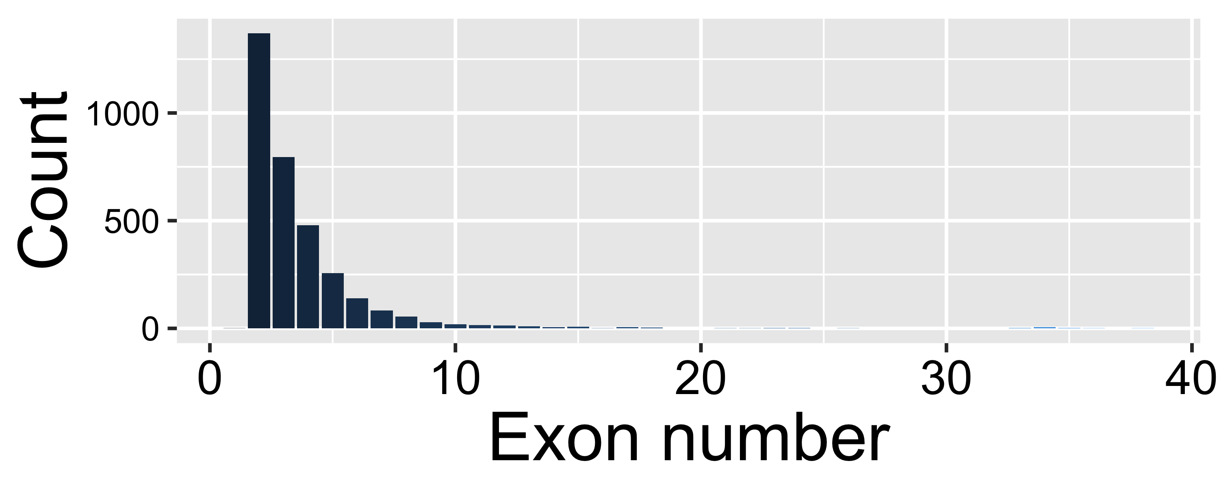
de novo lncRNAs
54 DE lncRNA

Slide 8
Strand specific sequencing
fr secondstrand
TCF21 KD RNAseq

Slide 9
Summary of lncRNA RAW/CLEAN reads
Paired-End, in Million
Control_SiRNA_1 276.9
Control_SiRNA_2 176.5
Control_SiRNA_3 210.4
129
86.5
107.2
Control_Cytokine_1 191.4
Control_Cytokine_2 203.1
Control_Cytokine_3 195.5
88.3
78.1
56.8
SMAD3_KD_1 227.6
SMAD3_KD_2 223.0
SMAD3_KD_3 183.3
122.7
118.1
75.2
PDGF_DD_1 217.8
PDGF_DD_2 200.7
PDGF_DD_3 178.5
85.3
108
98
TCF21_KD_1 210.9
TCF21_KD_2 218.1
TCF21_KD_3 183.1
124.5
118
84.7
TNF_Alpha_1 176.2
TNF_Alpha_2 186.5
TNF_Alpha_3 170.3
69
132.8
126.5
Serum_1 199.8
Serum_2 180.4
Serum_3 190.4
97.5
91
154.5
TGF_B_1 153.3
TGF_B_2 197.6
TGF_B_3 176.9
77.1
106.3
122.6

Slide 10
 | Merge GTFs(3 reps) | Merge BAMs
Total | 11067 | 11646
Known | 1377 | 1367
Single-exon | 230 | 254
Total
>80% Overlap
Known
>80% Overlap
Merge GTF
Merge BAM
Merge GTF
Merge BAM
6995
(5739)
1071
(1070)
4072
5907
306
297

