Slide 1
2019-NCOV PRESENTATION
Binqian Gao, Mohan Xing, Peirang Xu, Vicky Zhang

Slide 2
Introduction
Chinese health officials have reported tens of thousand of infections with 2019-nCoV in China,with the virus reportedly from person-to-person in parts of the country
Infections with 2019-nCoV, most of them associated with travel from Wuhan, China
It is being reported in a growing number of international locations, including the United States

Slide 3
Background
new coronavirus
Transfer: flu type
Symptom: pneumonia, body temperature normal
Incubation period: 14 days
Immune system kill lung cells
Death rate : >3%

Slide 4
Motivation
American Website
Chinese Website
Pros: Clean design
Cons: 1. Update slow
2. No analysis
3. No historical data
Pros: Update fast
Cons: 1. No design
2. Language
3. User interaction is poor

Slide 5
Our visualization
Update fast
Nice Visualization + User interaction
Detail Analysis + Prediction
Provide historical data

Slide 6
Logic
Extract Data -> Database -> Webframe -> HTML + Javascript
(web scraping) (Sqlite) (Flask) (Bootstrap)(D3.js, Leaflet, Jquery)

Slide 7
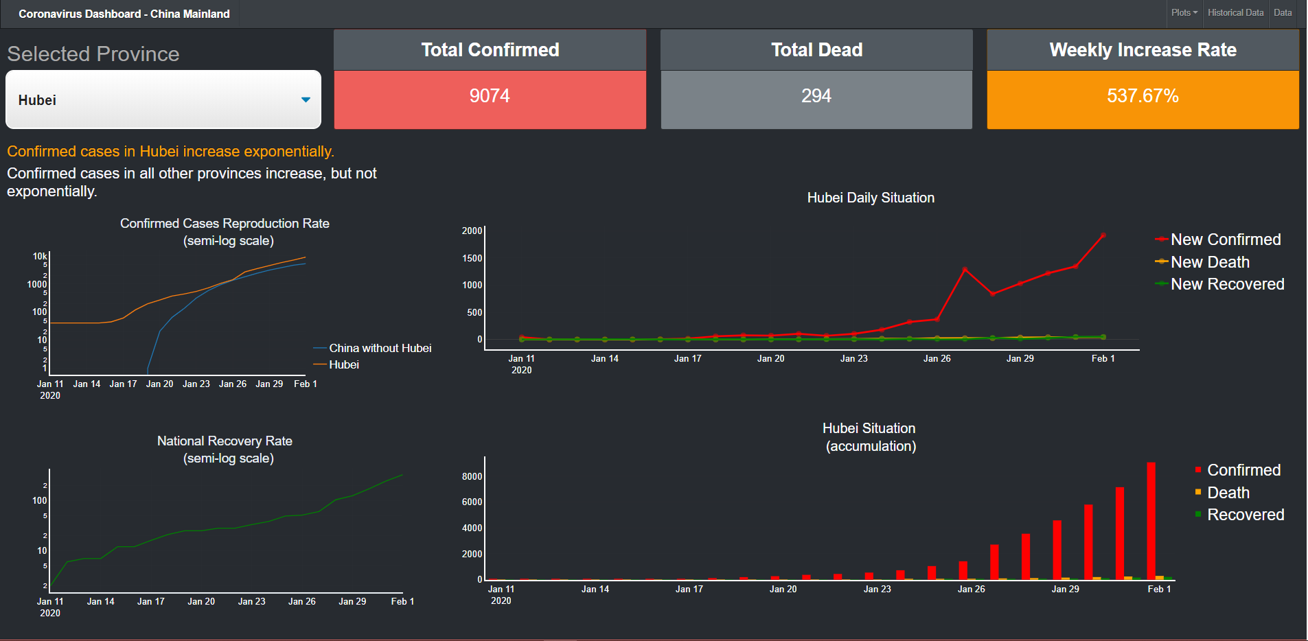

Slide 8
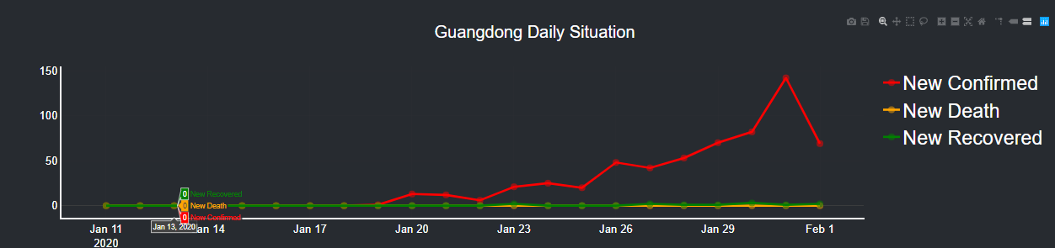
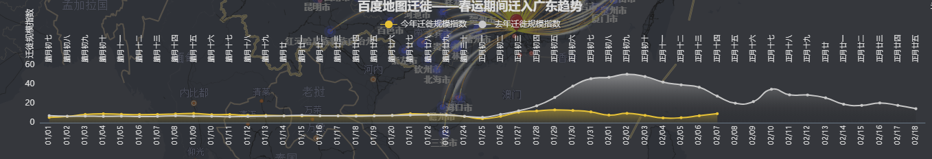
Top 2
Risky
City

Slide 9
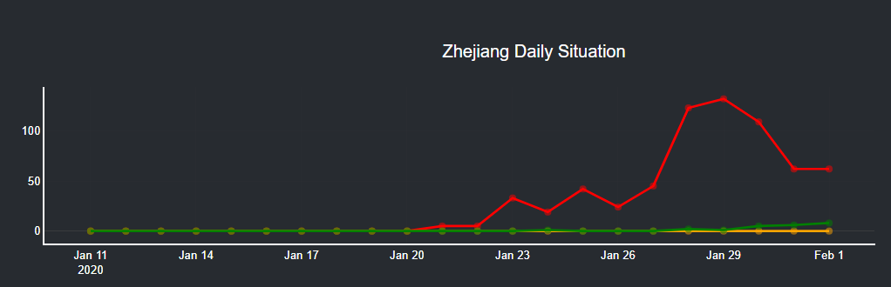
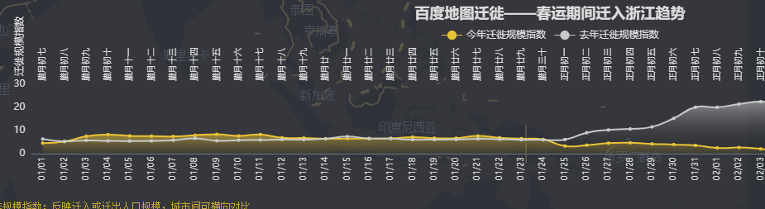
Top 3
Risky
City

Slide 10
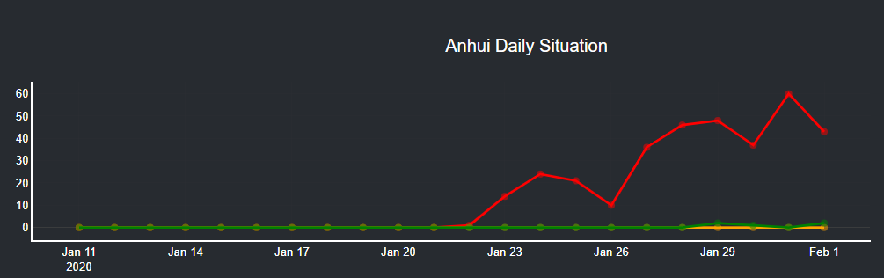
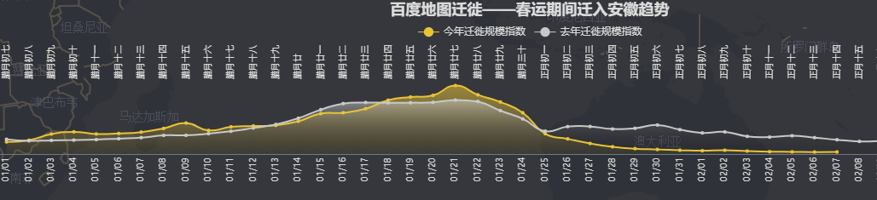
Top 1
“Migration-into”
Province

Slide 11
To do risk prediction, the significance of migration varies in provinces or cities
Migration may not be the main factor for high risk provinces

Slide 12
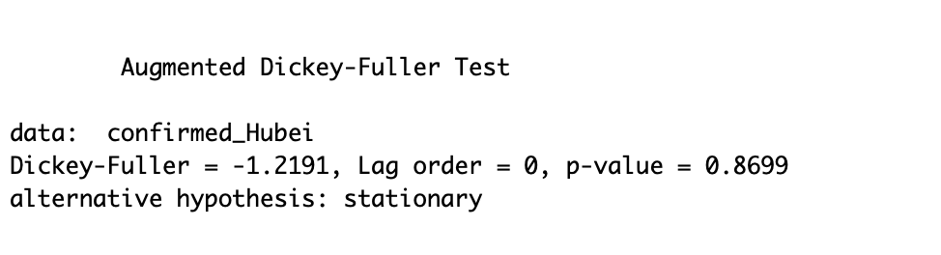
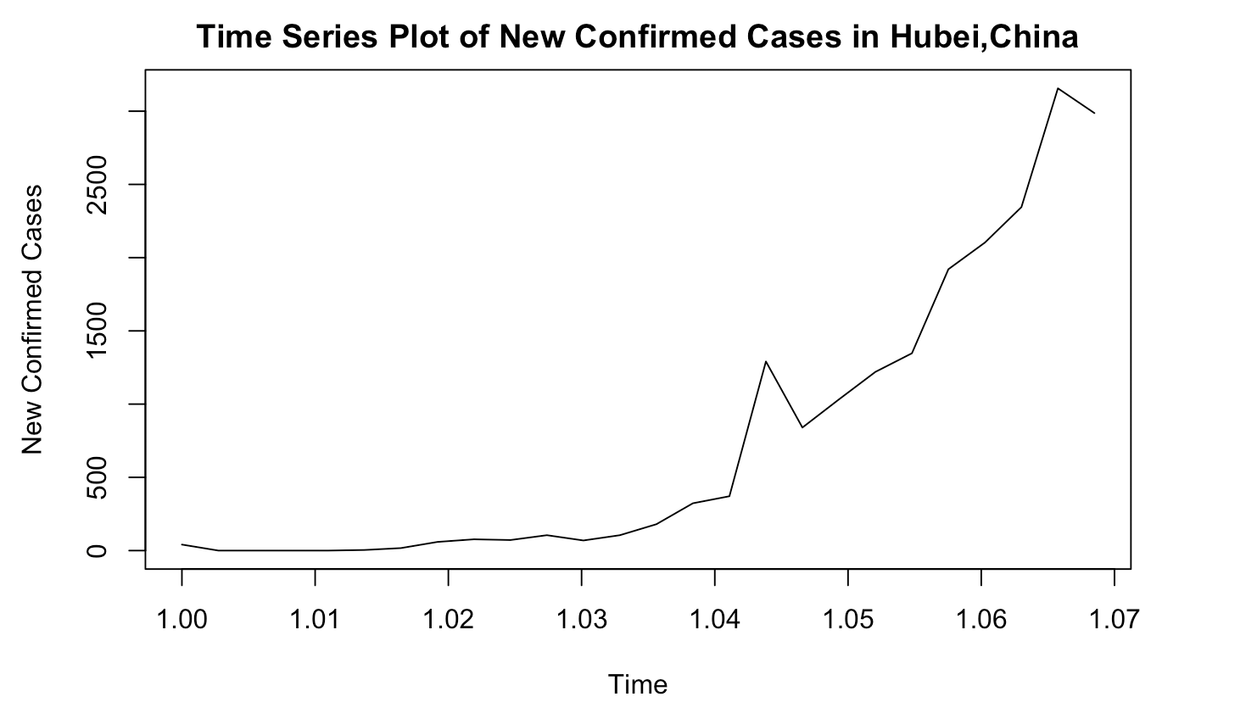
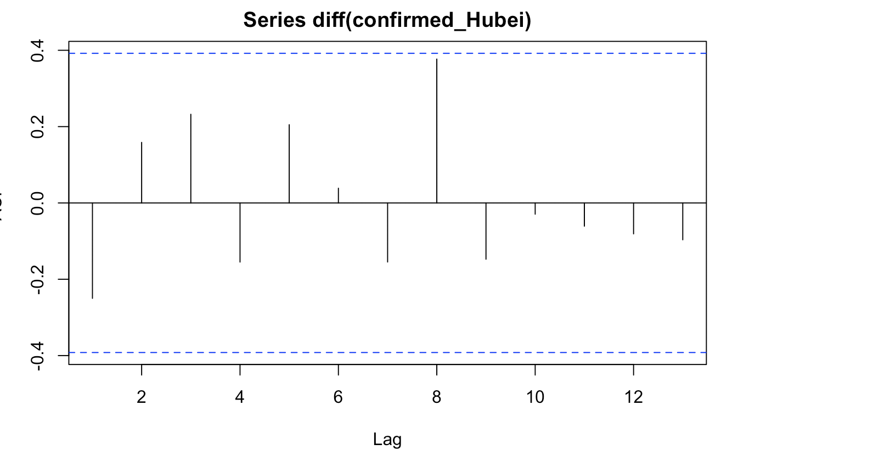
Forecasting

Slide 13
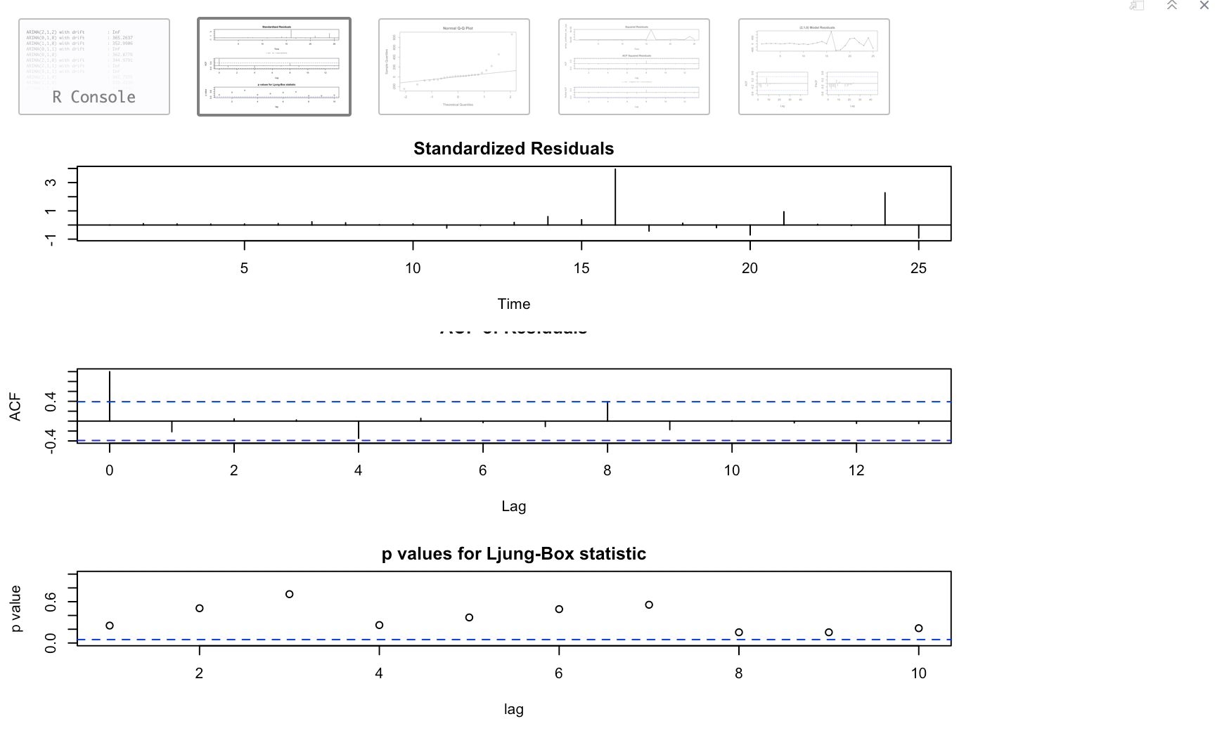
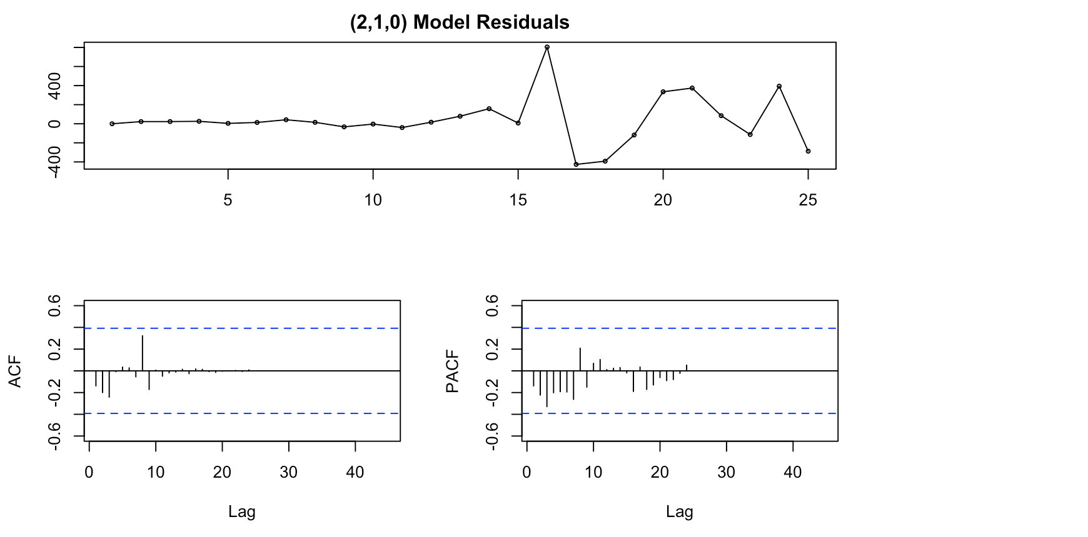
Forecasting

Slide 14
The End
“ If anything is going to kill tens of millions of people in a short time, it will probably be a global epidemic. And the disease would most likely be a form of the flu, because the flu virus spreads easily through the air”
“ I had hoped that hitting the 100th anniversary of this epidemic would spark a lot of discussion about whether we`re ready for the next global epidemic”
“Unfortunately, it didn`t, and we still are not ready.”
----------Bill Gates

