Slide 1
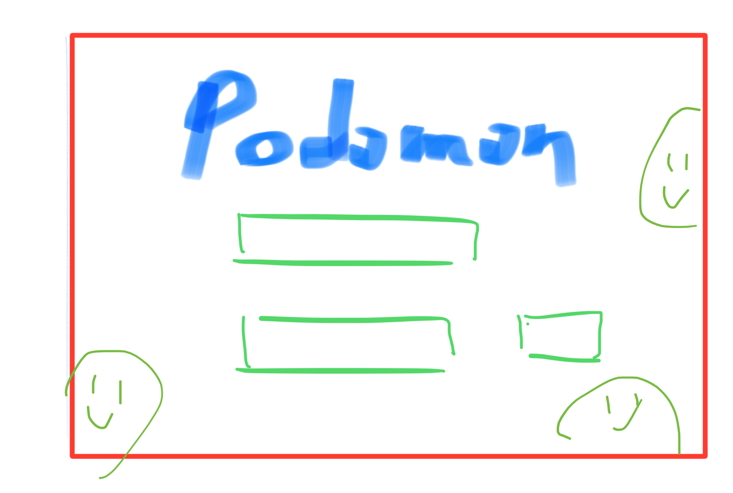
<div class="login__main">
Islogin=false
<div class="login__logo">
<input class="login__username">
<input class="login__submit">
<input class="login__password">

Slide 2
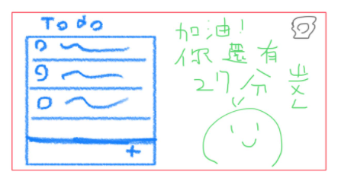
Islogin=True
<div class="podomon__main">
<h1 class="podomon__time">
<div class= "podomon__buttons">
<Slider marks={marks} step={null} defaultValue={37} />
<TodoApp class="todo__main">

Slide 3
<div class= "podomon__buttons">
Status:
還未開始計時
Status:正在計時
Status:暫停計時
<Button icon={
<span class="material-icons">
stop</span>
}></Button>
<Button icon={
<span class="material-icons">
play_arrow</span>
}></Button>
<Button icon={
<span class="material-icons">
pause</span>
}></Button>

