Slide 1



Product RESEARCH REPORT
This is how I conduct Amazon Product Research Report using Power BI
Prepare by Chong Wee Ling

Slide 2

Know Your Target Market
Strength-Based
Who is your potential customer when choosing a product?
Know what they want and sell it to them.

Slide 3

Introduction
The Amazon Product analysis project, this project seeks to evaluate a dataset of Amazon Products, one of the world’s most popular e-commerce platforms. Given the large number of products sold and analyzing Amazon product data allows you to acquire useful insights into industry trends, which can help you uncover new business prospects.
This dataset may contain information about price, discount price, product ratings and no. of ratings. By analyzing this data, we hope to obtain a better understanding of consumer satisfaction, uncover common difficulties, and explore strategies to improve the entire customer experience.

Slide 4

Problem Statement
The aims is to analyse the products catalogue to gain insights into their listed products. The dataset includes some fields describing the products in terms of pricing, discounts and ratings. This analysis can help provide valuable information for pricing strategies and product positioning.
Key objectives:
Product analysis based on pricing, discount and ratings.
Most popular products by categories and sub-categories.
Analyze the pricing patterns and ranges within each category and sub-category.
Explore any potential correlations ratings with other details about the products.

Slide 5
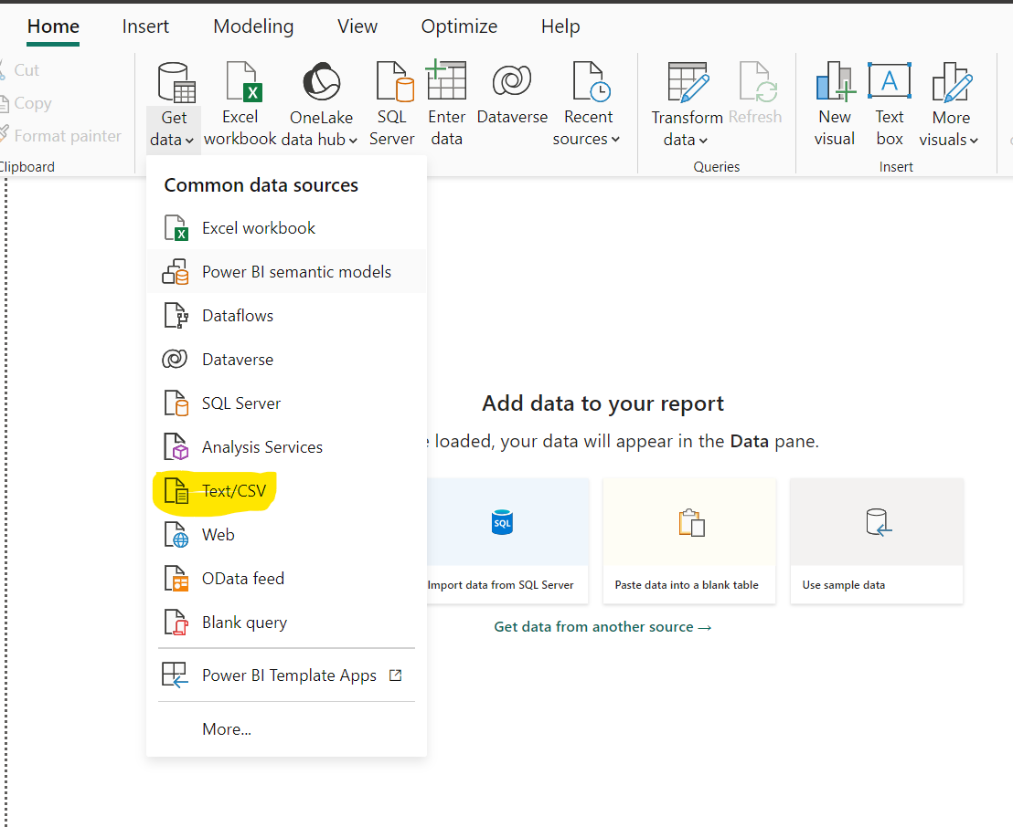
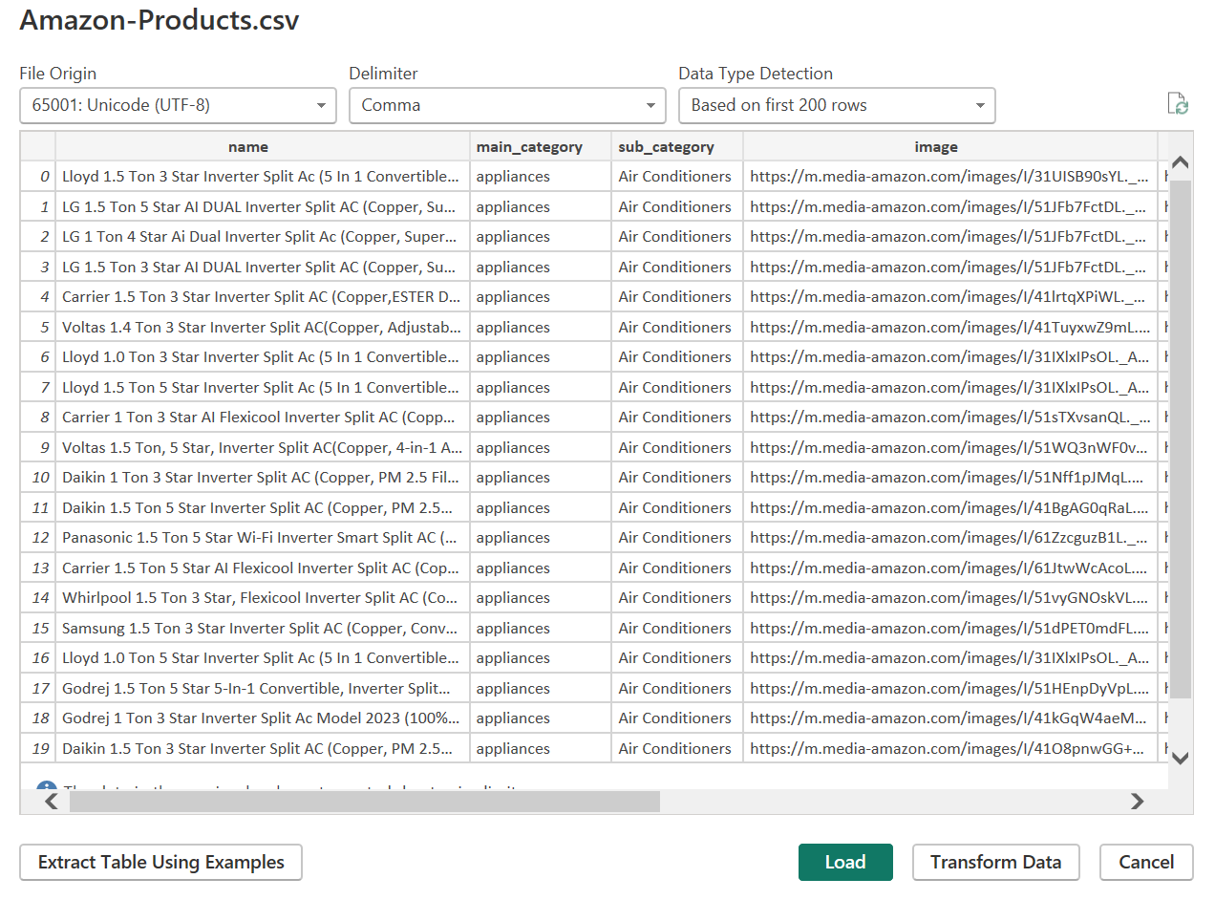
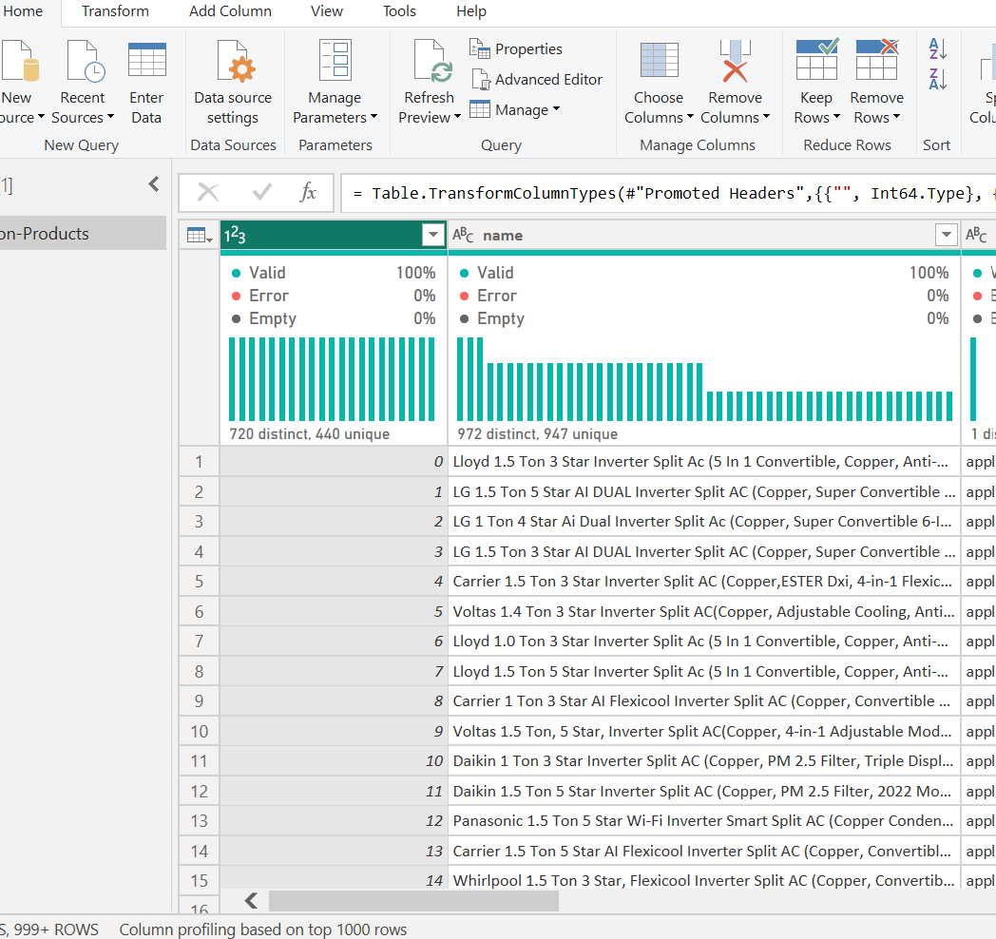
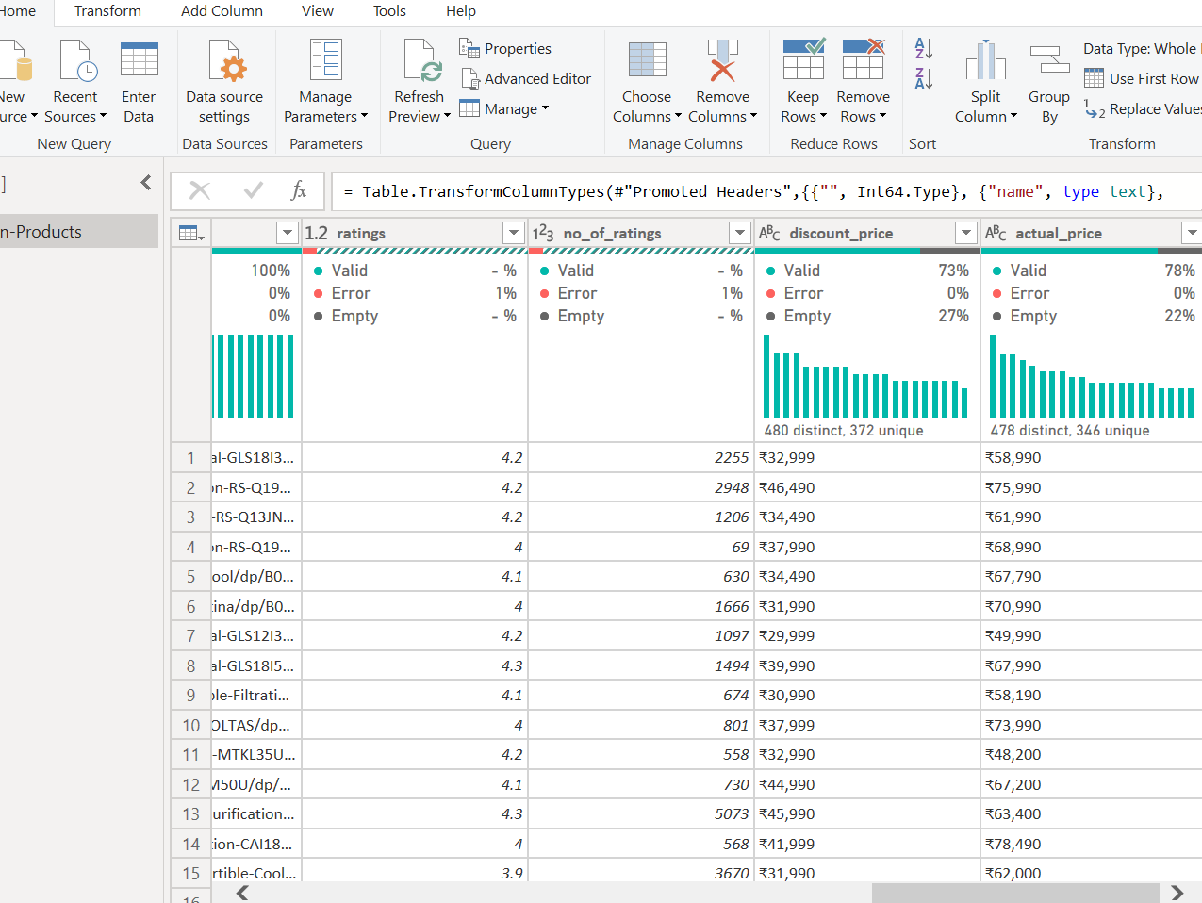
Data Preparation
Load Data: Import the dataset into Power BI. Ensure all columns are correctly recognized (e.g., text, numerical, dates).
Open Power BI Desktop
Go to the Home tab and click on “Get Data”
Choose “Text/CSV” and select the Amazon Products.csv file you uploaded.
Load the data in Power BI.
Data Cleaning: Handle missing values, correct data types, and remove any anomalies.
Go to the Home tab and click on "Transform Data" to open Power Query Editor.
Inspect the dataset and ensure columns are correctly formatted (e.g., prices as currency, ratings as numbers).
Import Amazon Product.CSV file
Choose Transform Data
Check column, ensure no error, empty fill, etc..
Data cleaning to remove error, null, empty cell and change currency.

Slide 6
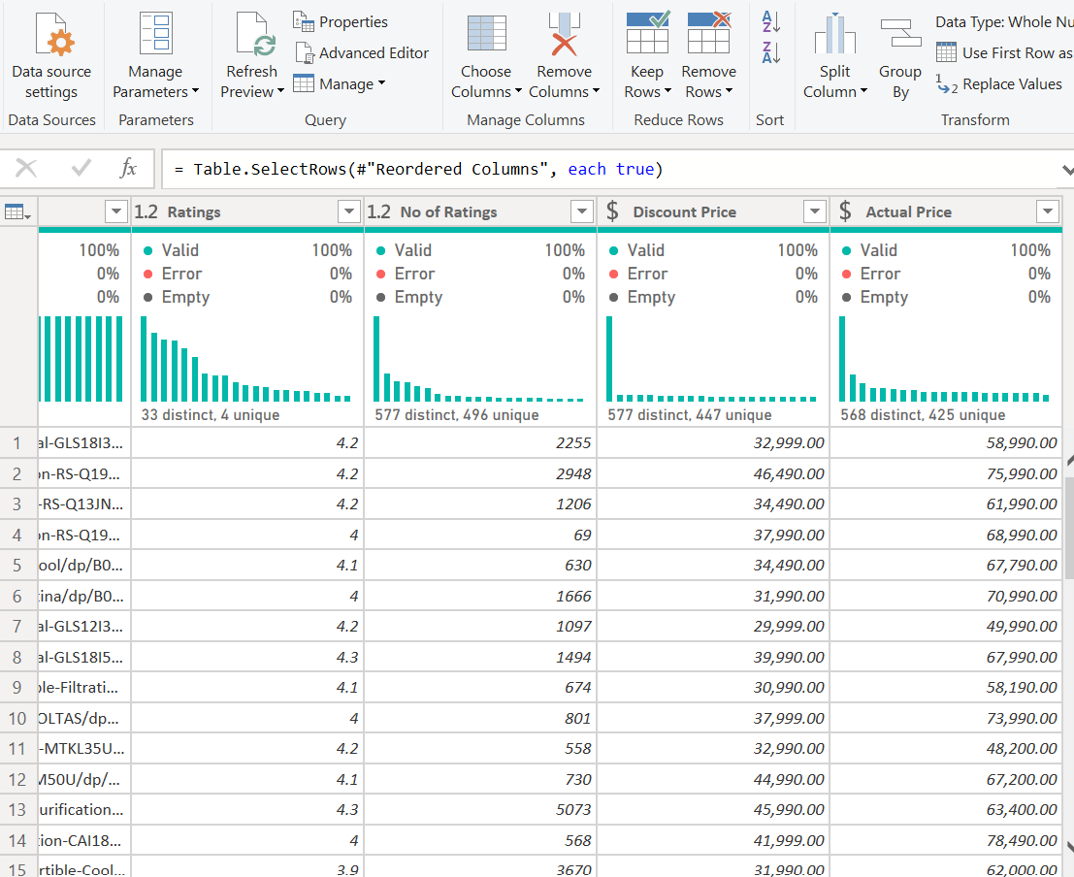
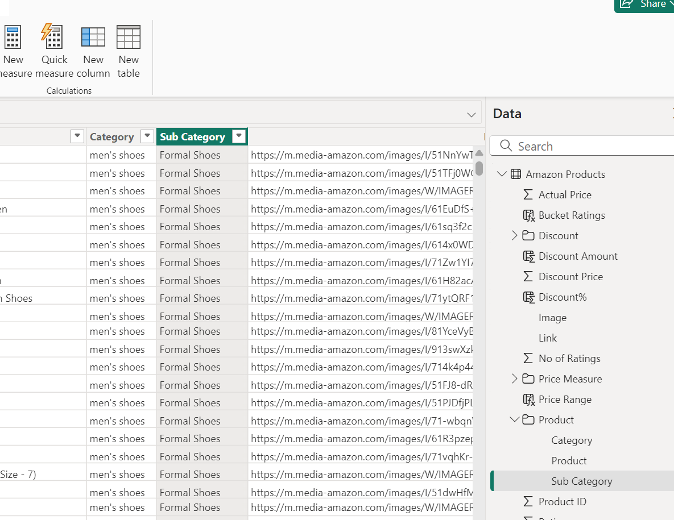
Derived Columns: Create any necessary derived columns and measure for analysis, such as bucket rating, discount amount, calculating discount percentages, average rating product, total rating or categorizing ratings.
Data Cleaning Steps:
Remove unnecessary columns: Delete any columns in the dataset that are not needed for your analysis or task.
Rename columns: Change the names of columns to make them clearer and easier to understand.
Fill missing values: Identify any empty cells in the dataset and either fill them with appropriate values (like averages or defaults) or deal with them in a way that makes sense for your analysis.
Ensure correct data types: Check that each column has the right type of data assigned to it, such as text, numbers, or dates, to facilitate accurate processing and analysis.
Data cleaning for error and empty cell. Ensure all error, empty cell clear.
If required, create new measure use for creation of dashboard.

Slide 7
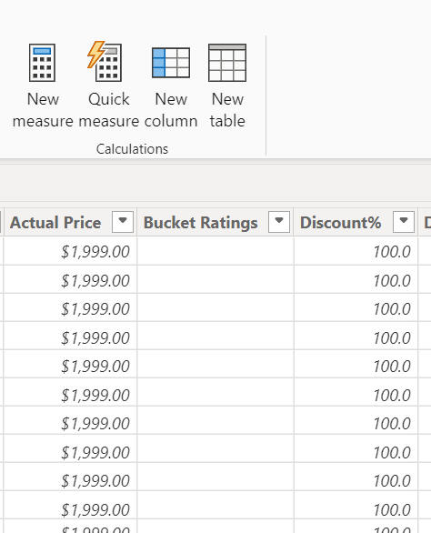
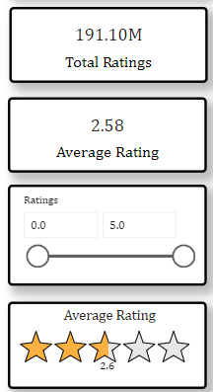

Continue Data Preparation:
Impute Missing Values: Identify any missing values in the dataset and decide on the method to impute them (e.g., using mean, median, or mode).
Change Data Types: Ensure all columns have the correct data types. For instance, make sure dates are in the date format, numeric columns are set correctly, etc.
Derive Custom Columns: If needed, create new columns that can help with analysis. For example, you might want to create a "Discount Percentage" column.
Key Performance Indicators (KPIs):
Define the KPIs that are important for your analysis. Some potential KPIs could be:
Average Product Rating
Number of Products with High Discounts
Average Price of Products in Different Categories
Number of High-Rated Products (e.g., ratings above 4)
Create new columns

Slide 8
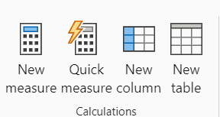
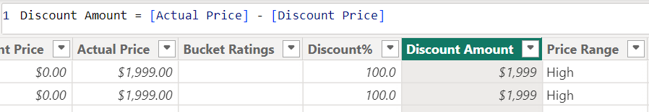
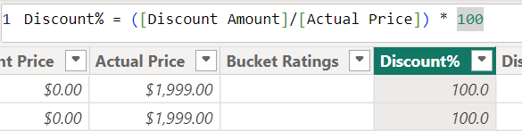
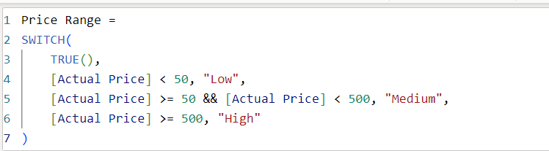
Transform Data
Go to Home > Open Table View.
Check for missing values, correct data types, and create necessary columns:
Discount Amount = [Actual Price] – [Discount Price]
Discount Percentage = ([Discount Amount] / [Actual Price]) * 100
New Measure
Average Rating = Average('Amazon Products'[Ratings])
Total Ratings = SUM('Amazon Products'[No of Ratings])
Price Range = SWITCH(
TRUE(),
[Actual Price] < 50, "Low",
[Actual Price] >= 50 && [Actual Price] < 100, "Medium",
[Actual Price] >= 100, "High“)

Slide 9
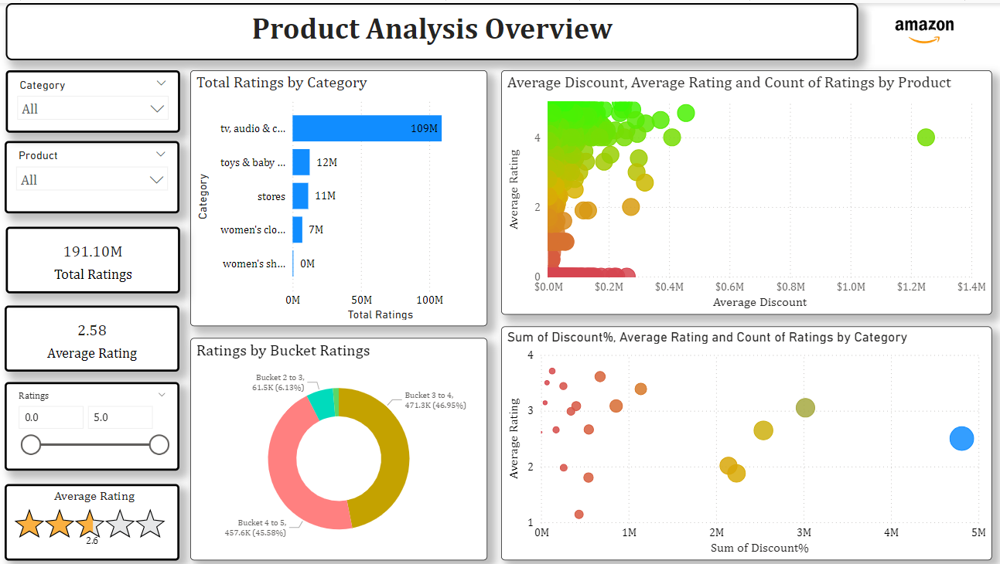
Product Analysis Overview
Overall Product Performance
Product Category Insights
Product Rating and Discount Analysis
This chart helps us understand that Amazon has a wide variety of products with many ratings. Most products are moderately discounted, have a decent average rating, and are rated by a moderate number of people. The TV, audio, and electronics category is the most popular and has the highest average rating.
Let’s explore each part:
Total Ratings by Category
Average Discount, Average Rating, and Count of Ratings by Product
Ratings by Bucket Ratings
Sum of Discount%, Average Rating, and Count of Ratings by Category

Slide 10
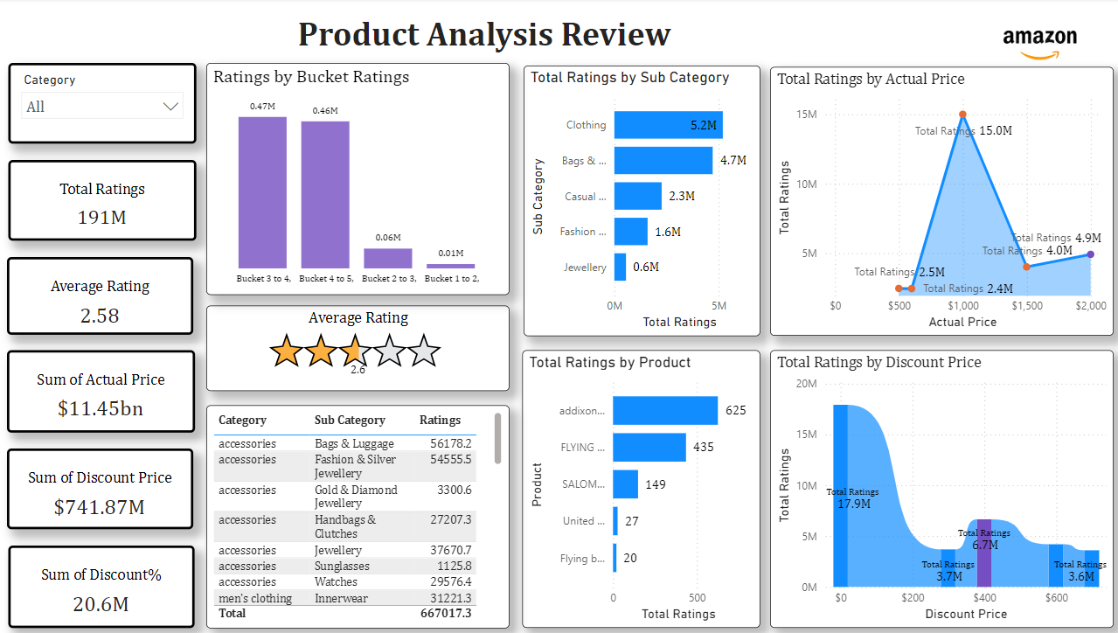
Product Analysis Review
Product Category and Subcategory Performance
Product Pricing and Rating Analysis
Product Sales and Discount Trends
The chart helps us to understand that Amazon has a wide variety of products with many ratings. Most products are moderately priced, have a decent average rating, and are rated by a moderate number of people. The Clothing category is the most popular and has the highest average rating.
Let's explore each part:
Total Ratings by Category
Ratings by Bucket Ratings
Total Ratings by Sub-Category
Total Ratings by Actual Price
Total Ratings by Product
Total Ratings by Discount Price

Slide 11
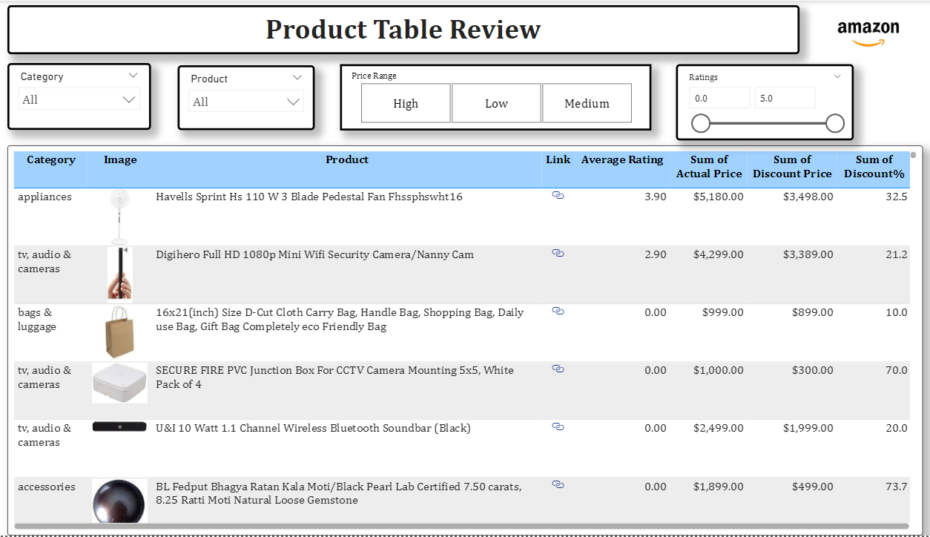
Product Table Review
Detailed Product Information
Product Catalog and Pricing
Product Ratings, Pricing, Discount Price and Discounts
The table is like a list of Amazon products. It helps us understand different products, their prices, and how much people liked them.
Let's explore each part:
Category and Image
Product
Link
Average Rating
Sum of Actual Price
Sum of Discount Price
Sum of Discount%
This table helps to us understand that Amazon has a wide variety of products in different categories. We can see the average rating of each product and compare the prices of different products. We can also see how much discount is offered on each product.

Slide 12
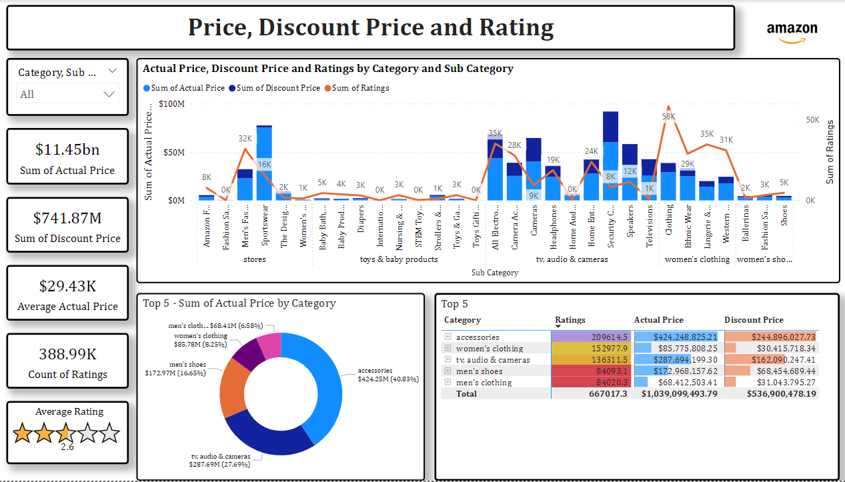
Price, Discount Price and Rating
Product Pricing and Discount Analysis
Product Rating and Sales Trends
Category and Subcategory Performance
The chart is like a map of Amazon products. It helps us understand how much different products cost, how much they cost after a discount, and how many people liked them.
It's explored each part:
Sum of Actual Price
Sum of Discount Price
Average Actual Price
Count of Ratings
Average Rating
Top 5 - Sum of Actual Price by Category
Top 5 - Sum of Actual Price by Sub-Category
Top 5 - Ratings
Summary:
The chart helps us understand that Amazon has a lot of products with a wide range of prices. Some products are very expensive, while others are quite affordable. Many people have rated products on Amazon, and the average rating is 2.6 out of 5.

Slide 13
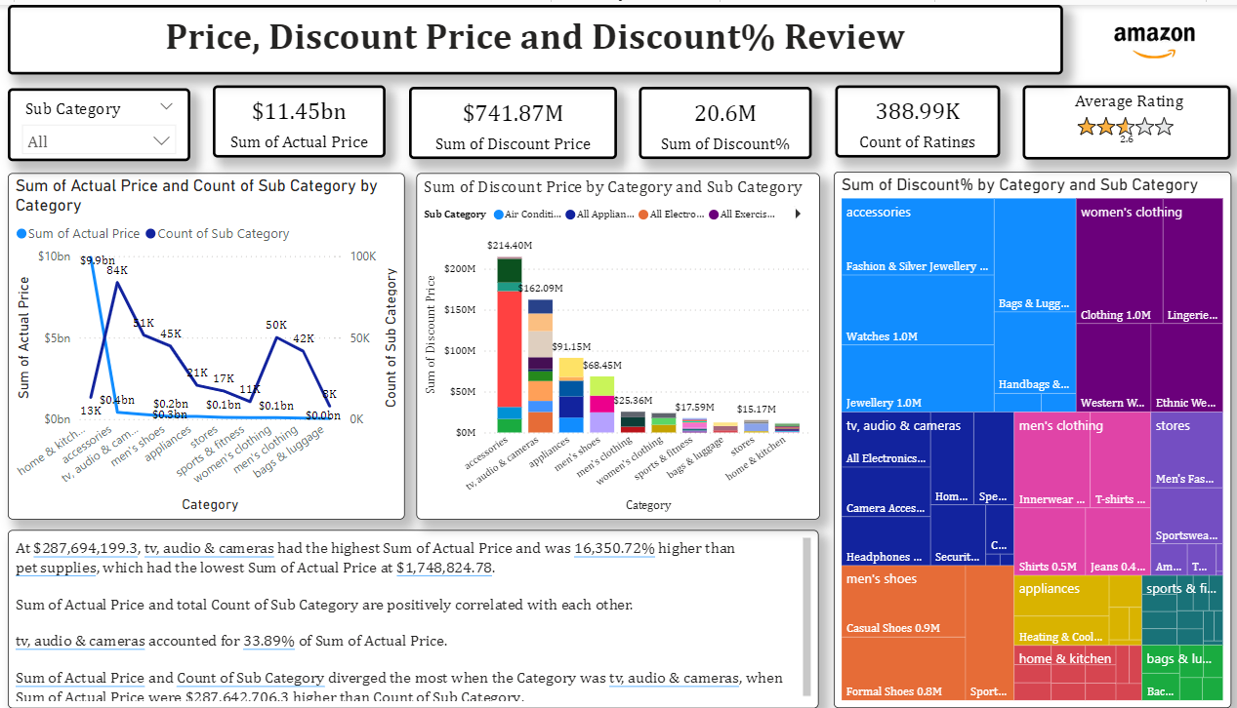
Price, Discount Price And Discount Percentage Review
This chart is like a map of Amazon products. It helps us understand how much different products cost, how much they cost after a discount, and how many people liked them.
Let's explore each part:
Sum of Actual Price, Sum of Discount Price, Sum of Discount%, and Count of Ratings
Sum of Actual Price and Count of Sub-Category by Category
Sum of Discount Price by Category and Sub-Category
Sum of Discount% by Category and Sub-Category
Summary:
The chart helps us understand that Amazon has a lot of products with different prices and discounts. We can see which categories have the most expensive products and which categories have the highest discounts. We can also see how many people have rated products on Amazon.

Slide 14
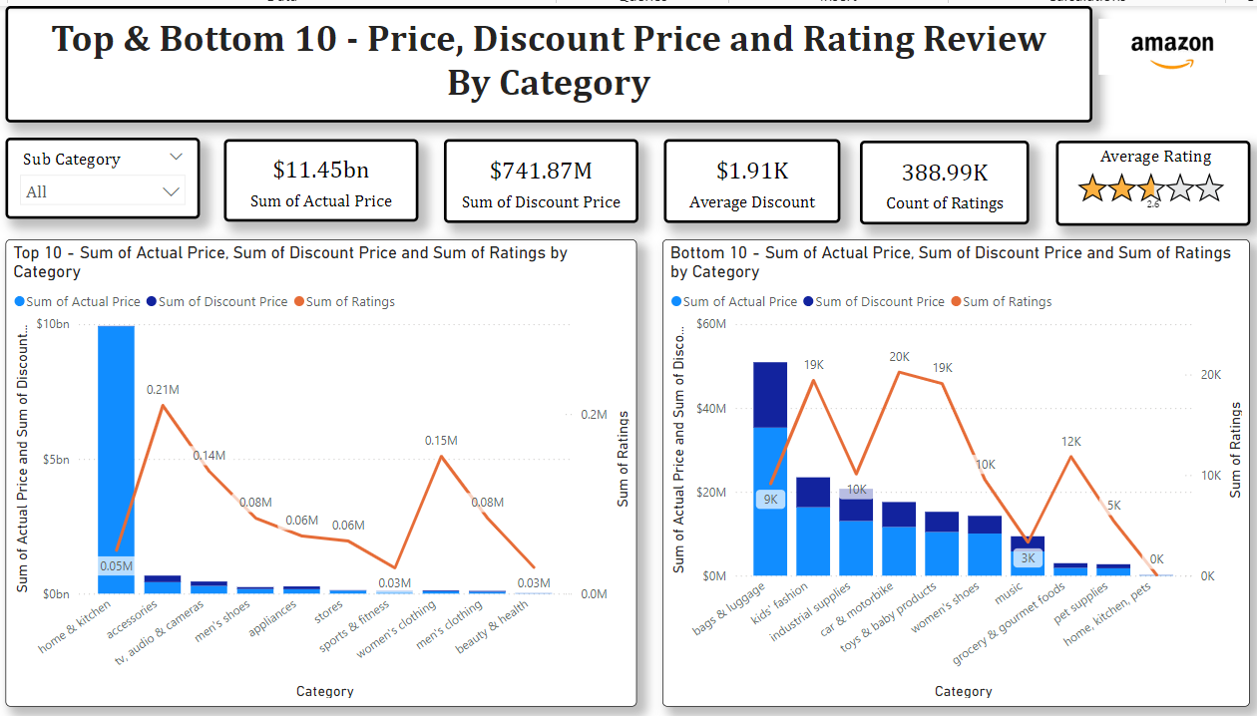
Top and Bottom 10 Product Categories by Price, Discount, and Rating
This chart is like a map of Amazon products. It helps us understand which product categories are the most and least popular, expensive, and discounted.
It will explore each part:
Top 10 Sum of Actual Price, Sum of Discount Price and Sum of Ratings by Category
Bottom 10 Sum of Actual Price, Sum of Discount Price and Sum of Ratings by Category
Summary:
The chart helps us understand that Amazon has a wide variety of products in different categories. We can see which categories are the most and least popular, expensive, and discounted. This information can help us choose which products to buy on Amazon.

Slide 15
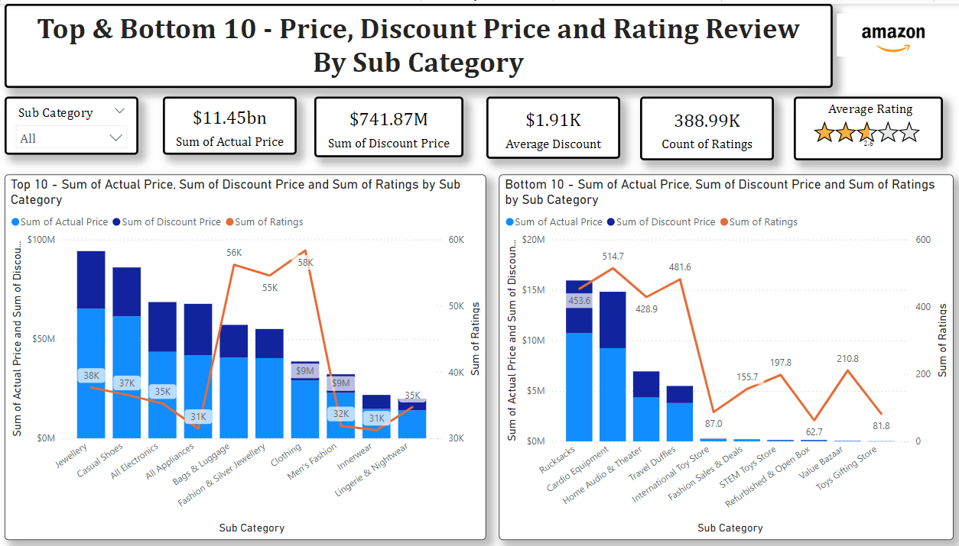
Top and Bottom 10 Product Subcategories by Price, Discount, and Rating
The chart is like a map of Amazon products. It helps us understand which specific product subcategories are the most and least popular, expensive, and discounted.
We will explore each part:
Top 10 Sum of Actual Price, Sum of Discount Price and Sum of Ratings by Sub-Category
Bottom 10 Sum of Actual Price, Sum of Discount Price and Sum of Ratings by Sub-Category
Summary:
This chart helps to us understand that Amazon has a wide variety of products within specific categories. We can see which subcategories are the most and least popular, expensive, and discounted. This information can help us choose specific products to buy on Amazon.

Slide 16
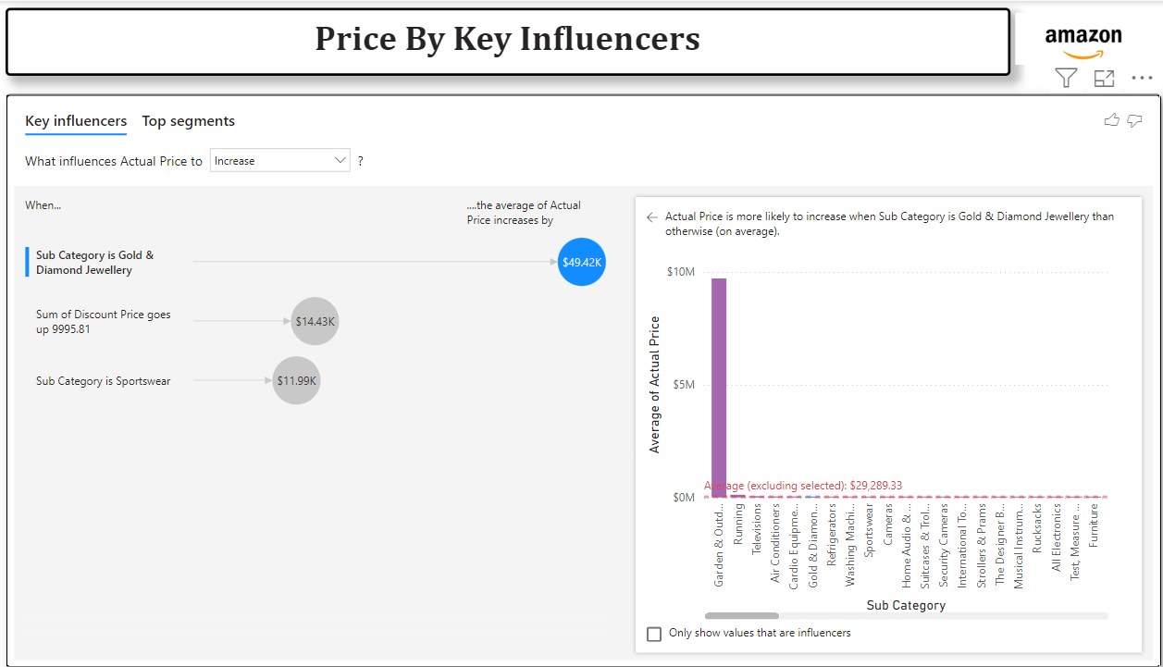
Key Drivers of Price Increases on Amazon
The chart is like a detective story about Amazon prices. It helps us understand what makes some products more expensive than others.
We explore each part:
1. What influences Actual Price to Increase:
This part is like a detective's notebook. It shows us the clues that can help us figure out why some products are more expensive.
2. Average of Actual Price:
This is like a treasure map. It shows us the most expensive product categories on Amazon. We can see that Gold & Diamond Jewellery is the most expensive category.
Summary:
This chart helps us understand that the type of product and how much it's discounted can influence its price. We can see that gold and diamond jewelry and some types of sportswear are usually more expensive on Amazon.

Slide 17
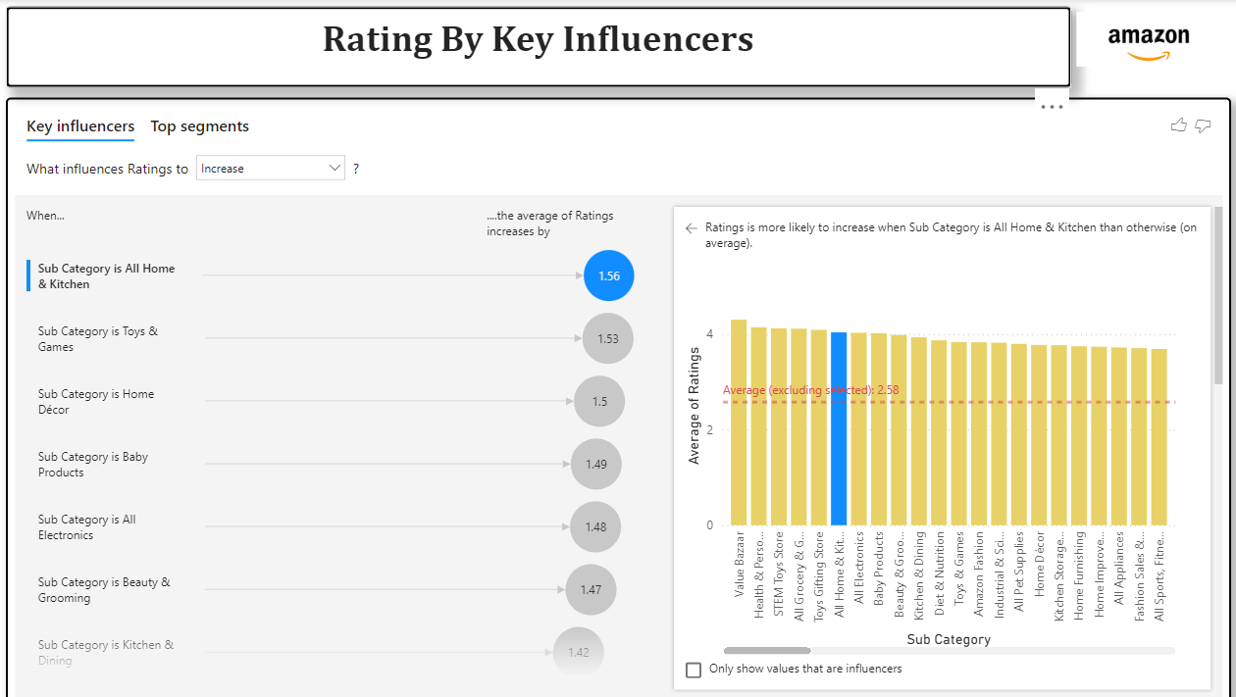
Key Drivers of High Ratings on Amazon
The chart is like a detective story about Amazon ratings. It helps us understand what makes some products have higher ratings than others.
We explore each part:
1. What influences Ratings to Increase:
This part is like a detective's notebook. It shows us the clues that can help us figure out why some products have higher ratings.
2. Average of Ratings:
This is like a treasure map. It shows us the product categories with the highest average ratings. We can see that All Home & Kitchen is the highest-rated category.
Summary:
The chart helps us understand that the product category can influence its rating. We can see that Home & Kitchen and Toys & Games products are usually rated higher on Amazon.

Slide 18
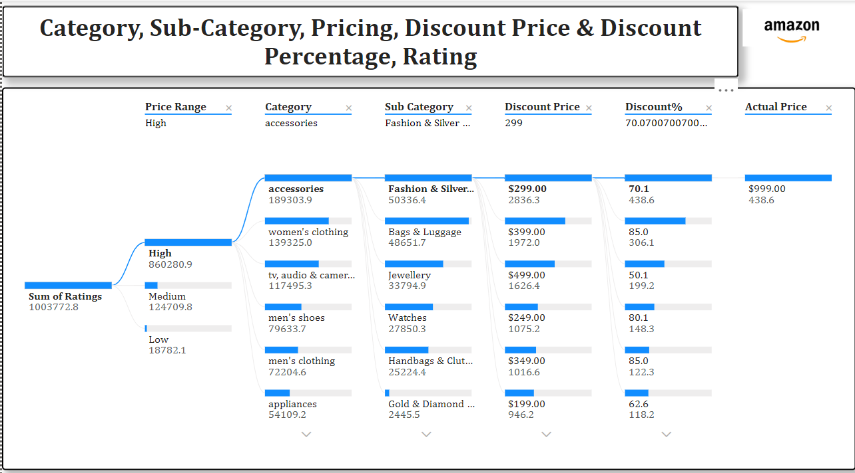
Amazon Product Pricing, Discount, and Rating Analysis
The chart is like a map of Amazon products. It helps us understand how much different products cost, how much they cost after a discount, and how many people liked them.
We will explore each part:
1. Price Range, Category, Sub-Category, Discount Price, Discount%, and Actual Price:
This part shows us information about different products on Amazon.
We can see the price range (High, Medium, Low), the category (like Accessories, Women's Clothing), the subcategory (like Fashion & Silver Jewelry, Bags & Luggage), the discount price, the discount percentage, and the original price of the product.
2. Sum of Ratings:
It shows us how many people have rated products in each price range.
We can see that the most products were rated in the Medium price range.
Summary:
The above chart helps us understand that Amazon has products in different price ranges, categories, and subcategories. We can see the discounts offered on different products and how many people have rated them.

Slide 19
Key Insights
Product Categories and Subcategories:
Popular Categories: TV, Audio & Cameras, and Home & Kitchen are among the most popular categories.
Expensive Categories: Gold & Diamond Jewelry and Sportswear are the most expensive categories.
Highly Rated Categories: Home & Kitchen and Toys & Games are the highest-rated categories.
Pricing and Discounts:
Price Ranges: Amazon offers products in a wide range of prices, from low-cost items to high-end luxury products.
Discount Strategies: Amazon employs various discount strategies to attract customers, including percentage discounts and fixed price reductions.
Price Drivers: Product category, subcategory, and original price are key factors influencing the final price of a product.
Customer Ratings and Preferences:
Rating Distribution: Most products on Amazon receive moderate ratings, with a few outliers receiving very high or very low ratings.
Rating Drivers: Product category, subcategory, and original price are key factors influencing customer ratings.

Slide 20
Recommendations
Targeted Marketing:
Personalized Recommendations: Utilize customer data to provide personalized product recommendations.
Targeted Advertising: Focus advertising efforts on high-potential customer segments.
Optimized Pricing Strategy:
Dynamic Pricing: Implement dynamic pricing strategies to maximize revenue.
Competitive Pricing Analysis: Continuously monitor competitor pricing to stay competitive.
Enhanced Product Information:
Detailed Product Descriptions: Provide clear and concise product descriptions.
High-Quality Images: Use high-quality images to showcase products effectively.
Improved Customer Experience:
Efficient Shipping and Returns: Streamline the shipping and return process.
Excellent Customer Support: Provide responsive and helpful customer support.

Slide 21
Future Scope
Sentiment Analysis: Analyze customer reviews to identify specific reasons for high and low ratings.
Product Lifecycle Analysis: Track the performance of products over time to identify trends and opportunities.
Predictive Analytics: Use machine learning to forecast future sales and customer behavior.
A/B Testing: Experiment with different pricing strategies, product descriptions, and marketing campaigns to optimize performance.
By implementing these recommendations and exploring future opportunities, Amazon can further enhance its customer experience, increase sales, and strengthen its market position.

