Slide 1
Intro to Machine Learning
Training by Jessica Garson
Twitter: @jessicagarson

Slide 2
Part 1
Introduction and Setting our Norms

Slide 3
Let’s Introduce Ourselves
Our name
A little about ourselves
Favorite Movie

Slide 4
Norms
What rules and guidelines do we want to set for this training?

Slide 5
A note before we get started
When I first got started none of this came easy to me and took me a long time for me to master
Today we will be learning about how to learn machine learning

Slide 6
The hard part
Setting up our environment
Notes:
Virtualbox

Slide 7
Middle school dance rules apply
Let’s move into groups based on our computer types
Macs sit with Macs
PCs sit with PCs

Slide 8
Download the anaconda package of python
http://continuum.io/downloads

Slide 9
Part 2
A few definitions and building our first model

Slide 10

What is Big Data?

Slide 11

What is Data Science?

Slide 12
What is Machine Learning?
Technically the act of teaching a computer how to learn
I see it a bit more as standardizing data in order to be capable of building predictions

Slide 13
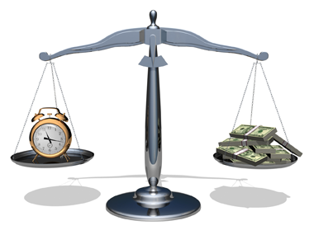
Why do this?

Slide 14
What is a model?
An educated guess
A predicted outcome based on the probability of an event to occur

Slide 15
Do we use any models in our every day life?
What type of predictions do we use on a regular basis?

Slide 16
What kind of tools do we need?
There are many statistical packages out there that can be useful for building models
Stata
SAS
Excel
SPSS
Python
R

Slide 17
Let’s build our first model
Which of the drivers will renew their license?

Slide 18
Discussion
Which drivers did you select as most likely to renew?
How did you arrive at this conclusion?

Slide 19
Part 3
A framework for thinking about the work needed

Slide 20
Starting with a question
What are we trying to do?
What do we want to predict?

Slide 21
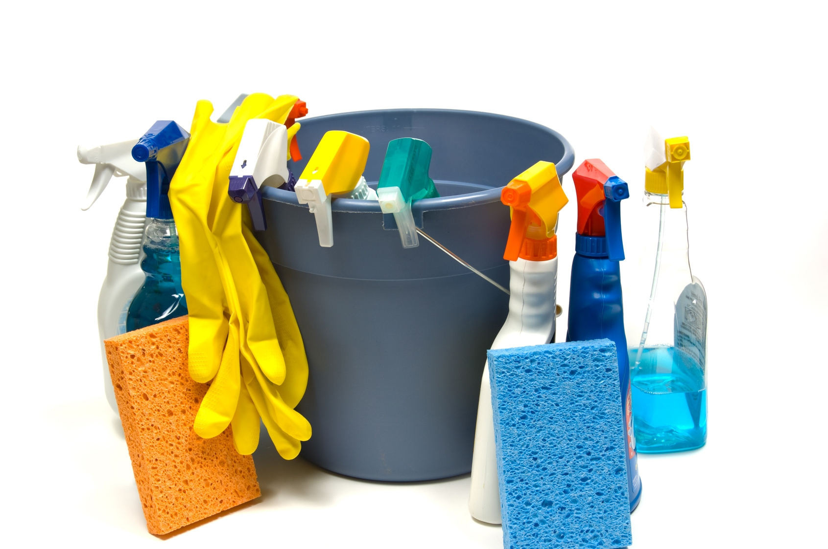
Step 1: Cleaning our data

Slide 22
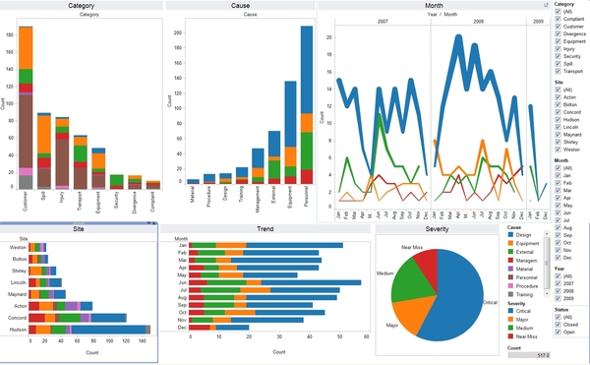
Step 2: Get to know our dataset

Slide 23

Step 3: Make predictions

Slide 24
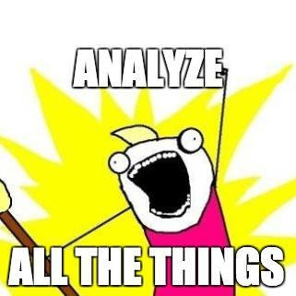
Step 4: Measure how well it worked?

Slide 25
Part 6
Getting the files for today’s workshop

Slide 26
Getting Started with the Command line
If you have a mac
Go to your finder
Go to applications
Go to the utilities folder
Go to where it says terminal
If you have a PC
If you don't have a command line prompt that you enjoy using I recommend Babun. You can download it here
There is also a command client that comes with anaconda for PC
Create your github profile if you don't have one yet
You can do this at the github webpage

Slide 27

We are going to fork and clone the repo

Slide 28
Part 7
Getting to know our dataset

Slide 29
Part 8
Data Viz

Slide 30
Part 9
Data Cleaning

Slide 31
Part 10
Joke or Not?

Slide 32
Part 11
Play around

Slide 33
Use the kaggle tutorial to learn about how to build models
https://www.kaggle.com/c/titanic

Slide 34
Contact Me
Jessica.Garson@gmail.com
Jessica.Garson@bm.com

