Slide 1
Therac-25
Will history repeat itself?
By Ash Tyndall

Slide 2
Linear Accelerators
“LINACs”
Medical application: treatment of various illnesses, particularly cancer.
Dispense X-ray or Electron based radiation.
Two companies involved:
  Atomic Energy of Canada Limited (AECL)
  Compagnie General Radiographique (CGR)
Therac-25, based on AECL and CGR work, released in 1983.

Slide 3
Remove hardware interlocks
100% software
safeguards

Slide 4
It’ll be fine…
At least six accidents.
Four deaths.
Dosages hundreds or thousands of times greater than normal.

Slide 5
Importance
Fairly self-evident
Medical software has an enormous capacity to kill and injure
All efforts should be made to prevent this
  Understand what has gone wrong in the past
  Know what to change in the future
  Know what changes prevent/don’t prevent accidents

Slide 6
Therac-25:
Will history repeat itself?
Introduction
The Incident
Safe Software Design
Post-Therac
Conclusion

Slide 7
The Incident
What went wrong with Therac-25?

Slide 8
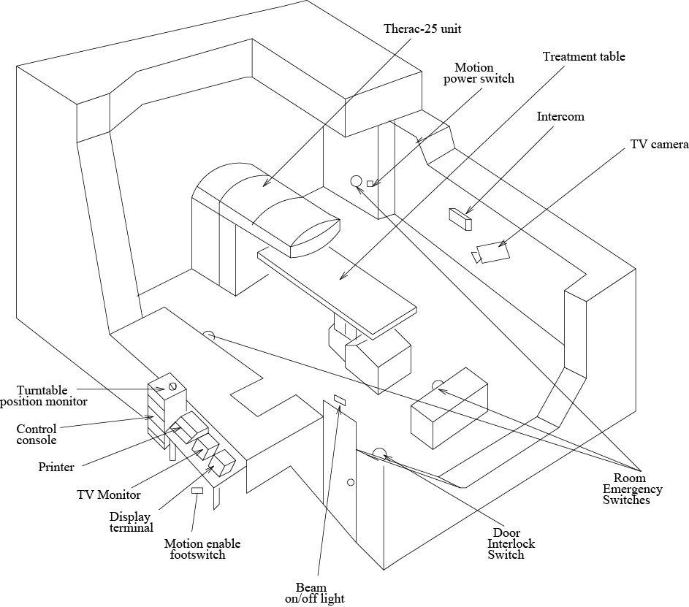
Typical Therac-25 facility circa 1988
Taken from [5]; Leveson, N. 1995.

Slide 9
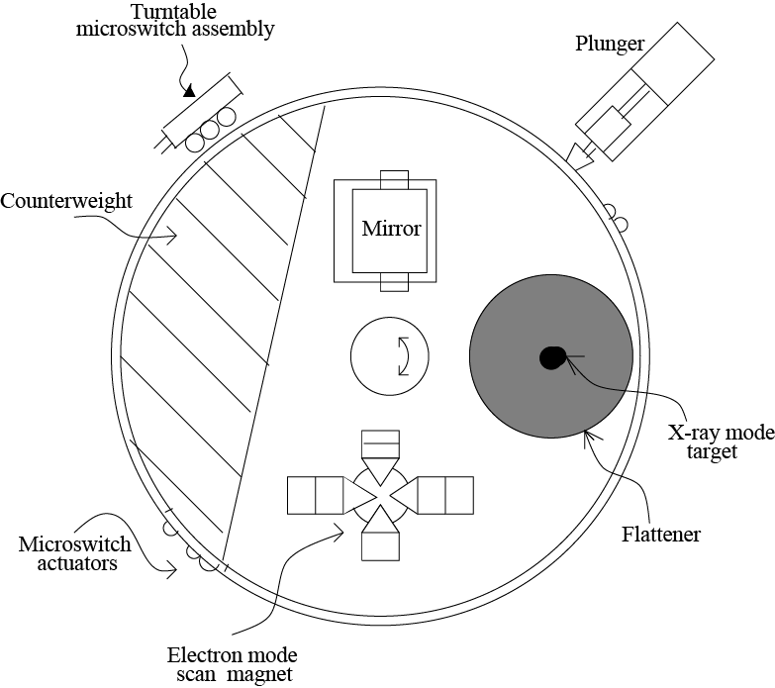
Design Preconditions
Scanning magnet
  Converted X-rays into electrons
  Process causes a lot of radiation to be lost as heat
  Requires substantial increase in X-ray output for equivalent electron beam power
Taken from [7]
[4] Leveson, N. G., and Turner, C. S. 1993. [7] Leveson, N. 1995.

Slide 10
Design Preconditions
Rotating turntable
  Beam flattener would rotate into place in front of X-ray emitter
  This process would take about 8 seconds
  Safeguard in software to prevent operator from activating beam before that
[4] Leveson, N. G., and Turner, C. S. 1993.

Slide 11
Upper turntable assembly
Taken from [7]; Leveson, N. 1995.

Slide 12
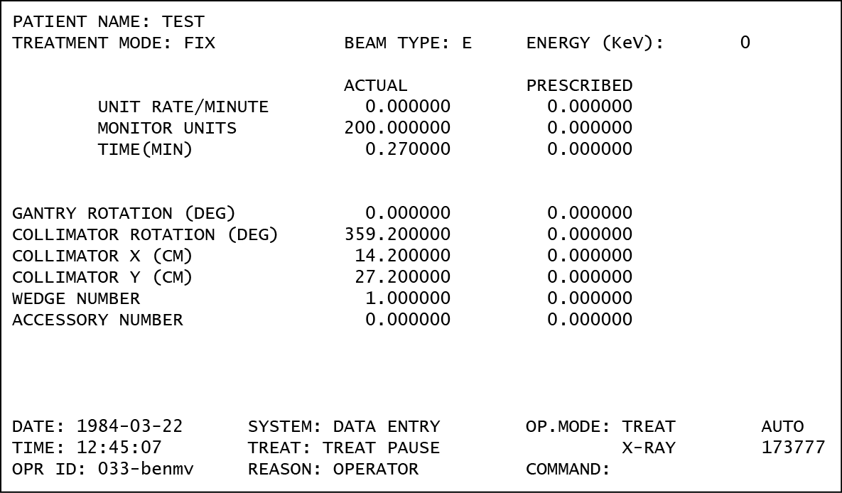
Therac-25 interface
Press “Enter” to verify
  Operator could press Enter to confirm that “Actual” was correct without entering “Prescribed”. Very quick process.
[4] Leveson, N. G., and Turner, C. S. 1993.
Set by physical machine configuration
Entered by operator to verify
0.000000
0.000000
0.000000
0.000000
0.000000
0.000000
0.000000
0.000000
0.000000
0.000000 VERIFIED
200.000000 VERIFIED
0.270000 VERIFIED
0.000000 VERIFIED
359.200000 VERIFIED
14.200000 VERIFIED
27.200000 VERIFIED
1.000000 VERIFIED
0.000000 VERIFIED
Taken from [7]; MIT Department of EE and CS. 2007.

Slide 13
What actually went wrong?
The main problem: Race condition in software.
Changing between X-ray and electron mode didn’t pause the machine for 8 seconds, like it should have.
If operator skipped through too quickly after changing from X-ray to electron mode, the turntable wouldn’t completely rotated, and the patient would get a massive dose of X-rays.
[4] Leveson, N. G., and Turner, C. S. 1993.

Slide 14
Safe Software Design
How do we design safe software?

Slide 15
Acceptable “Mishap Risk”
Safety can’t be 0% probability
Humans are willing to accept some risks
Mishap
  “an unplanned event or series of events that result in death, injury, occupational illness, damage to or loss of equipment or property, or damage to the environment” — Department of Defence via Dunn [3]
Takes into account both:
  Probability of it occurring.
  Severity if it were to occur.
[3] Dunn, W. R. 2003.

Slide 16
Safeware
Nancy Leveson
Published 1995
“Safeware” design principles
“Safeware” culture
[5] Leveson, N. 1995.

Slide 17
“Safeware” design
Hazard-free design
  Get rid of it
Hazard reduction
  Reduce the likelihood of it being hazardous
Hazard control
  Reduce the likelihood of it causing an accident
Damage control
  Know what to do if it all goes wrong
[5] Leveson, N. 1995.

Slide 18
Engineering a Safer World
Nancy Leveson
Published 2011
State of the art
System-Theoretic Accident Model and Processes
[6] Leveson, N. 2011.

Slide 19
STAMP
Forms a core part of
Engineering a Safer World
Components:
  Safety constraints, not events
  Hierarchical safety control structures
  Process models
[6] Leveson, N. 2011.

Slide 20
Post Therac
What was done to stop Therac-25 reoccurring?

Slide 21
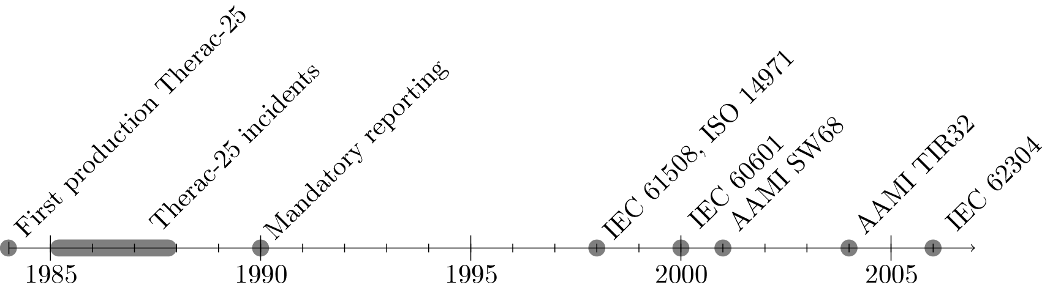
Regulation timeline
Regulatory bodies slow to react
Complicated, with a variety of national and international standards
Discussed in more detail in report

Slide 22
Data Analysis
Did international regulation cause a reduction in medical device software errors?
“Manufacturer and User Facility Device Experience” Database.
Database of “adverse events,” (i.e. mishaps) which a variety of parties are obligated to report into.
Available freely on the US FDA website.
Covers mostly 1995—2014.
[8] US FDA, 2014.

Slide 23
Event Categories (1,000+)
Failure to run on AC/DC
Abnormal
Absorption
Accessory incompatible
Measurements, inaccurate
Adaptor, failure of
Agglutinate, failure to
Automatic injection system overinfusion
Failure to back-up
Failure to convert to back-up
Balloon rupture
Balloon asymmetrical
Balloon burst
Contamination during use
Intermittent continuity
Continuous
Continuous firing
Continuous mode failure
Use of Incorrect Control Settings
Cool, failure to
Coolant, contraindicated
Cooling system, failure of
Insufficient cooling
Display misread
Erratic display
No display or display failure
Incorrect display
Disposable
Dissection
Distilled water, contaminated
Dome collapse
Rupture due to trauma
Saline, use of homemade
Salt tablet(s), use of
Seal, incorrect
Sediment filter problems
Self-activation or keying
……
……
[8] US FDA, 2014.

Slide 24
“Software” categories
Computer failure
Computer hardware error
Computer software issue
Incorrect display
Error or warning message, failure to produce
Power calculation error due to software problem
Incorrect software programming calculations
Algorithms, inconsistent
Semiautomatic code, failure to override
Year 2000 (Y2K) related problem
Date-related software issue
Application network issue
Application program issue
Application program version or upgrade problem
Application security issue
Computer operating system issue
Computer system security issue
Data back-up problem
Loss of Data
Operating system becomes non-functional
Operating system version or upgrade problem
Problem with software installation
Programming issue
[8] US FDA, 2014.

Slide 25
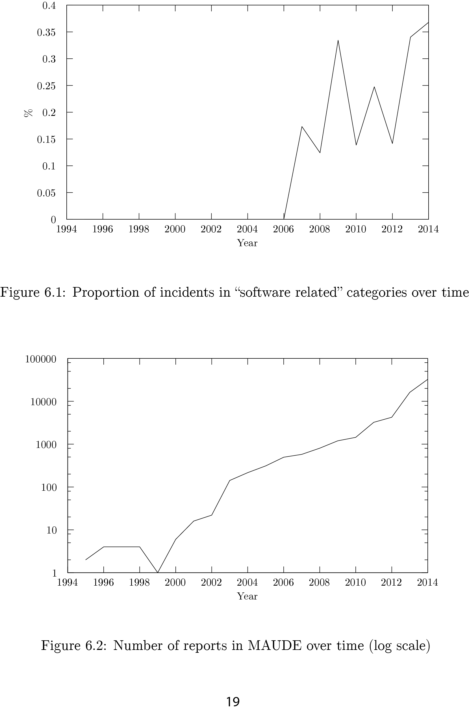
Proportion of incidents in “software related” categories over time
Difficult to derive any
particular trends.
Categories aren’t used in a lot of data.
Many software categories very recent.
Category overload.
Based on data from [8]; US FDA. 2014.

Slide 26
Regulatory Gaps
In-house software
Much more difficult to regulate, as it’s not marketed publicly.
1 case: > 20% overdose due to in-house software providing data in a format the LINAC did not understand.
Miscalculation of radiation dispersion caused 3%-7% overdose in ~4,000 people.
“[M]any radiotherapy centres use such handcrafted software, which are not standardised and may not be thoroughly checked before clinical use.”
— Derreumaux et. al. [2]
[2] Derreumaux, S., et. al. 2008.

Slide 27
Conclusion – My thoughts
Safe software design requires consideration from the beginning.
Therac-25 did not consider safety from the beginning, and suffered serious bugs as a result.
Regulators were very slow to regulate against medical device software, which is very worrying.
In-house software shows that regulation is not necessarily sufficient, nor will it regulate quickly enough.
Will history repeat itself?
Unfortunately, it looks like it already has.

Slide 28
Future Research
How have LINAC interfaces changed from a HCI perspective, and have they made incidents like Therac-25 less prevalent?
Correlating the introduction of regulation at national and international levels and the prevalence of adverse events.
Manually categorising some portion of MAUDE to get better insight into the prevalence of software-caused adverse events.
More in-depth research into in-house software and how regulators could help product consumers from it.

Slide 29
References
Besnard, D., Baxter, G., et al. Human compensations for undependable systems. Tech. Rep. CS-TR-819, University of Newcastle upon Tyne, 2003. Accessed: 2014-09-20, URL: http://www.dirc.org.uk/publications/techreports/papers/12.pdf.
Derreumaux, S., Etard, C., Huet, C., Trompier, F., Clairand, I., Bottollier-Depois, J.-F., Aubert, B., and Gourmelon, P. Lessons from recent accidents in radiation therapy in france. Radiation protection dosimetry (2008).
Dunn, W. R. Designing safety-critical computer systems. Computer 36, 11 (2003), 40-46.
Leveson, N. G., and Turner, C. S. An investigation of the Therac-25 accidents. Computer 26, 7 (1993), 18-41.
Leveson, N. SafeWare: System Safety and Computers. Computer Science and Electrical Engineering Series. Addison-Wesley, 1995.
Leveson, N. Engineering a Safer World: Systems Thinking Applied to Safety. Engineering systems. MIT Press, 2011.
MIT Department of Electrical Engineering and Computer Sciences. Therac-25 Hands-On Assignment, 6.033 - Computer System Engineering, 2007. Accessed: 2014-10-20, URL: http://web.mit.edu/6.033/2007/wwwdocs/assignments/handson-therac.html.
U.S. Food and Drug Administration. Manufacturer and User Facility Device Experience Database (MAUDE), 2014. Accessed: 2014-09-20, URL: http://www.fda.gov/MedicalDevices/DeviceRegulationandGuidance/PostmarketRequirements/ReportingAdverseEvents/ucm127891.htm.
U.S. Food and Drug Administration. What is a Serious Adverse Event?, 2014. Accessed: 2014-09-20, URL: http://www.fda.gov/safety/medwatch/howtoreport/ucm053087.htm.
Wallace, D. R., and Kuhn, D. R. Failure modes in medical device software: an analysis of 15 years of recall data. International Journal of Reliability, Quality and Safety Engineering 8, 04 (2001), 351-371.

Slide 30
Cut content follows…

Slide 31
A Brief History
1960s-70s:
  CGR develops the Neptune and Sagittaire LINACs
Mid-70s
  CGR and AECL partner to build the Therac-6 and later the Therac-20, based on CGR’s previous design, but augmented with computer control.
  AECL develops a new “double-pass” design for LINACs.
1981
  CGR and AECL officially part ways due to “competitive pressures.”
1983
  Therac-25, based on “double-pass” design, begins public sale by AECL.

Slide 32
“Safeware” principles
Safety design from the beginning.
Safety at every level of a company.
Safety culture.
[5] Leveson, N. 1995.

Slide 33
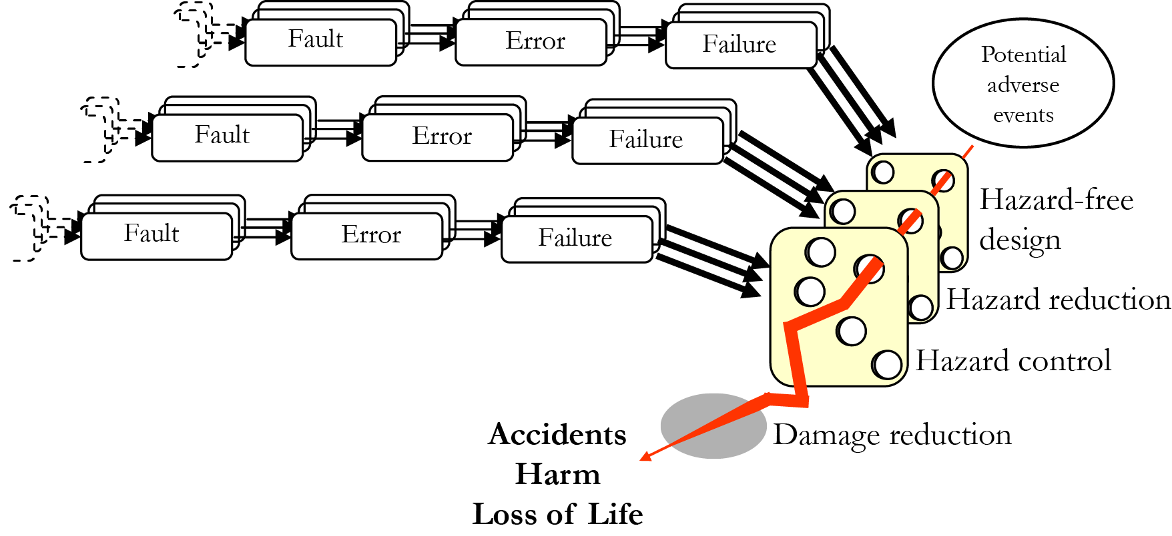
Model of Safeware's hazard reduction
Adapted from [1]; Besnard, D., Baxter, G., et al. 2003.

Slide 34
A failure at multiple levels
Little documentation kept on software
Poor testing practices
  AECL didn’t test software separately
Software of Unknown Pedigree
  Based on the software of the Therac-6
  Same bug found to exist in the Therac-20 (but non-fatal due to hardware interlocks)
Poor Human-Computer Interaction
  “Treatment Pause” function; operator could continue after error
  Meaningless and unexplained error codes
  “Verify” accuracy by pressing enter; habituated not thoroughly checking
[4] Leveson, N. G., and Turner, C. S. 1993.

Slide 35
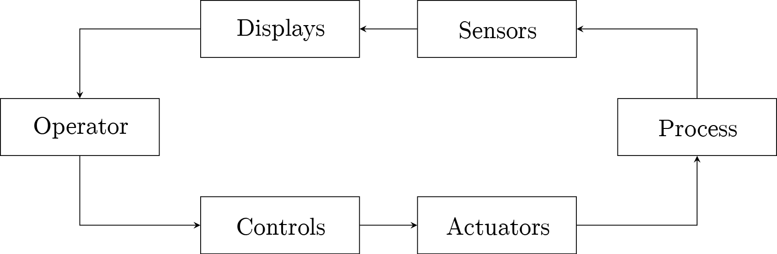
Synthesised perception model
Adapted from Fig. 4.1 of [6]; Leveson, N. 2011.

Slide 36
Control Theory
Human as Monitor
Given poor information
  Sensors indicating radiation dosage were saturated by the extreme overdose
  System error messages were just error codes with no documentation
  Both dangerous and benign errors had the same code, operator being habitualized
How can the user be a successful monitor, and keep the system in check, if their perception of the system is so poor?
[5] Leveson, N. 1995. [6] Leveson, N. 2011.

Slide 37
STAMP
“In systems theory, emergent properties, such as safety, arise from the interactions among the system components.
The emergent properties are controlled by imposing constraints on the behaviour of and interactions among the components.
Safety them becomes a control problem where the goal of the control is to enforce the safety constraints.
Accidents result from inadequate control or enforcement of safety-related constraints on the development, design and operation of the system.”
— Leveson [p. 75, 6]
[6] Leveson, N. 2011.

Slide 38
STAMP
Safety constraints, not events
“Events leading to losses occur only because safety constraints were not successfully enforced.”
— Leveson [p. 76, 6]
Safety is a reliability problem, not a control problem.
[6] Leveson, N. 2011.

Slide 39
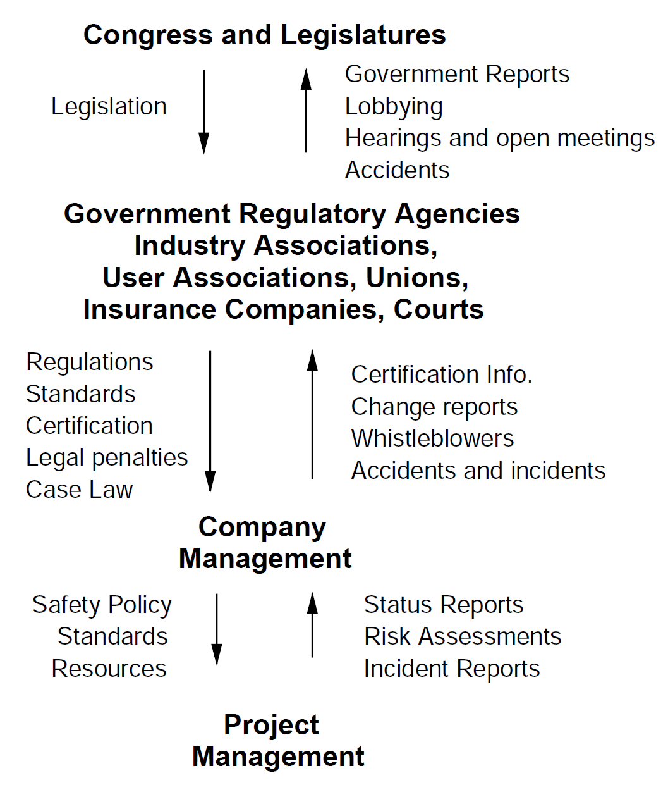
STAMP
Hierarchical safety control structures
Constraints enforce things below them in a hierarchy.
Excerpt from sociotechnical control model
Taken from [p. 82, 6]
[6] Leveson, N. 2011.

Slide 40
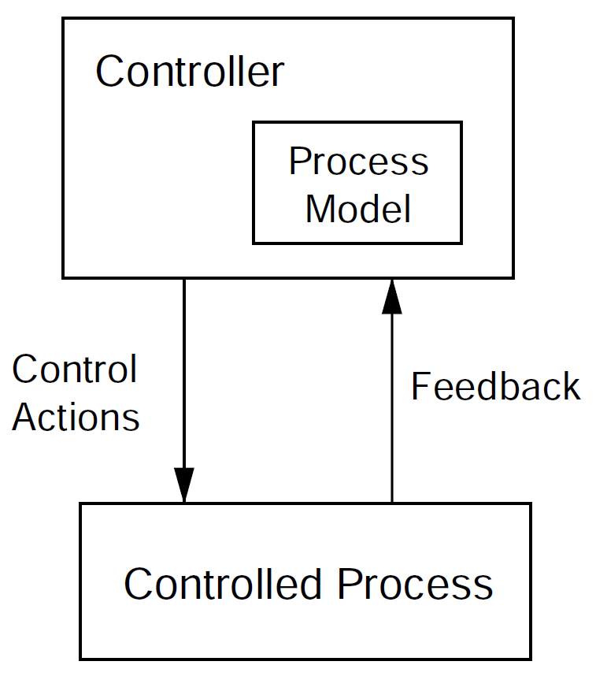
STAMP
Process models
Requirements to control a process
  Goals
  Action Condition
  Observation Condition
  Model
Meaning
  Required safety constraints
  How to accomplish them
  How to know it’s working
  How actions cause observations, and thus goals
Process Model in Controller
Taken from [p. 88, 6]
[6] Leveson, N. 2011.

Slide 41
Number of reports in MAUDE over time (log scale)
Maude appears to have a lot less data in the past, making trends difficult to predict.
Note the log scale.
Based on data from [8]; US FDA. 2014.

Slide 42
Other Data
Wallace & Kuhn
1983-91: 6% of incidents are software related.
1994-96: 11%, 10%, 9%
Contacted for more data, unfortunately didn’t have more specific dates.
[10] Wallace, D. R., and Kuhn, D. R. 2001.

