Slide 1
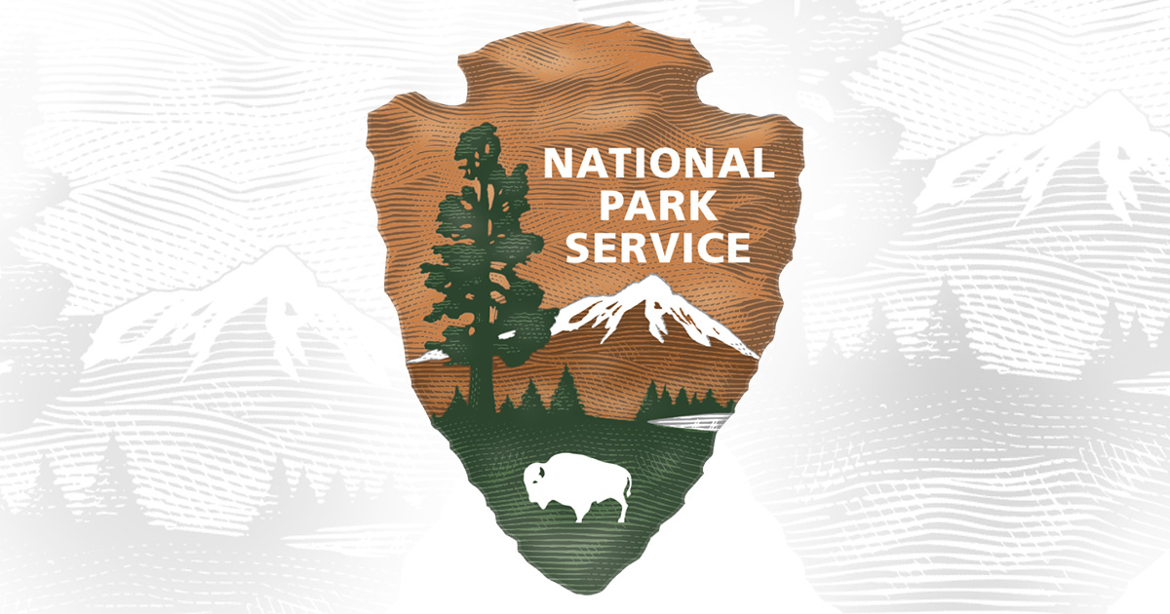
What makes a National Park popular?
An analysis of factors that could drive visitors to US National Parks
By Dan Dreger, Jessica Bailey, Joe Demler, Mohamed Abdelsalam, Yun Kim
Notes:
Share our main question, define popularity as num of visitors in 2022, mention some possible driving factors (our questions) and open poll.

Slide 2
How do we pick our favorite parks?
Weather
Size
Camping
Activities
Proximity to populated areas
Age of park

Slide 3
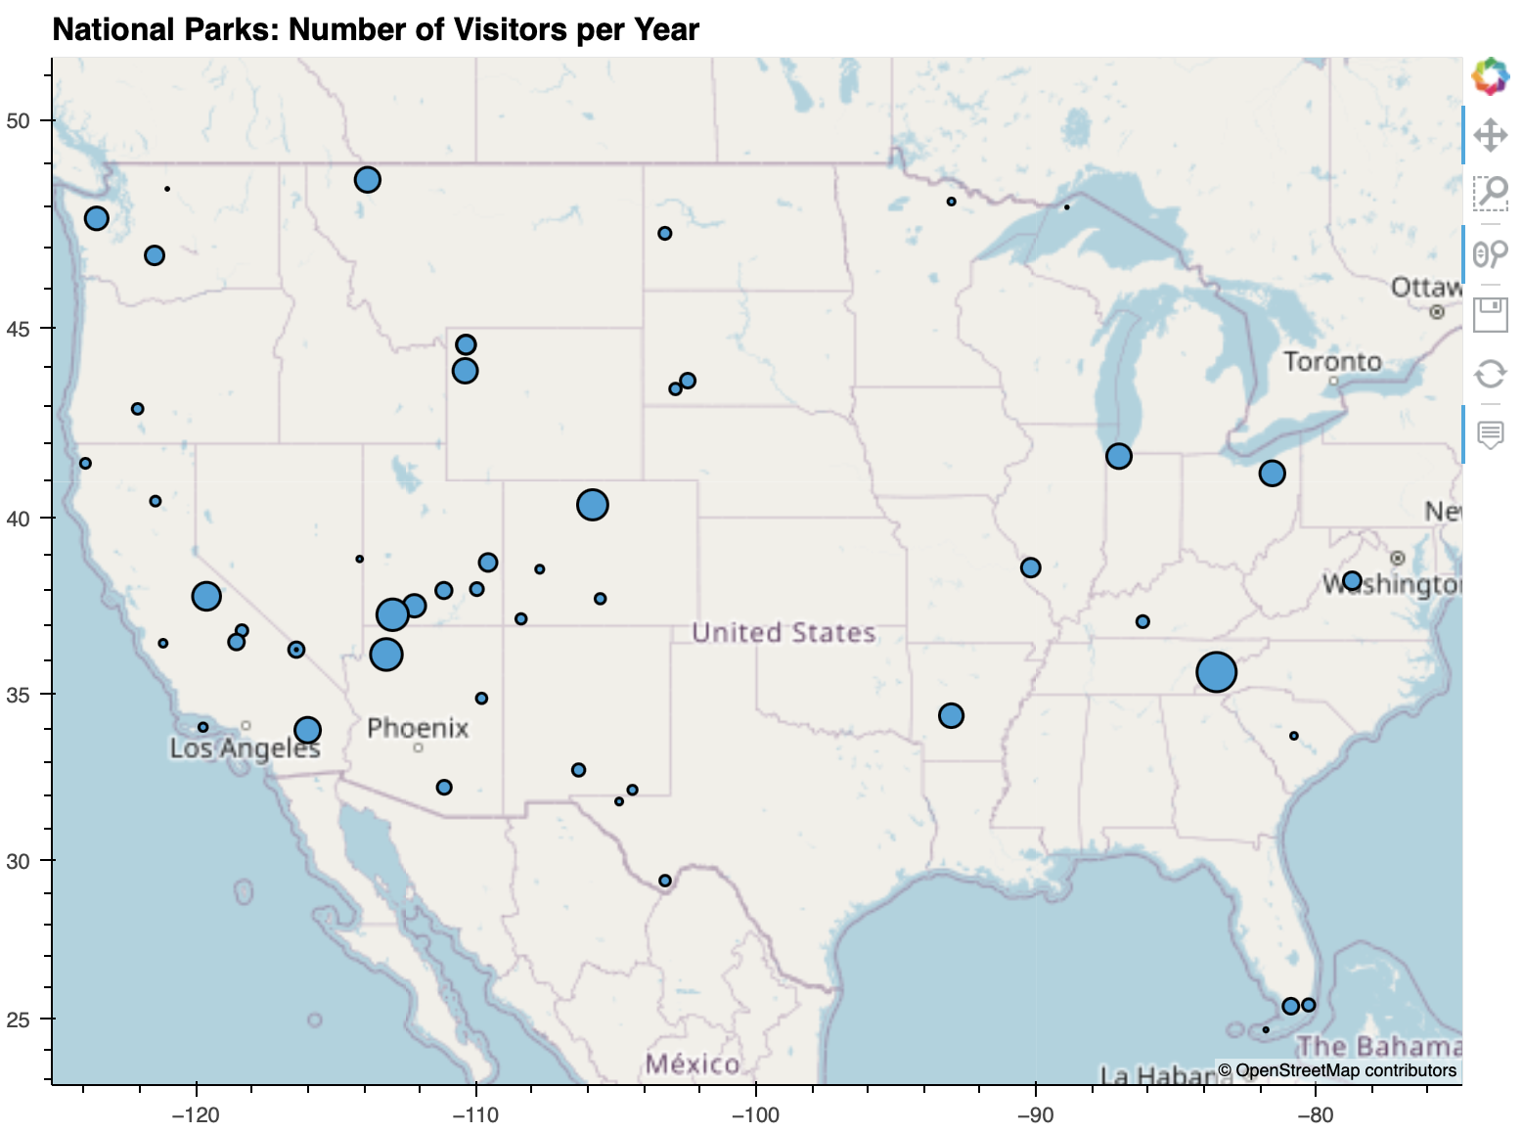
Most visited National Parks?
Great Smoky Mountains

Slide 4
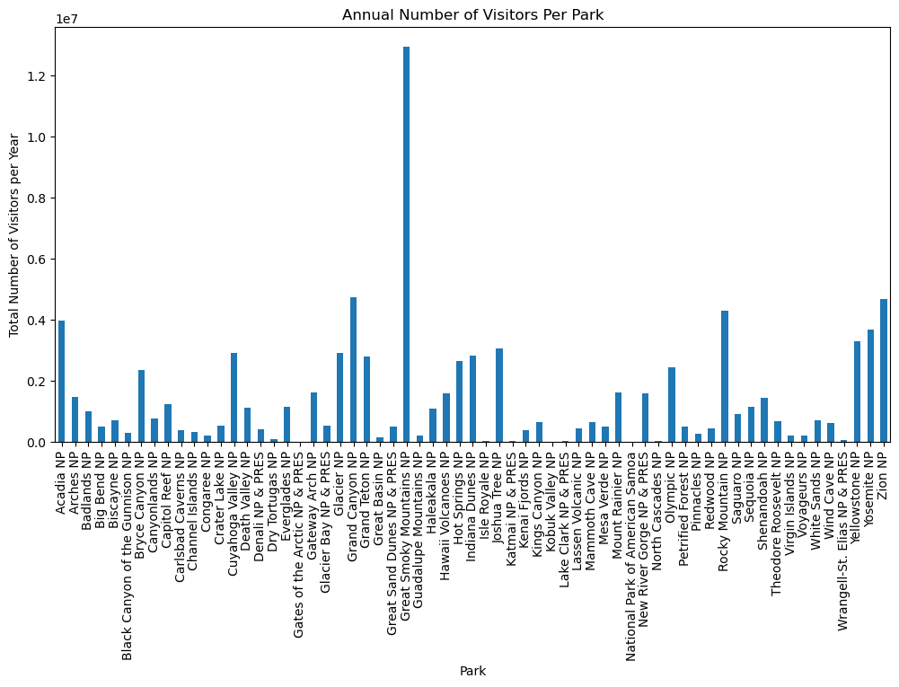
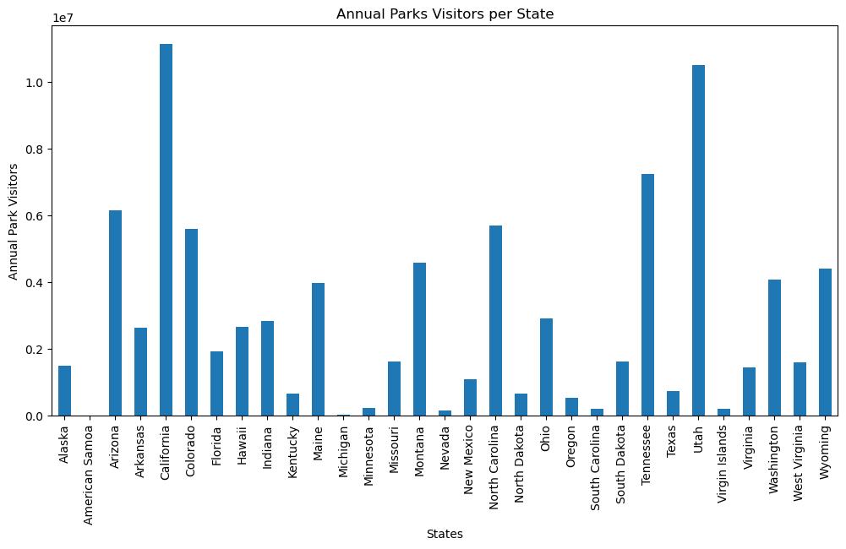
Annual visitors per park and per state

Slide 5
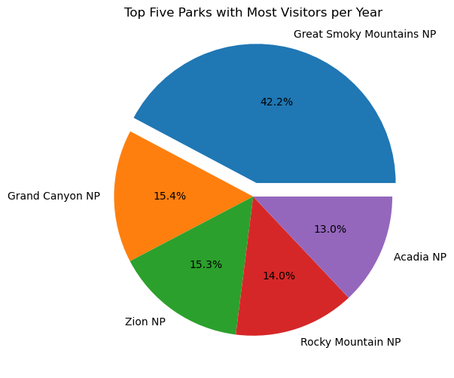
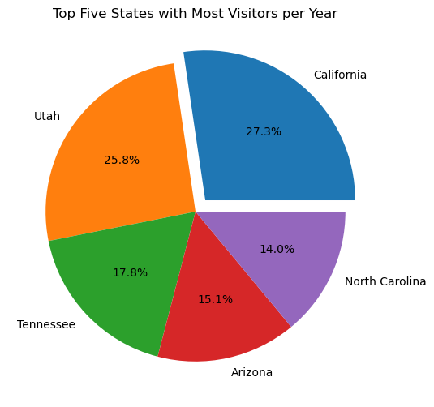
Top 5 parks and top 5 states

Slide 6
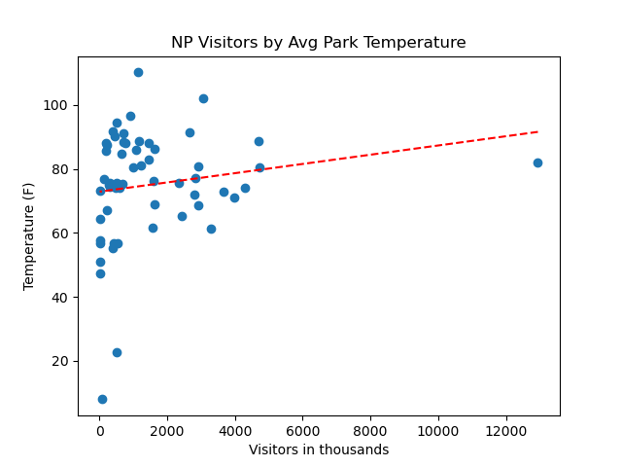
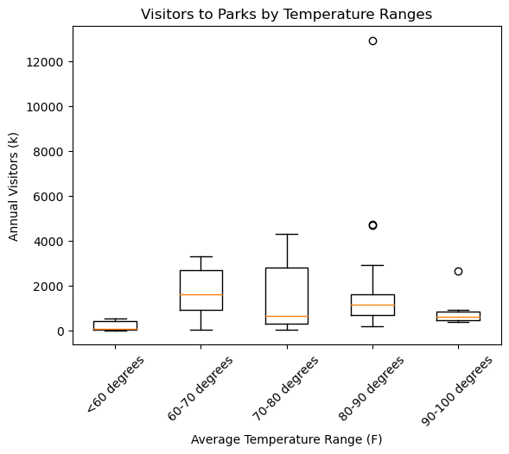
Do we choose to visit parks that have better weather?
p = 0.011 (Kruskal-Wallis)
Add charts
r = 0.17

Slide 7
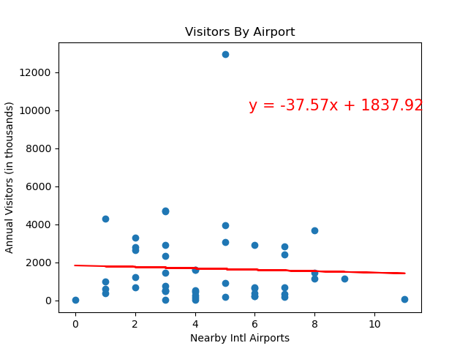
Do more people visit national parks with many international airports nearby?

Slide 8
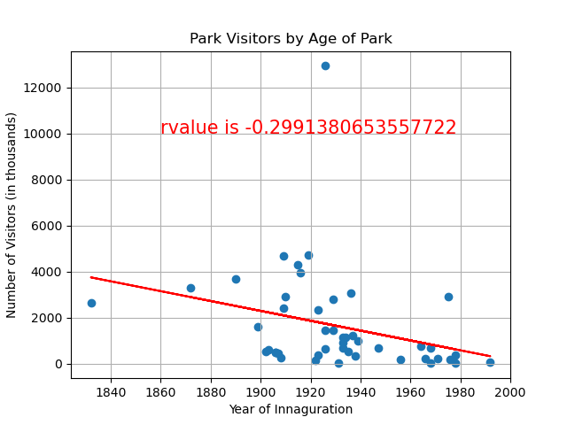
Do more people visit older, more "historic" national parks?
Notes:
P = 0.386

Slide 9
Does the number of activities offered by a national park affect the number of annual visitors?
Add charts/visuals

Slide 10
Does the total number of acres in a national park affect the number of overnight stays?
Add charts/visuals
Notes:
We had the same questions! Here’s what we found.

Slide 11
Conclusions & Limitations
Bullet points

