Slide 1
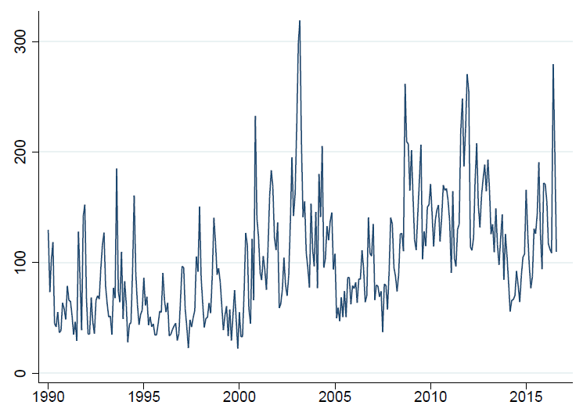
Gulf War II
Lehman
Brothers
Failure,
Global
Financial Crisis
Surprise Three-Party Political Merger
Daewoo Motors Bankruptcy, Financial Fraud and Accounting Scandals
Heavy industry Restructuring
Eurozone Fears
Brexit
Real-Name Financial Transactions Law Enacted
Parliament Impeaches President Roh Moo-hyun(March);
Constitutional Court Overturns Move (May)
North Korea Renounces
1953 Truce
South Korean Presidential Election
Economic and Financial Restructuring
Recession in China
Death of Kim Il-Sung
Asian Financial Crisis
9/11
Large Anti-FTA
Protests
Soviet Union
Collapse
Policy Uncertainty Index
Notes: Index reflects scaled monthly counts of articles in six South Korean newspapers containing ‘uncertain’ or ‘uncertainty’, ‘economic’ or ‘economy’ or ‘commerce’, and one or more of the policy terms specified for South Korea in Appendix A. The series is normalized to mean 100 from 1995 to 2014.

