Slide 1
A
Project Proposal
On
“A DEEP LEARNING BASED HUMAN ACTIVITY RECOGNITION USING WI-FI SIGNALS”
Presented By:-
Ashish Kumar Pokharel (NCE077BCT006)
Prashant Subedi(NCE077BCT021)
Sabina Pandey (NCE077BCT028)
Saksham Maharjan (NCE077BCT029)

Slide 2
Overview
Introduction
Literature Review
Problem Statement
Objectives
Scope
Proposed Methodology
Expected Output
References

Slide 3
Introduction
This project proposes a human activity recognization using wi-fi signals which employs deep learning algorithms to classify human activities.
The project focuses on systematic collection and analysis of Wi-Fi signal data to accurately identify and categorize human activities.

Slide 4
Literature Review
Moshiri et al. collected data for seven human activities using Nexmon tool on Rpi, for human activity in a single room. They created the famous CSI-HAR dataset.
Mekruksavanich et al. used CNN-GRU-AttNet model and improved the accuracy by 4.65% using the CSI-HAR dataset collected by [1].

Slide 5
Literature Review
A new methodology for wifi based human activity through wall was proposed by Abuhoreyah et al. which used Nexmon tool with Raspi and alpha _____ wifi card with antennas for better coverage.

Slide 6
Problem Statement
Traditional methods require close proximity to routers and are affected by reflections in confined spaces.
Sensing human activities through walls is underexplored.
Recognizing activities involving multiple individuals through walls is inaccurate due to signal overlap and attenuation.

Slide 7
Objective
Objectives of this project are as follows:
To explore human motion sensing through wall.
To implement deep learning network to recognize the activities.
To utilize Raspberry Pi and Nexmon Firmware to monitor CSI data.
To design a system capable of collecting data through walls using wider-angle wi-fi sensing.

Slide 8
Scope
This system will facilitates elderly care and patient monitoring.
Will help identify falls or prolonged inactivity to alert care-givers.
Could enhance patient safety by providing real-time alerts without the need for frequent physical checks.
Could detect room occupancy and adjusts environmental controls such as lighting, heating, and cooling accordingly.

Slide 9
Proposed Methodology
Hardware Requirements
Raspberry Pi 4B model
NIC
High gain antennas
Software Requirements
Nexmon firmware
Tensorflow or Pytorch
Python Libraries (NumPy, Pandas, Matplotlib)
Visual Studio Code, Jupyter Notebook
Tkinter

Slide 10
Proposed Methodology
Data Collection
Empty
Lie
Walk
Run
Sit
Fall
Stand

Slide 11
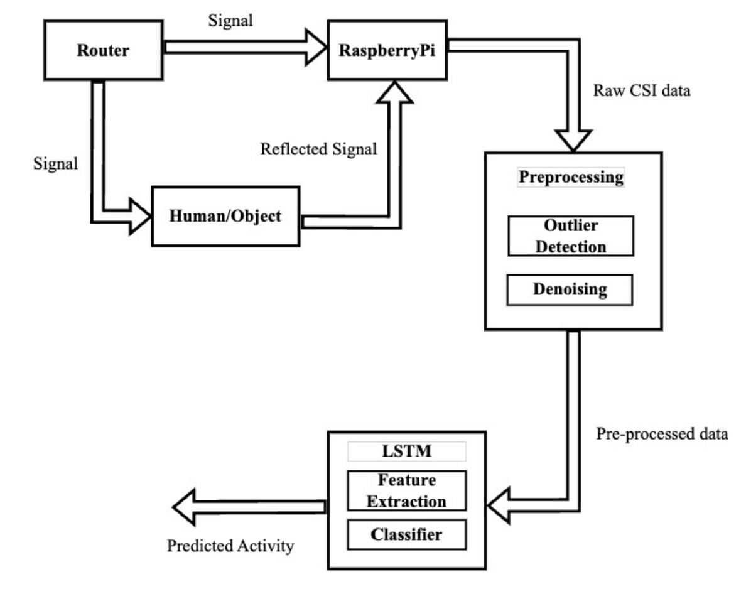
Proposed Methodology

Slide 12
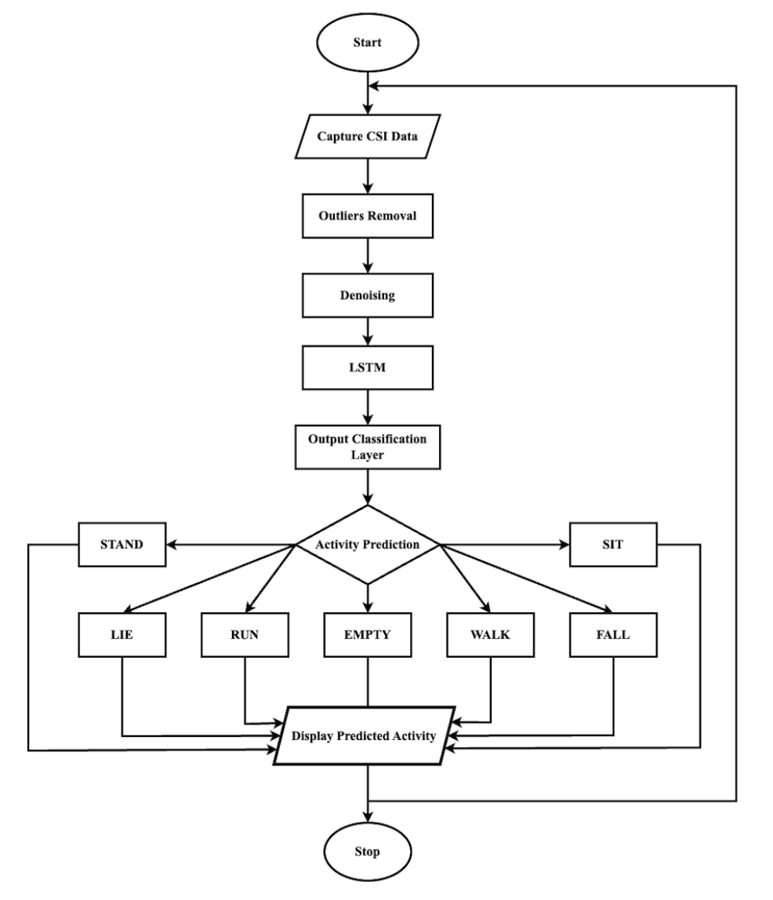
Proposed Methodology

Slide 13
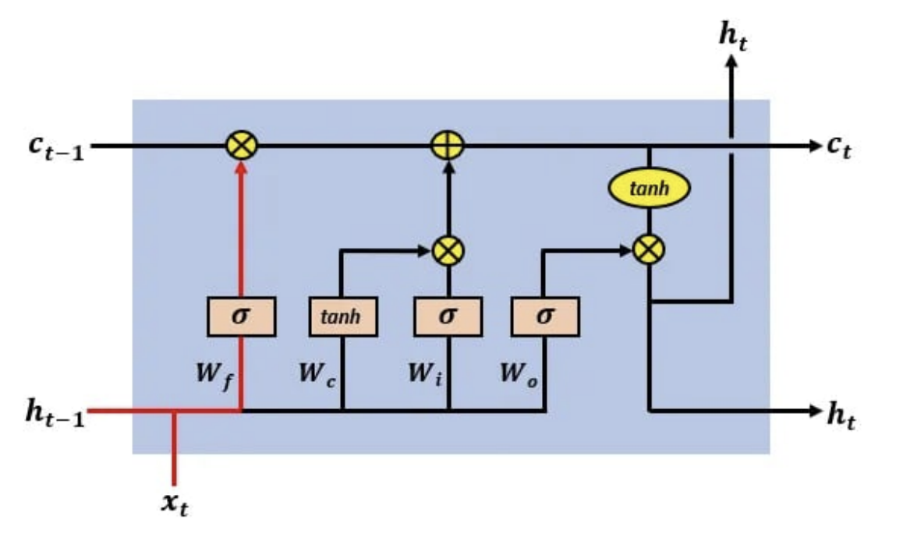
Proposed Methodology
ALGORITHM

Slide 14
Proposed Methodology
LSTM cell consists of:
Input gate decides if the current cell input information is in needed to be stored in cell state.
Forget gate decides if the previous cell state information should be forgotten or not.
Output gate decides what information is to be produced as output.

Slide 15
Expected Output
A desktop application developed using Tkinter that can identify human activity using Wi-Fi signals.

Slide 16
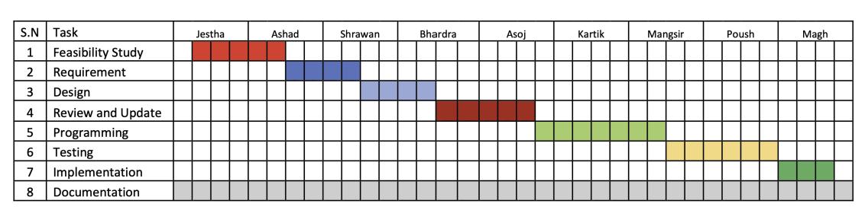
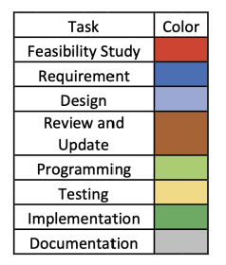
Project Timeline

Slide 17
References
[1] P. F. Moshiri, R. Shahbazian, M. Nabati, and S. A. Ghorashi, “A csi-based human activity recognition using deep learning,” Sensors (Basel, Switzerland), vol. 21, 10 2021.
[2] S. Mekruksavanich, W. Phaphan, N. Hnoohom, and A. Jitpattanakul, “Attentionbased hybrid deep learning network for human activity recognition using wifi channel state information,” Applied Sciences (Switzerland), vol. 13, 8 2023.
[3] F. S. Abuhoureyah, Y. C. Wong, and A. S. B. M. Isira, “Wifi-based human activity recognition through wall using deep learning,” Engineering Applications of Artificial Intelligence, vol. 127, 1 2024.

Slide 18
Thank You

