Slide 1
Online Ordering
By: Mercedes Kent
Tejash Patel
Jessie Wilkins

Slide 2
Purpose
The purpose was to create an online ordering system
Wanted to give the customer a way to order for future orders
Allow them to customize their order based on the items offered

Slide 3
Database
We started by using MySql but did not work well with Visual Studios
Switched to Microsoft Database

Slide 4
C#
Used Visual Studios IDE
We choose C# because
Used it to create our web application

Slide 5
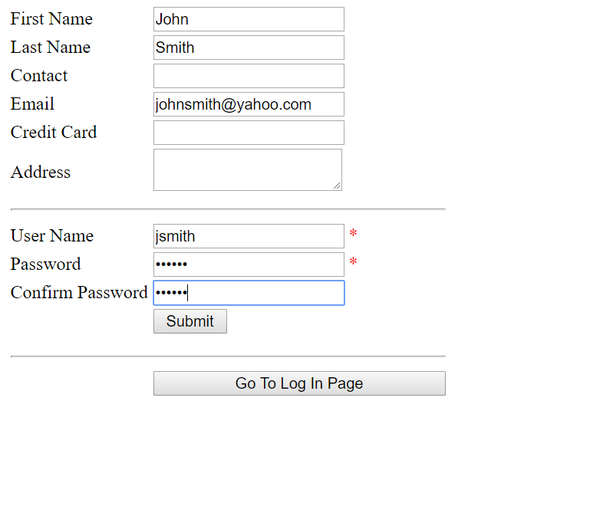
Sign-up Page

Slide 6
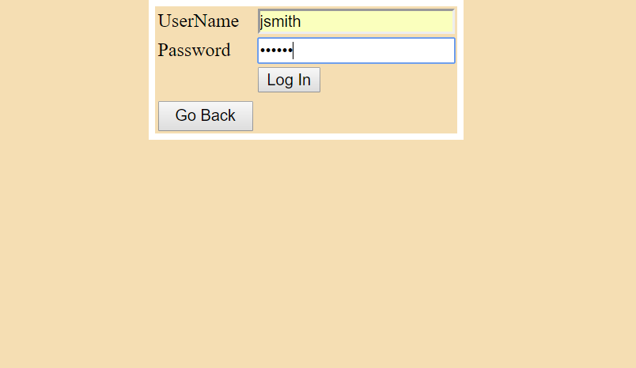
Login Page

Slide 7
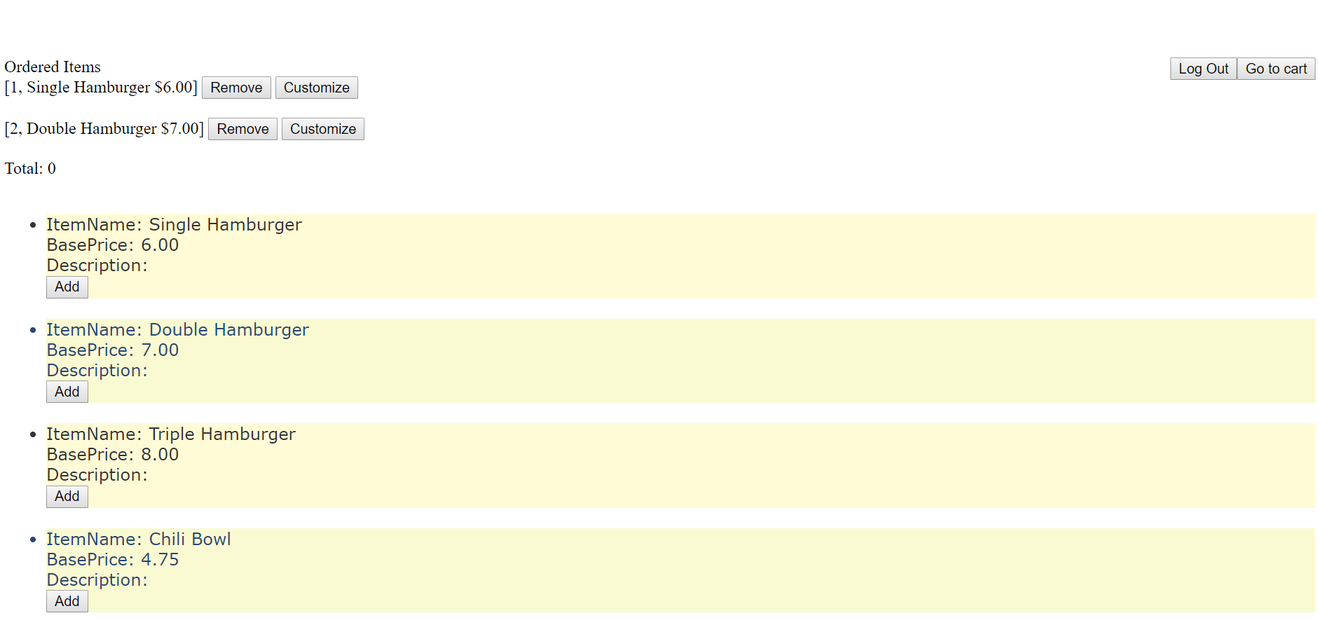
Web Application

Slide 8
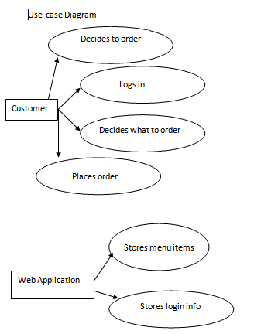

Diagrams
Use case Activity

Slide 9
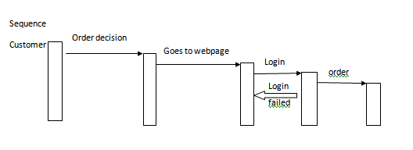

Diagrams
Sequence
State

Slide 10
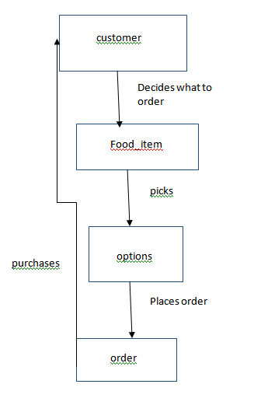
Diagrams
Class

Slide 11
Problems we faced
Communication problems
Merging problems
Database(Mysql did not work well with visual studios)
Unfamiliarity with ASP.NET

Slide 12
QUESTIONS?

