Slide 1
Online Ordering
By: Mercedes Kent
Tejash Patel
Jessie Wilkins

Slide 2
Purpose
The purpose was to create an online ordering system
Wanted to give the customer a way to order for future orders
Allow them to customize their order based on the items offered

Slide 3
Requirements
The project should allow a user to:
setup an account
log in to the webpage
place an order
choose what customization they would like
check out
give them a time frame on when their order will be done
review their order

Slide 4
Database
We started by using MySql but did not work well with Visual Studios
Switched to Microsoft Database

Slide 5
C#
Used Visual Studios IDE
We choose C# because
Used it to create our web application
Testing

Slide 6
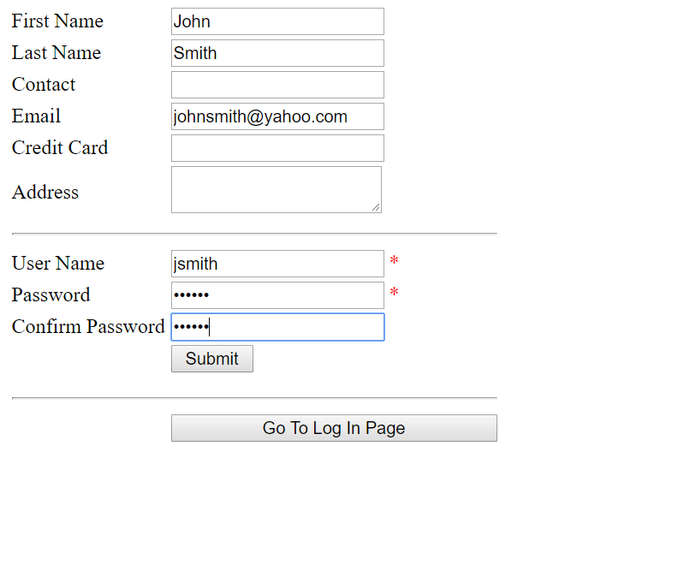
Sign-up Page

Slide 7
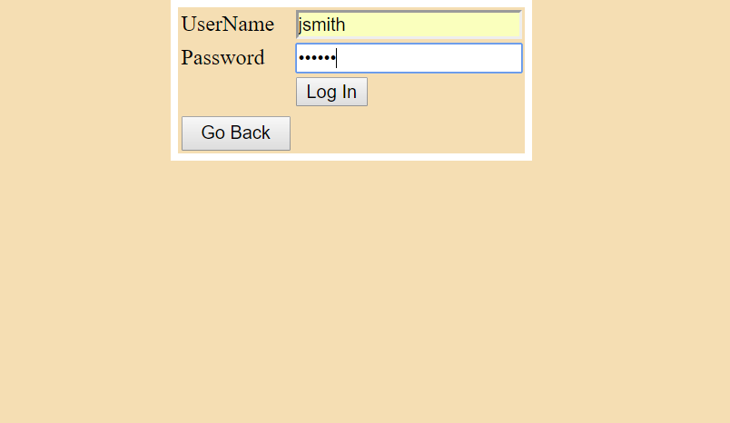
Login Page

Slide 8
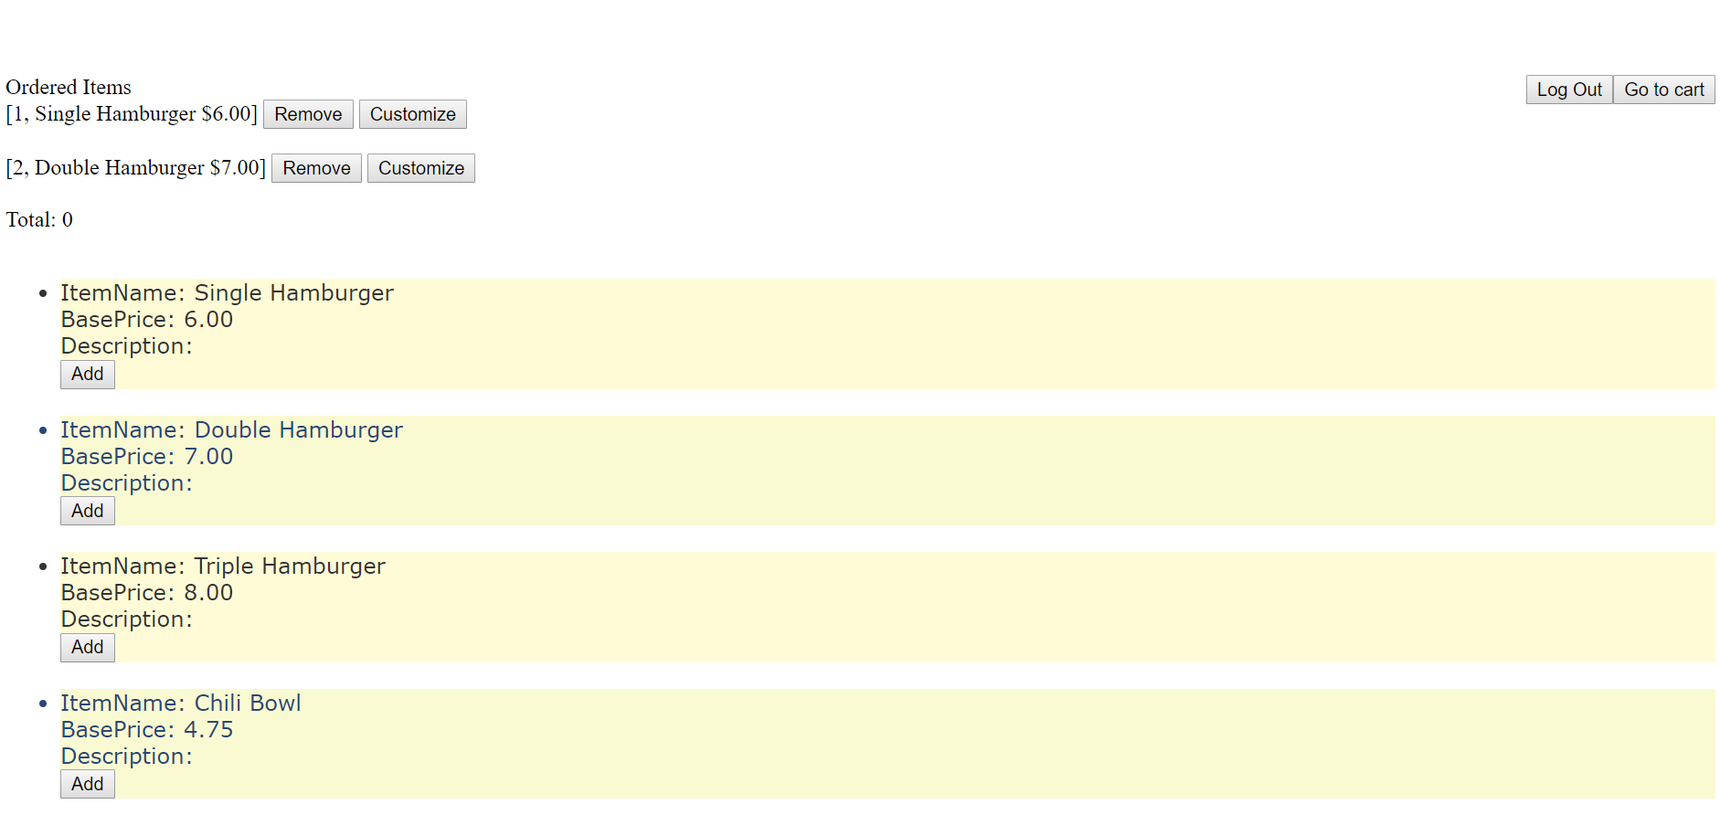
Web Application

Slide 9
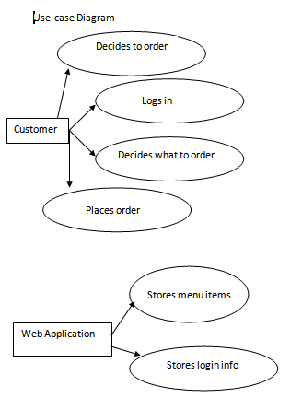

Diagrams
Use case Activity

Slide 10
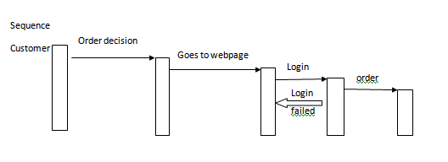

Diagrams
Sequence
State

Slide 11
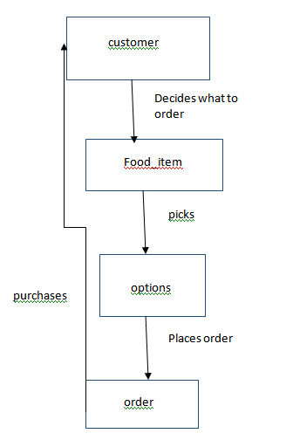
Diagrams
Class

Slide 12
Problems we faced
Communication problems
Merging problems
Database(Mysql did not work well with visual studios)
Unfamiliarity with ASP.NET

Slide 13
QUESTIONS?

