Slide 1
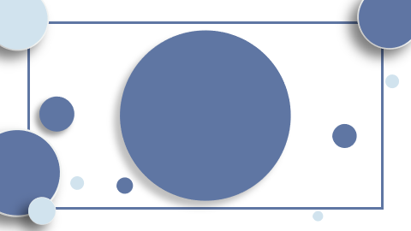
"Revolutionizing Machine Translation: The Transformer's Architecture and Advanced Attention Mechanisms"

Slide 2
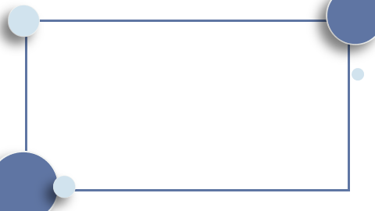
Table of Contents
Introduction Transformer Architecture: A Paradigm Shift in Model Design Scaled Dot-Product Attention: Efficient Dependency Mapping Multi-Head Attention: Parallel Processing for Enhanced Resolution Conclusion

Slide 3

Introduction
- Unveiling the Transformer: A groundbreaking architecture revolutionizing machine translation with unparalleled parallelization and training efficiency. - Core innovation: The Transformer eschews traditional RNNs and convolutions, harnessing self-attention for direct positional interrelation. - Scaled Dot-Product Attention: A nimble, scalable mechanism enabling dynamic weighting of input relevance. - Multi-Head Attention: An ingenious composition of simultaneous attention layers, enhancing model's focus and context discernment.

Slide 4
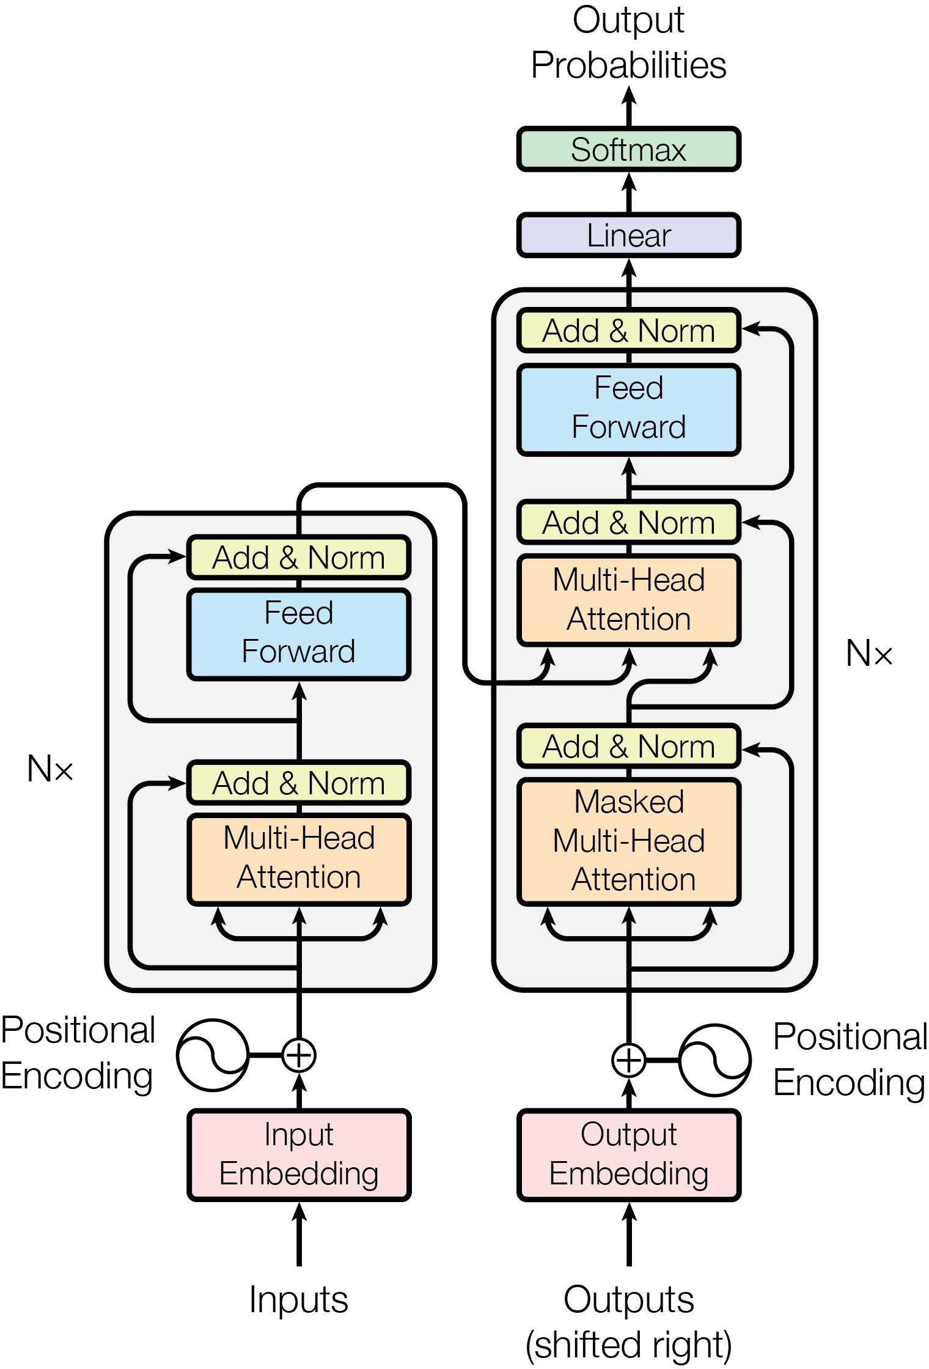
Transformer Architecture: A Paradigm Shift in Model Design
- **Transformer Model Architecture**: A stack of N=6 identical layers forms both the encoder and decoder, revolutionizing parallel processing in neural networks. - **Scaled Dot-Product Attention**: This function maps queries and key-value pairs to outputs, using weighted sums, optimizing the network's focus and context understanding.

Slide 5
- **Multi-Head Attention**: Parallel attention layers enable the model to capture diverse contextual information, improving prediction accuracy and model robustness.

Slide 6

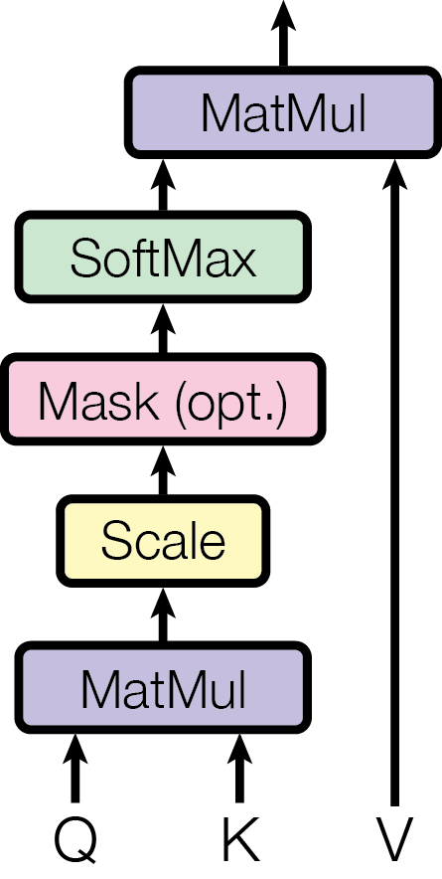
Scaled Dot-Product Attention: Efficient Dependency Mapping
- **Scaled Dot-Product Attention**: Central to the Transformer's efficiency. - Maps queries to key-value pairs for output vectors. - Output is a weighted sum, with weights from query-key compatibility. - Enables direct dependencies between distant elements, enhancing parallelization.

Slide 7
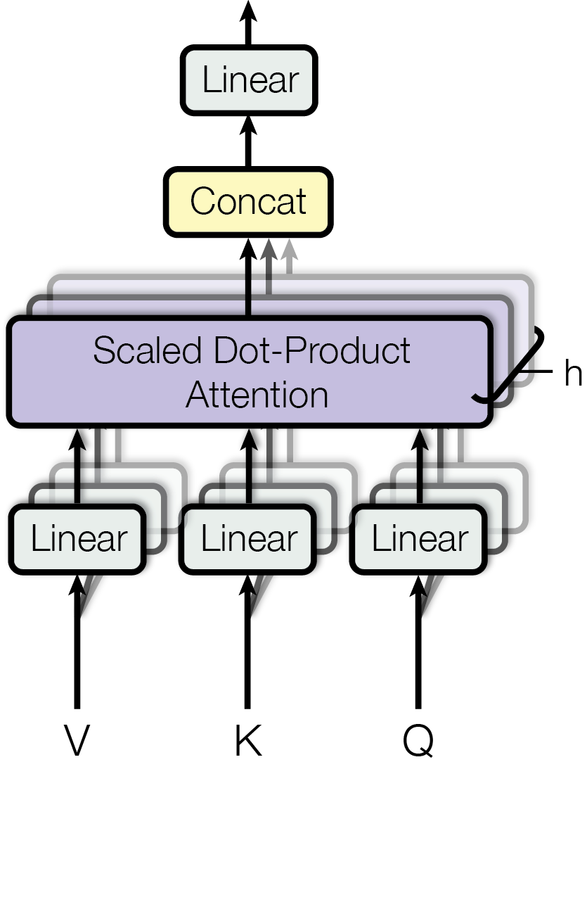
Multi-Head Attention: Parallel Processing for Enhanced Resolution
- **Multi-Head Attention:** - Enables parallel processing, increasing efficiency. - Consists of multiple attention layers. - Enhances the model's ability to focus on different positions.

Slide 8
Conclusion
- The Transformer revolutionizes machine translation with its unique architecture, eschewing RNNs for efficient self-attention. - Scaled Dot-Product Attention dynamically weighs inputs, optimizing dependency mapping. - Multi-Head Attention, with parallel layers, sharpens focus and contextual understanding.

