Slide 1

"Transformer Model: Advancing Sequence Transduction with Self-Attention"

Slide 2

Table of Contents
Introduction Introduction of the Transformer Model Architecture Advantages of Self-Attention Mechanisms Over RNNs Parallelization and Training Efficiency Benefits Implementation of Multi-Head Attention Positional Encoding Techniques in Transformers Transformer's Application to Machine Translation Conclusion

Slide 3

Introduction
- Unveiling the Transformer: A groundbreaking neural network eschewing recurrent and convolutional layers for pure attention mechanisms. - Enhances parallel processing, expediting training in machine translation and parsing. - Marks a paradigm shift in sequence transduction efficiency and model simplicity.

Slide 4
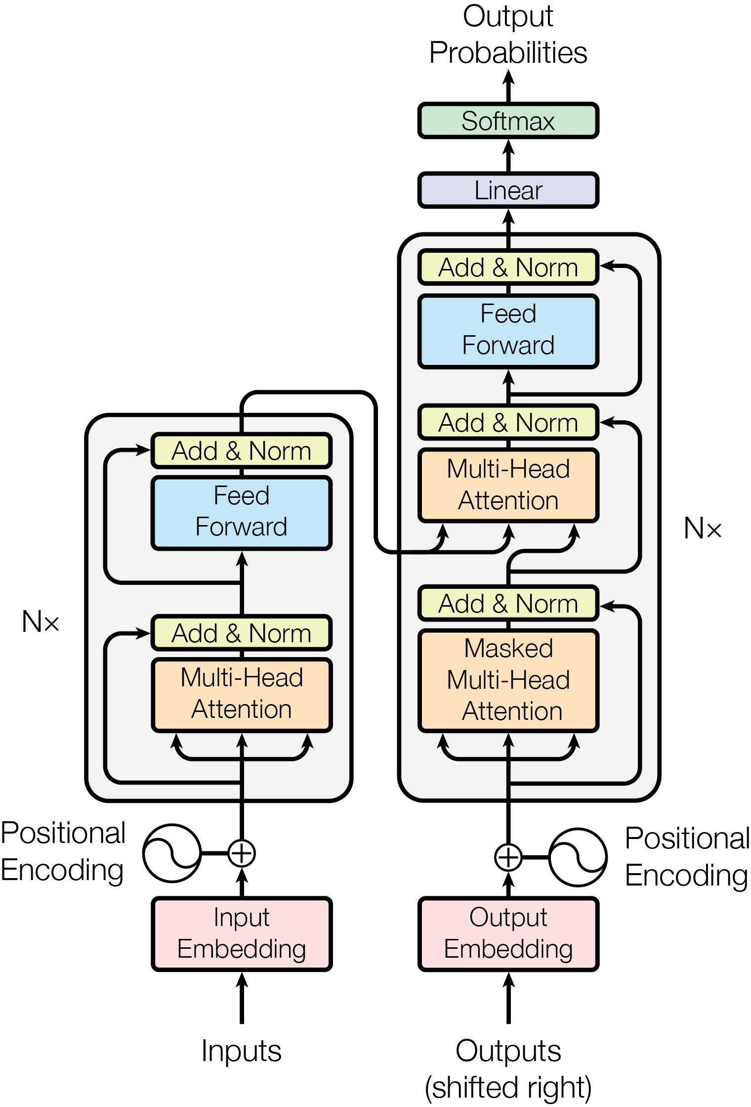
Introduction of the Transformer Model Architecture
- Transformer Model: A novel architecture eschewing RNNs and CNNs. - Relies solely on attention mechanisms for input-output global dependencies. - Enhances parallelization, reducing training time for sequence transduction. - Achieves state-of-the-art results in machine translation and parsing tasks.

Slide 5
Advantages of Self-Attention Mechanisms Over RNNs
- Self-attention reduces sequential computation, allowing parallel processing and faster training. - Unlike RNNs, it connects all positions with constant operations, aiding long-distance learning. - It improves upon RNNs by enabling direct modeling of dependencies regardless of position distance. - The Transformer architecture with self-attention achieves state-of-the-art results in translation tasks.

Slide 6
Parallelization and Training Efficiency Benefits
- Transformer architecture boosts training efficiency by enabling more parallelization. - Eliminates sequential computation, allowing simultaneous processing of data. - Reduces training time significantly compared to RNNs or CNNs. - Facilitates faster learning of long-range dependencies in data. - Enhances model performance with reduced computational resources.

Slide 7

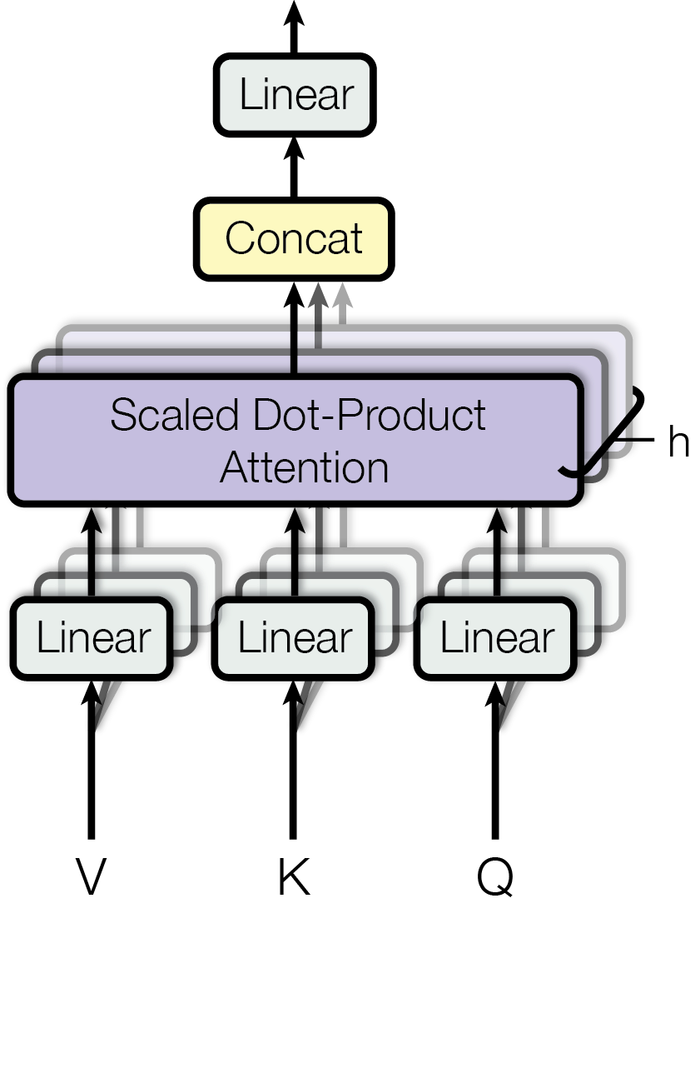
Implementation of Multi-Head Attention
- Multi-Head Attention in Transformers allows parallel processing of sequence information, enhancing model efficiency. - It splits the input into multiple heads, enabling the model to focus on different parts of the sequence simultaneously. - This mechanism is key to the Transformer's ability to handle dependencies regardless of distance within the sequence. - By employing multiple attention heads, the model gains a multi-faceted understanding of the input data. - The innovation of Multi-Head Attention is central to the Transformer's performance in tasks like machine translation.

Slide 8
Positional Encoding Techniques in Transformers
- Transformers use positional encodings to track token order, crucial since they lack recurrence. - Sinusoidal functions are employed for encoding, facilitating relative positioning for the model. - This method allows Transformers to understand sequence order, vital for tasks like translation.

Slide 9
Transformer's Application to Machine Translation
- Transformer architecture excels in machine translation by leveraging self-attention. - Eliminates recurrent, convolutional layers for improved parallelization. - Achieves state-of-the-art results in English-to-German and English-to-French tasks. - Trains faster on GPUs, reducing costs and time significantly.

Slide 10
Conclusion
- The Transformer revolutionizes sequence modeling, replacing RNNs with faster, simpler attention-based mechanisms. - It accelerates training, sets new benchmarks in translation tasks, and shows promise in parsing. - Future work may expand its applicability, further enhancing its transformative impact.

