Slide 1
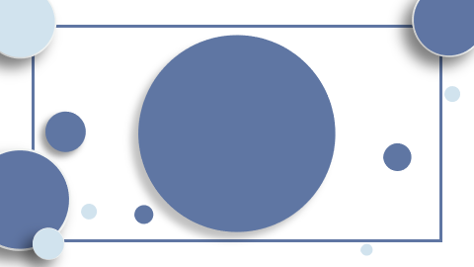
"Transformer: Revolutionizing Machine Translation and Parsing with Attention Mechanisms"

Slide 2
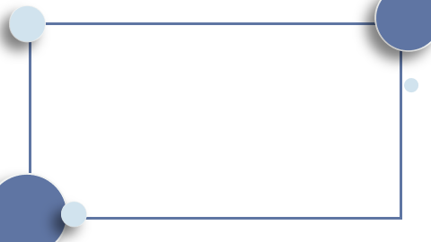
Table of Contents
Introduction Introduction of the Transformer architecture. Superiority in machine translation tasks. Elimination of recurrence and convolutions. Efficiency in parallelization and training duration. High BLEU scores on English-to-German and English-to-French tasks. Generalization capabilities to English constituency parsing. Conclusion

Slide 3

Introduction
- Unveiling the Transformer: A groundbreaking neural network architecture. - Surpasses traditional models with advanced attention mechanisms. - Achieves unprecedented efficiency in machine translation. - Proves versatile in complex tasks like English constituency parsing.

Slide 4
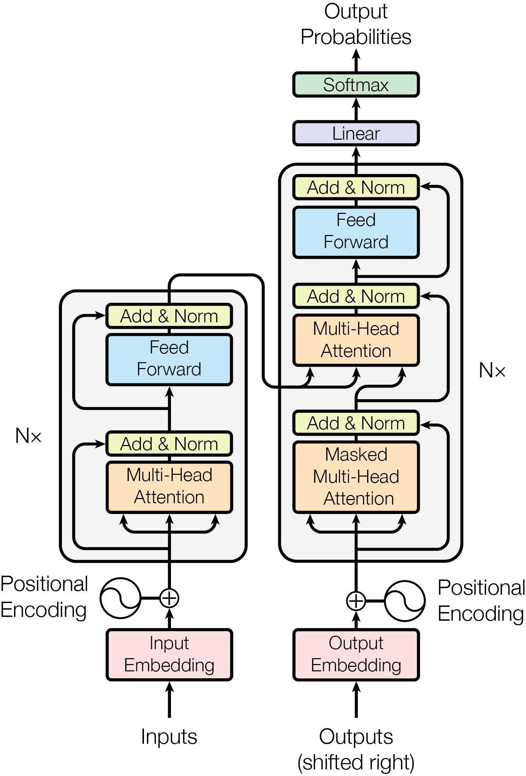
Introduction of the Transformer architecture.
- Transformer: A novel neural network architecture. - Eschews recurrence and convolutions for attention mechanisms. - Yields superior machine translation quality. - More parallelizable, trains faster than traditional models. - Successfully applied to English constituency parsing.

Slide 5

Superiority in machine translation tasks.
- Transformer architecture excels in machine translation. - Outperforms recurrent and convolutional networks. - Achieves high BLEU scores: 28.4 in English-to-German, 41.8 in English-to-French. - Requires less training time on fewer GPUs. - Demonstrates superior quality and parallelizability.

Slide 6
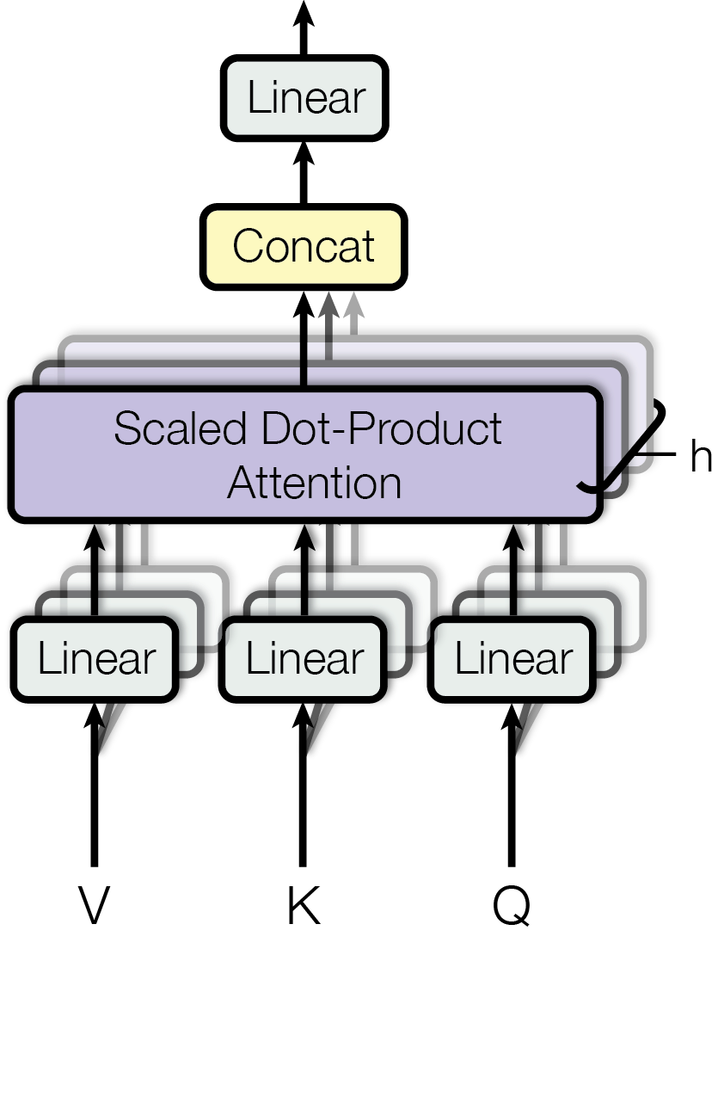
Elimination of recurrence and convolutions.
- Transformer architecture innovates by eliminating recurrent and convolutional layers. - Focuses solely on attention mechanisms for processing sequences. - Results in superior parallelization and reduced training time. - Achieves state-of-the-art performance in machine translation tasks. - Demonstrates versatility by adapting to English constituency parsing.

Slide 7
Efficiency in parallelization and training duration.
- Transformer architecture excels in parallelization, boosting efficiency. - Training time is significantly reduced compared to traditional models. - Achieves superior machine translation quality with less computational cost. - Demonstrates versatility by adapting to English constituency parsing tasks.

Slide 8
High BLEU scores on English-to-German and English-to-French tasks.
- Transformer network achieves high BLEU scores, surpassing previous models. - Scores: 28.4 for English-to-German; 41.8 for English-to-French. - Results indicate significant advancements in machine translation efficiency.

Slide 9
Generalization capabilities to English constituency parsing.
- Transformer architecture excels in machine translation. - It outperforms traditional models using attention mechanisms. - Demonstrates efficiency in training time and adaptability. - Successfully applied to English constituency parsing. - Shows promise in generalizing beyond initial design scope.

Slide 10
Conclusion
- Transformer: Groundbreaking architecture revolutionizing neural networks. - Outshines traditional models with superior attention mechanisms. - Transforms machine translation with unmatched efficiency and speed. - Exhibits remarkable adaptability to complex tasks, including parsing.

