Slide 1
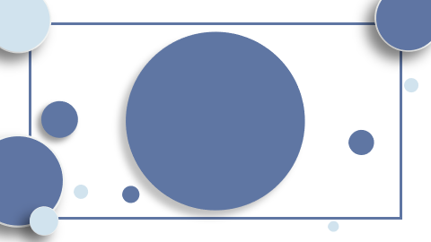
"Revolutionizing Sequence Transduction: Unveiling the Transformer Architecture and Attention Innovations"

Slide 2

Table of Contents
Introduction The Transformer: A Novel Model Architecture Scaled Dot-Product Attention: Enhancing Computational Efficiency Multi-Head Attention: Parallel Processing Innovation Self-Attention: A Key to Model Interpretability and Performance Conclusion

Slide 3

Introduction
- Unveiling the Transformer: A groundbreaking architecture revolutionizing sequence transduction through pure attention mechanisms. - Decoding Scaled Dot-Product Attention: The key to efficient, nuanced language processing. - Harnessing the power of parallelism with Multi-Head Attention for faster, more complex tasks. - The Transformer's model structure: A paradigm shift from recurrent layers to a streamlined, attention-centric design.

Slide 4
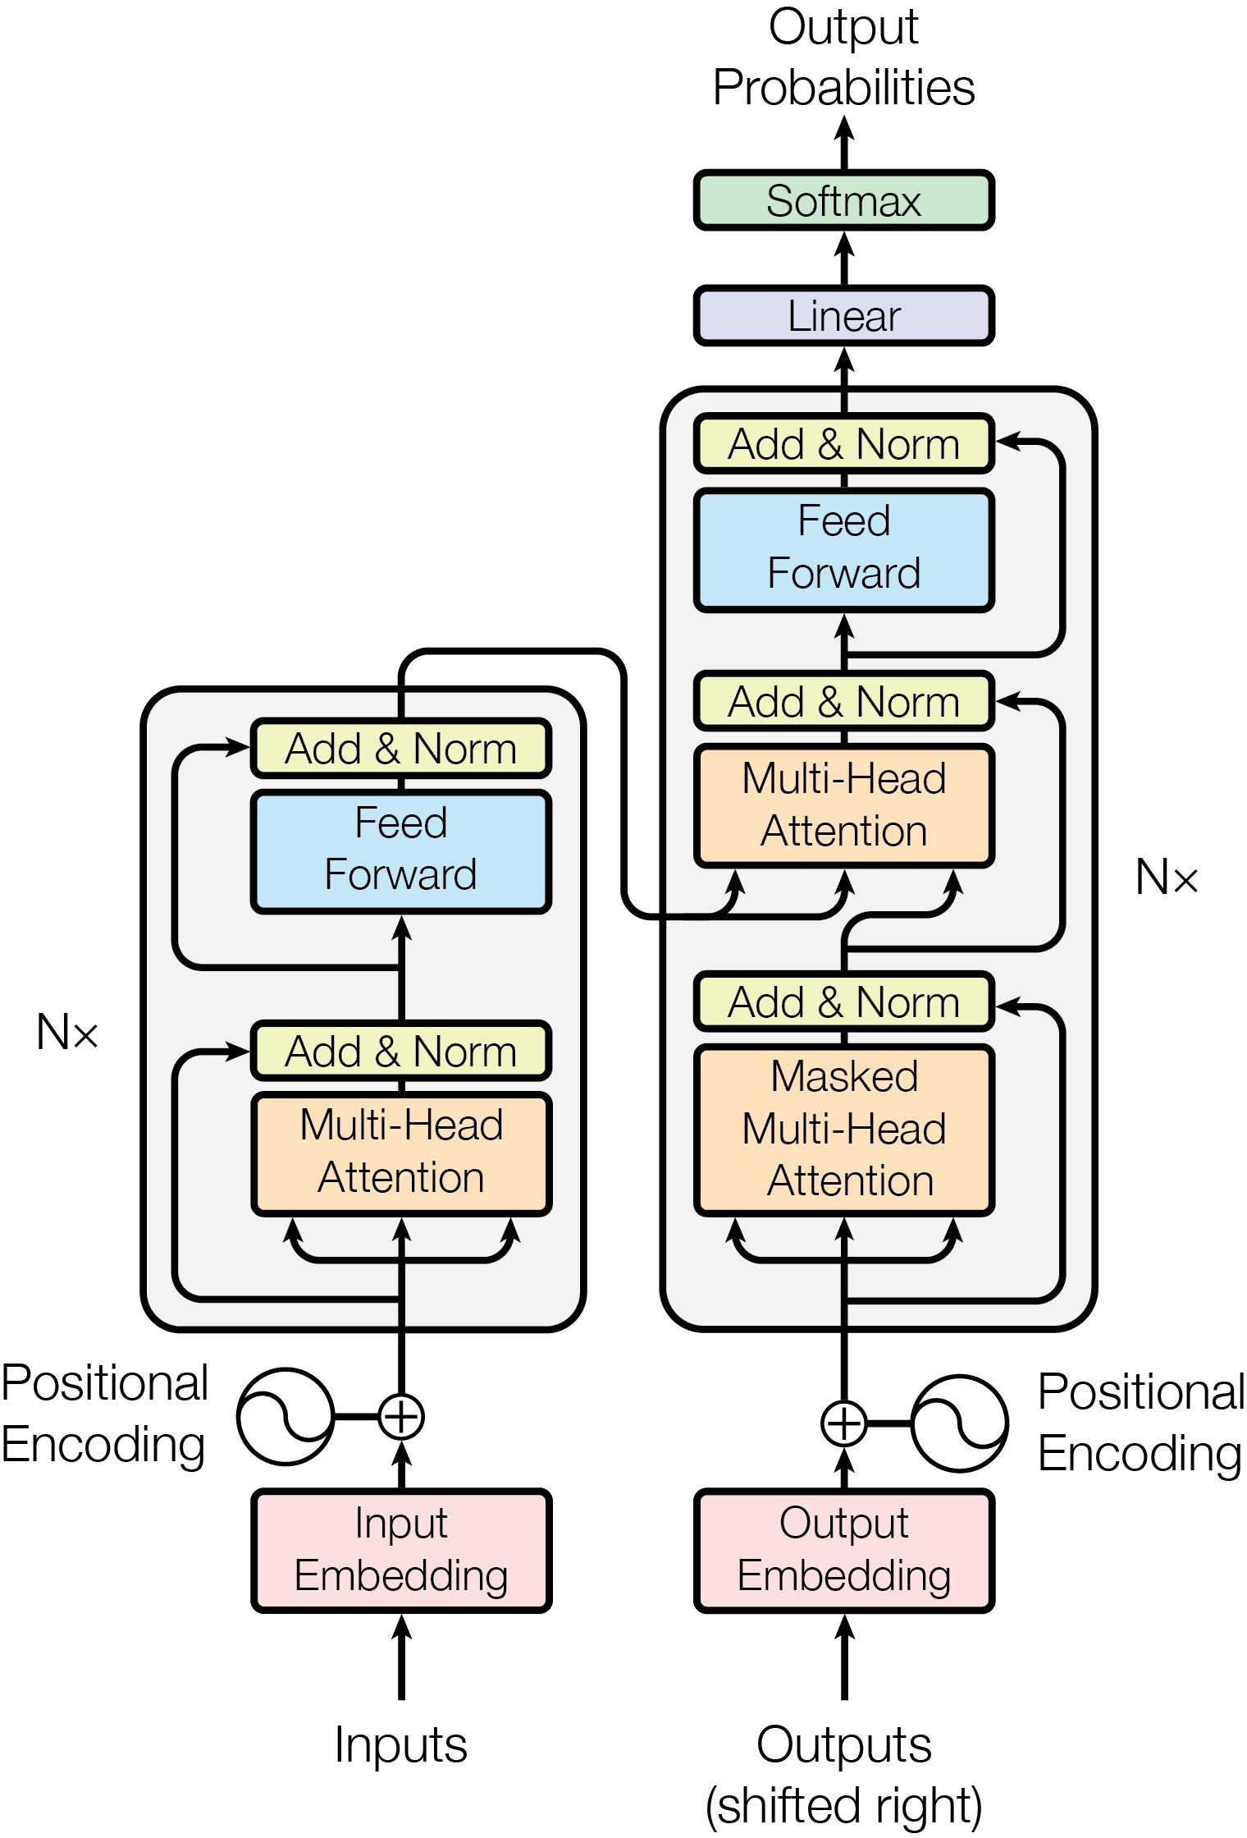
The Transformer: A Novel Model Architecture
- **The Transformer - Model Architecture**: A revolutionary encoder-decoder structure, eschewing RNNs for stacked self-attention layers. - **Scaled Dot-Product Attention**: Enhances the model's focus, scaling dot products by inverse square root of dimensionality for balance. - **Multi-Head Attention**: Operates in parallel, allowing the model to process diverse information simultaneously, enhancing efficiency. - **Parallel Processing Capabilities**: Facilitates faster training and superior performance in tasks like language translation and parsing.

Slide 5
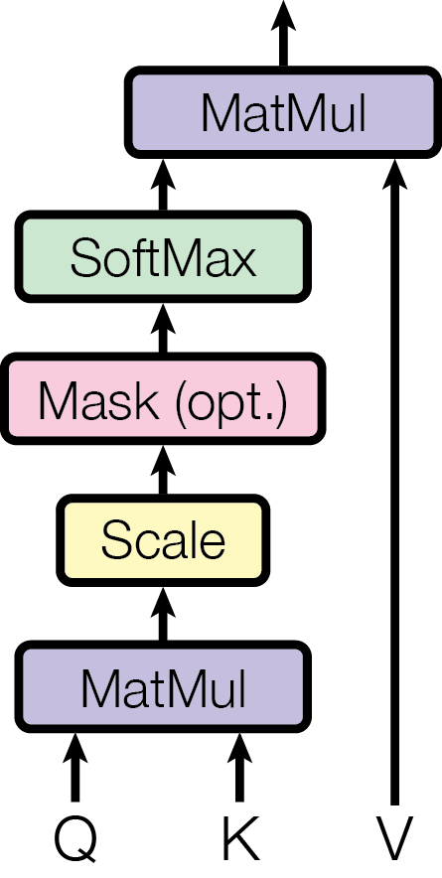
Scaled Dot-Product Attention: Enhancing Computational Efficiency
- **The Transformer Model Architecture**: A novel approach that uses stacked self-attention and point-wise, fully connected layers, eliminating traditional RNNs. - **Scaled Dot-Product Attention**: This mechanism computes attention-driven output as a weighted sum, enhancing efficiency by scaling dot products. - **Computational Efficiency**: Scaled attention counters large dot product values, preventing gradient issues and enabling faster, space-efficient operations. - **Multi-Head Attention**: It runs several attention layers in parallel, allowing the model to handle different representation subspaces simultaneously.

Slide 6
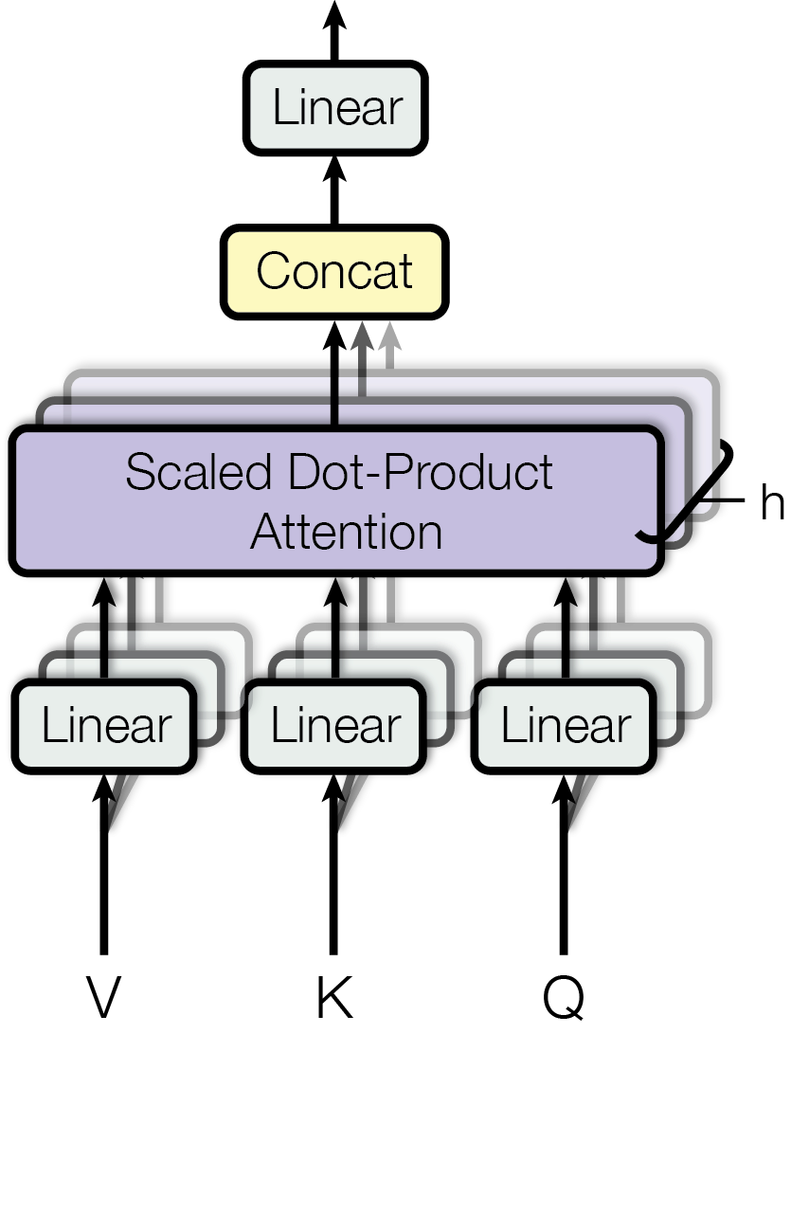
Multi-Head Attention: Parallel Processing Innovation
- **The Transformer Model Architecture**: Innovatively structured, it uses stacked self-attention and fully connected layers, eliminating recurrent processes. - **Scaled Dot-Product Attention**: This mechanism scales dot products by inverse square root of the dimension, facilitating efficient attention weight calculation. - **Multi-Head Attention**: Employs parallel attention layers, allowing the model to process different representation subspaces simultaneously. - **Parallel Processing Capabilities**: Enhances performance and training efficiency, as multiple attention heads operate concurrently, reducing computational cost.

Slide 7

Self-Attention: A Key to Model Interpretability and Performance
- **The Transformer Model Architecture**: Innovatively structured for sequence transduction, it eliminates recurrent layers, relying solely on attention mechanisms for input-output representations. - **Scaled Dot-Product Attention**: This attention mechanism computes outputs as weighted sums, enhancing interpretability by relating different sequence positions directly and efficiently. - **Multi-Head Attention**: Operates in parallel, allowing the model to process various sequence parts simultaneously, improving performance and interpretability across different subspaces. - **Self-Attention's Role**: Central to the Transformer, it enables direct modeling of dependencies, regardless of sequence distance, contributing to both model performance and interpretability.

Slide 8
Conclusion
- The Transformer revolutionizes sequence transduction with a unique attention-based architecture, eschewing recurrent layers. - Scaled Dot-Product Attention streamlines computational efficiency, enabling nuanced language processing. - Multi-Head Attention leverages parallelism, accelerating complex task processing. - Self-Attention enhances interpretability and performance, marking a paradigm shift in model design.

