Slide 1
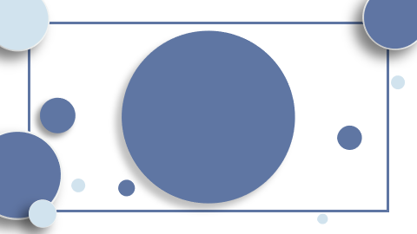
"Introducing the Transformer: Advancing Machine Translation with Attention Mechanisms"

Slide 2

Table of Contents
Introduction Introduction of the Transformer architecture. Elimination of recurrence and convolutions. Utilization of attention mechanisms exclusively. Advantages in machine translation tasks. Record-setting BLEU scores on benchmark datasets. Reduced training time and computational resources. Conclusion

Slide 3
Introduction
- Unveiling the Transformer: A groundbreaking architecture revolutionizing neural networks by prioritizing attention mechanisms over traditional recurrence and convolutions. - Demonstrates unmatched efficiency and performance in machine translation and parsing tasks, marking a significant leap in AI capabilities. - Employs innovative self-attention techniques to process data in parallel, drastically cutting down training time and computational resources. - Sets new benchmarks in machine learning, outperforming established models with its unique, attention-centric approach.

Slide 4

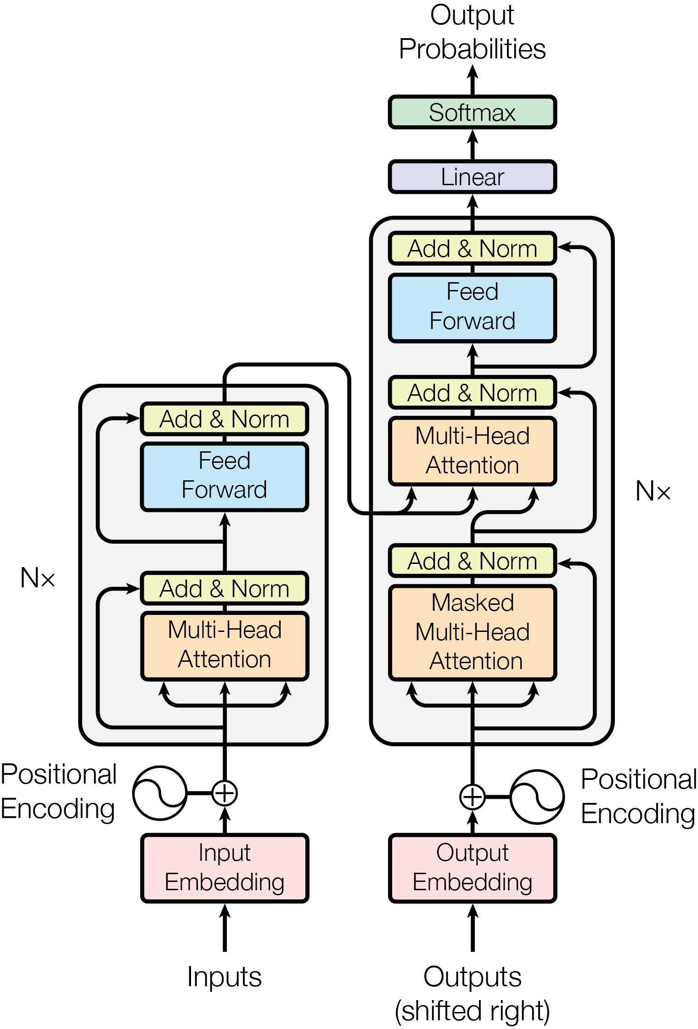
Introduction of the Transformer architecture.
- Transformer: A novel neural network by Google Brain. - Relies solely on attention mechanisms, no recurrence/convolutions. - Outperforms previous models in machine translation tasks. - Achieves high BLEU scores, showcasing efficiency and quality. - Successfully applied to English constituency parsing.

Slide 5
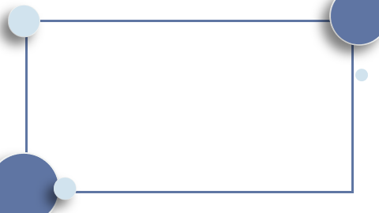
Elimination of recurrence and convolutions.
- Transformer architecture replaces recurrent/convolutional networks. - Relies solely on attention mechanisms. - Achieves superior machine translation results. - More parallelizable, trains faster. - Successfully applied to English constituency parsing.

Slide 6
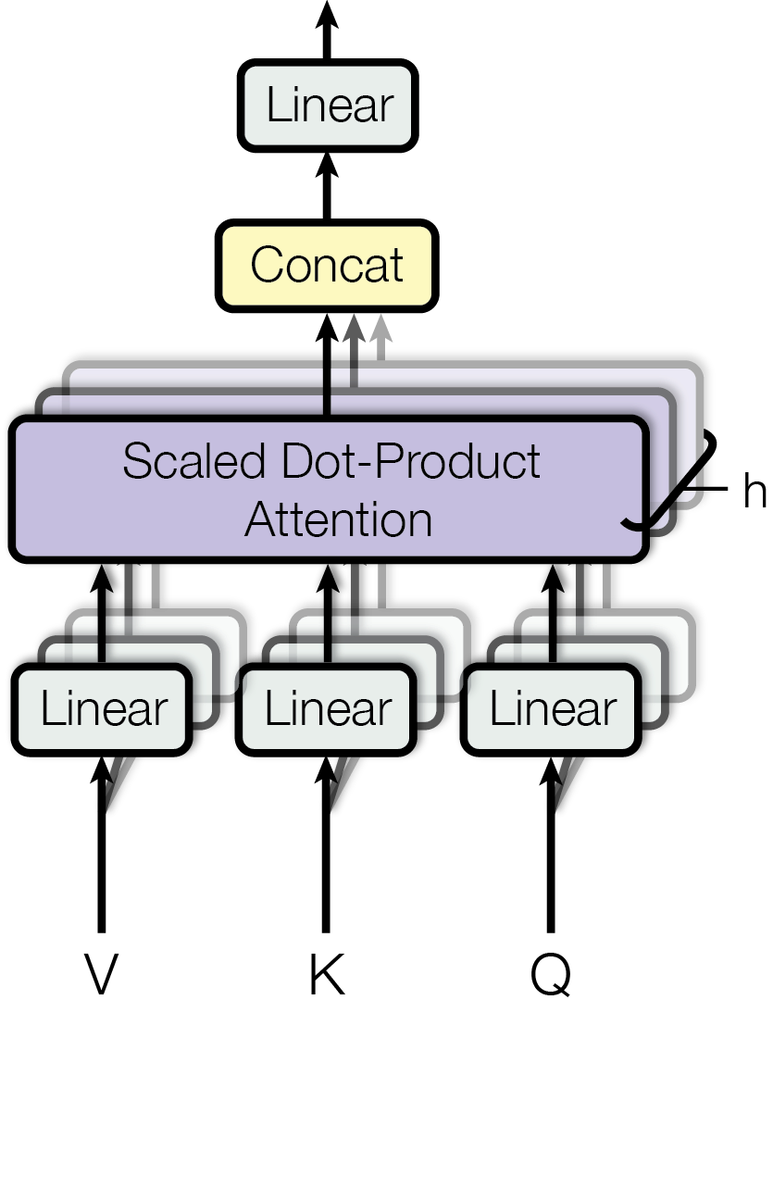
Utilization of attention mechanisms exclusively.
- Transformer architecture uses only attention mechanisms, no RNNs/convolutions. - Achieves constant operation count for input/output relations. - Multi-Head Attention improves resolution in this setup. - Self-attention aids diverse tasks like reading comprehension and summarization. - Outperforms prior models in machine translation efficiency and quality.

Slide 7
Advantages in machine translation tasks.
- Transformer architecture outperforms in machine translation. - Achieves 28.4 BLEU on English-to-German task. - Surpasses previous bests by over 2 BLEU points. - Sets record 41.8 BLEU on English-to-French task. - Requires less training time on fewer GPUs.

Slide 8
Record-setting BLEU scores on benchmark datasets.
- Transformer model sets new benchmarks in machine translation. - Achieves 28.4 BLEU on English-to-German, surpassing prior bests. - Records 41.8 BLEU for English-to-French, a new single-model high. - Training on 8 GPUs for 3.5 days reduces costs significantly.

Slide 9
Reduced training time and computational resources.
- Transformer architecture prioritizes efficiency. - Achieves state-of-the-art results with less training time. - Outperforms complex models on translation tasks. - Requires significantly fewer computational resources. - Demonstrates quick adaptability to new tasks.

Slide 10
Conclusion
- The Transformer redefines neural network paradigms, focusing on attention over recurrence and convolutions, enhancing machine translation and parsing efficiency. - It achieves unprecedented BLEU scores, optimizes training time, and reduces computational demands, setting new industry standards. - Future applications may extend beyond text, leveraging its scalable, attention-based framework for diverse data modalities.

