Slide 1
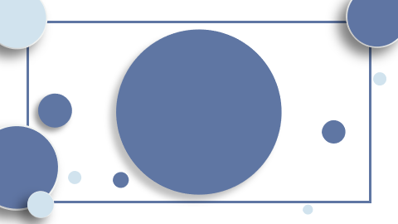
Title: "Revolutionizing Machine Translation: The Transformer's Self-Attention Architecture"

Slide 2
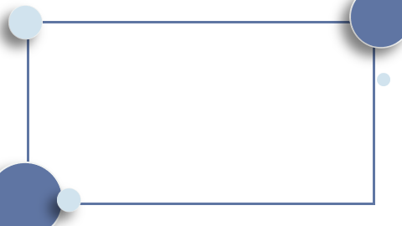
Table of Contents
Introduction Introduction of the Transformer Model Architecture. Implementation of Scaled Dot-Product Attention Mechanism. Integration of Multi-Head Attention for Parallel Processing. Advancements in Machine Translation with the Transformer. Conclusion

Slide 3

Introduction
In the rapidly evolving field of neural network architectures, the Transformer stands out as a groundbreaking model that revolutionizes machine translation. Here's an overview of its core concepts:

Slide 4
- **The Transformer Model Architecture**: A pioneering approach that eschews traditional recurrent and convolutional layers in favor of a design powered entirely by self-attention mechanisms. - **Scaled Dot-Product Attention**: The crux of the Transformer, enabling dynamic weighting of input significance, which enhances the model's interpretative ability. - **Multi-Head Attention**: A novel structure that runs several attention mechanisms in parallel, refining the model's focus and improving its capacity to capture diverse contextual nuances. - **Performance and Efficiency**: The Transformer demonstrates superior translation quality, achieving state-of-the-art results with remarkable training efficiency, a testament to its advanced design.

Slide 5

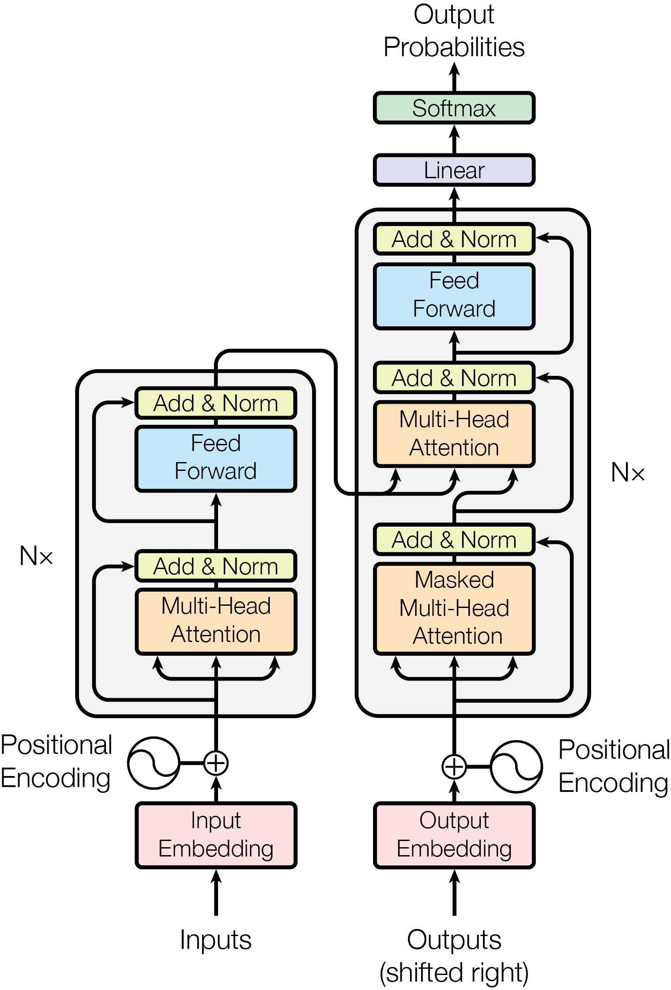
Introduction of the Transformer Model Architecture.
- **The Transformer Model Architecture**: A novel neural network design that eliminates recurrent layers in favor of self-attention mechanisms, optimizing machine translation tasks. - **Scaled Dot-Product Attention**: A key component that computes attention scores, influencing the model's focus during sequence transduction. - **Multi-Head Attention**: Operates with parallel attention layers, each providing a unique perspective, enhancing the model's ability to learn from different positional contexts. - **Performance and Efficiency**: The Transformer demonstrates superior results in machine translation, outperforming previous architectures while maintaining efficiency.

Slide 6
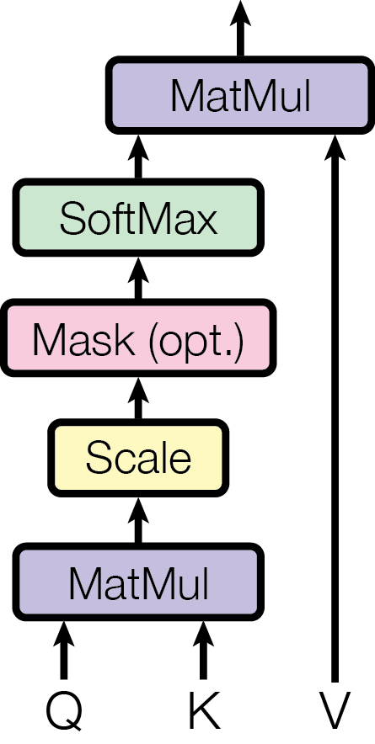
Implementation of Scaled Dot-Product Attention Mechanism.
- **The Transformer Model Architecture**: A novel neural network design that eliminates recurrent layers in favor of self-attention mechanisms. - **Scaled Dot-Product Attention**: A key component of the Transformer, calculating attention as a weighted sum of values based on query-key compatibility. - **Multi-Head Attention**: This feature runs several attention layers in parallel, enhancing the model's ability to focus on different positions. - **Efficiency in Machine Translation**: The Transformer demonstrates superior performance in translation tasks, outperforming RNN-based models.

Slide 7
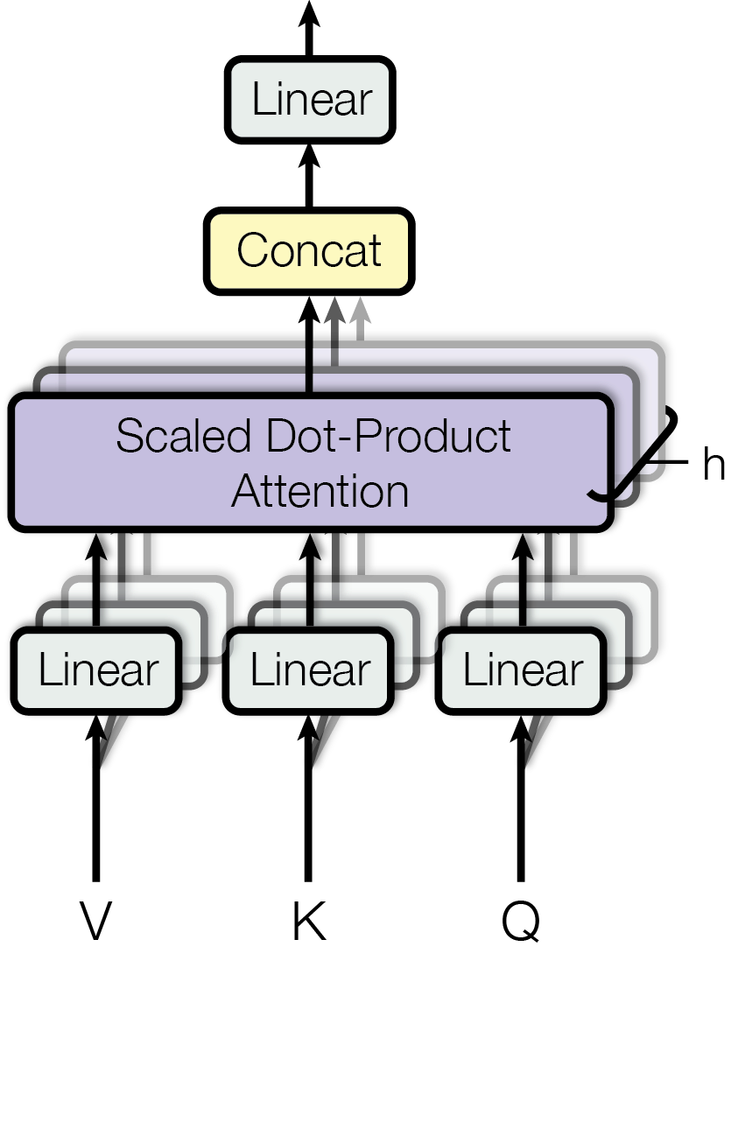
Integration of Multi-Head Attention for Parallel Processing.
- **The Transformer Model Architecture**: Innovatively structured, it computes input and output representations in parallel, leveraging self-attention for efficiency. - **Scaled Dot-Product Attention**: A key component, it scales attention with input size, optimizing the self-attention process for varying sequence lengths. - **Multi-Head Attention**: This feature runs multiple attention layers concurrently, enhancing the model's ability to focus on different positions and represent complex dependencies. - **Performance in Machine Translation**: The Transformer demonstrates superior efficiency and effectiveness in translation tasks, outperforming RNN and CNN models.

Slide 8
Advancements in Machine Translation with the Transformer.
- **The Transformer Model Architecture**: A novel neural network that computes input and output representations entirely through self-attention, bypassing the need for RNNs or convolution.

Slide 9
- **Scaled Dot-Product Attention**: A key component of the Transformer, enabling the model to weigh the influence of different parts of the input data.

Slide 10
- **Multi-Head Attention**: This feature of the Transformer allows for parallel processing of multiple attention layers, enhancing the model's ability to focus on various parts of the input sequence.

Slide 11
- **Performance in Machine Translation**: The Transformer demonstrates superior efficiency and effectiveness in machine translation tasks, outperforming previous RNN and CNN-based models.

Slide 12
Conclusion
In conclusion, the article encapsulates the transformative impact of the Transformer model on neural network architectures for machine translation:

Slide 13
- Introduced the Transformer, a model eschewing recurrent and convolutional layers for self-attention. - Detailed the Scaled Dot-Product Attention mechanism, central to the Transformer's interpretative power. - Described Multi-Head Attention, enhancing parallel processing and contextual understanding. - Highlighted the Transformer's superior performance and efficiency in machine translation tasks.

