Slide 1
Boolean Algebra Digital Logic Computer Org. & Arch. Computer Operating Systems

Slide 2
Objectives
In this lecture, you will learn basic concepts about
Boolean algebra
Digital logic gates
Digital logic circuits
Computer organization & architecture
Computer operating systems

Slide 3
Boolean Algebra

Slide 4
Boolean Algebra
Introduced by George Boole (1815-1864), British mathematician and philosopher
In general, an algebra over finite sets of discrete values
Variables can have values of either 0 (false) or 1 (true).
Fundamental in today’s digital computing.

Slide 5
Boolean Variables/Values
A Boolean variable can be either 1 (true) or 0 (false).
Boolean algebra is operating over these Boolean values.

Slide 6
Boolean Operators
Relational operators (<, <=, ==, >, >=, and !=),
Logic AND, OR, NOT
Notations used for AND is a period (.) or nothing like
Notations used for OR is a plus sign (+) like
Notations for NOT like

Slide 7
Operator Precedence
Dictate which operation will perform first
Precedence Order Decreases

Slide 8
Boolean Expression
A Boolean expression can be the following
A Boolean variable,
A relational expression, or
Any combination of Boolean variables, relational expressions, and Boolean expressions with logical operators AND, OR, NOT, and parentheses.

Slide 9
Boolean Functions
A Boolean function maps a set of Boolean variables to a Boolean value.
Consider
Boolean variables A, and B can only hold 0 or 1. The operator “+” denotes an OR.
So, the Boolean function represents logical OR.

Slide 10
Truth Table
A visual representation of a Boolean function.
Input variables to the left, and an output to the rightmost
All possible input values (combinations) are listed.
Normally, they are listed in ascending order.
A | B | f(A,B)
0 | 0 | 0
0 | 1 | 1
1 | 0 | 1
1 | 1 | 1

Slide 11
Laws of Boolean Algebra
Like regular algebra, there are laws in the Boolean algebra that ease the computation, or simplify Boolean expressions.
Some of the laws from regular algebra may NOT apply to Boolean algebra.
Examples:
Distribution law
Inverse law
Commutative law

Slide 12
Laws of Boolean Algebra
More example laws:
Associative law
Identity law
Redundance law
False law
True law
De Morgan’s law

Slide 13
Boolean Expression Simplification
Consider A+AB
Actually, A+AB=A
Consider
Actually,
We can apply Boolean Algebra laws to simplify expressions.
Key to design efficient digital circuits

Slide 14
Digital Logic Gates

Slide 15
2-Input Boolean Functions
A | B | f(A,B)
0 | 0 | ?
0 | 1 | ?
1 | 0 | ?
1 | 1 | ?

Slide 16
AND
Boolean function f(A, B) is true only if both A and B are true. f(A, B)=AB
AND function is also called Boolean product.
A | B | f(A,B)
0 | 0 | 0
0 | 1 | 0
1 | 0 | 0
1 | 1 | 1

Slide 17
OR
Boolean function f(A, B) is false only if both A and B are false. f(A, B)=A+B
OR function is also called Boolean sum.
A | B | f(A,B)
0 | 0 | 0
0 | 1 | 1
1 | 0 | 1
1 | 1 | 1

Slide 18
NOT
Boolean function f(A) is true only if A is false.
NOT function is also called Boolean inverse.
A | f(A)
0 | 1
1 | 0

Slide 19
Exclusive OR (XOR)
Boolean function f(A, B) is true only if one of A and B is true, not both.
A | B | f(A,B)
0 | 0 | 0
0 | 1 | 1
1 | 0 | 1
1 | 1 | 0

Slide 20
NAND
A | B | f(A,B)
0 | 0 | 1
0 | 1 | 1
1 | 0 | 1
1 | 1 | 0
Not AND

Slide 21
NOR
A | B | f(A,B)
0 | 0 | 1
0 | 1 | 0
1 | 0 | 0
1 | 1 | 0
Not OR

Slide 22
Gate Symbols
Symbols that represent electronic circuits for gates
not

Slide 23
Transistor Implementation
Transistors are used to implement logic gates.
E.g., NOT gate

Slide 24
Characteristics of Gates
Outputs are subject to inputs only.
Switching time form on to off, or off back to on, takes a few nanoseconds in transistors.
Propagation delay from inputs to outputs refers to the time between the inputs change and the new reflected outputs.
Gate delay refers to the propagation delay for a gate.

Slide 25
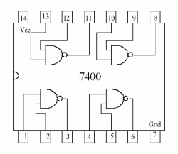
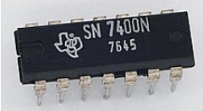
Computational Completeness
Any Boolean function can be computed using one type of computationally complete gates.
NOR and NAND are computationally complete gates.
They are easily to be manufactured than others.
Normally, you have a pack of NANDs in an IC. You want to reuse them as many as possible to save cost and space.

Slide 26
Equivalent NOT

Slide 27
Equivalent AND

Slide 28
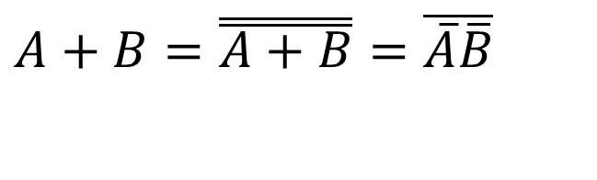
Equivalent OR
$$A+B=\overset{̿}{A+B}=\overline{\overline{A}\overline{B}}$$

Slide 29
Logic Gate Equivalence
Invert the inputs
Exchange AND and OR
Invert the output

Slide 30
Digital Logic Circuits

Slide 31
Digital Computation
Boolean algebra deals with operations over binary digits and generates binary results.
Arithmetic operations can be described by truth tables.
Truth tables can be converted to Boolean expressions.
Digital circuits can be built based on Boolean expressions (sum or product).

Slide 32
Combinational Logic
The output of a logic circuit depends only on its inputs.
E.g., the full adder
It is called combinational logic, combinational circuit, or combinatorial logic.
Combinational logic does not remember its previous state.

Slide 33
Combinational Logic Design
Find out what are inputs and what are outputs
Build truth tables
Derive Boolean functions
Simplify Boolean functions
Create the circuit

Slide 34
Example: Half Adder
Truth table and Boolean function

Slide 35
Example: Half Adder
Logic circuit

Slide 36
Example: Full Adder

Slide 37
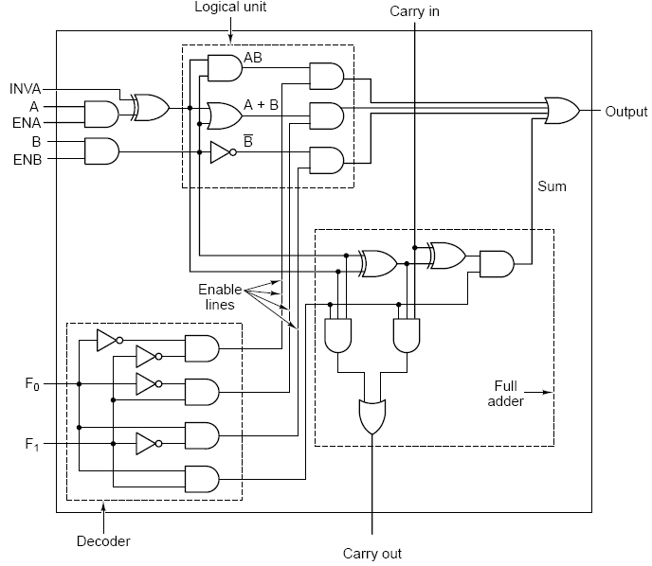
Example: 1-Bit ALU

Slide 38
Sequential Logic
Outputs of sequential logic are based on inputs and its current internal state.
Usually, sequential logic circuit involves clock, which triggers state transition.
Sequential logic: Latch, Flip-Flop, Registers, Memory, etc.

Slide 39
Example: Latch
The most basic sequential logic
Can keep (or, remember) one bit of information
No clock involved

Slide 40
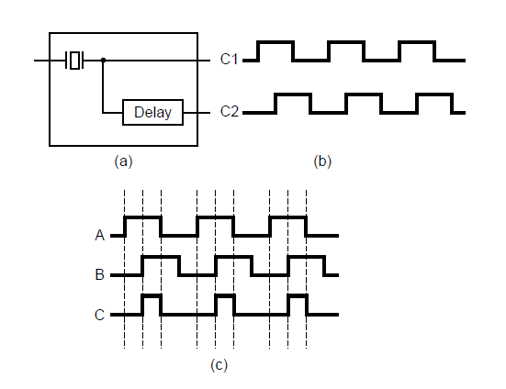
Clocks
Every computer contains at least one clock that:
Regulates how quickly instructions can be executed
Synchronizes the activities of its components.
A fixed number of clock cycles are required to carry out each data movement or computational operation.
(a) A clock. (b) The timing diagram for the clock.
(c) Generation of an asymmetric clock.

Slide 41
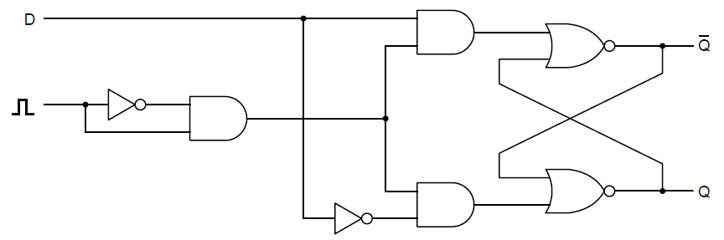
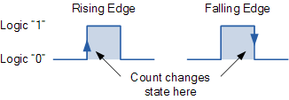
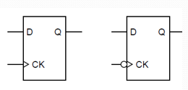
Example: D Flip-Flop
A flip-flop is a latch triggered by a rising edge or a falling edge of the clock.
Symbols for D flip-flops

Slide 42
Example: Registers
Registers are groups of flip-flops, where each flip-flop is capable of storing one bit of information.
Normally, 8-bit/16-bit/32-bit/64-bit registers
Store data in CPU for computation
Can also be used to build memories

Slide 43
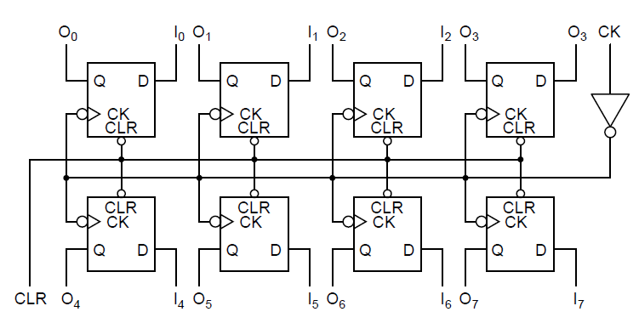
Example: Registers
An 8-bit register constructed from single-bit flip-flops

Slide 44
Density of Integrated Circuit
SSI
Small-scale integration packages gates
Dozens of gates per chip
MSI
Medium-scale integration packages functions, e.g. adders, multiplexors
Hundreds of gates per chip
LSI
Large-scale integration packages complete units, e.g. a calculator chip
Thousands of gates per chip
VLSI
Very large-scale integration packages complex units with millions of transistors.

Slide 45
Computer Organization & Architecture

Slide 46
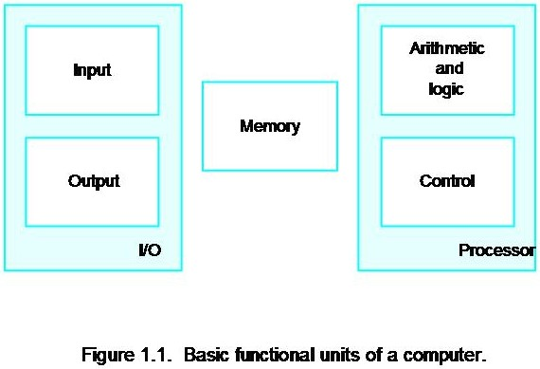
Basic Structure of Computers
Coded info is stored in memory for later use
Program is stored in memory and determines the processing steps
Input unit accepts code info from human operators, electromechanical devices (ie keyboard), other computers via networks
ALU uses the coded info to perform the desired operations
All actions are coordinated by the control unit
The output unit sends the results back out externally
Collectively called the I/O unit
Collectively called the processor
The von Neumann Architecture

Slide 47
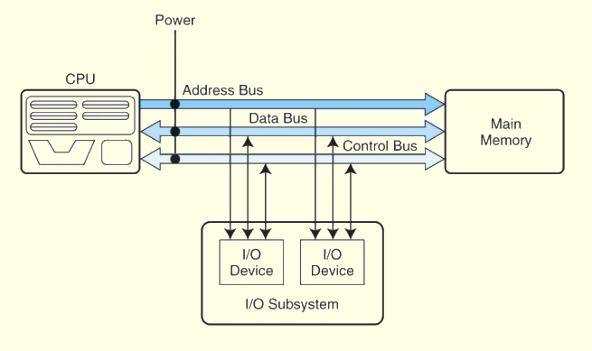
The Bus
Buses consist of data lines, control lines, and address lines.
Address lines determine the location of the source or destination of the data.
Data lines convey bits from one device to another. Move the actual information that must be moved from one location to another.
Control lines determine the direction of data flow, and when each device can access the bus.

Slide 48
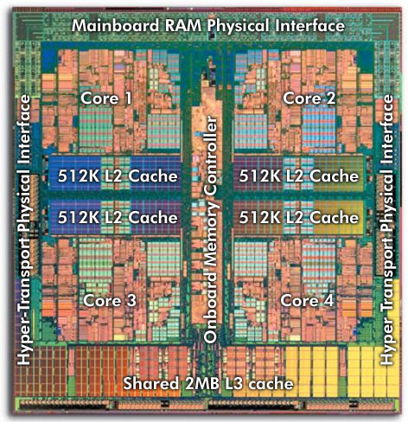
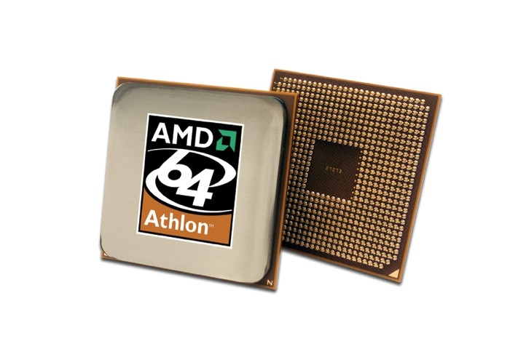
CPU
Inside CPU
Outside Appearance (Top & Bottom)

Slide 49
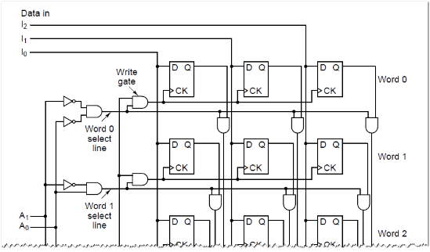
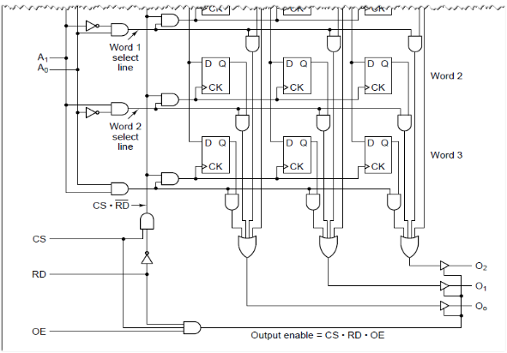
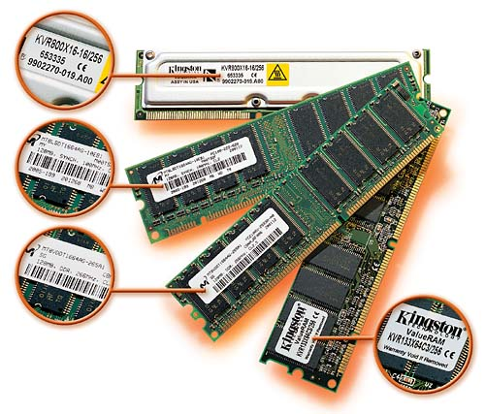
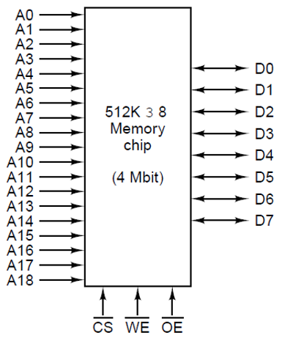
Memory
Computer memory consists of a linear array of addressable storage cells that are similar to registers.
x

Slide 50
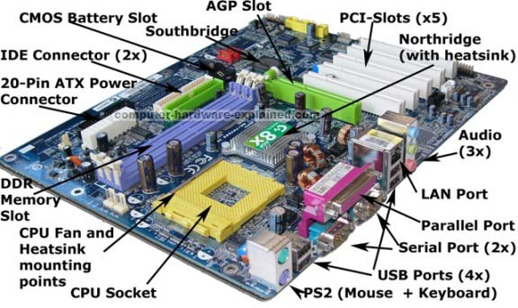
Motherboard

Slide 51
Computer Operating Systems

Slide 52
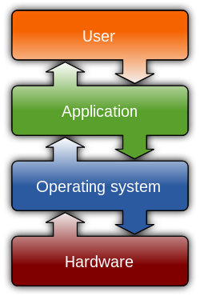
Definition
An Operating System (OS) is low-level system software that
manages computer hardware and software resources;
provides common services for computer programs to interact with computer hardware and other programs.
https://en.wikipedia.org/wiki/File:Operating_system_placement.svg

Slide 53
OS Services
Program execution
OS provides an environment where a user can run programs without having to worry about memory allocation or CPU scheduling.
I/O operations
OS helps a user/program utilize input/output devices without knowing hardware details of the I/O devices.
File system manipulation
OS provides an interface for a user/program to access and manage files and directorys.
Communication
OS facilitates communication between processes to exchange information, whether the processes are running on the same computer or on different computers.

Slide 54
OS Services
Error detection
OS constantly checks for errors in CPU, I/O, memory, etc., and takes actions to ensure correct and consistent computing.
Resource allocation
OS manages resources (memory, CPU, file storage, etc.) using schedulers for multi-user or multi-tasking environments.
Protection
OS ensures that all access to system resources is controlled and authenticated.

Slide 55



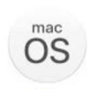

Common Operating Systems
Linux
Microsoft Windows
Apple macOS
Google Android
Apple iOS

Slide 56
Summary
Boolean algebra
Boolean variable, operators, function, truth table
Digital logic gates
Six basic gates, symbols, and truth tables
Digital logic circuits
Combinational logic, sequential logic
Computer Organization & Architecture
The von Neumann architecture
Computer Operating Systems
Functions, services

Slide 57
Thank You!

