Slide 1
Programming Logic and Design Ninth Edition
Chapter 2
Elements of High-Quality Programs

Slide 2
Objectives
In this chapter, you will learn about:
Declaring and using variables and constants
Performing arithmetic operations
The advantages of modularization
Modularizing a program
Hierarchy charts
Features of good program design

Slide 3
Declaring and Using Variables and Constants
Understanding Data Types
Data type describes:
What values can be held by the item
How the item is stored in memory
What operations can be performed on the item
All programming languages support these data types:
Numeric consists of numbers that can be used in math
String is anything not used in math

Slide 4
Understanding Unnamed, Literal Constants
There are two types of constants
Numeric constant (or literal numeric constant)
Contains numbers only
Number does not change
String constant (or literal string constant)
Also known as Alphanumeric values
Can contain both alphabetic characters and numbers
Strings are enclosed in quotation marks

Slide 5
Working with Variables
Variable are named memory locations
Contents can vary or differ over time
Declaration is a statement that provides a variable's:
Data type
Identifier (variable’s name)
Optionally, an initial value

Slide 6
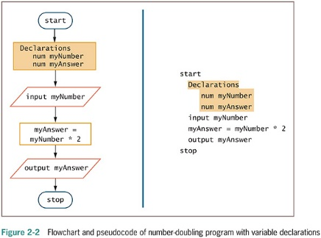
Working with Variables (continued)

Slide 7
Understanding a Declaration’s Data Type
Numeric variable
Holds digits
Can perform mathematical operations on it
String variable
Can hold text
Letters of the alphabet
Special characters such as punctuation marks
Type-safety
Prevents assigning values of an incorrect data type

Slide 8
Understanding a Declaration’s Identifier
An identifier is a variable’s name
Programmer chooses reasonable and descriptive names for variables
Programming languages have rules for creating identifiers
Most languages allow letters and digits
Some languages allow hyphens
Reserved keywords are not allowed

Slide 9
Understanding a Declaration’s Identifier (continued -1)
Variable names are case sensitive
Variable names:
Must be one word
Must start with a letter
Should have some appropriate meaning

Slide 10
Understanding a Declaration’s Identifier (continued -2)

Slide 11
Variable Naming Conventions
Camel casing
Variable names have a “hump” in the middle such as hourlyWage
Pascal casing
Variable names have the first letter in each word in uppercase such as HourlyWage
Hungarian notation
A form of camel casing in which the data type is part of the name such as numHourlyWage

Slide 12
Variable Naming Conventions (continued)
Snake casing
Parts of variable names are separated by underscores such as hourly_wage
Mixed case with underscores
Similar to snake casing, but new words start with a uppercase letter such as Hourly_Wage
Kebob case
Parts of variable names are separated by dashes such as hourly-wage

Slide 13
Assigning Values to Variables
Assignment statement
set myAnswer = myNumber * 2
Assignment operator
Equal sign
A binary operator, meaning it requires two operands—one on each side
Always operates from right to left, which means that it has right-associativity or right-to-left associativity
The result to the left of an assignment operator is called an lvalue

Slide 14
Initializing a Variable
Initializing the variable - declare a starting value
num yourSalary = 14.55
string yourName = “Janita”
Garbage – a variable’s unknown value
Variables must be declared before they are used in the program

Slide 15
Declaring Named Constants
Named constant
Similar to a variable
Can be assigned a value only once
Assign a useful name to a value that will never be changed during a program’s execution
Magic number
Unnamed constant
Use taxAmount = price * SALES_TAX_AMOUNT instead of taxAmount = price * .06

Slide 16
Performing Arithmetic Operations
Standard arithmetic operators:
+ (plus sign)—addition
− (minus sign)—subtraction
* (asterisk)—multiplication
/ (slash)—division

Slide 17
Performing Arithmetic Operations (continued -1)
Rules of precedence
Also called the order of operations
Dictate the order in which operations in the same statement are carried out
Expressions within parentheses are evaluated first
All the arithmetic operators have left-to-right associativity
Multiplication and division are evaluated next
From left to right
Addition and subtraction are evaluated next
From left to right

Slide 18
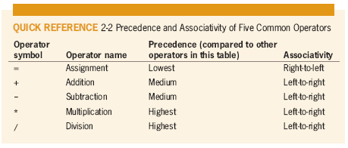
Performing Arithmetic Operations (continued -2)

Slide 19
The Integer Data Type
Dividing an integer by another integer is a special case
Dividing two integers results in an integer, and any fractional part of the result is lost
The decimal portion of the result is cut off, or truncated
A remainder operator (called the modulo operator or the modulus operator) contains the remainder of a division operation
24 Mod 10 is 4
Because when 24 is divided by 10, 4 is the remainder

Slide 20
Understanding the Advantages of Modularization
Modules
Subunit of programming problem
Also called subroutines, procedures, functions, or methods
To call a module is to use its name to invoke the module, causing it to execute
Modularization
Breaking down a large program into modules
Called functional decomposition

Slide 21
Modularization Provides Abstraction
Abstraction
Paying attention to important properties while ignoring nonessential details
Selective ignorance
Newer high-level programming languages
Use English-like vocabulary
One broad statement corresponds to dozens of machine instructions
Modules provide another way to achieve abstraction

Slide 22
Modularization Allows Multiple Programmers to Work on a Problem
Easier to divide the task among various people
Rarely does a single programmer write a commercial program
Professional software developers can write new programs quickly by dividing large programs into modules
Assign each module to an individual programmer or team

Slide 23
Modularization Allows You to Reuse Work
Reusability
Feature of modular programs
Allows individual modules to be used in a variety of applications
Many real-world examples of reusability
Reliability
Assures that a module has been tested and proven to function correctly

Slide 24
Modularizing a Program
Main program
Basic steps (mainline logic) of the program
Include in a module
Module header
Module body
Module return statement
Naming a module
Similar to naming a variable
Module names are followed by a set of parentheses

Slide 25
Modularizing a Program (continued -1)
When a main program wants to use a module
“Calls” the module’s name
Flowchart
Symbol used to call a module is a rectangle with a bar across the top
Place the name of the module you are calling inside the rectangle
Draw each module separately with its own sentinel symbols

Slide 26
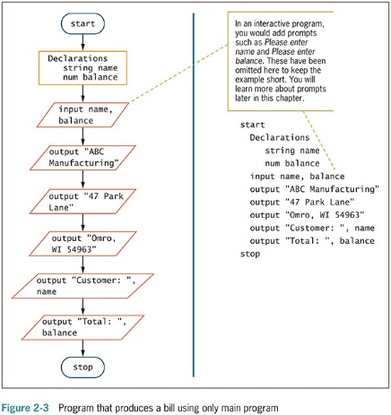
Modularizing a Program (continued -2)

Slide 27
Modularizing a Program (continued -3)
Statements taken out of a main program and put into a module have been encapsulated
Main program becomes shorter and easier to understand
Modules are reusable
When statements contribute to the same job, we get greater functional cohesion

Slide 28
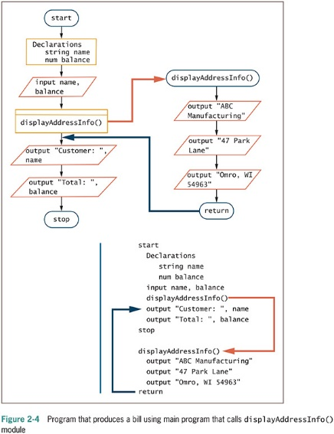
Modularizing a Program (continued -4)

Slide 29
Declaring Variables and Constants within Modules
Place any statements within modules
Input, processing, and output statements
Variable and constant declarations
Variables and constants declared in a module are usable only within the module
Visible
In scope, also called local
Portable
Self-contained units that are easily transported

Slide 30
Declaring Variables and Constants within Modules (continued -1)
Global variables and constants
Declared at the program level
Visible to and usable in all the modules called by the program
Many programmers avoid global variables to minimize errors

Slide 31
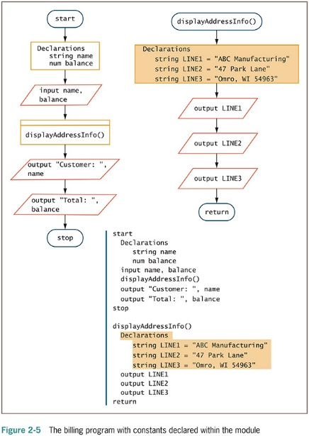
Declaring Variables and Constants within Modules (continued -2)

Slide 32
Understanding the Most Common Configuration for Mainline Logic
Mainline logic of almost every procedural computer program follows a general structure
Declarations for global variables and constants
Housekeeping tasks - steps you must perform at the beginning of a program to get ready for the rest of the program
Detail loop tasks - do the core work of the program
End-of-job tasks - steps you take at the end of the program to finish the application

Slide 33
Understanding the Most Common Configuration for Mainline Logic
A loop is a repetition of a series of steps
Avoid an infinite loop (repeating flow of logic that never ends)
Making a decision
Testing a value
Decision symbol: Diamond shape
Dummy value
Data-entry value that the user will never need
Sentinel value
eof (“end of file”)
Marker at the end of a file that automatically acts as a sentinel

Slide 34
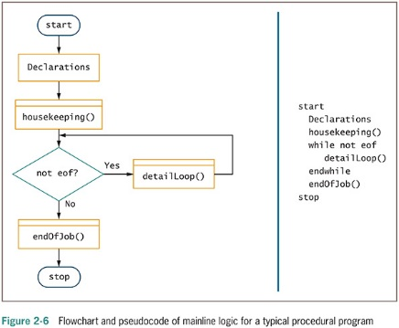
Understanding the Most Common Configuration for Mainline Logic (continued -1)

Slide 35
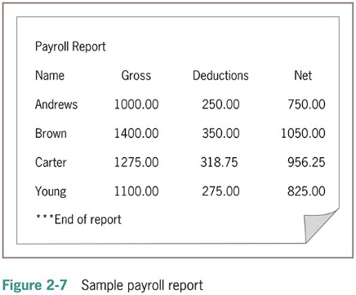
Understanding the Most Common Configuration for Mainline Logic (continued -2)

Slide 36
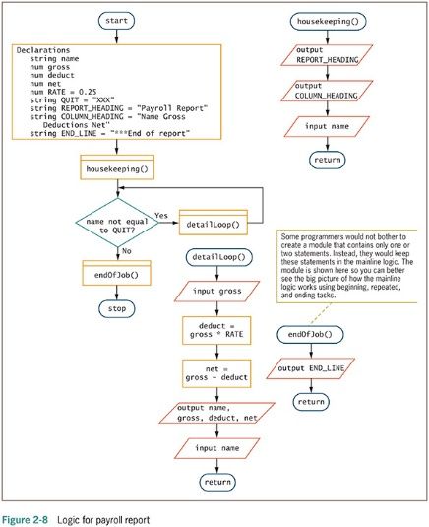
Understanding the Most Common Configuration for Mainline Logic (continued -3)

Slide 37
Creating Hierarchy Charts
Hierarchy chart
Shows the overall picture of how modules are related to one another
Tells you which modules exist within a program and which modules call others
Specific module may be called from several locations within a program
Planning tool
Develop the overall relationship of program modules before you write them
Documentation tool

Slide 38
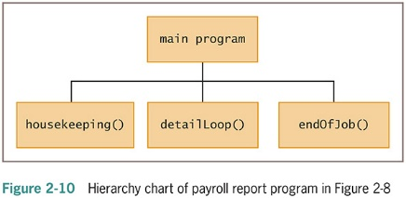
Creating Hierarchy Charts (continued -1)

Slide 39
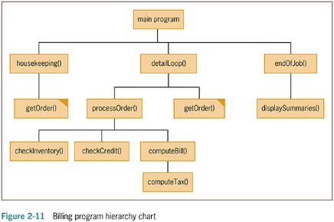
Creating Hierarchy Charts (continued -2)

Slide 40
Features of Good Program Design
Use program comments where appropriate
Identifiers should be chosen carefully
Strive to design clear statements within your programs and modules
Write clear prompts and echo input
Continue to maintain good programming habits as you develop your programming skills

Slide 41
Using Program Comments
Program comments
Written explanations of programming statements
Not part of the program logic
Serve as internal documentation for the program
Syntax used differs among programming languages
Flowchart
Use an annotation symbol to hold information that expands on what is stored within another flowchart symbol

Slide 42
Using Program Comments (continued -1)
Examples of declarations:
num sqFeet // sqFeet is an estimate provided by the seller of the property
num pricePerFoot // pricePerFoot is determined by current market conditions
num lotPremium // lotPremium depends on amenities such as whether lot is waterfront

Slide 43
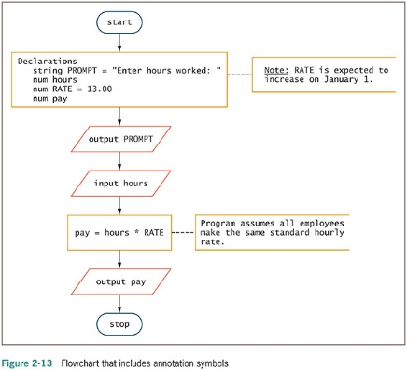
Using Program Comments (continued -2)

Slide 44
Choosing Identifiers
General guidelines
Give a variable or a constant a name that is a noun (because it represents a thing)
Give a module an identifier that is a verb (because it performs an action)
Use meaningful names
Self-documenting
Use pronounceable names
Be judicious in your use of abbreviations
Avoid digits in a name

Slide 45
Choosing Identifiers (continued)
General guidelines (continued)
Use the system your language allows to separate words in long, multiword variable names
Consider including a form of the verb to be
Name constants using all uppercase letters separated by underscores (_)
Programmers create a list of all variables
Data dictionary

Slide 46
Designing Clear Statements
Avoid confusing line breaks
Use temporary variables to clarify long statements

Slide 47
Avoiding Confusing Line Breaks
Most modern programming languages are free-form
Make sure your meaning is clear
Do not combine multiple statements on one line

Slide 48
Using Temporary Variables to Clarify Long Statements
Temporary variable
Work variable
Not used for input or output
Working variable that you use during a program’s execution
Consider using a series of temporary variables to hold intermediate results

Slide 49
Using Temporary Variables to Clarify Long Statements (continued)
// Using a single statement to compute commission
salesCommission = (sqFeet * pricePerFoot +
lotPremium) * commissionRate
// Using multiple statements to compute commission
basePropertyPrice = sqFeet * pricePerFoot
totalSalesPrice = basePropertyPrice + lotPremium
salesCommission = totalSalesPrice * commissionRate

Slide 50
Writing Clear Prompts and Echoing Input
Prompt
Message displayed on a monitor to ask the user for a response
Used both in command-line and GUI interactive programs
Echoing input
Repeating input back to a user either in a subsequent prompt or in output

Slide 51
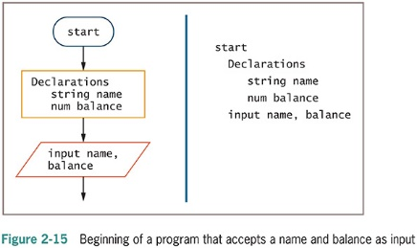
Writing Clear Prompts and Echoing Input (continued -1)

Slide 52
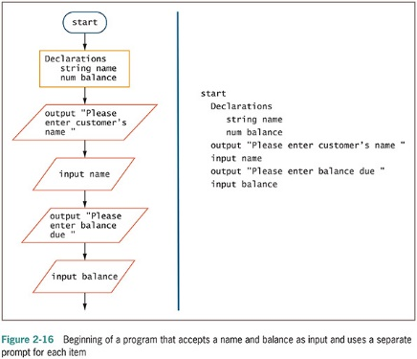
Writing Clear Prompts and Echoing Input (continued -2)

Slide 53
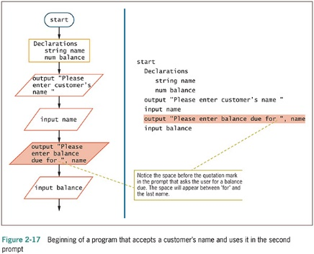
Writing Clear Prompts and Echoing Input (continued -3)

Slide 54
Maintaining Good Programming Habits
Every program you write will be better if you:
Plan before you code
Maintain the habit of first drawing flowcharts or writing pseudocode
Desk-check your program logic on paper
Think carefully about the variable and module names you use
Design your program statements to be easy to read and use

Slide 55
Summary
Programs contain literals, variables, and named constants
Arithmetic follows rules of precedence
Break down programming problems into modules
Include a header, a body, and a return statement
Hierarchy charts show relationship among modules
As programs become more complicated:
Need for good planning and design increases

