Slide 1
Programming Logic and Design Ninth Edition
Chapter 7
File Handling and Applications

Slide 2
Objectives
In this lecture, you will learn about:
Computer files
The data hierarchy
Performing file operations

Slide 3
Understanding Computer Files
Computer file
A collection of data stored on permanent storage devices such as your computer’s hard drive, a hard drive on the cloud, DVDs, USB drives, and reels of magnetic tape
Text files (numbers, names, salaries) that can be read by a text editor
Binary files (images and music) not encoded as text

Slide 4
Understanding Computer Files (continued -1)
Computer files have:
A filename - an identifying name given to a computer file that frequently describes the contents
JanuaryPayroll
PreviousMonthSales
A filename extension - a group of characters added to the end of a filename that describes the type of the file
.txt
.dat
.docx

Slide 5
Understanding Computer Files (continued -2)
Computer files have:
A specific creation time and modification date
A file size measured in bytes
byte – one character
kilobyte – thousands of bytes
megabyte – millions of bytes
gigabyte – billions of bytes
terabyte – trillions of bytes

Slide 6
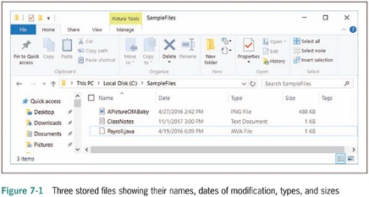
Understanding Computer Files (continued -3)

Slide 7
Understanding Computer Files (continued -4)
Organizing files
Directories and folders
Organization units on storage devices
Path
Combination of disk drive plus the complete hierarchy of directories
Example: C:\Logic\SampleFiles\PayrollData.dat

Slide 8
Understanding the Data Hierarchy
Data hierarchy
Describes the relationships between data components
Consists of:
Characters – letters, numbers, and special symbols
Fields – data items representing a single attribute of a record
Records – groups of fields that go together for some logical reason
Files – groups of related records
Database – holds related file data in tables

Slide 9
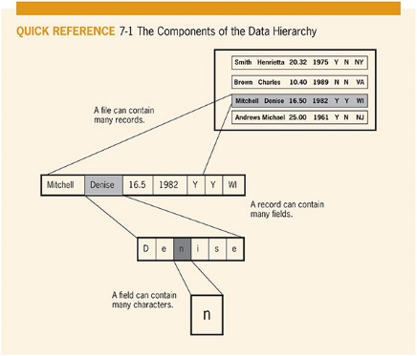
Understanding the Data Hierarchy (continued)

Slide 10
Performing File Operations
File operations to use data files in your programs
Declare a file identifier
InputFile employeeData
OutputFile updatedData
Open the file
open employeeData "EmployeeData.dat"
Reading from a file and processing the data
input name from employeeData
input address from employeeData
input payRate from employeeData

Slide 11
Performing File Operations (continued -1)
Reading from a file and processing the data
Programming languages have different ways of determining how much data to input
In many languages, a delimiter such as a comma, semicolon, or tab character is stored between data fields

Slide 12
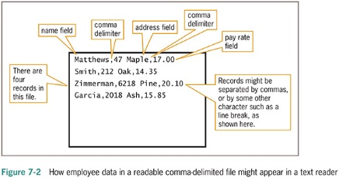
Performing File Operations (continued -2)

Slide 13
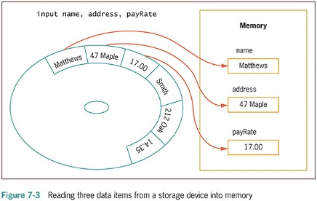
Performing File Operations (continued -3)

Slide 14
Performing File Operations (continued -4)
Sequential file
Program reads all the records in this file from beginning to end, processing them one at a time
Sorting
The process of placing records in order by the value in a specific field or fields
Ascending order – records sorted in order from lowest to highest values
Descending order – records sorted in order from highest to lowest values

Slide 15
Performing File Operations (continued -5)
Writing data to a file
When you store data in a computer file on a persistent storage device, you write to the file
output name, address, payRate to employeeData
Closing a file
When you finish using a file, the program should close the file
Always close every file you open
Default input and output devices (keyboard and monitor) do not require opening or closing

Slide 16
A Program that Performs File Operations
Backup file
a copy kept in case values need to be restored to their original state
The backup copy is called a parent file
The newly revised copy is a child file

Slide 17
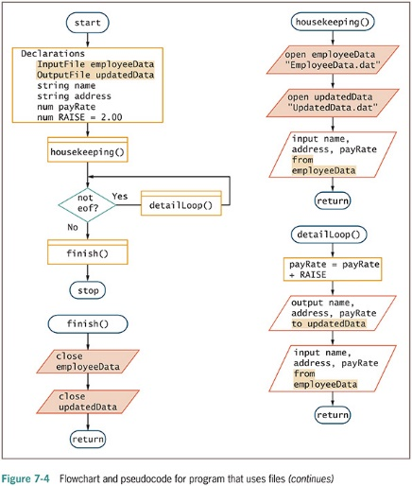
A Program that Performs File Operations (continued -1)

Slide 18
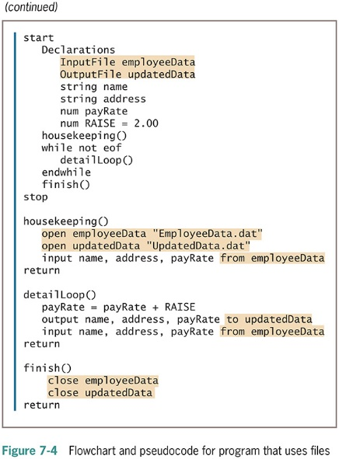
A Program that Performs File Operations (continued -2)

Slide 19
Summary
Computer file
A collection of data stored on a nonvolatile device in a computer system
Data items are stored in a hierarchy
To use a data file you must declare, open, read, write, and close the file
Sequential file: records stored one after another in some order

