Slide 1
Programming Logic and Design Ninth Edition
Chapter 9
Advanced Modularization Techniques

Slide 2
Objectives
In this lecture, you will learn about:
• The parts of a method
• Methods with no parameters
• Methods that require parameters
• Methods that return a value

Slide 3
The Parts of a Method
Method
A program module that contains a series of statements that carry out a task
Invoke or call a method from another program or method
Any program can contain an unlimited number of methods
Each method can be called an unlimited number of times
Calling program or method is called the method’s client

Slide 4
The Parts of a Method (continued)
Method must include
Method header (also called the declaration or definition)
Method body
Contains the implementation (Statements that carry out the tasks)
Method return statement (Returns control to the calling method)
Variables and constants
Local: declared in a method
Global: known to all program modules

Slide 5
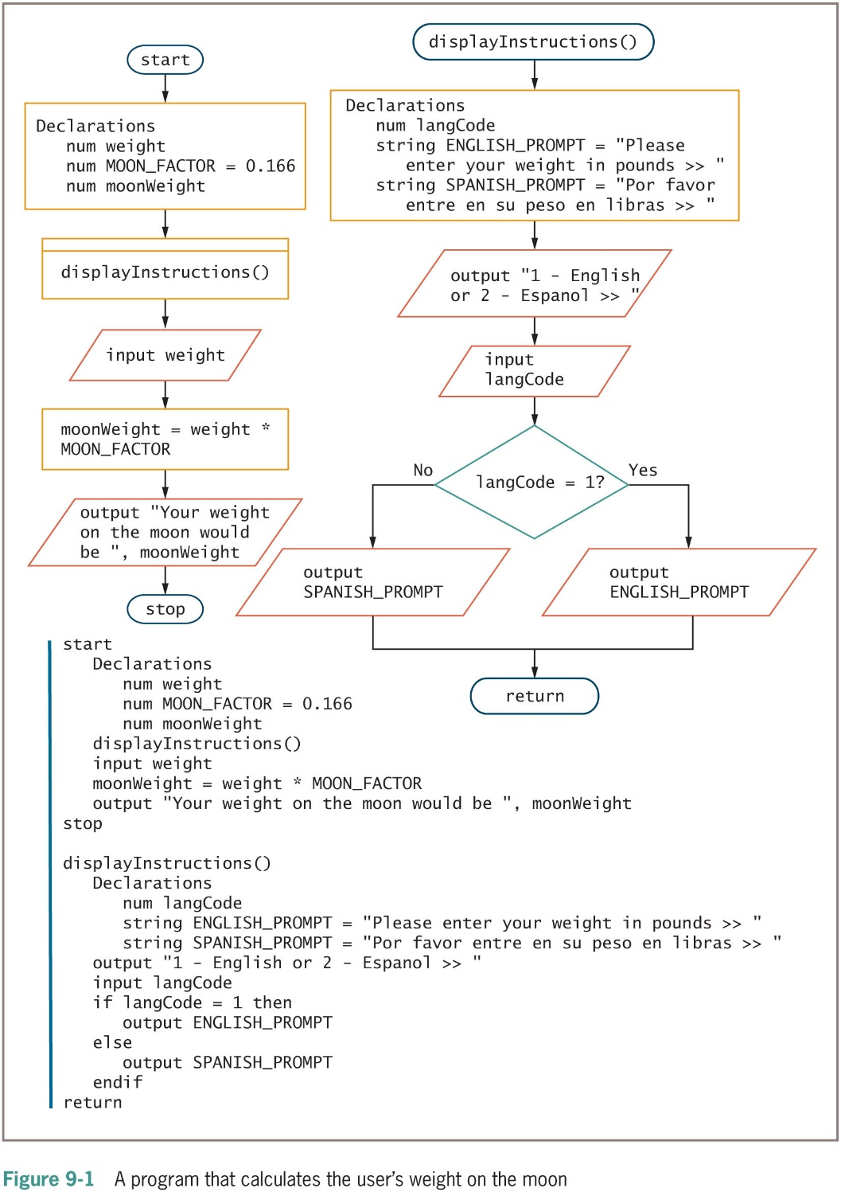
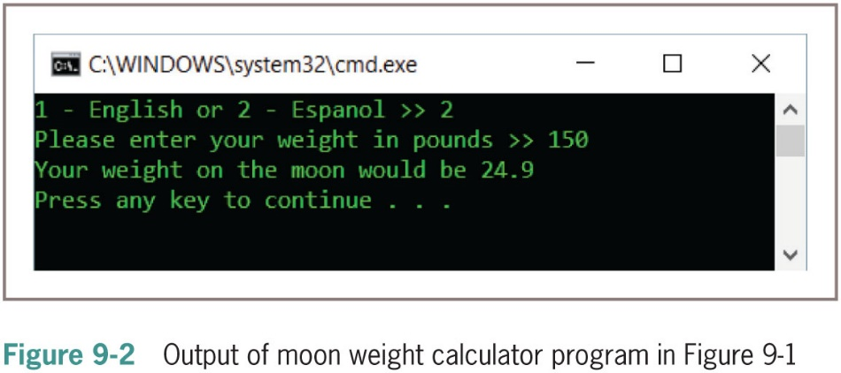
Using Methods with No Parameters

Slide 6
Using Methods with No Parameters (continued -1)
When methods must share data
Pass the data into and return the data out of methods
When you call a method from a program, you must know four things:
What the method does
Name of the called method
Type of information to send to the method, if any
Type of return data to expect from the method, if any

Slide 7
Creating Methods that Require Parameters
Argument to the method
Pass a data item into a method from a calling program
Parameter to the method
Method receives the data item
When a method receives a parameter, you must provide a parameter list that includes:
The type of the parameter
The local name for the parameter
Signature
Method’s name and parameter list

Slide 8
Creating Methods that Require Parameters (continued -1)
Improve the moon weight program by making the final output more user-friendly
Several approaches
Rewrite the program without including any methods
Retain the displayInstructions() method, but make the langCode variable global
Retain the displayInstructions() method as is, but add a section to the main program that also asks the user for a preferred language
Store the variable that holds the language code in the main program

Slide 9
Creating Methods that Require Parameters (continued -2)
Passed by value
A copy of a value is sent to the method and stored in a new memory location accessible to the method
Each time a method executes, parameter variables listed in the method header are redeclared

Slide 10
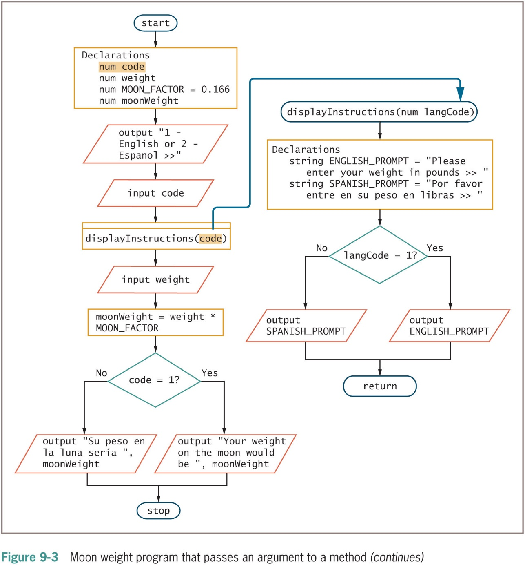
Creating Methods that Require Parameters (continued -3)

Slide 11
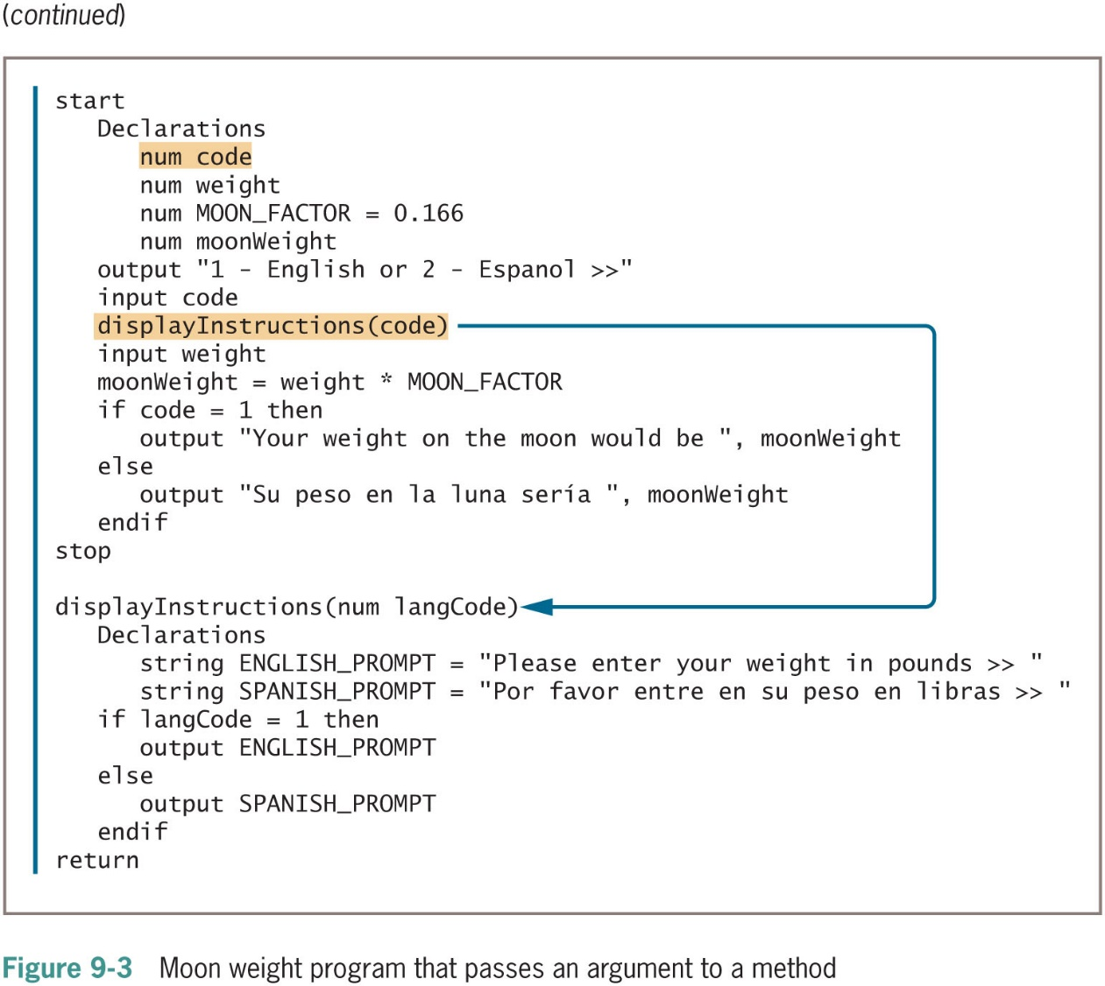
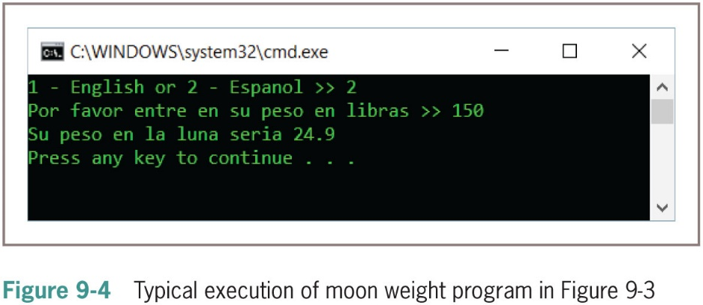
Creating Methods that Require Parameters (continued -4)

Slide 12
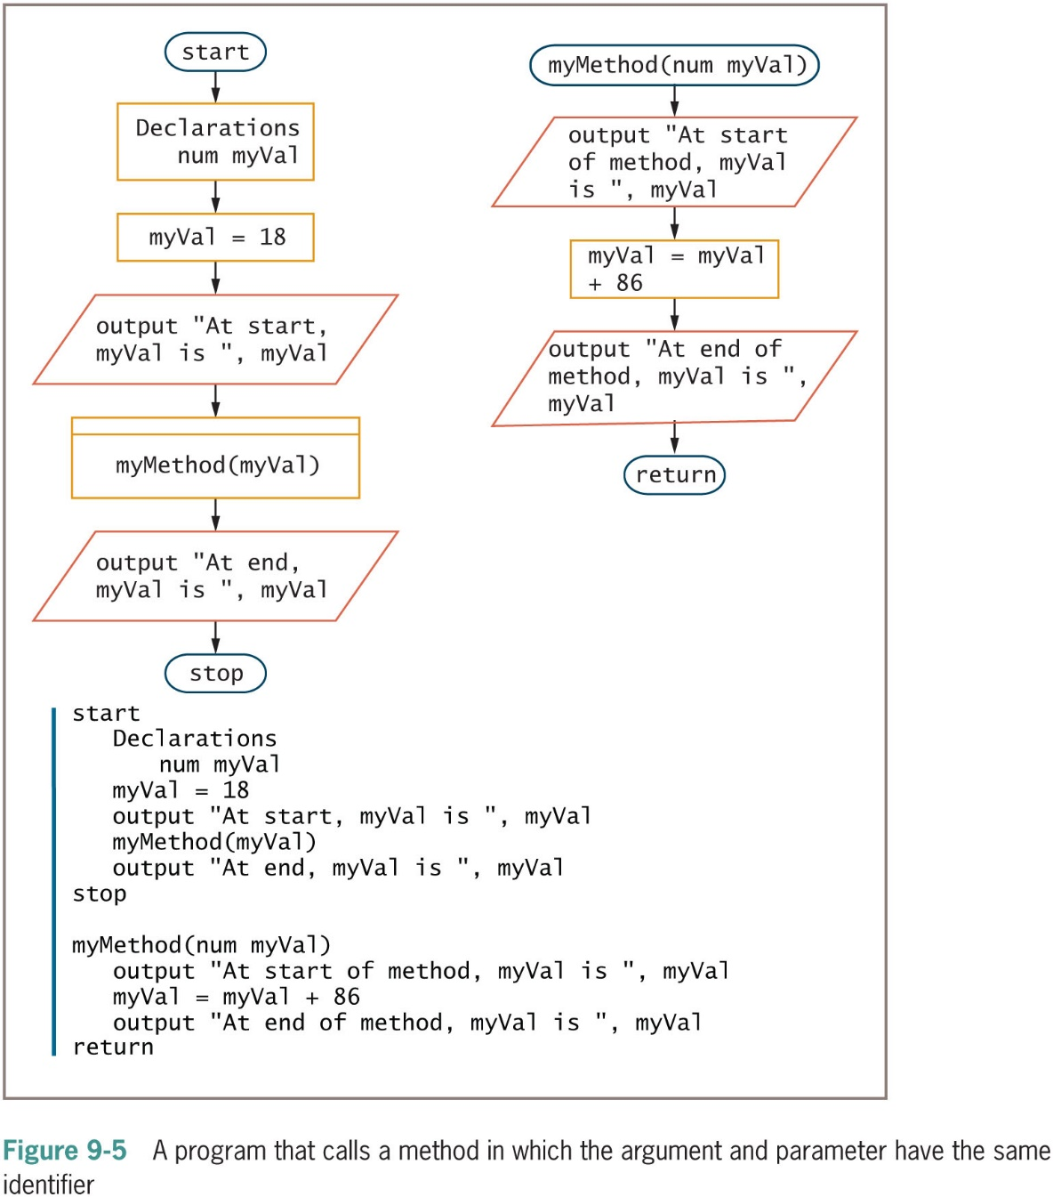
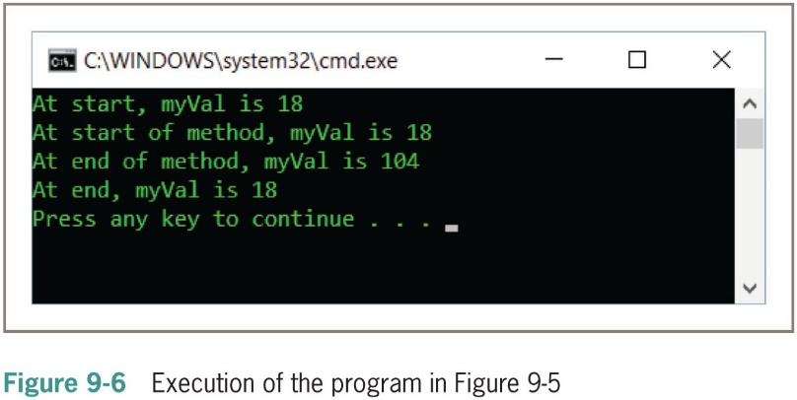
Creating Methods that Require Parameters (continued -5)

Slide 13
Creating Methods that Require Multiple Parameters
Methods can require more than one parameter
List the arguments within the method call, separated by commas
List a data type and local identifier for each parameter within the method header’s parentheses
Separate each declaration with a comma
The data type must be repeated with each parameter
Arguments sent are called actual parameters
Variables that accept the parameters in the method are called formal parameters

Slide 14
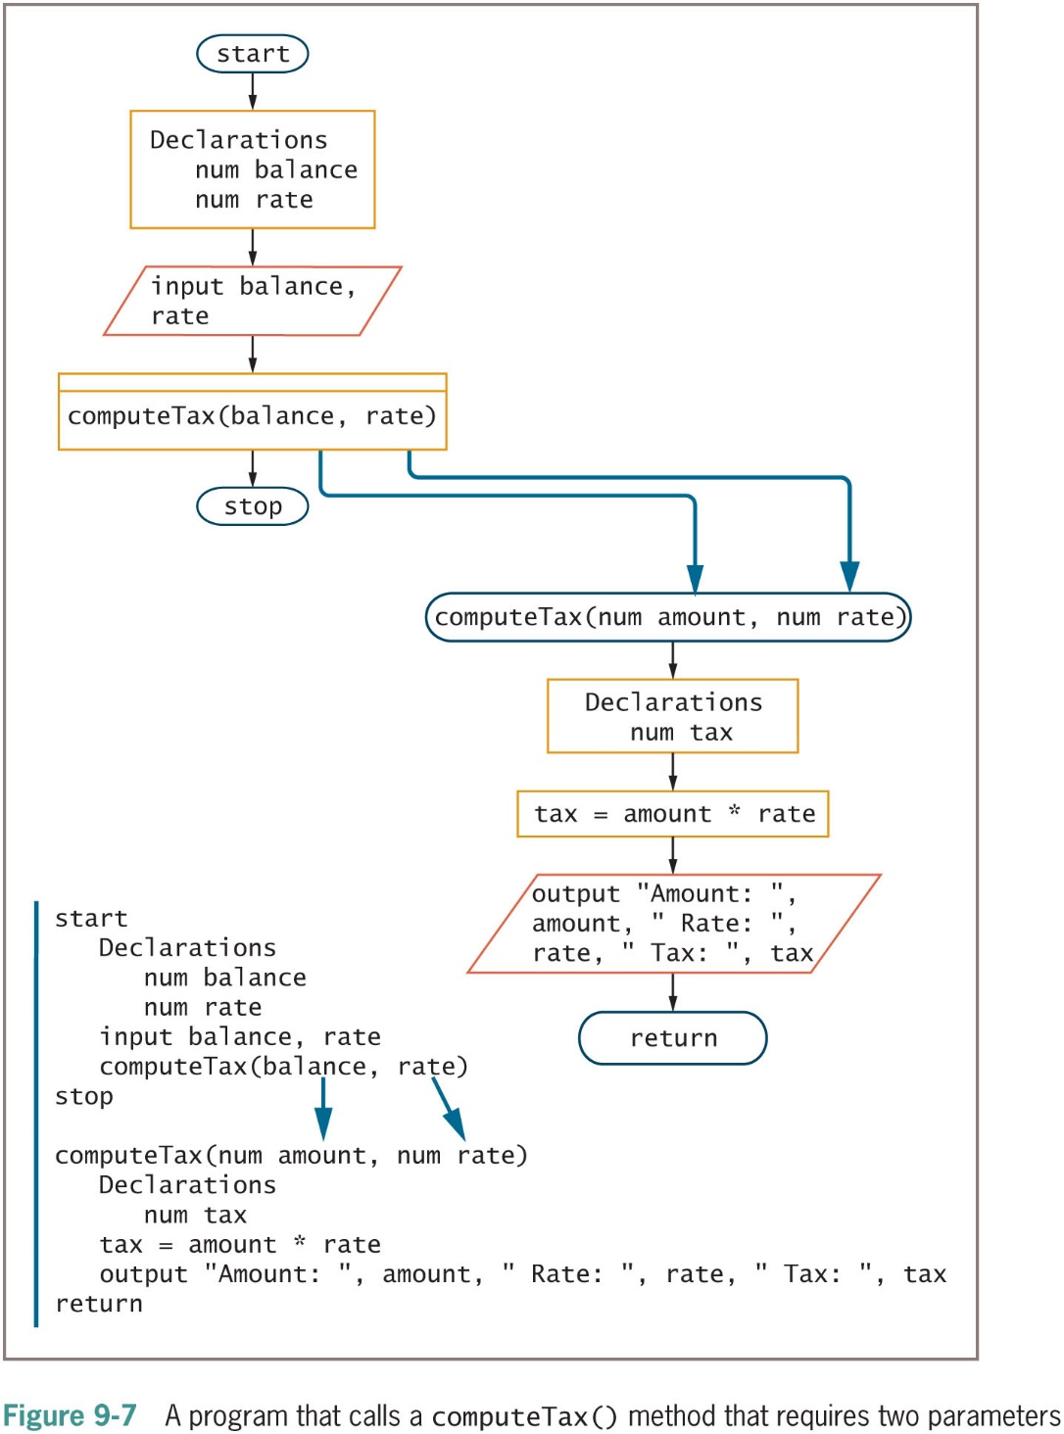
Creating Methods that Require Multiple Parameters (continued -1)

Slide 15
Creating Methods that Return a Value
A variable declared within a method ceases to exist when the method ends
Goes out of scope
To retain a value that exists when a method ends, return the value from the method back to the calling method
When a method returns a value, the method must have a return type that matches the data type of the value that is returned

Slide 16
Creating Methods that Return a Value (continued -1)
Return type for a method
Indicates the data type of the value that the method will send back
Can be any type
Also called method’s type
Listed in front of the method name when the method is defined
Method can also return nothing
Return type void
Void method

Slide 17
Creating Methods that Return a Value (continued -2)
Example: num getHoursWorked()
Returns a numeric value
Usually, you want to use the returned value in the calling method
Not required
Store in variable or use directly without storing
output "Hours worked is ", getHoursWorked()

Slide 18
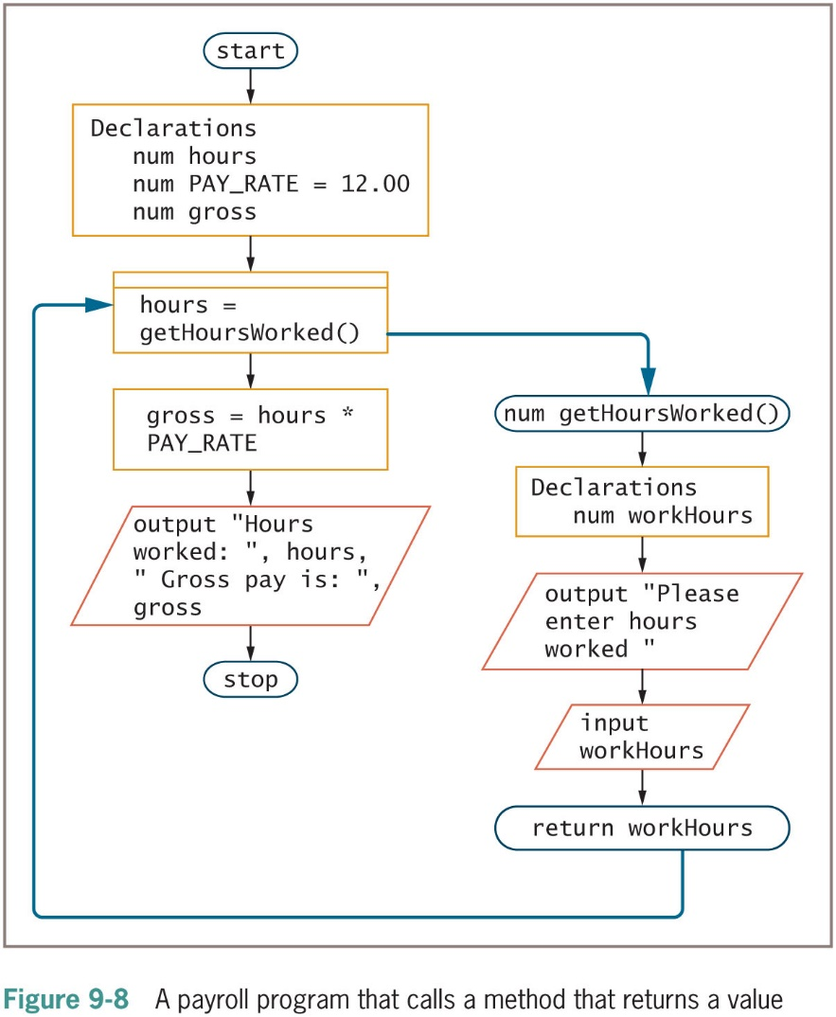
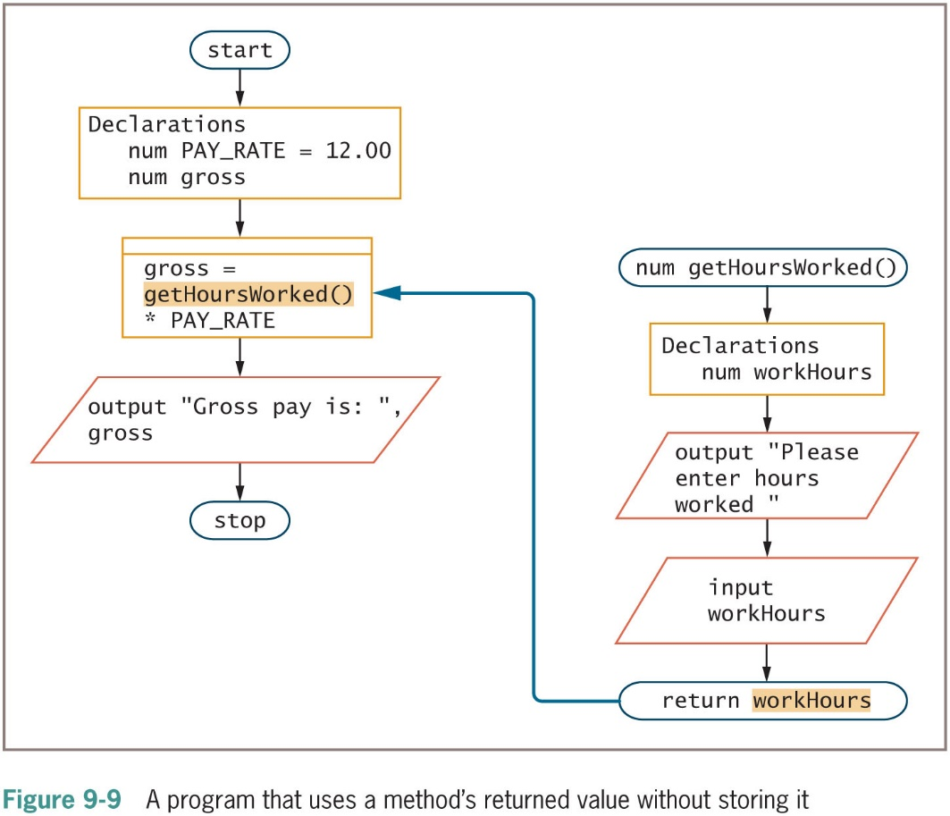
Creating Methods that Return a Value (continued -3)

Slide 19
Creating Methods that Return a Value (continued -4)
Technically, you are allowed to include multiple return statements in a method
It’s not recommended
Violates structured logic

Slide 20
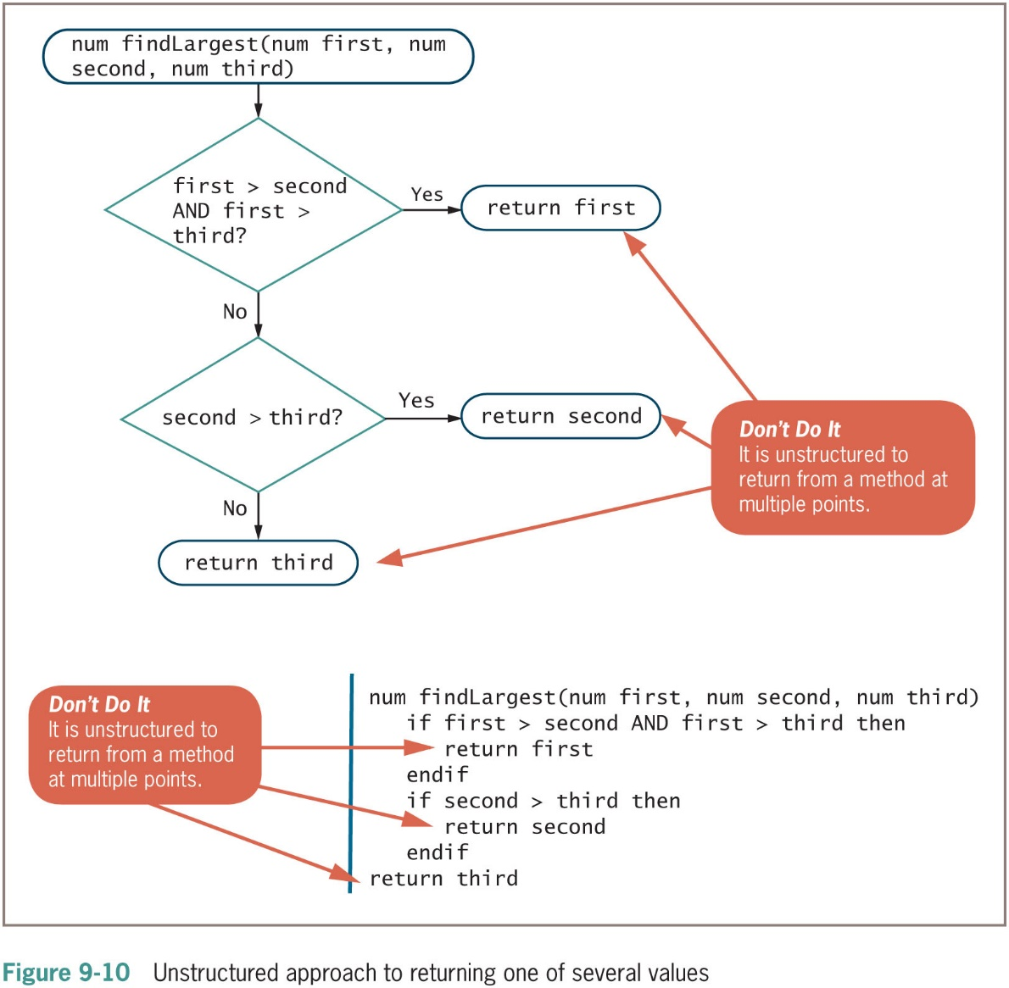
Creating Methods that Return a Value (continued -5)

Slide 21
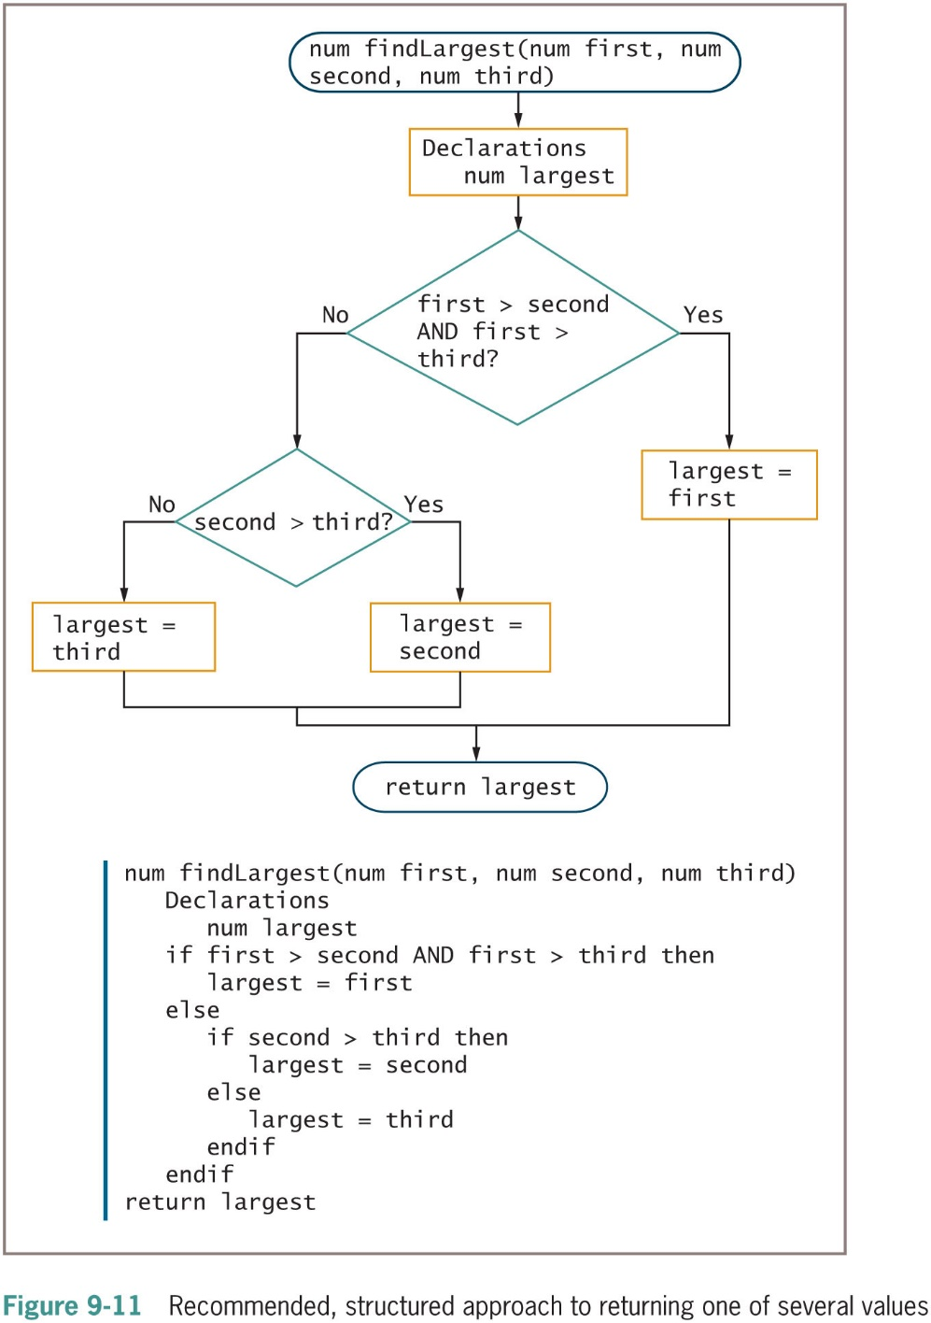
Creating Methods that Return a Value (continued -6)

Slide 22
Creating Methods that Return a Value (continued -7)
To use a method, you should know:
What the method does in general, but not necessarily how it carries out tasks internally
The method’s name
The method’s required parameters, if any
The method’s return type, so that you can use any returned value appropriately
Overhead refers to the extra resources and time required by an operation, such as calling a method

Slide 23
Summary
A method is a program module that contains a series of statements that carry out a task
Must include a header body and return statement
A program can contain an unlimited number of methods
Methods can be called an unlimited number of times
Data passed to a method is called an argument
Data received by a method is called a parameter
Returned values must have a return type

