Slide 1
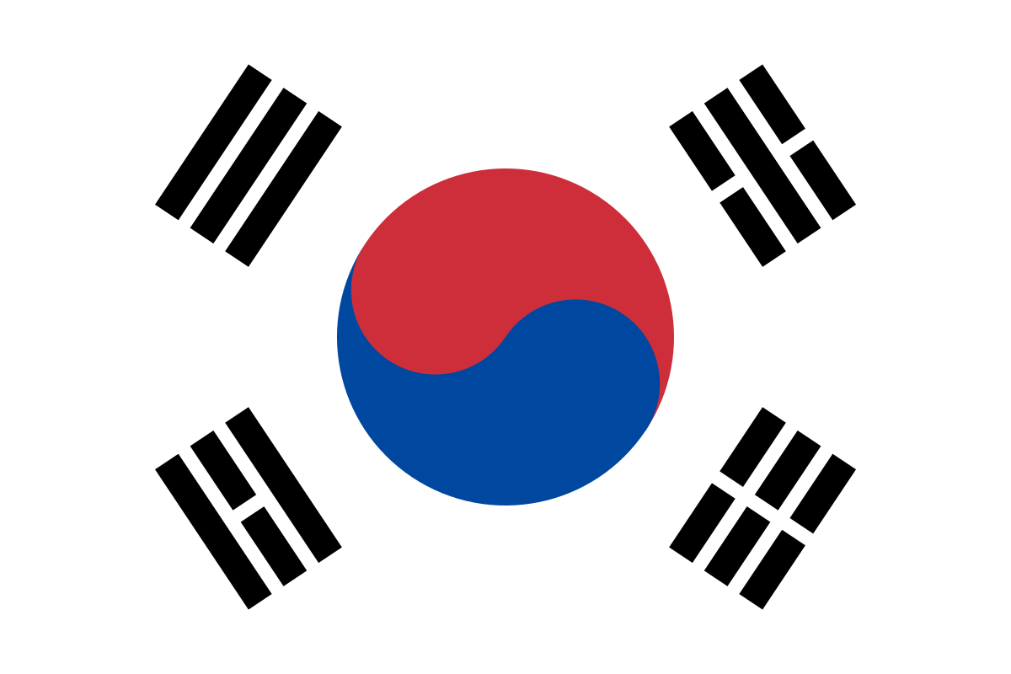
Top four famous foods in south korea

Slide 2
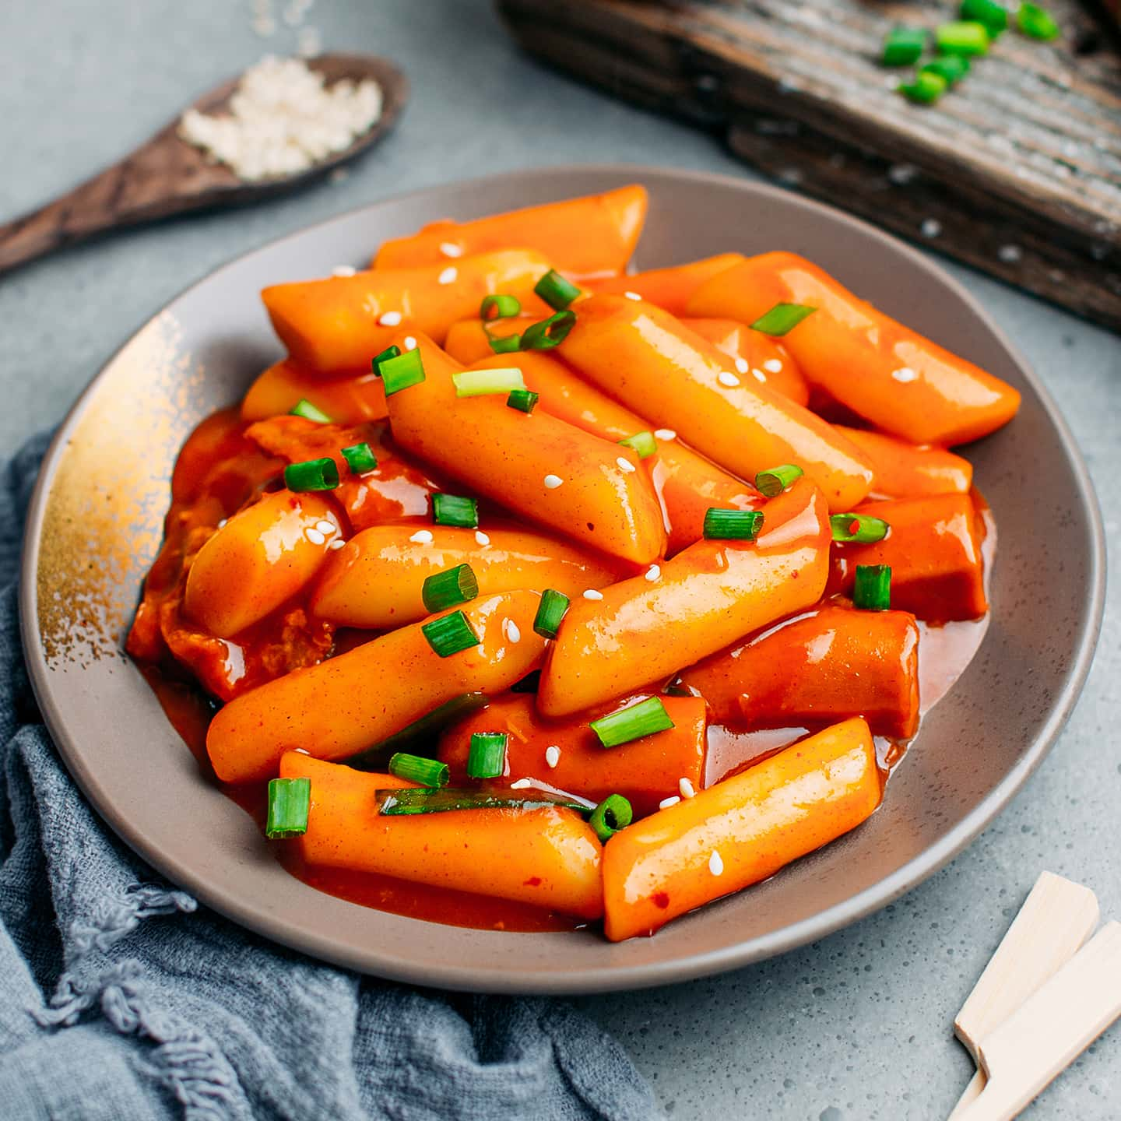
tteokbokki
Tteokbokki: A popular Korean street food.
Main Ingredient: Steamed rice cakes (tteok).
Preparation: Rice cakes are stir-fried with a traditional red chili paste (gochujang).
Flavor: Spicy, savory, and slightly sweet.
Street Food Staple: Commonly served at street food stalls in Korea.

Slide 3
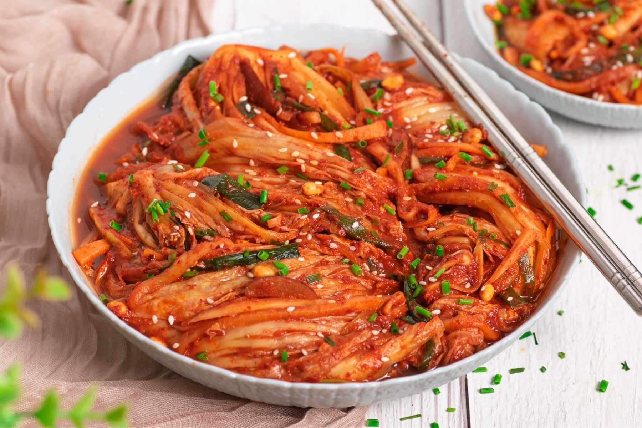
KIMCHI
Kimchi: A traditional Korean dish made from fermented vegetables, usually napa cabbage or radishes.
Preparation: Typically made in large quantities and stored for long-term fermentation.
Main Ingredients: Vegetables, chili pepper flakes, garlic, ginger, and fish sauce.
Serving: Commonly served as a side dish in Korean meals.
Flavor: Spicy, sour, and umami-rich due to fermentation.

Slide 4
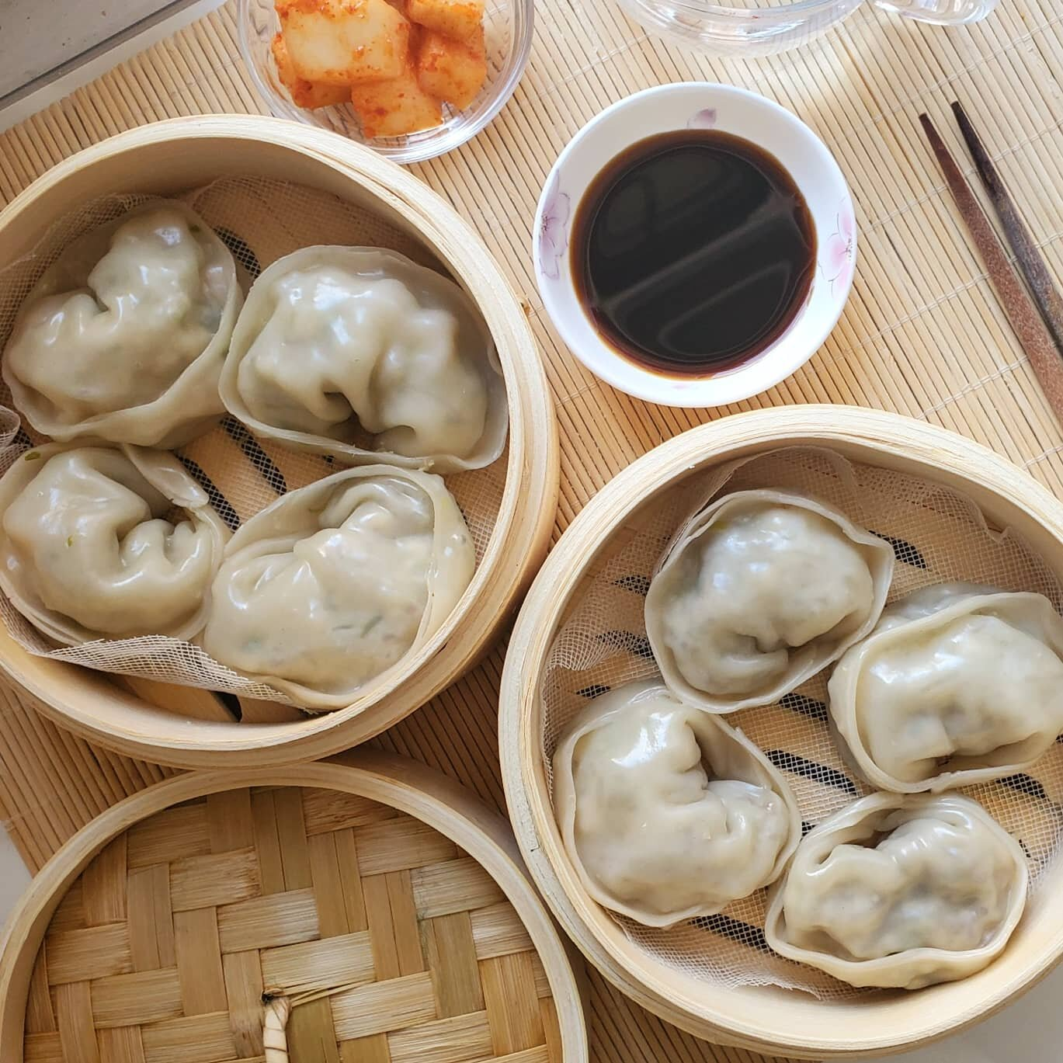
mandoo
Mandoo: A traditional Korean dumpling, often enjoyed as a snack or appetizer.
Main Ingredients: Ground meat (usually pork or beef), vegetables, tofu, and seasonings wrapped in a thin dough.
Preparation: Can be steamed, boiled, or pan-fried for a crispy exterior.
Serving: Often served with a dipping sauce made of soy sauce, vinegar, and sesame oil.

Slide 5
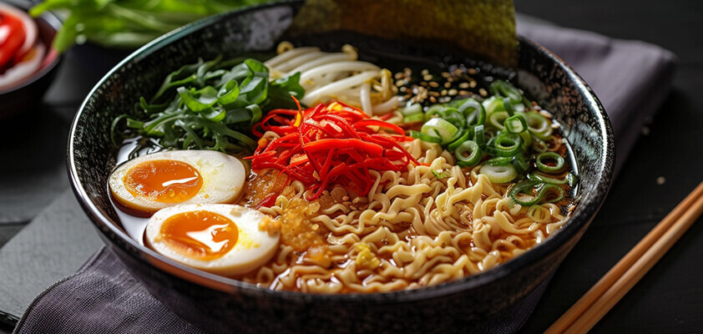
RAmEn
Ramen: A popular Japanese noodle dish, widely enjoyed in Korea as well.
Main Ingredients: Wheat noodles served in a rich broth made from meat, fish, or vegetables.
Broth Flavors: Common varieties include miso, soy sauce, and pork-based tonkotsu.
Toppings: Typically garnished with ingredients like boiled eggs, nori (seaweed), green onions, and slices of meat (often pork).

Slide 6
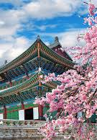
THANK YOU
By,
J. Jessie Geona,
VI – A2

