Slide 1
ipd-sim
A Simulation Framework for Iterated Prisoner’s Dilemma Scenarios
By Jessica Boe

Slide 2
Project Motivation
The iterated prisoner’s dilemma has applications in a multitude of disciplines:
Game Theory
Business
Competition
Marketing
Trade Wars
Criminology
Psychology
Foreign Relations

Slide 3
Project Objectives
To study the prisoner’s dilemma across disciplines, we need a framework that allows for user flexibility
While simulation tools currently exist, they require coding knowledge and are console-based or are very limited in scope
ipd-sim combines Axelrod with a GUI interface to run scenarios
Notes:
To study the prisoner’s dilemma across disciplines, we need a dynamic framework that allows for both flexibility in input variables, simulation types, and easily digestible result analysis
While simulation tools currently exist, they require coding knowledge and are console-based or are very limited in scope
ipd-sim combines the power of established, vetted simulation tool Axelrod with an easy accessible GUI interface to let non-technical users run and examine iterated prisoner’s dilemma scenarios

Slide 4
The prisoner’s dilemma: BAsics
The prisoner’s dilemma is the most famous of non-zero sum games
An example of a zero-sum game is tennis, or chess, where one player’s gain is another player’s loss
However, in the prisoner’s dilemma, cooperating with the other player can be the most effective strategy

Slide 5
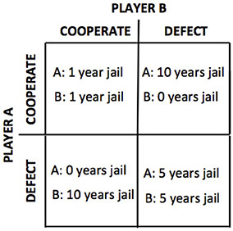
The prisoner’s dilemma: BAsics
The most basic incarnation of the prisoner’s dilemma is where two players are being interrogated separately by police, and can either stay silent (cooperate) or implicate their opponent (defect) for their crimes
There are 4 possible outcomes:
(C,C)
(C,D)
(D,C)
(D,D)
The winner is the person who has the highest score, and thus spends the most time out of jail

Slide 6
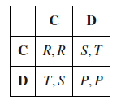
The prisoner’s dilemma: BAsics
However, these variables need not apply only to staying out of jail
The matrix can be tweaked to allow for variables having more and less weight than in the default scenario
As can be derived from the first matrix, the second one has 4 parameters:
T: Temptation
R: Reward
P: Punishment
S: Sucker
To constitute a prisoner’s dilemma, the following inequality must hold true:
T > R > S > P

Slide 7
Iterated prisoner’s dilemma
After a few turns, you can say ‘defecting’ is the best strategy for potential point gain
However, the game becomes fascinating when played over multiple rounds
Depending on the payoff matrix, the number of turns, how many games are played per turn, and the players involved, there are an infinite number of results!
Notes:
After a few turns, you can say that the easiest way to gain points in a single game match, would be to defect, and the safest way would be to cooperate
However, the real interesting part of the iterated prisoner’s dilemma is when multiple matches are played, and you can study which strategies work best under the given parameters
Depending on the payoff matrix, the number of turns, how many games are played per turn, and the players involved, there are an infinite number of results!

Slide 8
Technology
This program was written in Python 3
The main game logic is accomplished with the use of Axelrod for Python
Axelrod is one of the only, and without a doubt the best, tool for simulating iterated prisoner’s dilemma scenarios
The GUI portion of this project uses PyQT5
Python doesn’t always have the best GUI tools, and although the learning curve for PyQT was very steep, it works very well
Data tools such as MatPlotLib, Tkinter, and NumPy are used for processing and analysis

Slide 9
Input/output
The program takes in the user input from the GUI
The user can run Tournament, Eco Tournament, and Moran Process scenarios, which are mapped to respective functions inside the main program
There are options for CSV output, population maps, and graphs

Slide 10
Strategies
Basic
- Cooperator
- Defector
- Tit for Tat
Intermediate
- Adaptive TfT
- Grudger
Random
Average Copier
Advanced
- Nydegger
- Revised Downing
- Adaptive Pavlov

Slide 11
Modes
Tournament
Standard Round Robin tournament
Pits 2 randomly selected players against each other until a winner is established
Ecological
- Piggy backs off of Tournament, except extends for however specified in Simulation Length parameter and shows the user what an ecological pool would look like over time
Moran
- Similar to Ecological, except establishes a clear winner as opposed to seeing which player classes are still around.
- This is the most random, as it MUST choose a winner and may overreach by .0000001 of a point to identify the winner, or else it will run indefinitely

Slide 12
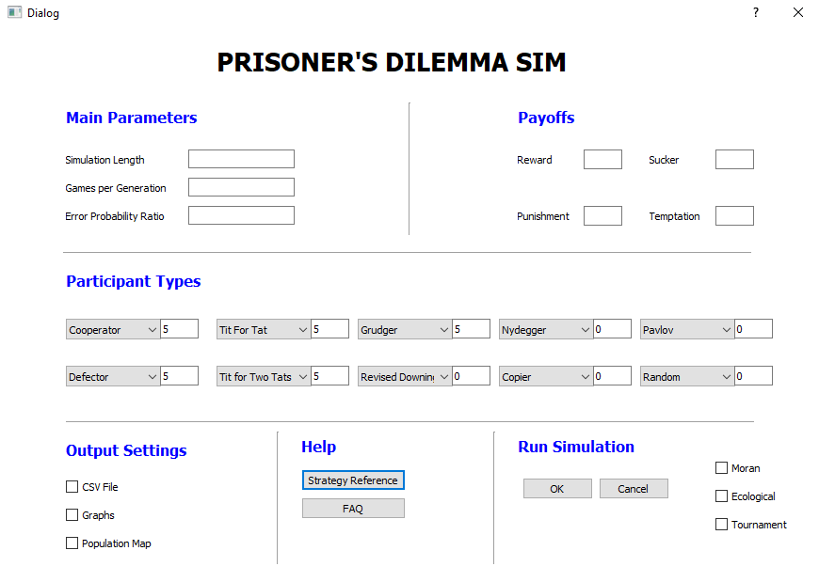
Main interface

Slide 13
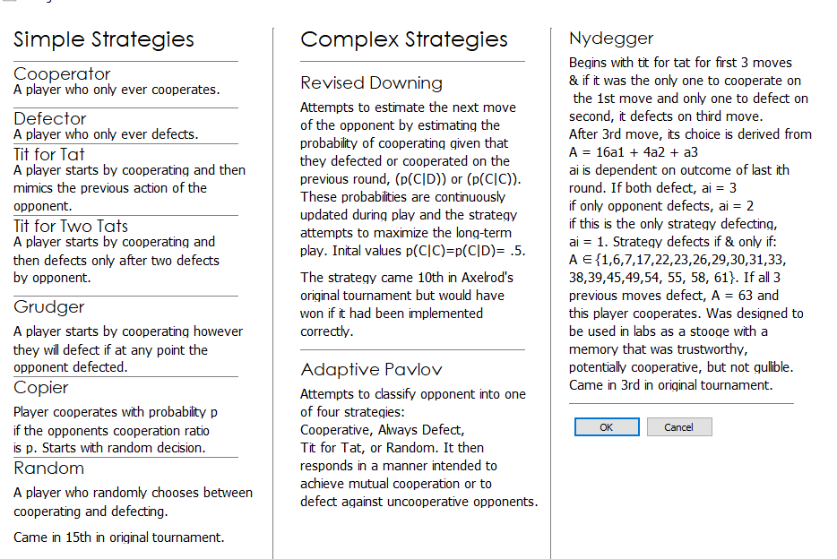
Strategy Interface

Slide 14
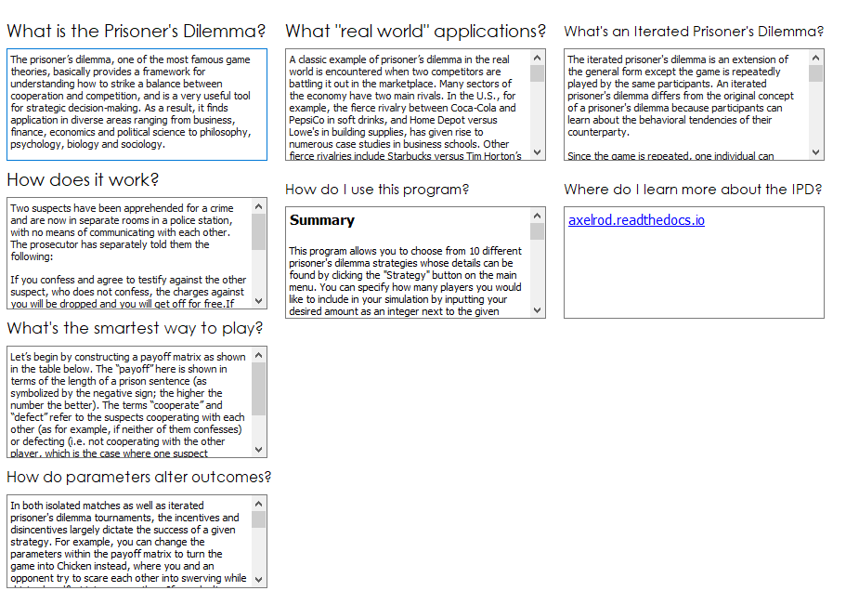
FAQ Interface

Slide 15
Simple i/o scenario
We will analyze the performance of the game with a very simple scenario, Cooperator vs Defector, with the following variables instantiated:
Sim Length: 100
Games/Gen: 10
Noise: 0.0
Temptation: 5
Reward: 3
Punishment: 1
Sucker: 0
Players: 1 Cooperator, 1 Defector

Slide 16
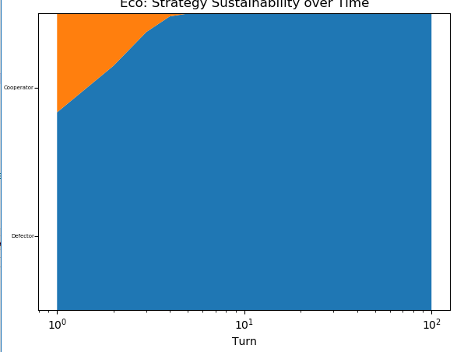
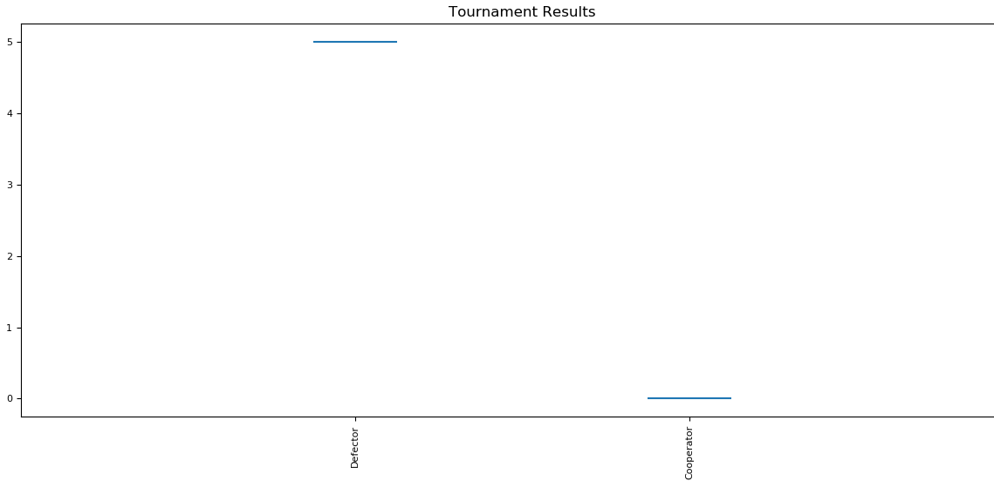
Simple i/o scenario: Results
- The result will always be that C,D option in the previous matrix, with Defector getting the Temptation payoff and Cooperator getting the Sucker payoff
- This is not sustainable over time
Notes:
By looking at the population map after 100 generations and the average median scores, one can easily that see that cooperating with a malicious party like Defector is not sustainable and your strategy will be weeded out of future generations

Slide 17
complex i/o scenario
We will analyze the performance of the game with a more complex scenario, Revised Downing vs Tit for Tat vs Defector vs Cooperator, with the same parameters instantiated:
Sim Length: 100
Games/Gen: 10
Noise: 0.0
Temptation: 5
Reward: 3
Punishment: 1
Sucker: 0
Players: 1 Cooperator, 1 Defector, 1 Tit for Tat, 1 Revised Downing

Slide 18
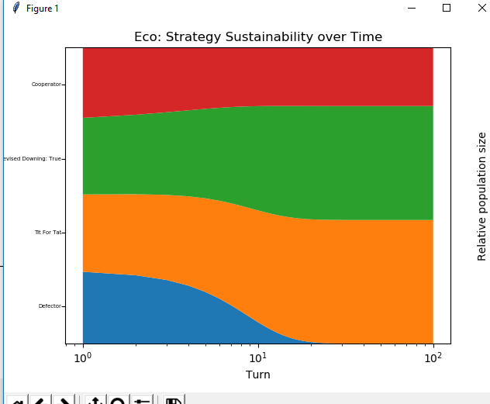
Complex i/o scenario: Results
Here, the defector gets weeded out after about 10 turns, with the more cooperative strategies thriving instead
Notes:
By looking at the population map after 100 generations and the average median scores, one can easily that see that cooperating with a malicious party like Defector is not sustainable and your strategy will be weeded out of future generations

Slide 19
More results
This game was intentionally basic, but by playing with the parameters you can get an infinite number of results
Some strategies also rely on randomness, which can also alter outcomes
This randomness also means that opponent behaviors can drastically differ
Stop by and demo the simulator with your own inputs!
Notes:
While this game was very basic, if you add more strategies, players, change the payoffs, number of generations the sim runs for, number of turns per generations, the noise, and/or some combination of all of these factors, you will get wildly different results

Slide 20
Future plans
Better data analysis
More customizability in terms of types of players
User can play and see if it can outsmart the computed strategies
Cleaner classifications with population maps and graphs

Slide 21

Thank you!

