Slide 1
Exploratory Data Analysis of Hotel Bookings Dataset
CAPSTONE PROJECT
Presented By:
Jessie Merlin B – 3RD Year, Department of Biotechnology
(St. Peter’s College of Engineering and Technology)

Slide 2
OUTLINE
Problem Statement
Proposed System/Solution
System Development Approach
Algorithm & Deployment
Result
Conclusion
Future Scope
References

Slide 3
Problem Statement
Have you ever wondered when the best time of year to book a hotel room is? Or the optimal length of stay in order to get the best daily rate? What if you wanted to predict whether or not a hotel was likely to receive a disproportionately high number of special requests? This hotel booking dataset can help you explore those questions! This data set contains booking information for a city hotel and a resort hotel, and includes information such as when the booking was made, length of stay, the number of adults, children, and/or babies, and the number of available parking spaces, among other things. All personally identifying information has been removed from the data. Explore and analyze the data to discover important factors that govern the bookings.

Slide 4
Proposed Solution
The proposed solution for this project involves conducting exploratory data analysis (EDA) on a hotel bookings dataset. EDA is a crucial step in data analysis that aims to understand the structure, patterns, and relationships within the dataset. By performing EDA, we can gain insights into factors that influence hotel bookings, identify trends or patterns in booking behaviour, and uncover potential strategies for optimizing bookings or improving customer experience.
The key steps in the proposed solution include:
1. Data Exploration: Load the dataset, check its structure, and understand the variables it contains.
2. Descriptive Statistics: Calculate summary statistics for numerical variables and explore the distribution of data.
3. Data Visualization: Create visualizations such as histograms, bar charts, and scatter plots to explore relationships between variables and identify patterns.

Slide 5
Proposed Solution
4. Feature Engineering: Create new features if necessary, such as total guests, booking lead time, etc., to enhance analysis.
5. Statistical Analysis: Perform statistical tests or regression analysis to identify significant factors affecting bookings.
6. Predictive Modelling: Build predictive models to forecast bookings or predict the likelihood of special requests.
7. Recommendations: Based on the analysis, provide recommendations for optimizing bookings, pricing strategies, marketing campaigns, or improving customer experience.
Overall, the proposed solution aims to leverage data-driven insights from EDA to inform decision-making and strategies related to hotel bookings.

Slide 6
System Approach
1. Identify the System Boundaries: Define the scope of the system. In this case, it includes the hotel booking process, from reservation to check-out.
2. Identify Components: Identify the main components of the system, such as customers, hotel staff, booking platform, hotel facilities, etc.
3. Understand Interactions: Explore how different components interact with each other. For example, how customer preferences influence booking decisions, how hotel amenities affect customer satisfaction, etc.
4. Feedback Mechanisms: Identify feedback loops within the system. For instance, customer reviews may impact future bookings, or hotel management decisions may influence customer experience.

Slide 7
System Approach
5. System Dynamics: Consider the dynamic nature of the system. Changes in one component (e.g., pricing strategy) may have ripple effects on other components (e.g., booking rates).
6. Data Collection and Analysis: Analyze system data to understand behavior and relationships.
7. Optimization and Improvement: Use insights gained from analysis to optimize system performance and make improvements. This may involve adjusting pricing strategies, enhancing customer service, optimizing resource allocation, etc.
8. Iterative Process: Recognize that system analysis is an iterative process. As new data becomes available or as the system evolves, continue to analyze and refine strategies to improve outcomes.
9. Sustainability and Resilience: Consider the long-term sustainability and resilience of the system. Identify potential risks and vulnerabilities, and develop strategies to mitigate them.

Slide 8
Algorithm & Deployment
1. Algorithm Development: Define objectives, preprocess data, choose and train an algorithm, fine-tune it.
2. Deployment: Choose deployment environment, containerize the algorithm, deploy to chosen platform, monitor and maintain.
3. API Development: Develop endpoints for model inference if needed.
4. Integration: Integrate with other systems or applications.
5. Testing and Validation: Conduct thorough testing and validate against requirements.
6. Documentation: Document architecture, deployment process, and usage instructions.
7. Security and Compliance: Implement security measures and ensure compliance.
8. Feedback Loop: Establish a feedback loop for continuous improvement.

Slide 9
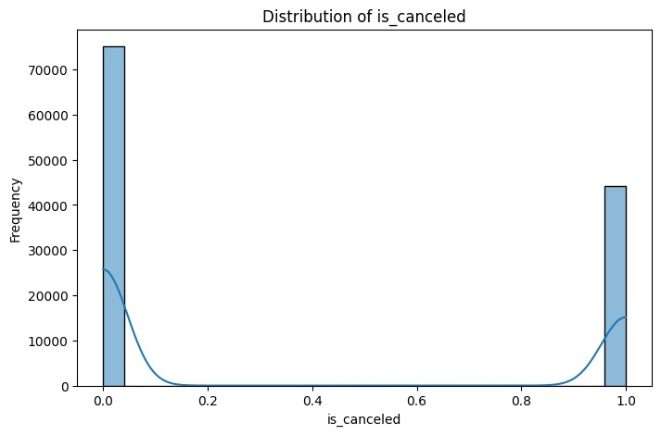
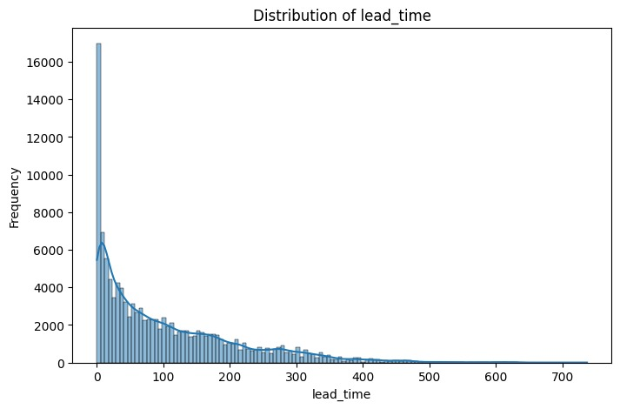
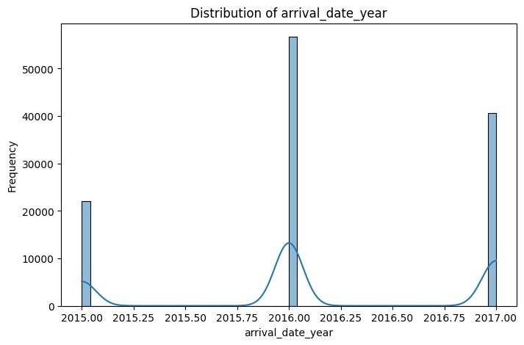
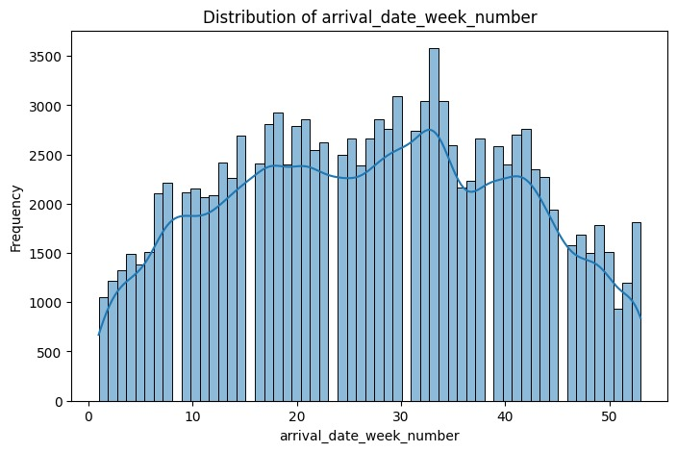
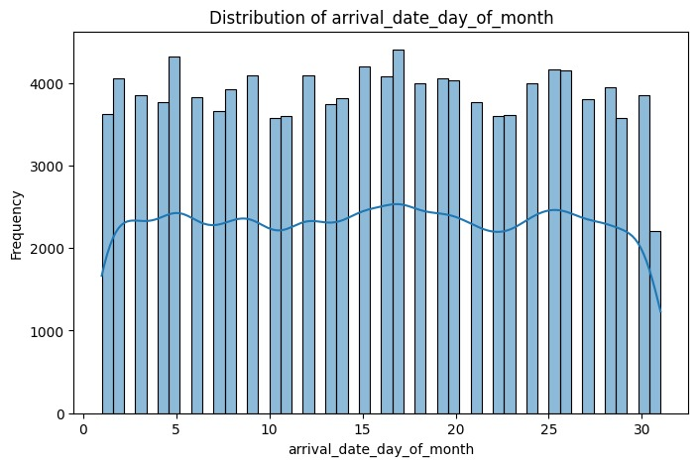
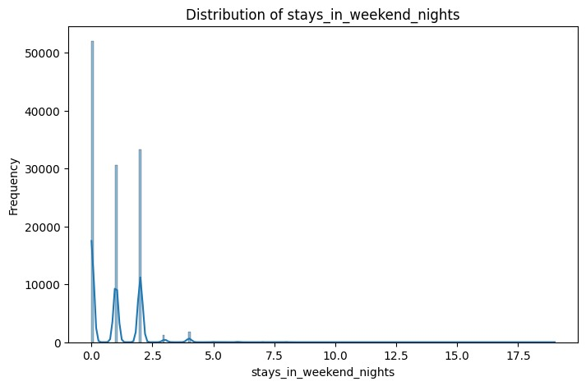
Result

Slide 10
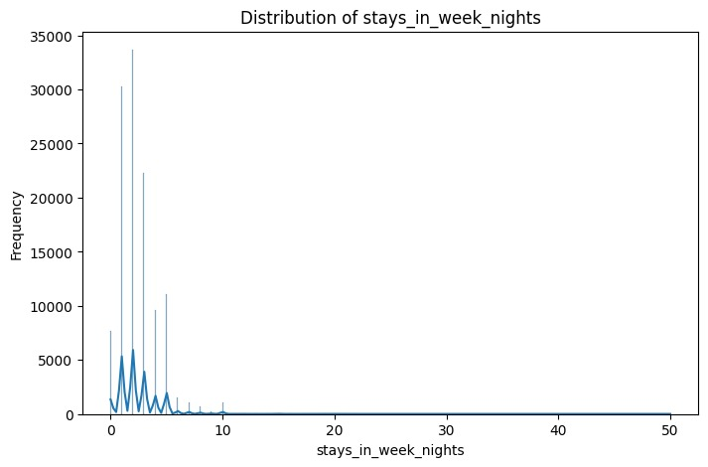
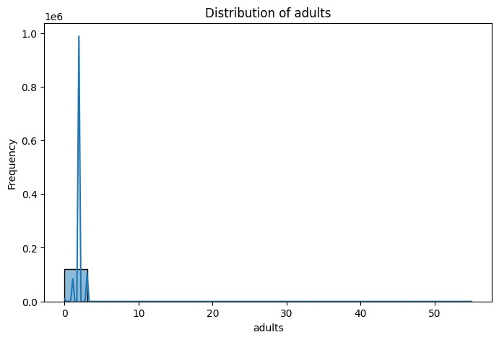
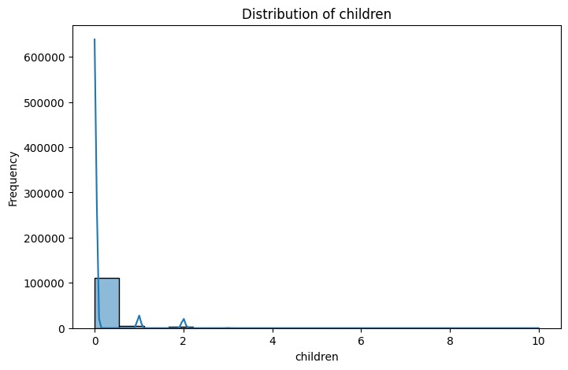
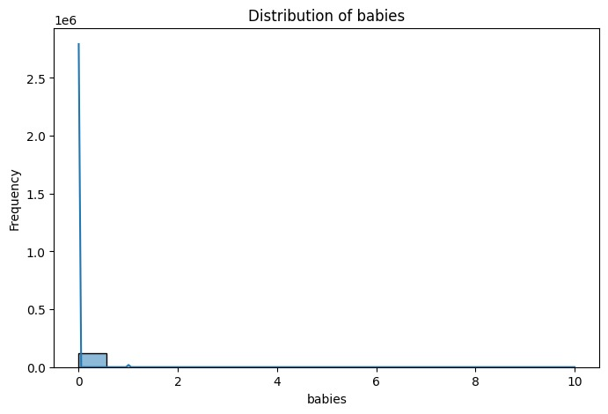
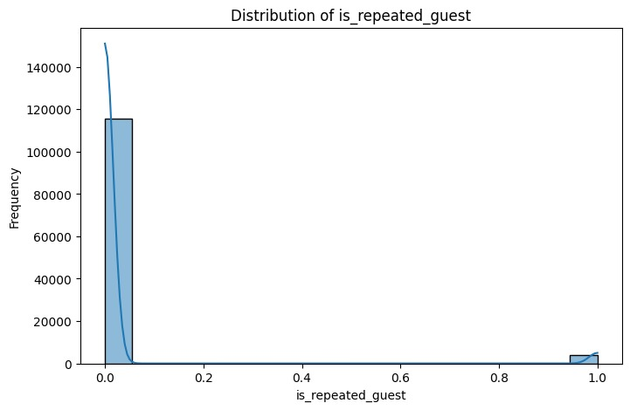
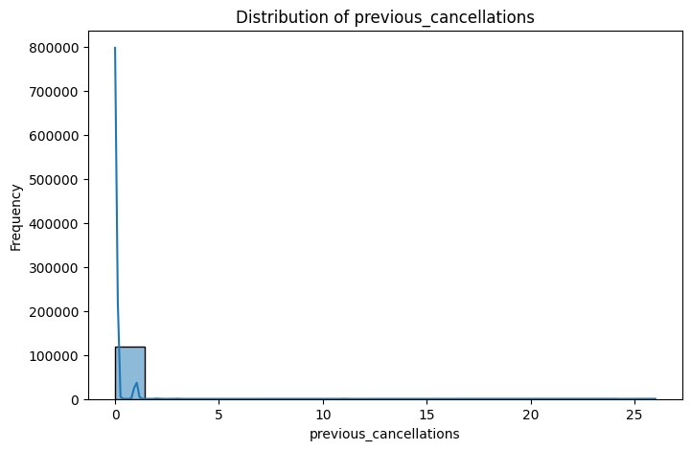
Result

Slide 11
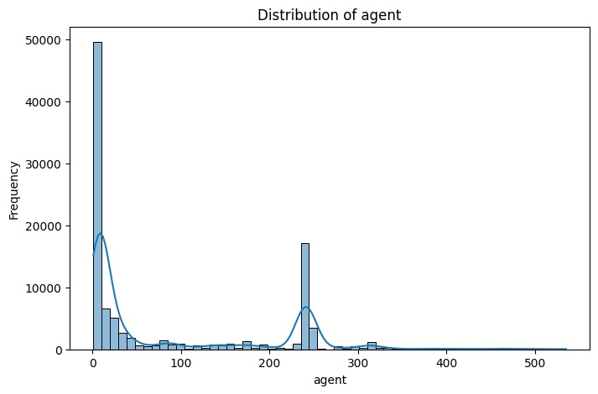
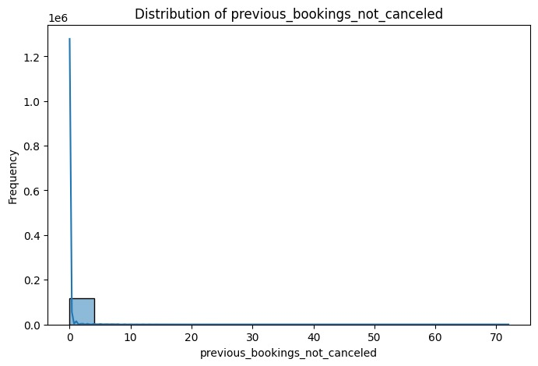
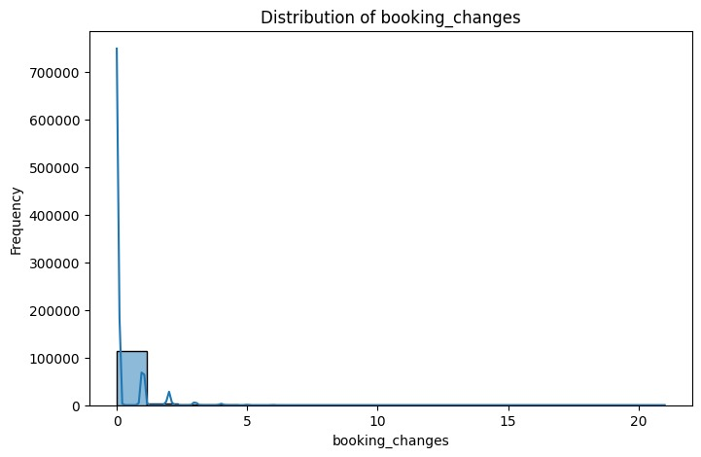
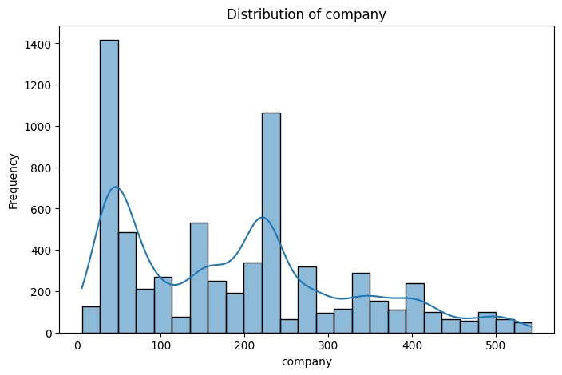
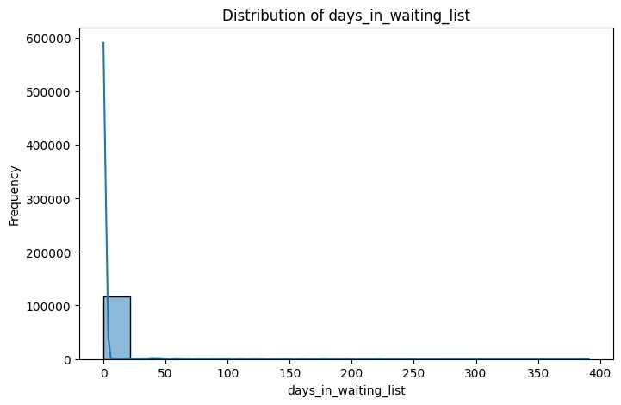
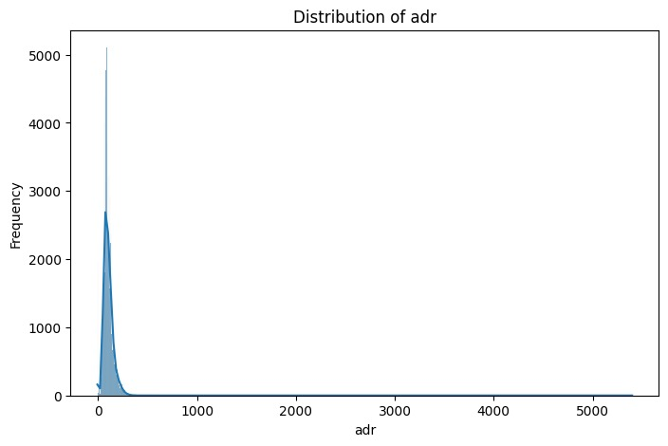
Result

Slide 12
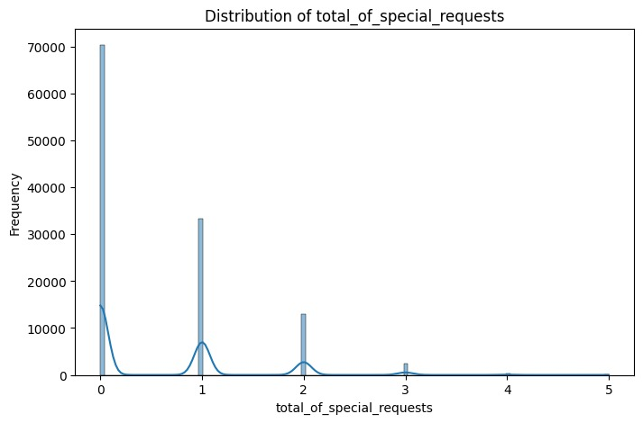
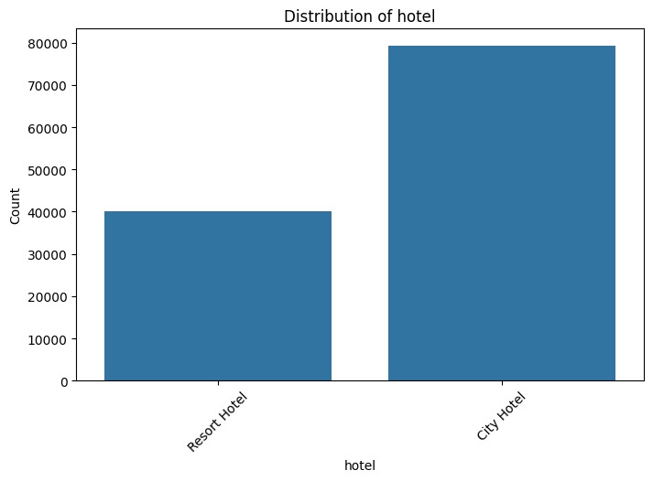
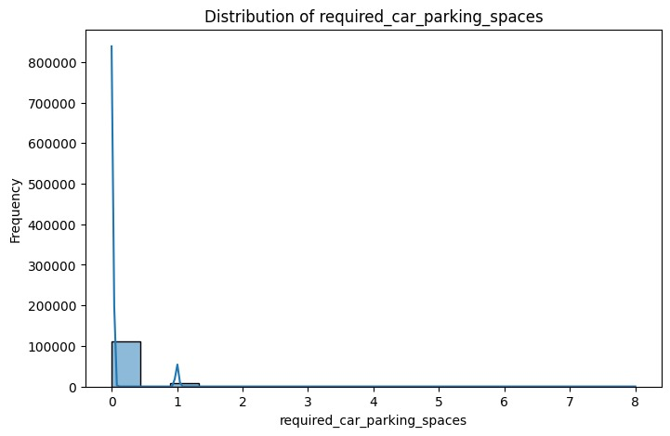
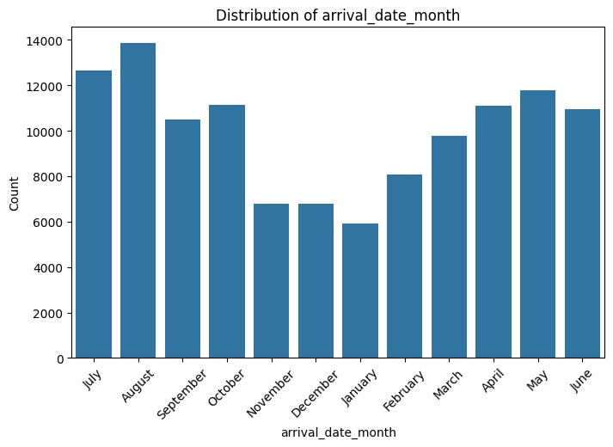
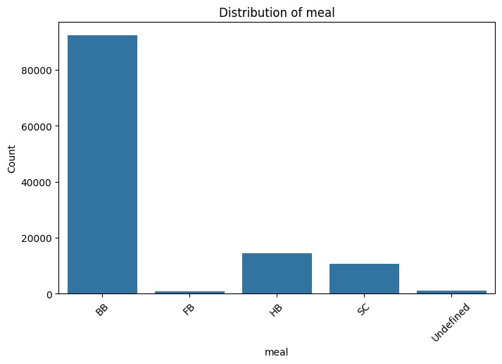
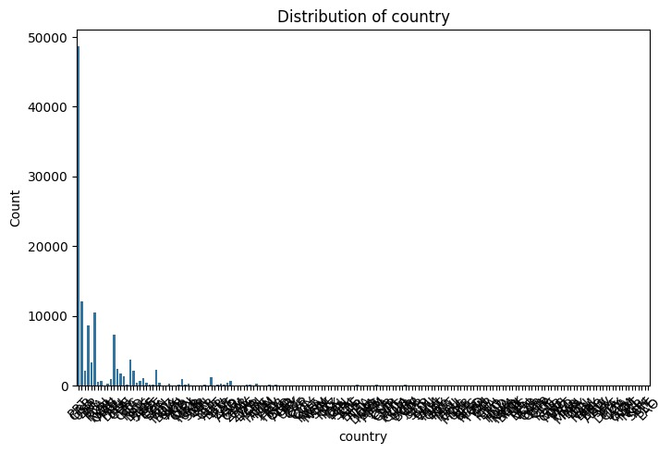
Result

Slide 13
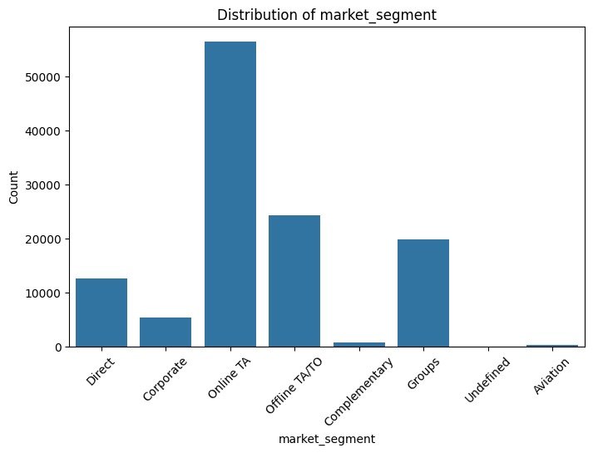
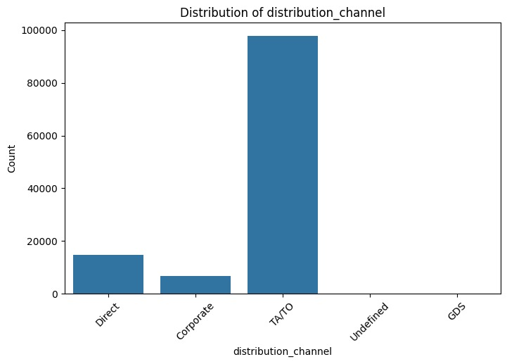
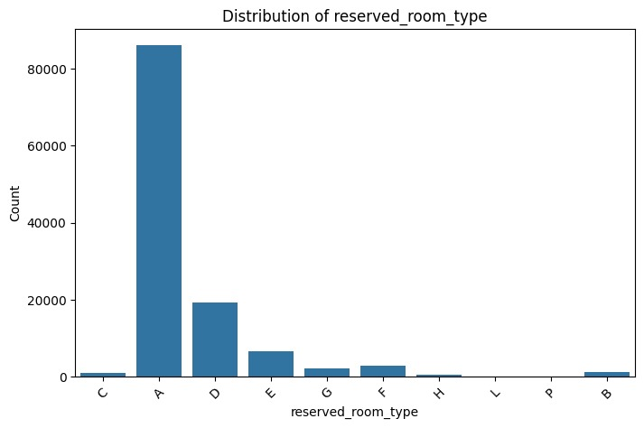
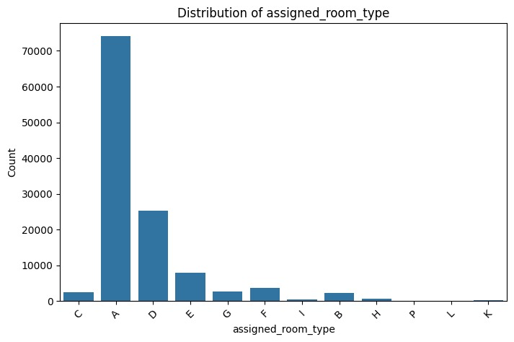
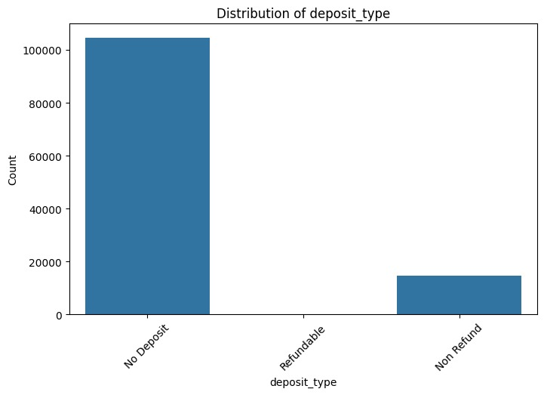
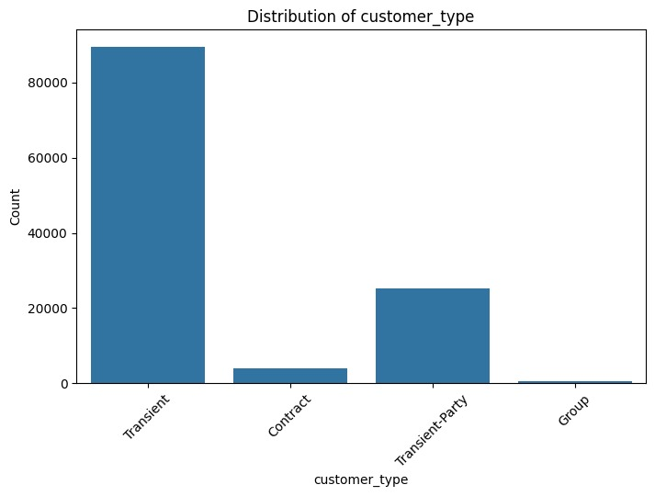
Result

Slide 14
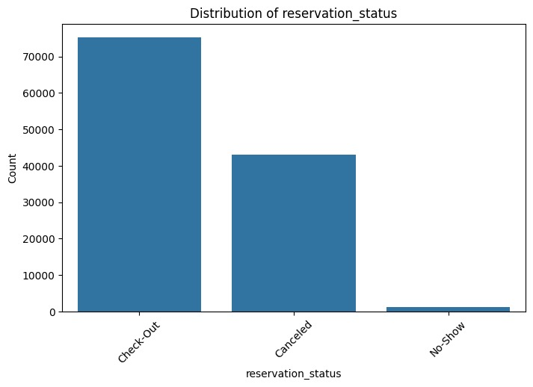
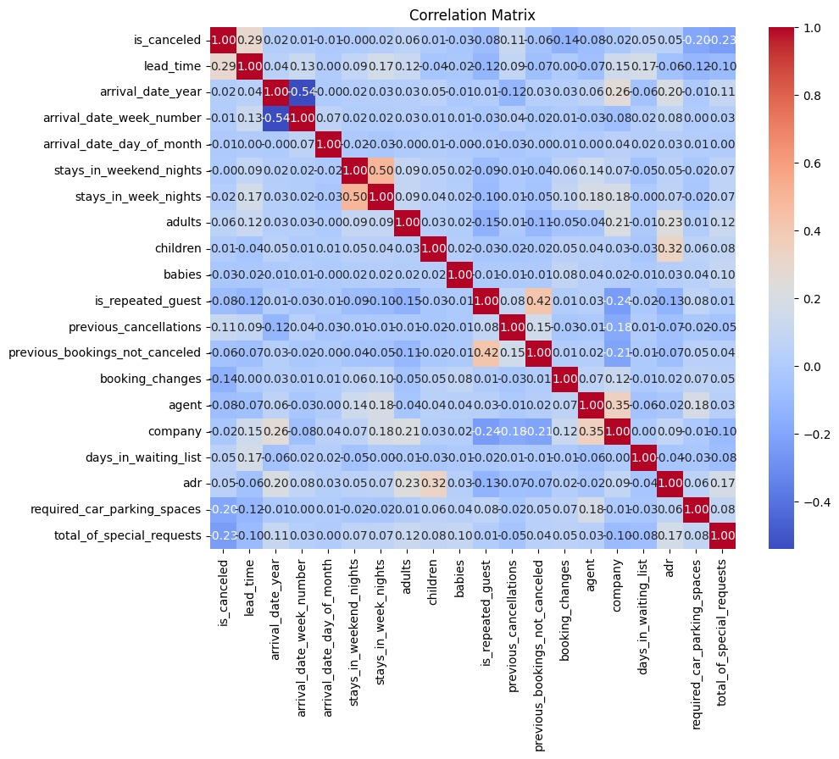
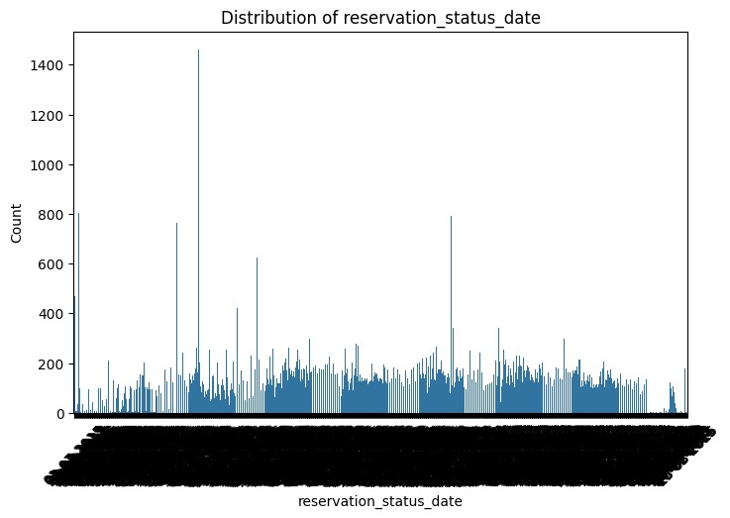
Result

Slide 15
Conclusion
In conclusion, this project focused on analyzing a hotel bookings dataset to gain insights into factors influencing bookings and optimize booking strategies. Through exploratory data analysis (EDA), we identified patterns, relationships, and trends within the dataset, providing valuable insights for decision-making in the hospitality industry.
Key findings from the analysis include:
Understanding the distribution of booking patterns, including peak booking times, length of stay, and types of guests.
Identifying significant factors influencing bookings, such as pricing, availability of amenities, and seasonality.
Developing predictive models to forecast booking rates or predict special requests, allowing for proactive management and resource allocation.
Recommending strategies for optimizing bookings, pricing, marketing campaigns, and enhancing customer experience based on data-driven insights.
By leveraging data-driven approaches and deploying machine learning algorithms, this project enables hoteliers to make informed decisions, improve operational efficiency, and enhance customer satisfaction. Additionally, the deployment of algorithms facilitates real-time monitoring and adaptive decision-making, ensuring continuous improvement and adaptation to changing market dynamics.

Slide 16
Future scope
The future scope of this project is promising, with several avenues for further exploration and enhancement:
1. Personalized Recommendations: Implement personalized recommendation systems based on guest preferences, past booking behaviour, and demographic information to enhance the guest experience and increase customer satisfaction.
2. Dynamic Pricing Strategies: Develop advanced pricing optimization models that incorporate dynamic pricing strategies, competitor analysis, and demand forecasting to maximize revenue and occupancy rates.
3. Customer Segmentation: Utilize machine learning algorithms for customer segmentation to tailor marketing campaigns, loyalty programs, and services to specific guest segments, thereby improving customer targeting and engagement.
4. Predictive Maintenance: Extend predictive modelling capabilities to anticipate maintenance needs for hotel facilities and equipment, enabling proactive maintenance scheduling and minimizing downtime.
5. Integration with IoT: Integrate data from Internet of Things (IoT) devices embedded in hotel rooms and facilities to gather real-time insights on guest preferences, room occupancy, energy usage, and environmental conditions.

Slide 17
Future scope
6. Sentiment Analysis: Incorporate sentiment analysis techniques to analyze customer reviews and feedback, gaining valuable insights into guest satisfaction levels and identifying areas for improvement.
7. Expansion to Other Hospitality Segments: Extend the analysis and modelling framework to other segments of the hospitality industry, such as vacation rentals, resorts, and event venues, to address specific challenges and opportunities unique to each segment.
8. Ethical Considerations: Address ethical considerations related to data privacy, security, and bias mitigation to ensure responsible and ethical use of guest data and machine learning models.
By exploring these avenues for future development, this project can continue to evolve and innovate, driving tangible benefits for hoteliers and enhancing the overall guest experience in the hospitality industry.

Slide 18
References
https://www.kaggle.com/
https://opendata.aws/
https://datasetsearch.research.google.com/
https://data.world/
https://app.datacamp.com/

Slide 19
THANK YOU

