Slide 1
Machine Learning in Breast Cancer Classification
Jana Hoffmann
Jessie Midgley
Julia Graf
Maike Nägele
Tutor: Anupam Gautam

Slide 2
Overview
01
02
03
04
Dataset
Models
CBIS-DDSM
ResNet-50
VGG-16
Model Training
Results & Outlook
Image preprocessing
Image augmentation
Validation

Slide 3
Dataset: CBIS-DDSM
753 calcification cases
891 mass cases
414 benign
339 malignant
472 benign
419 malignant
ADD IMAGES

Slide 4
Models: ResNet-50
benign
Softmax
ID Block x 2
ID Block x 3
ID Block x 5
ID Block x 2
Flattem
AveragePooling
BatchNorm
Fully Connected
Conv2D
MaxPooling2D
ConvBlock
InputLayer
ReLu
ConvBlock
ConvBlock
ConvBlock
malignant
Stage 1
Stage 2
Stage 3
Stage 4
Stage 5

Slide 5
Models: VGG-16
benign
Sigmoid
Conv2D
Conv2D
Conv2D
Conv2D
Flattem
MaxPooling2D
MaxPooling2D
Conv2D
Conv2D
Conv2D
Conv2D
InputLayer
MaxPooling2D
MaxPooling2D
Conv2D
Conv2D
Conv2D
MaxPooling2D
Conv2D
Conv2D
malignant
Block 1
Block 2
Block 3
Block 4
Block 5

Slide 6
Image Preprocessing
Woman looking in the mirror having neck pain
Close-up woman experiencing pain
Man with a tooth pain
Close-up woman taking pills at office
Woman with headache on couch
Woman with runny nose staying under blankets

Slide 7
Image Augmentation
Woman looking in the mirror having neck pain
Close-up woman experiencing pain
Man with a tooth pain
Close-up woman taking pills at office
Woman with headache on couch
Woman with runny nose staying under blankets

Slide 8
Validation
Woman looking in the mirror having neck pain
Close-up woman experiencing pain
Man with a tooth pain
Close-up woman taking pills at office
Woman with headache on couch
Woman with runny nose staying under blankets

Slide 9
Results: ResNet-50

Slide 10
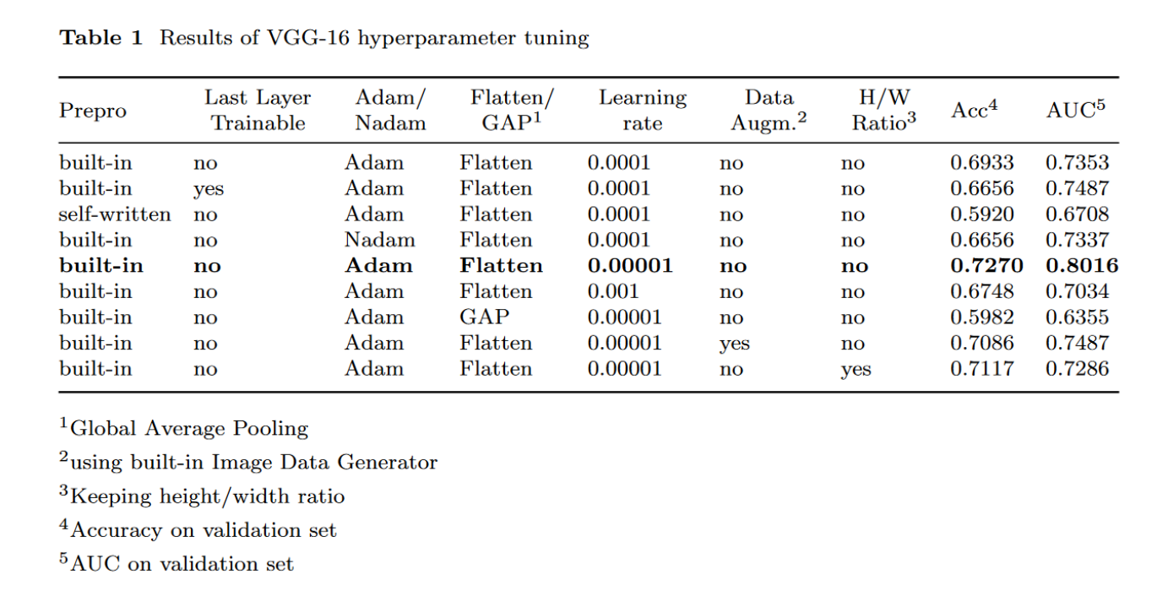
Results: VGG-16

Slide 11
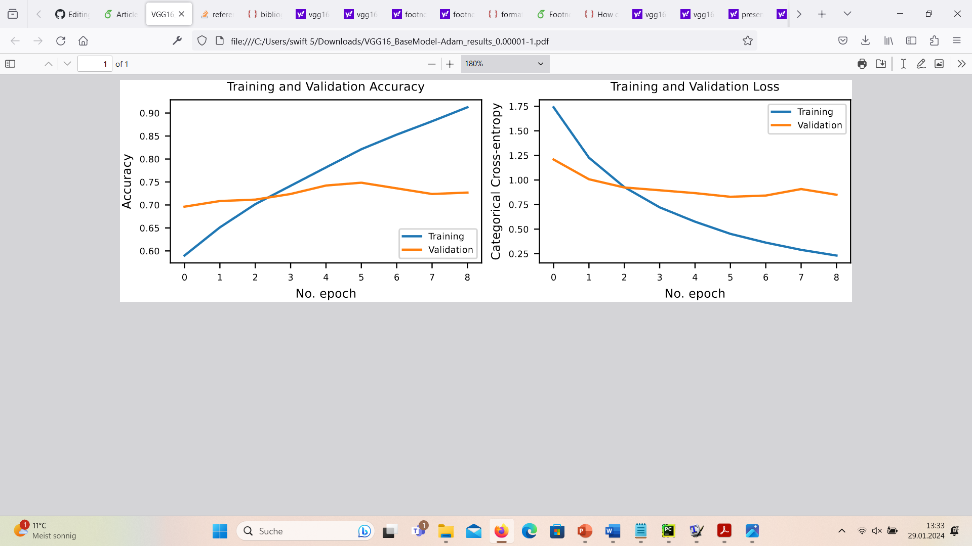
Results: VGG-16
 | Accuracy | AUC
Training | 0.913 | 0.967
Validation | 0.727 | 0.802

Slide 12
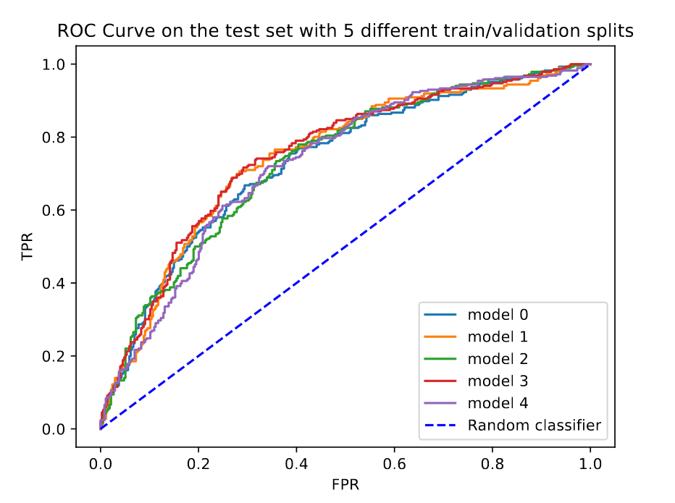
Results
 | Accuracy | AUC
Training | 0.913 | 0.967
Validation | 0.727 | 0.802
Test | 0.686 | 0.737

Slide 13
Limitations & Outlook

Slide 14
Limitations & Outlook
Thanks
Sources

