Slide 1
Group Project: Machine Learning and Cancer Breast Cancer Image Classification
Group Q: Jana Hoffmann, Jessie Midgley, Julia Graf, Maike Nägele
Anupam Gautam
31.01.2024

Slide 2
Overview
Dataset (Jessie) + Intro
Models: VGG16 (Maike) & ResNet50 (Jessie)
Image Preprocessing (Julia) & Image Augmentation (Jana)
Validation (Jana)
Results (Maike & Julia)
Outlook (Maike)

Slide 3
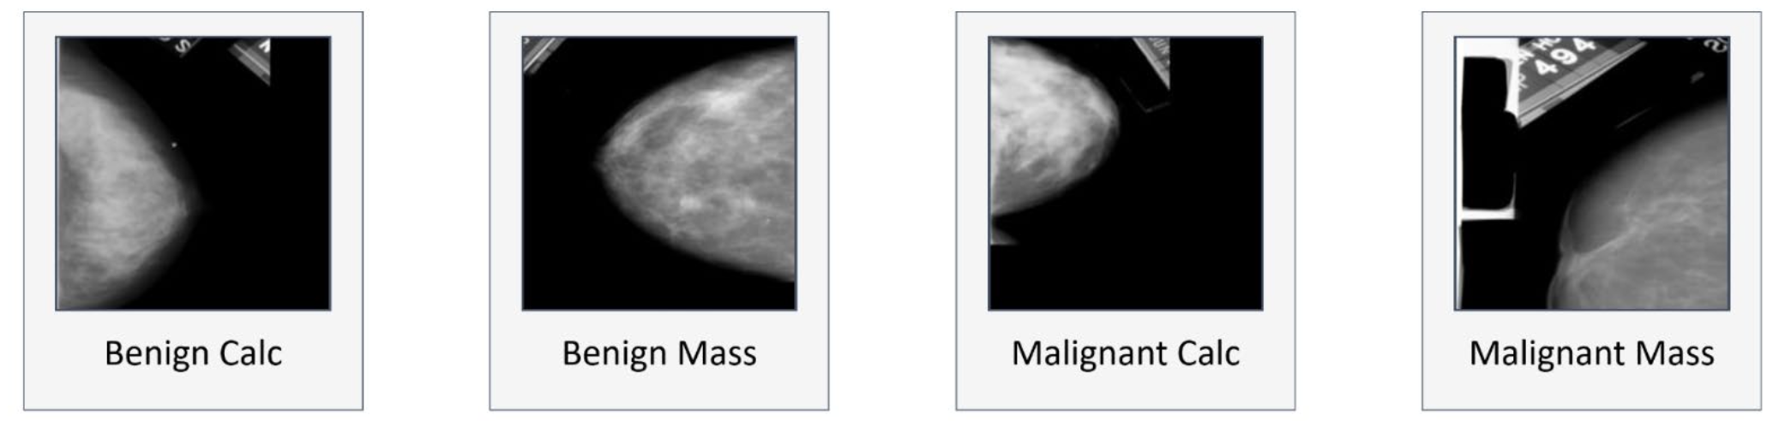
Dataset
CBIS-DDSM
753 calcification cases
414 benign
339 malignant
891 mass cases
472 benign
419 malignant
(Montaha et al., 2021)

Slide 4
Models ResNet50
benign
Softmax
BatchNorm
ID Block x 2
ID Block x 5
ID Block x 2
Flattem
MaxPooling2D
ID Block x 3
AveragePooling
InputLayer
Conv2D
ReLu
ConvBlock
ConvBlock
ConvBlock
ConvBlock
Fully Connected
malignant
Stage 1
Stage 2
Stage 3
Stage 4
Stage 5

Slide 5
Models VGG16
benign
Sigmoid
InputLayer
Conv2D
Conv2D
Conv2D
Conv2D
Conv2D
Conv2D
Conv2D
Conv2D
Flatten
MaxPooling2D
MaxPooling2D
MaxPooling2D
Conv2D
Conv2D
Conv2D
MaxPooling2D
Conv2D
Conv2D
MaxPooling2D
malignant
Block 1
Block 2
Block 3
Block 4
Block 5

Slide 6
Image Preprocessing

Slide 7
Image Augmentation

Slide 8
Validation

Slide 9
Results ResNet50

Slide 10
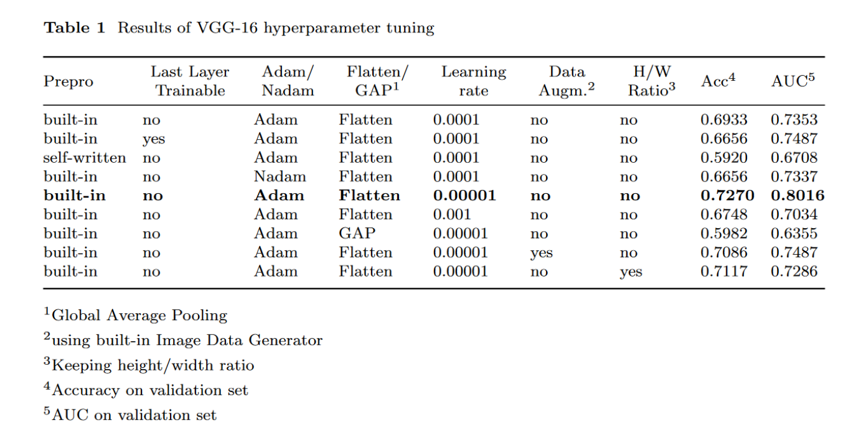
Results VGG16

Slide 11
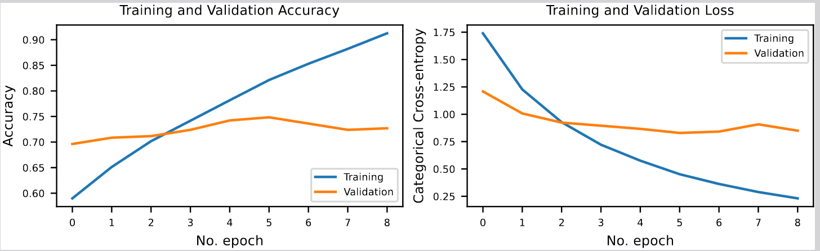
Results VGG16
 | Accuracy | AUC
Training | 0.913 | 0.967
Validation | 0.727 | 0.802

Slide 12
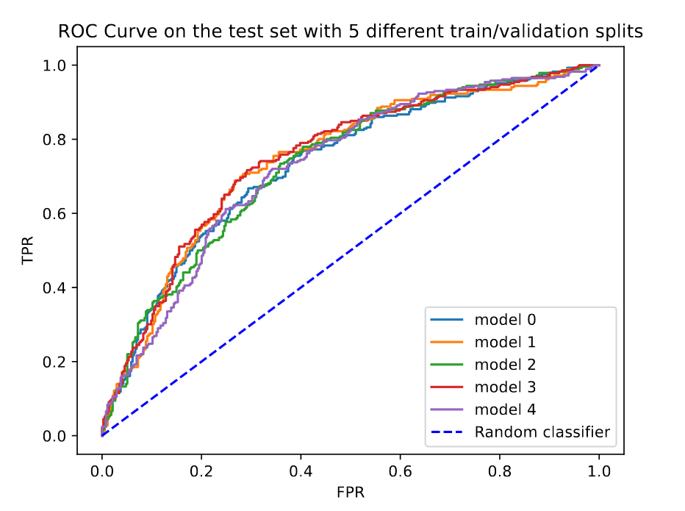
Results VGG16
 | Accuracy | AUC
Training | 0.913 | 0.967
Validation | 0.727 | 0.802
Test | 0.686 | 0.737

Slide 13
Limitations / Outlook
limited amount of data
time and memory constraints
multi-classification (mass and calcification subtypes)
using different models
other classification techniques

Slide 14
Sources

