Slide 1

Clustering
CS246: Mining Massive Datasets
Jure Leskovec, Stanford University
http://cs246.stanford.edu

Slide 2
High Dimensional Data
High dim. data
Locality sensitive hashing
Clustering
Graph data
PageRank, SimRank
Community Detection
Infinite data
Filtering data streams
Web advertising
Dimensionality reduction
Spam Detection
Queries on streams
Machine learning
SVM
Decision Trees
Perceptron, kNN
Apps
Recommender systems
Association Rules
Duplicate document detection

Slide 3
The Problem of Clustering
Given a set of points, with a notion of distance between points, group the points into some number of clusters, so that
Members of a cluster are close/similar to each other
Members of different clusters are dissimilar
Usually:
Points are in a high-dimensional space
Similarity is defined using a distance measure
Euclidean, Cosine, Jaccard, edit distance, …

Slide 4
Example: Clusters & Outliers
x
xx x
x x
x x x
x
x x x
x
x
xx x
x x
x x x
x
x x x
x
x
x x
x x x x
x x x x
x x x
x x
x x
x x x x
x x x x
x x x
x x
x x
x x x x
x x x
x
x x
x x x x
x x x
x
x
Outlier
Cluster

Slide 5
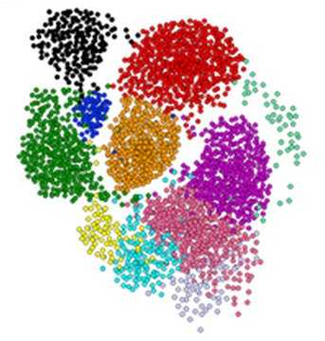
Clustering is a hard problem!

Slide 6
Why is it hard?
Clustering in two dimensions looks easy
Clustering small amounts of data looks easy
And in most cases, looks are not deceiving
Many applications involve not 2, but 10 or 10,000 dimensions
High-dimensional spaces look different: Almost all pairs of points are at about the same distance --> The Curse of Dimensionality

Slide 7
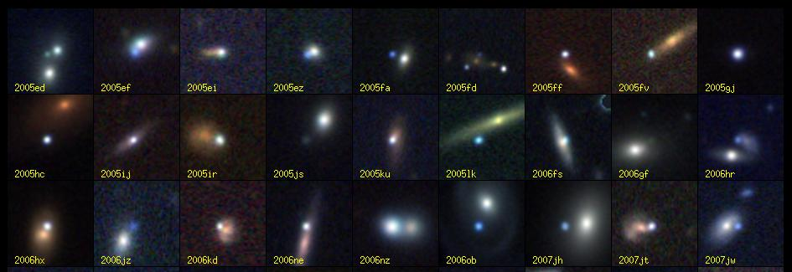
Clustering Problem: Galaxies
A catalog of 2 billion “sky objects” represents objects by their radiation in 7 dimensions (frequency bands)
Problem: Cluster into similar objects, e.g., galaxies, nearby stars, quasars, etc.
Sloan Digital Sky Survey

Slide 8
Clustering Problem: Music CDs
Intuitively: Music divides into categories, and customers prefer a few categories
But what are categories really?
Represent a CD by a set of customers who bought it
Similar CDs have similar sets of customers, and vice-versa

Slide 9
Clustering Problem: Music CDs
Space of all CDs:
Think of a space with one dim. for each customer
Values in a dimension may be 0 or 1 only
A CD is a “point” in this space (x₁, x₂,…, x_{k}), where x_{i} = 1 iff the i ^{th} customer bought the CD
For Amazon, the dimension is tens of millions
Task: Find clusters of similar CDs

Slide 10
Clustering Problem: Documents
Finding topics:
Represent a document by a vector (x₁, x₂,…, x_{k}), where x_{i} = 1 iff the i ^{th} word (in some order) appears in the document
It actually doesn’t matter if k is infinite; i.e., we don’t limit the set of words
Documents with similar sets of words may be about the same topic

Slide 11
Cosine, Jaccard, and Euclidean
As with CDs we have a choice when we think of documents as sets of words or shingles:
Sets as vectors: Measure similarity by the cosine distance
Sets as sets: Measure similarity by the Jaccard distance
Sets as points: Measure similarity by Euclidean distance

Slide 12
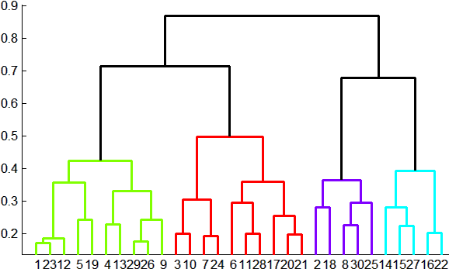
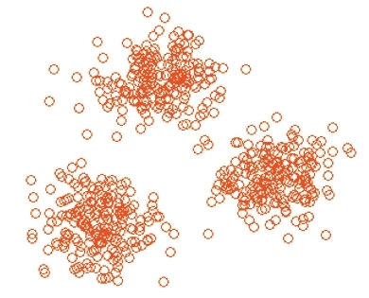
Overview: Methods of Clustering
Hierarchical:
Agglomerative (bottom up):
Initially, each point is a cluster
Repeatedly combine the two “nearest” clusters into one
Divisive (top down):
Start with one cluster and recursively split it
Point assignment:
Maintain a set of clusters
Points belong to “nearest” cluster

Slide 13
Hierarchical Clustering
Key operation: Repeatedly combine two nearest clusters
Three important questions:
1) How do you represent a cluster of more than one point?
2) How do you determine the “nearness” of clusters?
3) When to stop combining clusters?

Slide 14
Which is Better?
Point assignment good when clusters are nice, convex shapes:
Hierarchical can win when shapes are weird:
Note both clusters have essentially the same centroid.
Aside: if you realized you had concentric
clusters, you could map points based on
distance from center, and turn the problem
into a simple, one-dimensional case.

Slide 15
Hierarchical Clustering
Key operation: Repeatedly combine two nearest clusters
(1) How to represent a cluster of many points?
Key problem: As you merge clusters, how do you represent the “location” of each cluster, to tell which pair of clusters is closest?
Euclidean case: each cluster has a centroid = average of its (data)points
(2) How to determine “nearness” of clusters?
Measure cluster distances by distances of centroids

Slide 16
Example: Hierarchical clustering
(5,3)
o
(1,2)
o
o (2,1) o (4,1)
o (0,0) o (5,0)
x (1.5,1.5)
x (4.7,1.3)
x (1,1)
x (4.5,0.5)
Data:
o … data point
x … centroid
Dendrogram

Slide 17
And in the Non-Euclidean Case?
What about the Non-Euclidean case?
The only “locations” we can talk about are the points themselves
i.e., there is no “average” of two points
Approach 1:
(1.1) How to represent a cluster of many points? clustroid = (data)point “closest” to other points
(1.2) How do you determine the “nearness” of clusters? Treat clustroid as if it were centroid, when computing inter-cluster distances

Slide 18
“Closest” Point?
(1.1) How to represent a cluster of many points? clustroid = point “closest” to other points
Possible meanings of “closest”:
Smallest maximum distance to other points
Smallest average distance to other points
Smallest sum of squares of distances to other points
For distance metric d clustroid c of cluster C is:
Datapoint
Centroid
X
Centroid is the avg. of all (data)points in the cluster. This means centroid is an “artificial” point.
Clustroid is an existing (data)point that is “closest” to all other points in the cluster.
Clustroid
Cluster on 3 datapoints

Slide 19
Defining “Nearness” of Clusters
(1.2) How do you determine the “nearness” of clusters? Treat clustroid as if it were centroid, when computing intercluster distances.
Approach 2: No centroid, just define distance Intercluster distance = minimum of the distances between any two points, one from each cluster

Slide 20
Cohesion
Approach 3: Pick a notion of cohesion of clusters
Merge clusters whose union is most cohesive
Approach 3.1: Use the diameter of the merged cluster = maximum distance between points in the cluster
Approach 3.2: Use the average distance between points in the cluster
Approach 3.3: Use a density-based approach
Take the diameter or avg. distance, e.g., and divide by the number of points in the cluster

Slide 21
Which is Best?
It really depends on the shape of clusters.
Which you may not know in advance.
Example: we’ll compare two approaches:
Merge clusters with smallest distance between centroids (or clustroids for non-Euclidean)
Merge clusters with the smallest distance between two points, one from each cluster

Slide 22
Case 1: Convex Clusters
Centroid-based merging works well.
But merger based on closest members might accidentally merge incorrectly.
C
A
B
A and B have closer centroids
than A and C, but closest points
are from A and C.

Slide 23
Case 2: Concentric Clusters
Linking based on closest members works well
But Centroid-based linking might cause errors

Slide 24
k-means clustering

Slide 25
k–means Algorithm(s)
Assumes Euclidean space/distance
Start by picking k, the number of clusters
Initialize clusters by picking one point per cluster
Example: Pick one point at random, then k-1 other points, each as far away as possible from the previous points
OK, as long as there are no outliers (points that are far from any reasonable cluster)

Slide 26
k-Means++
Basic idea: Pick a small sample of points, cluster them by any algorithm, and use the centroids as a seed
In k-means++, sample size = k times a factor that is logarithmic in the total number of points
How to pick sample points: Visit points in random order, but the probability of adding a point p to the sample is proportional to D(p)².
D(p) = distance between p and the nearest picked point.

Slide 27
k-Means | |
k-means++, like other seed methods, is sequential
You need to update D(p) for each unpicked p due to new point
Parallel approach: Compute nodes can each handle a small set of points
Each picks a few new sample points using same D(p).
Really important and common trick: Don’t update after every selection; rather make many selections at one round
Suboptimal picks don’t really matter

Slide 28
Populating Clusters
1) For each point, place it in the cluster whose current centroid it is nearest
2) After all points are assigned, update the locations of centroids of the k clusters
3) Reassign all points to their closest centroid
Sometimes moves points between clusters
Repeat 2 and 3 until convergence
Convergence: Points don’t move between clusters and centroids stabilize

Slide 29
Example: Assigning Clusters
x
x
x
x
x
x
x
x
x
x
x
x … data point
… centroid
Clusters after round 1

Slide 30
Example: Assigning Clusters
x
x
x
x
x
x
x
x
x
x
x
x … data point
… centroid
Clusters after round 2

Slide 31
Example: Assigning Clusters
x
x
x
x
x
x
x
x
x
x
x
x … data point
… centroid
Clusters at the end

Slide 32
Getting the k right
How to select k?
Try different k, looking at the change in the average distance to centroid as k increases
Average falls rapidly until right k, then changes little
Best value
of k
Average
distance to
centroid
k

Slide 33
Example: Picking k
x
xx x
x x
x x x
x
x x x
x
Too few;
many long
distances
to centroid
x
x x
x x x x
x x x x
x x x
x x
x x
x x x x
x x x
x
x

Slide 34
Example: Picking k
x
xx x
x x
x x x
x
x x x
x
x
Just right;
distances
rather short
x x
x x x x
x x x x
x x x
x x
x x
x x x x
x x x
x
x

Slide 35
Example: Picking k
Too many;
little improvement
in average
distance
x
xx x
x x
x x x
x
x x x
x
x
x x
x x x x
x x x x
x x x
x x
x x
x x x x
x x x
x
x

Slide 36
The BFR Algorithm
Extension of k-means to large data

Slide 37
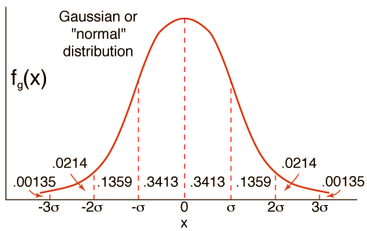
BFR Algorithm
BFR [Bradley-Fayyad-Reina] is a variant of k-means designed to handle very large (disk-resident) data sets
Assumes that clusters are normally distributed around a centroid in a Euclidean space
Standard deviations in different dimensions may vary
Clusters are axis-aligned ellipses
Goal is to find cluster centroids; point assignment can be done in a second pass through the data.

Slide 38
BFR Overview
Efficient way to summarize clusters: Want memory required O(clusters) and not O(data)
IDEA: Rather than keeping points BFR keeps summary statistics of groups of points
3 sets: Cluster summaries, Outliers, Points to be clustered
Overview of the algorithm:
1. Initialize K clusters/centroids
2. Load in a bag points from disk
3. Assign new points to one of the K original clusters, if they are within some distance threshold of the cluster
4. Cluster the remaining points, and create new clusters
5. Try to merge new clusters from step 4 with any of the existing clusters
6. Repeat steps 2-5 until all points are examined

Slide 39
BFR Algorithm
Points are read from disk one main-memory-full at a time
Most points from previous memory loads are summarized by simple statistics
Step 1) From the initial load we select the initial k centroids by some sensible approach:
Take k random points
Take a small random sample and cluster optimally
Take a sample; pick a random point, and then k–1 more points, each as far from the previously selected points as possible

Slide 40
Three Classes of Points
3 sets of points which we keep track of:
Discard set (DS):
Points close enough to a centroid to be summarized
Compression set (CS):
Groups of points that are close together but not close to any existing centroid
These points are summarized, but not assigned to a cluster
Retained set (RS):
Isolated points waiting to be assigned to a compression set

Slide 41
BFR: “Galaxies” Picture
Points in
the RS
Compressed sets.
Their points are in
the CS.
A cluster. Its points
are in the DS.
The centroid
Discard set (DS): Close enough to a centroid to be summarized
Compression set (CS): Summarized, but not assigned to a cluster
Retained set (RS): Isolated points

Slide 42
Summarizing Sets of Points
For each cluster, the discard set (DS) is summarized by:
The number of points, N
The vector SUM, whose i^{th} component is the sum of the coordinates of the points in the i^{th} dimension
The vector SUMSQ: i^{th} component = sum of squares of coordinates in i^{th} dimension
A cluster. All its points are in the DS.
The centroid

Slide 43
Summarizing Points: Comments
2d + 1 values represent any size cluster
d = number of dimensions
Average in each dimension (the centroid) can be calculated as SUM_{i} / N
SUM_{i} = i^{th} component of SUM
Variance of a cluster’s discard set in dimension i is: (SUMSQ_{i} / N) – (SUM_{i} / N)²
And standard deviation is the square root of that
Next step: Actual clustering
Note: Dropping the “axis-aligned” clusters assumption would require storing full covariance matrix to summarize the cluster. So, instead of SUMSQ being a d-dim vector, it would be a d x d matrix, which is too big!

Slide 44
The “Memory-Load” of Points
Steps 2-5) Processing “Memory-Load” of points:
Step 3) Find those points that are “sufficiently close” to a cluster centroid and add those points to that cluster and the DS
These points are so close to the centroid that they can be summarized and then discarded
Step 4) Use any in-memory clustering algorithm to cluster the remaining points and the old RS
Clusters go to the CS; outlying points to the RS
Discard set (DS): Close enough to a centroid to be summarized.
Compression set (CS): Summarized, but not assigned to a cluster
Retained set (RS): Isolated points

Slide 45
The “Memory-Load” of Points
Steps 2-5) Processing “Memory-Load” of points:
Step 5) DS set: Adjust statistics of the clusters to account for the new points
Add Ns, SUMs, SUMSQs
Consider merging compressed sets in the CS
If this is the last round, merge all compressed sets in the CS and all RS points into their nearest cluster
Discard set (DS): Close enough to a centroid to be summarized.
Compression set (CS): Summarized, but not assigned to a cluster
Retained set (RS): Isolated points

Slide 46
BFR: “Galaxies” Picture
Points in
the RS
Compressed sets.
Their points are in
the CS.
A cluster. Its points
are in the DS.
The centroid
Discard set (DS): Close enough to a centroid to be summarized
Compression set (CS): Summarized, but not assigned to a cluster
Retained set (RS): Isolated points

Slide 47
A Few Details…
Q1) How do we decide if a point is “close enough” to a cluster that we will add the point to that cluster?
Q2) How do we decide whether two compressed sets (CS) deserve to be combined into one?

Slide 48
How Close is Close Enough?
Q1) We need a way to decide whether to put a new point into a cluster (and discard)
BFR suggests two ways:
The Mahalanobis distance is less than a threshold
High likelihood of the point belonging to currently nearest centroid

Slide 49
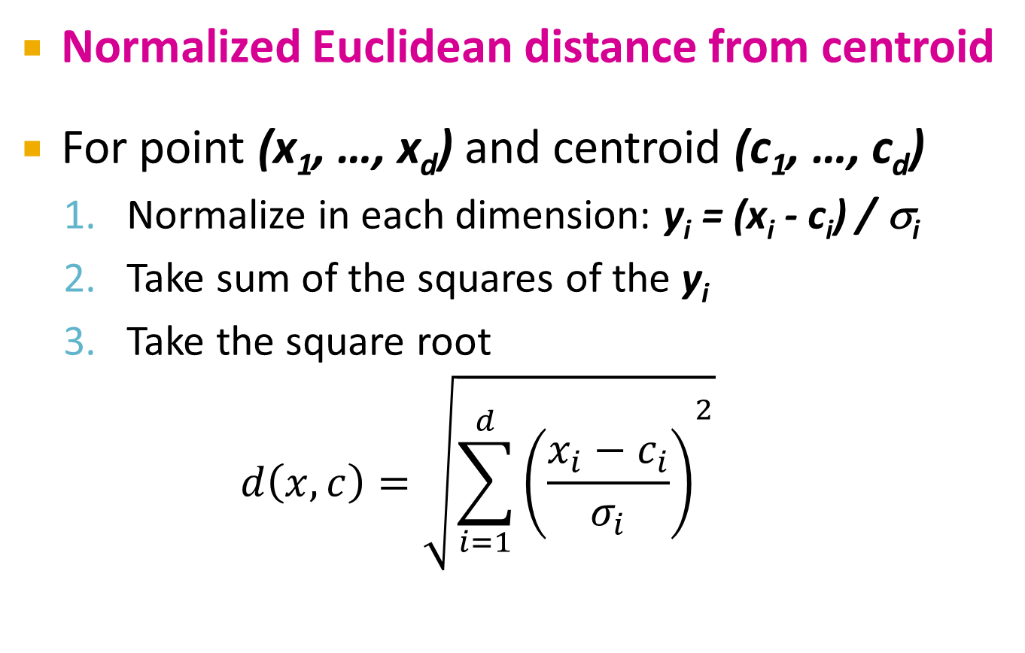
Mahalanobis Distance
Normalized Euclidean distance from centroid
For point (x₁, …, x_{d}) and centroid (c₁, …, c_{d})
Normalize in each dimension: y_{i} = (x_{i} - c_{i}) / σ_{i}
Take sum of the squares of the y_{i}
Take the square root
$$d\left(x,c\right)=\sqrt{{\sum_{i=1}^{d}{\left(\frac{x_{i}−c_{i}}{σ_{i}}\right)}}^{2}}$$
σ_{i} … standard deviation of points in the cluster in the i^{th} dimension

Slide 50
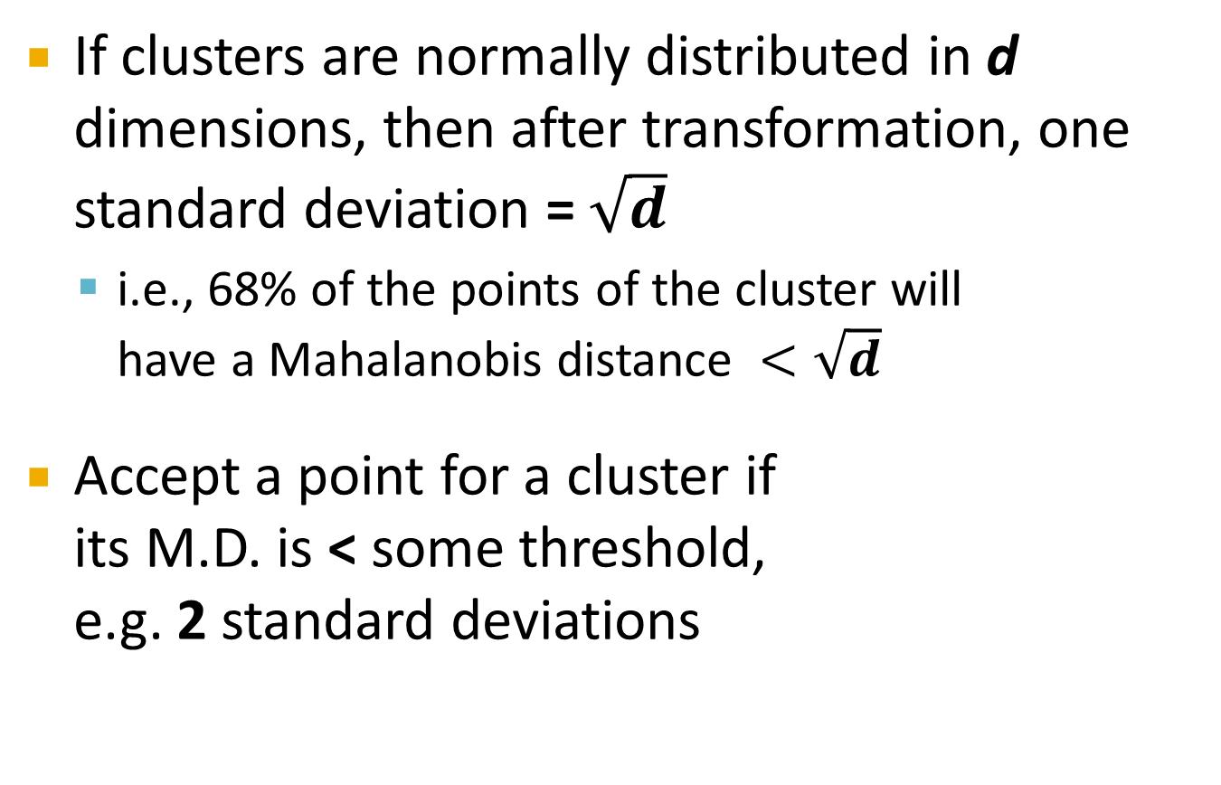
Mahalanobis Distance
If clusters are normally distributed in d dimensions, then after transformation, one standard deviation = $\sqrt{d}$
i.e., 68% of the points of the cluster will have a Mahalanobis distance $<\sqrt{d}$
Accept a point for a cluster if its M.D. is < some threshold, e.g. 2 standard deviations

Slide 51
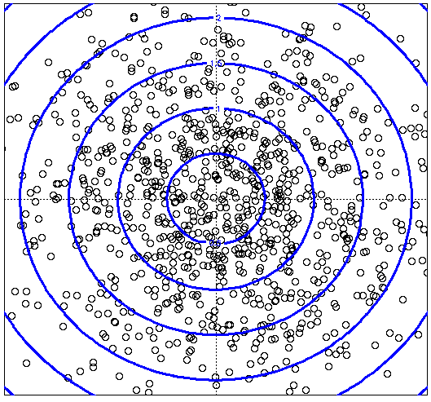
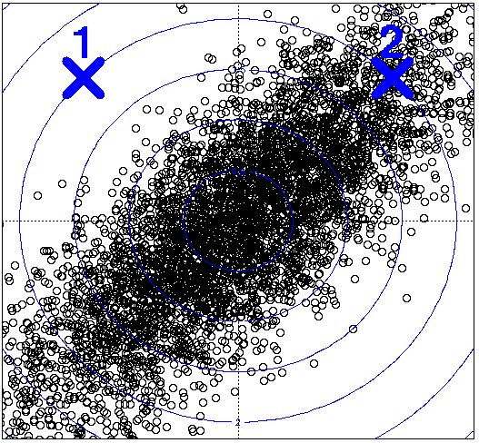
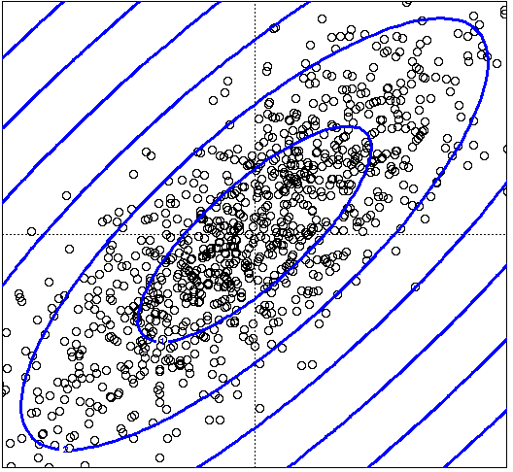
Picture: Equal M.D. Regions
Euclidean vs. Mahalanobis distance
Contours of equidistant points from the origin
Uniformly distributed points, Euclidean distance
Normally distributed points, Euclidean distance
Normally distributed points, Mahalanobis distance

Slide 52
Should 2 CS clusters be combined?
Q2) Should 2 CS subclusters be combined?
Compute the variance of the combined subcluster
N, SUM, and SUMSQ allow us to make that calculation quickly
Combine if the combined variance is below some threshold
Many alternatives: Treat dimensions differently, consider density

Slide 53
The CURE Algorithm
Extension of k-means to clusters of arbitrary shapes

Slide 54
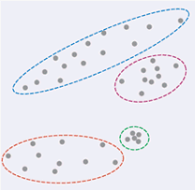
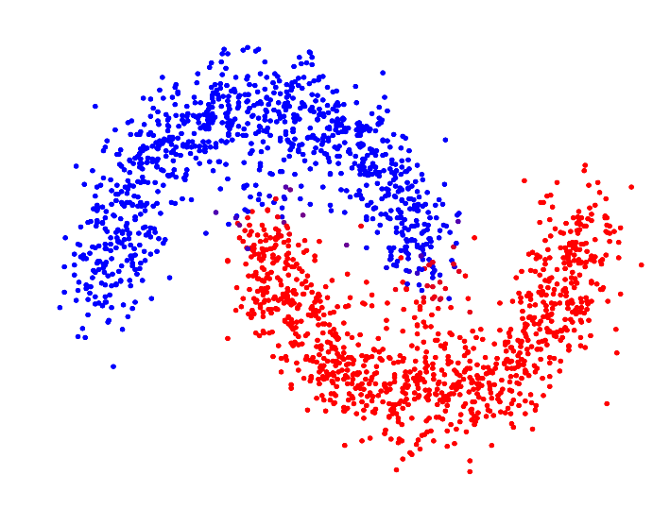
The CURE Algorithm
Vs.
Problem with BFR/k-means:
Assumes clusters are normally distributed in each dimension
And axes are fixed – ellipses at an angle are not OK
CURE (Clustering Using REpresentatives):
Assumes a Euclidean distance
Allows clusters to assume any shape
Uses a collection of representative points to represent clusters

Slide 55
Example: Stanford Salaries
h
h
h
e
e
e
h
e
e
e
h
e
e
e
e
salary
h
e
h
h
h
h
h
h
h
age

Slide 56
Starting CURE
2 Pass algorithm. Pass 1:
0) Pick a random sample of points that fit in main memory
1) Initial clusters:
Cluster these points hierarchically – group nearest points/clusters
2) Pick representative points:
For each cluster, pick a sample of points, as dispersed as possible
From the sample, pick representatives by moving them (say) 20% toward the centroid of the cluster

Slide 57
Example: Initial Clusters
h
h
h
e
e
e
h
e
e
e
h
e
e
e
e
h
salary
e
h
h
h
h
h
h
h
age

Slide 58
Example: Pick Dispersed Points
h
h
h
e
e
e
h
e
e
e
h
e
e
e
e
h
salary
e
Pick (say) 4
remote points
for each
cluster.
h
h
h
h
h
h
h
age

Slide 59
Example: Pick Dispersed Points
h
h
h
e
e
e
h
e
e
e
h
e
e
e
e
h
salary
e
Move points
(say) 20%
toward the
centroid.
h
h
h
h
h
h
h
age

Slide 60
Finishing CURE
Pass 2:
Now, rescan the whole dataset and visit each point p in the data set
Place it in the “closest cluster”
Normal definition of “closest”: Find the closest representative to p and assign it to representative’s cluster
p

Slide 61
Why the 20% Move Inward?
Intuition:
A large, dispersed cluster will have large moves from its boundary
A small, dense cluster will have little move.
Favors a small, dense cluster that is near a larger dispersed cluster

Slide 62
Summary
Clustering: Given a set of points, with a notion of distance between points, group the points into some number of clusters
Algorithms:
Agglomerative hierarchical clustering:
Centroid and clustroid
k-means:
Initialization, picking k
BFR
CURE

