Slide 1
GHANA ADVENTURES TRAVEL & TOUR COMPANY.
Ghana Adventures Insight.
Team members:
1. Jessica Williams – Lead Data Analyst/Project Lead
2. Monica Birago Adom – Statistical Analysis Lead/Data Analyst
3. Nana Kofi Abankwah – Data Visualization Specialist.

Slide 2
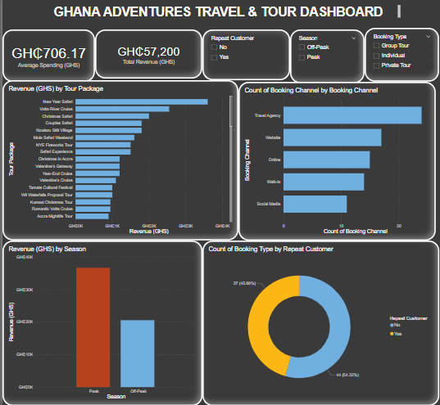
DASHBOARD
VIEW DASHBOARD HERE

Slide 3
How can Ghana Adventures use data-driven marketing to boost off-Peak season bookings?
Key Insight:
Strategic Recommendations
Reward Repeat Customers
Launch a loyalty program (e.g., points, early access, referral bonuses) to increase retention.
Use customer feedback to enhance the most-loved packages.
2.Social Media Promotion : Utilize social media platforms to promote the Mole Safari Weekend by highlighting its unique aspects and experiences.
3. Discounted Rates: Mole Weekend Safari packages attracts more customers during the peak season.
Design packages such as "Unwind After Work" for workers who book during the off-peak season. Create a package specifically designed for workers who want to relax during the weekend including:
Massage Therapy: Offer massage therapy sessions to help guests relax and rejuvenate.
Cocktail Night: Host a cocktail night with drinks .Photography Sessions: A package focused on photography, with guided sessions and expert tips.
A Day for Two: A romantic getaway package for couples.
4. Diversify Booking Channels: Explore direct bookings via a website or online to reduce reliance on agencies.
Promote on social media and travel platforms to reach new segments.

Slide 4
The best and worst-selling tour packages analysis.
Key Insights:
Which tours should be expanded, adjusted, or discontinued?
Expand:
Focus on top-selling tours such as the New Year Safari, Volta River Cruise, and Christmas Safari, which are both popular and profitable.
For the New Year Safari, consider expanding it into multi-day or multi-destination packages. Introduce early bird discounts and VIP options to attract a broader range of travelers.
For the Volta River Cruise, introduce new experiences like sunset or dinner cruises, and offer group or romantic packages to enhance appeal and increase bookings.
Adjust/ Discontinued:
Improve underperforming tours such as the Larabanga Mosque Visit by bundling them with other experiences and enhancing storytelling.
Rebrand it as a Spiritual Heritage Tour featuring guided storytelling.
Pair with nearby attractions like Mole National Park or local community experiences for added value.

Slide 5
CUSTOMER RETURN RATE AND SPENDING PATTERN
Business Insights
Spending Patterns:
1. Average revenue per customer: Returned customers have a higher average revenue per customer (GH₵ 824.32) compared to new customers (GH₵ 606.82).
2. Increased spending: Returned customers tend to spend more than new customers, which could be due to increased trust, satisfaction, or loyalty to the business.
Customer Return Rate:
1. Return rate: 37 returned customers out of a total of 81 customers (37 returned + 44 new) is a return rate of approximately 45.7%.
2. Loyal customer base: A return rate of 45.7% suggests that your business has a loyal customer base, which is a positive sign for long-term growth and revenue.
How can they encourage customer loyalty and repeat bookings?
Recommendations:
1. Retention strategy: Focus on retaining existing customers, as they tend to spend more and are more likely to return.
2. Loyalty programs: Consider implementing loyalty packages or rewards to incentivize customers to return and increase their spending.
3. New customer acquisition: Continue to focus on acquiring new customers, but also prioritize retaining existing ones to maximize revenue and growth.

Slide 6
THANK YOU !!!!!

