Slide 1

Citation network analysis
Khodorchenko M., M4117c

Slide 2

Short Description
The network of publications in the arXiv's High Energy Physics Phenomenology (hep-ph) section. The directed links that connect the publications are citations. Some publications cite themselves, and therefore the network contains loops.
Properties:
directed;
34 546 vertices (publications)
421 578 edges (citations)

Slide 3
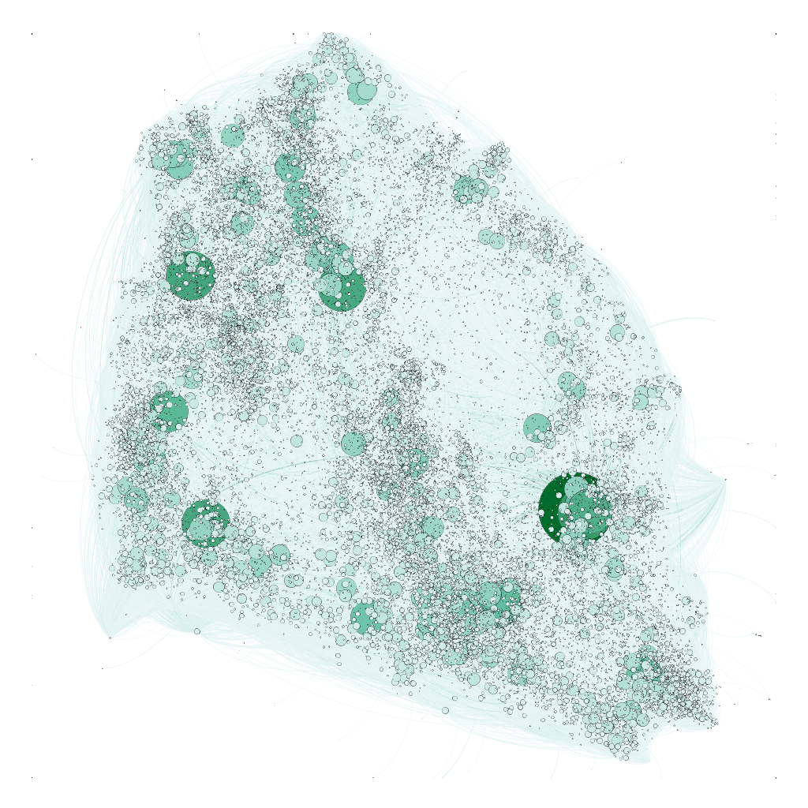
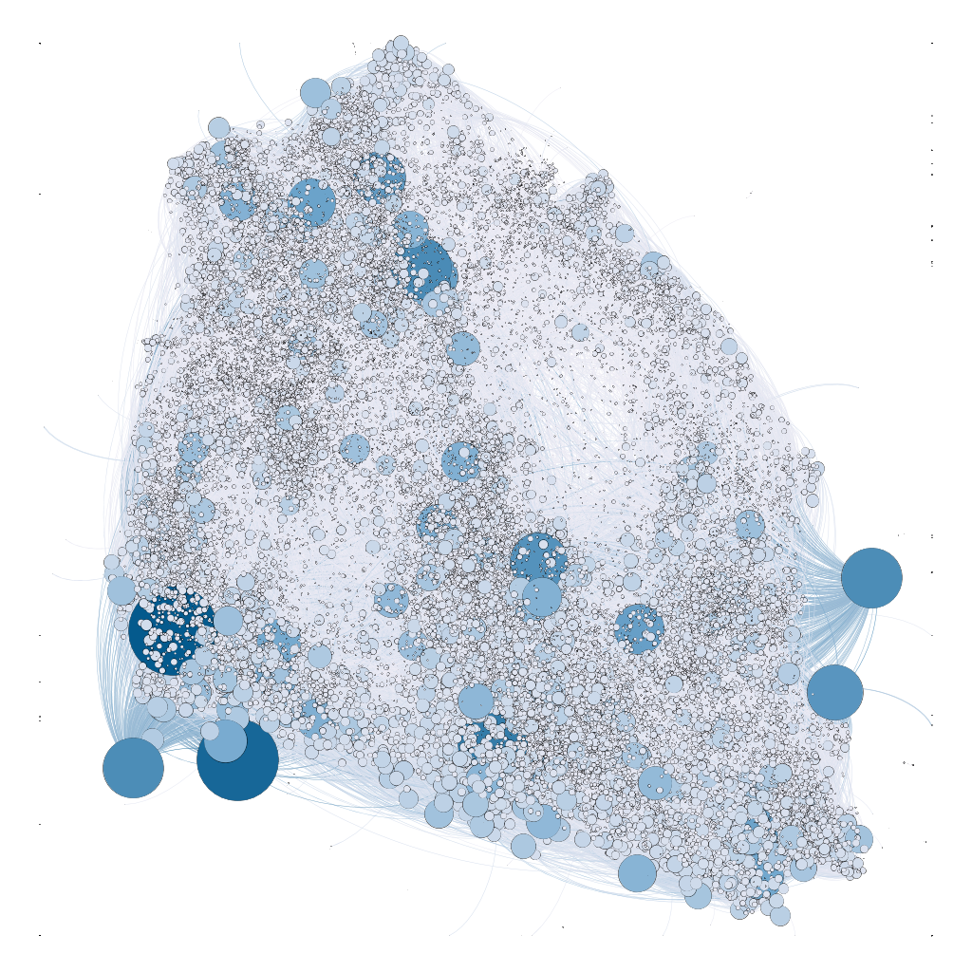
In-degree
Out-degree

Slide 4
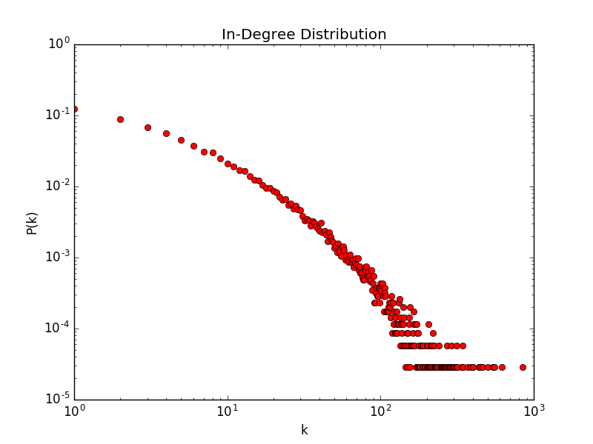
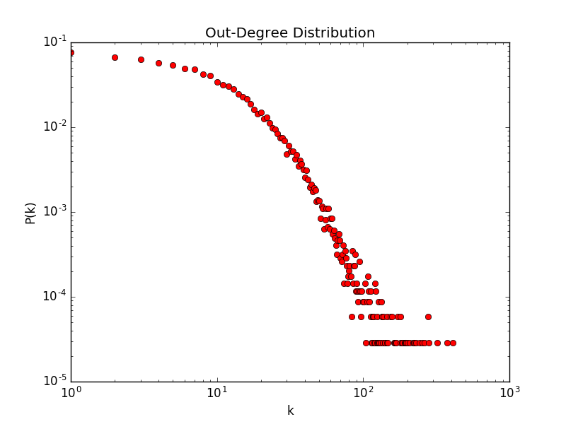
Degree Distributions
Average degree: Gephi (12.203)

Slide 5
Filtering the giant component
Significant reduce in amount of nodes and edges:
Nodes: 34546 -> 12711
Edges: 421578 -> 139981
TODO: Other components should be checked

Slide 6
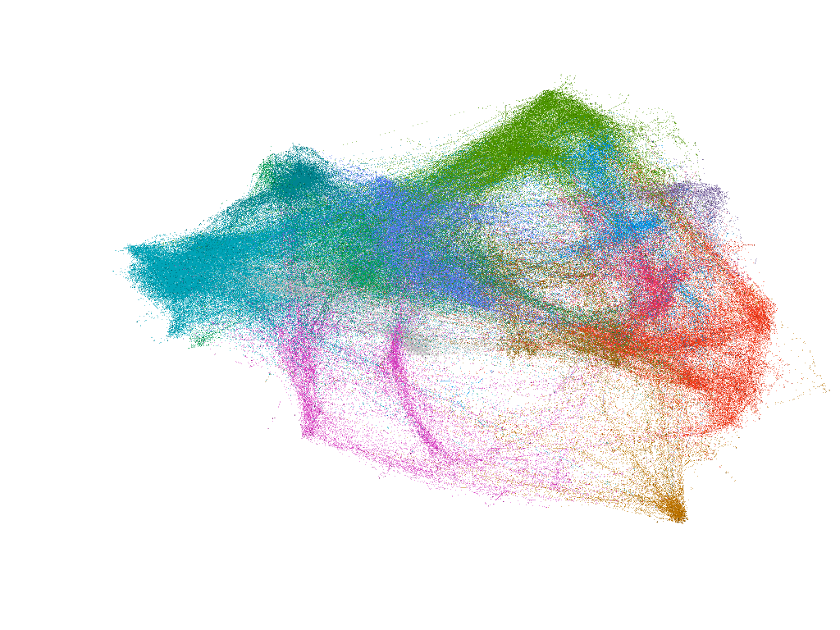

Slide 7
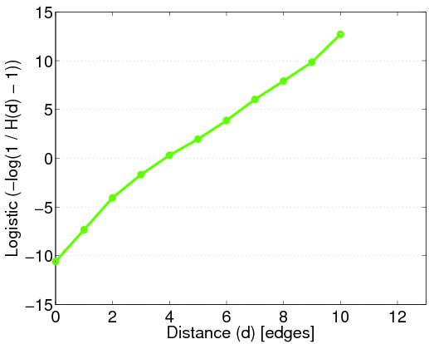

Distances

Slide 8
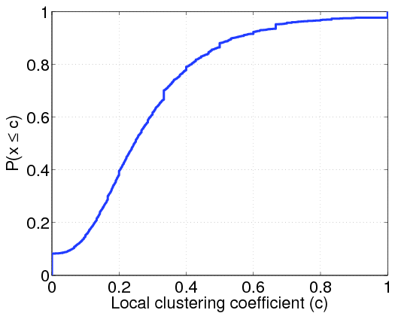
Clustering Coefficient Distribution

Slide 9
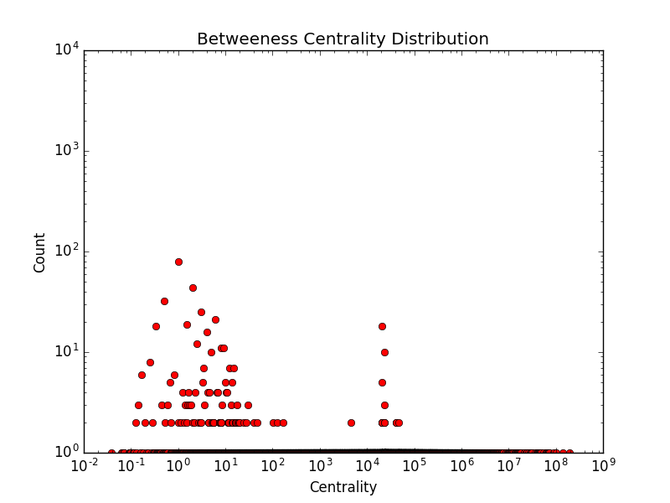
Betweenness Centrality in log log scale
$С_{B}(ν_{κ})$ evaluates the appearance of node $ν_{κ}$ on the all shortest paths in a network

Slide 10
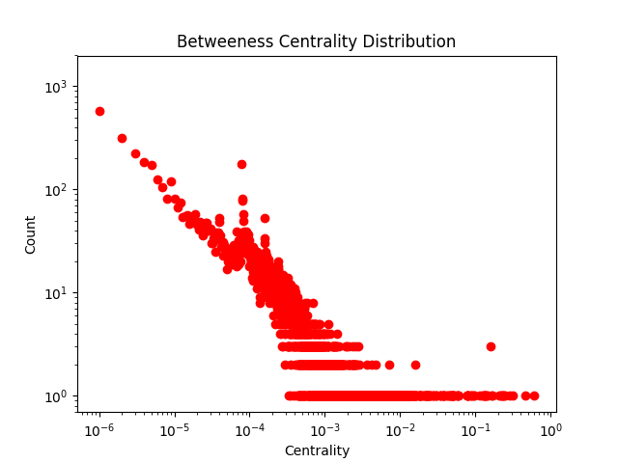

Slide 11
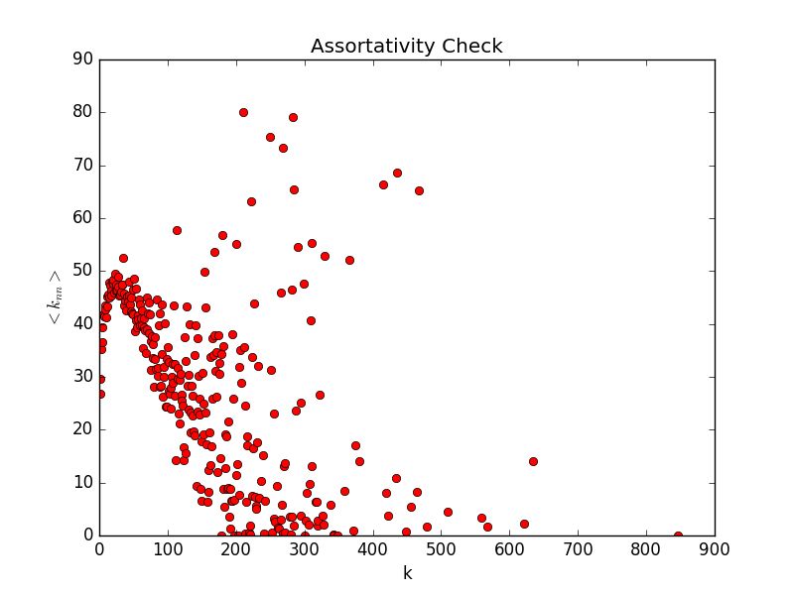
Assortativity
The average degree connectivity is the average nearest neighbor degree of nodes with degree k.
This network is disassortative
Degree Pearson correlation coefficient: -0.002628226403824088

Slide 12


Estimation of Power Law Exponent
$$γ=1+n{\left(\sum_{uεV}{\ln{\frac{d(u)}{d_{min}}}}\right)}^{−1}$$
Here,
$$γ =3.0410 (d_{min}= 42)$$
Emergence of scaling in random networks. Science, 286(5439):509–512, 1999.

Slide 13

Other Metrics

Slide 14
Models to check
Not exactly matches the power low
- BA model

Slide 15

Thank you!

