Slide 1

Citation network analysis
Khodorchenko M., M4117c

Slide 2

Short Description
The network of publications in the arXiv's High Energy Physics Phenomenology (hep-ph) section. The directed links that connect the publications are citations. Some publications cite themselves, and therefore the network contains loops.
Properties:
directed;
34 546 vertices (publications)
421 578 edges (citations)

Slide 3
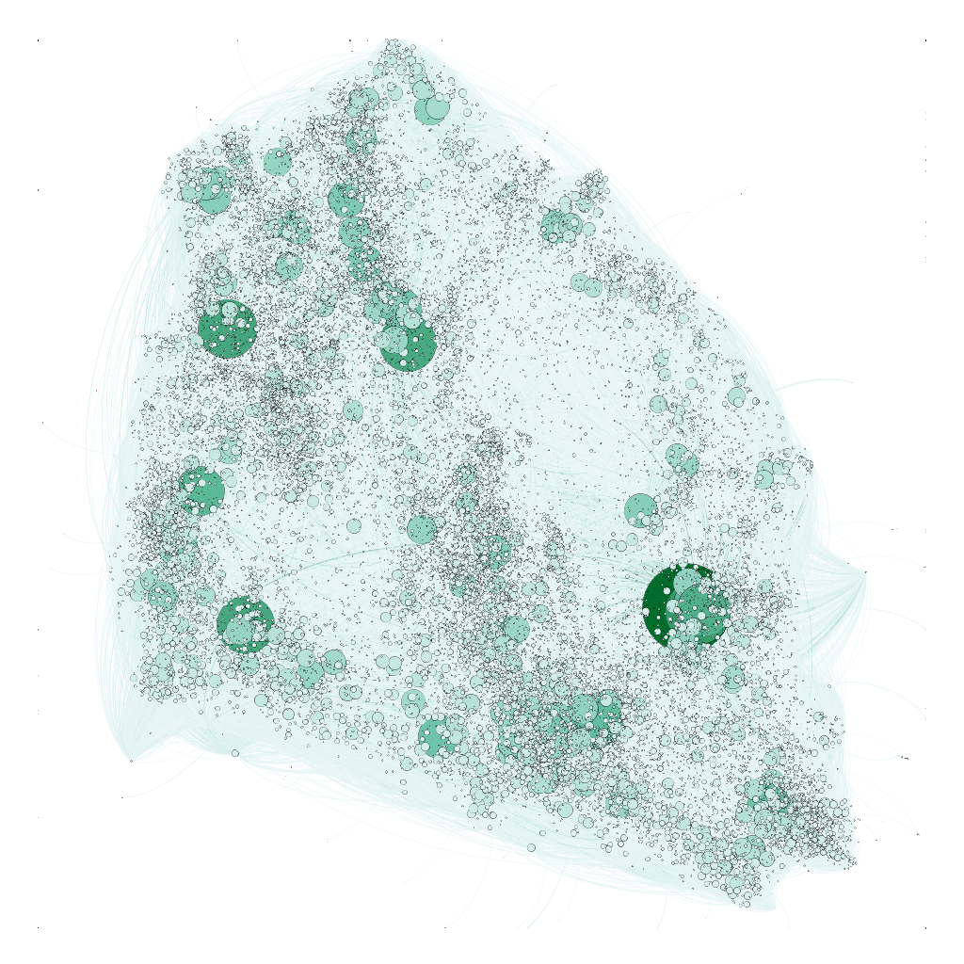
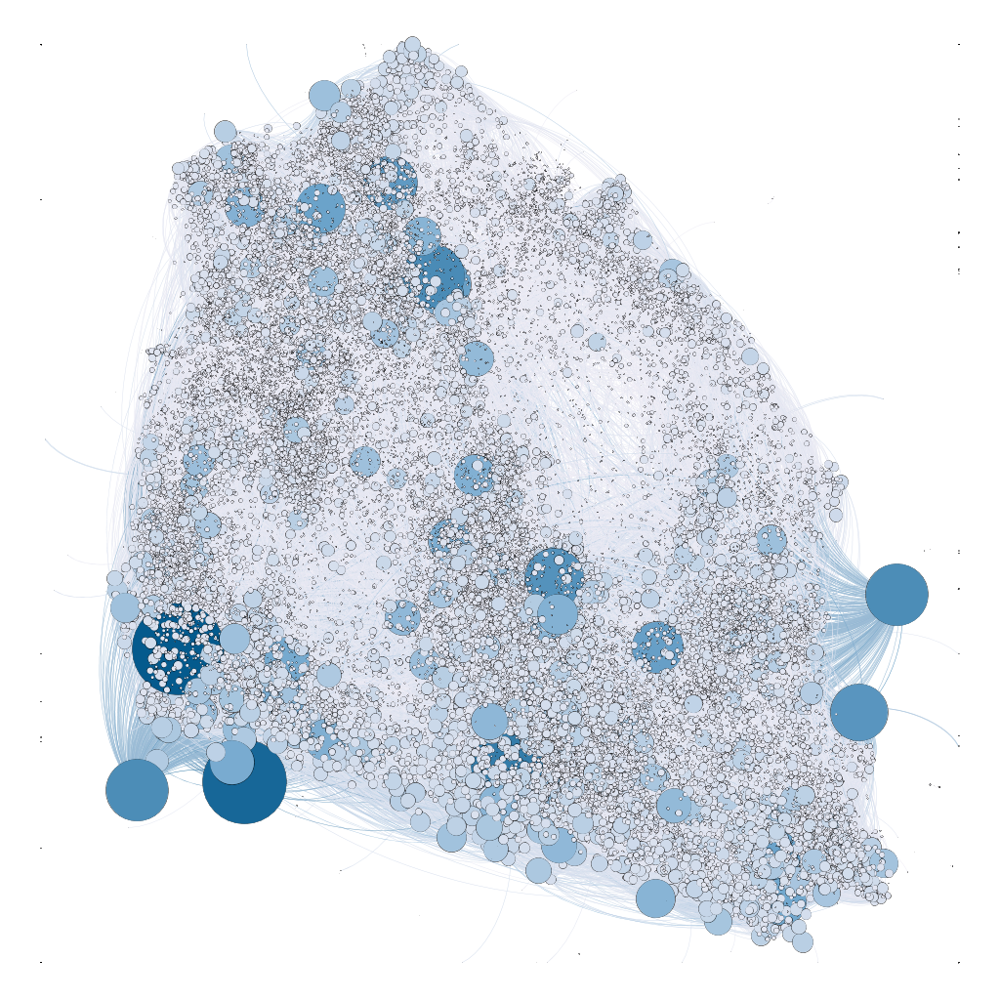
In-degree
Out-degree

Slide 4
Filtering the biggest component
Significant reduce in amount of nodes and edges:
Nodes: 34546 -> 12711
Edges: 421578 -> 139981
Other components are too small no more than 12 nodes.

Slide 5
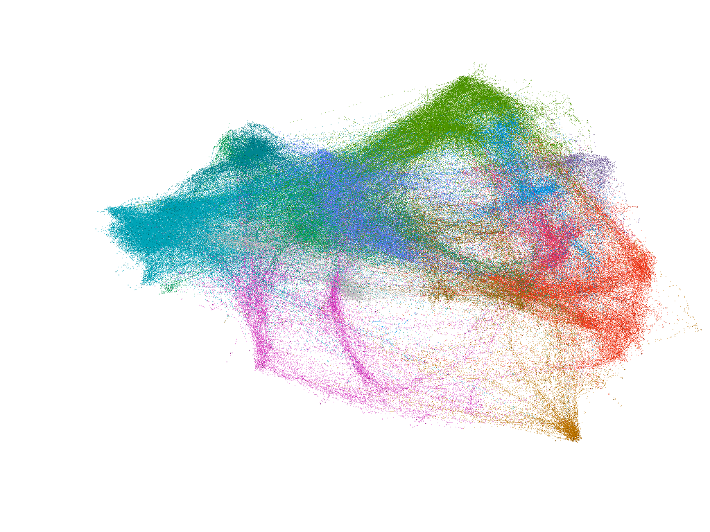

Slide 6
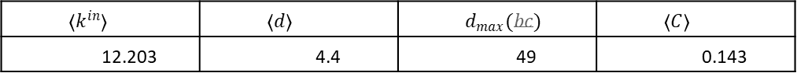
Main statistics
$$〈k^{in}〉$$ | $$〈d〉$$ | $$d_{max}(bc)$$ | $$〈C〉$$
12.203 | 4.4 | 49 | 0.143

Slide 7
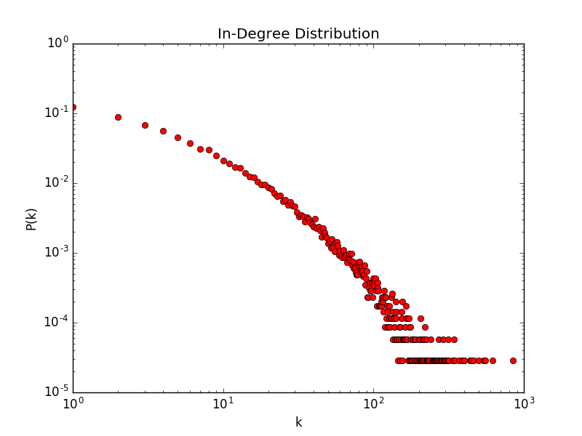
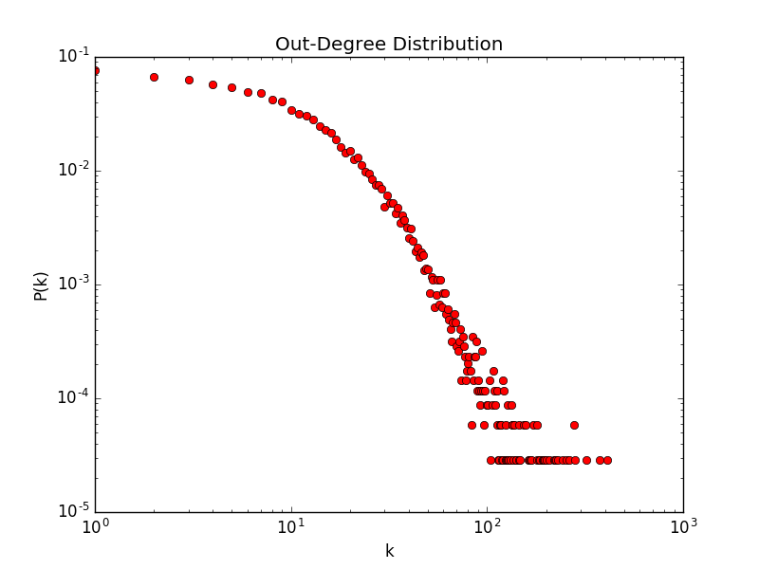
Degree Distributions
Average degree: 12.203

Slide 8


Estimation of Power Law Exponent
$$γ=1+n{\left(\sum_{uεV}{\ln{\frac{d(u)}{d_{min}}}}\right)}^{−1}$$
Here,
For in-degree with $k_{min}$ = 10, $γ$ = 2.29
For out-degree with $k_{min}$ = 50, $γ$ = 4.16
Emergence of scaling in random networks. Science, 286(5439):509–512, 1999.

Slide 9
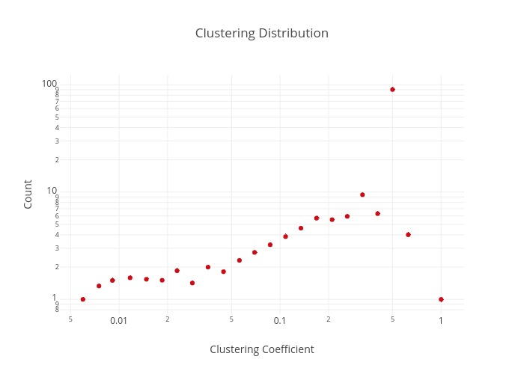
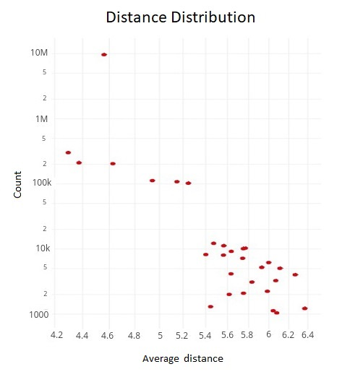
Distance and clustering distributions

Slide 10
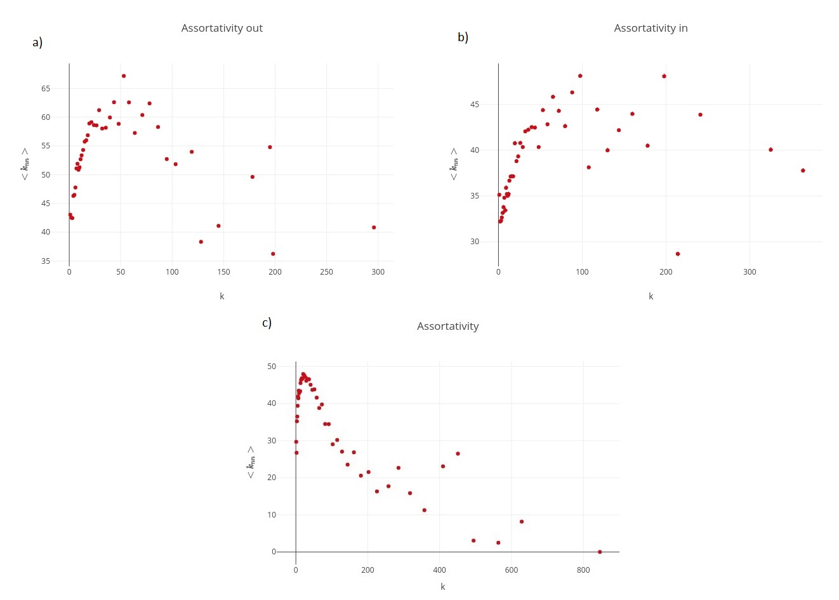
Assortativity
The average degree connectivity is the average nearest neighbor degree of nodes with degree k.
Degree Pearson correlation coefficient: -0.002628226403824088

Slide 11
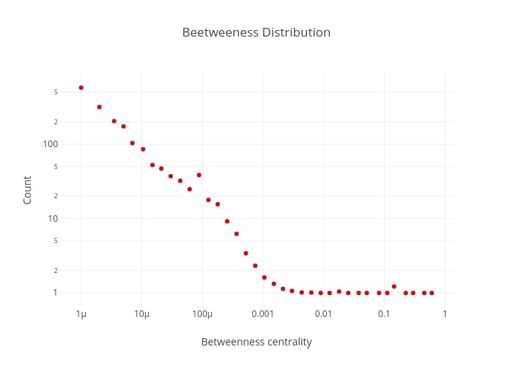
Betweenness Centrality
$С_{B}(ν_{κ})$ evaluates the appearance of node $ν_{κ}$ on the all shortest paths in a network

Slide 12
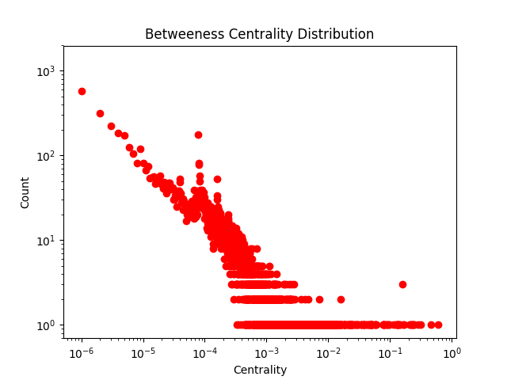

Slide 13
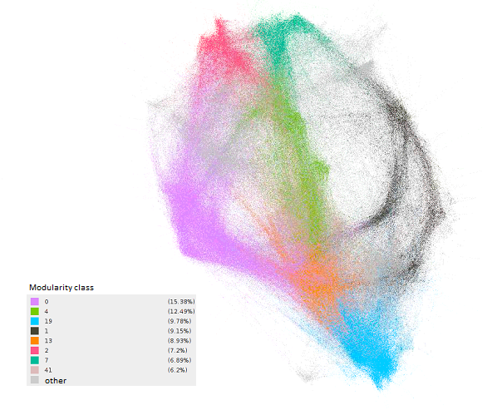
Communities

Slide 14

Other Metrics

Slide 15
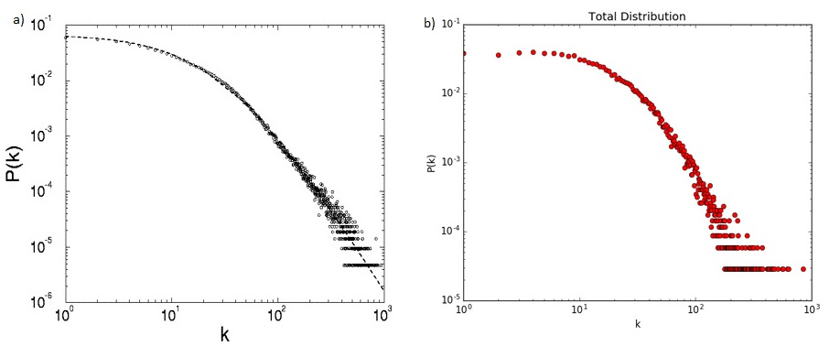

Extended model
$p$ = 0.9, $m$ = 1, $κ$ = 31.68, $γ$ = 3.07

Slide 16
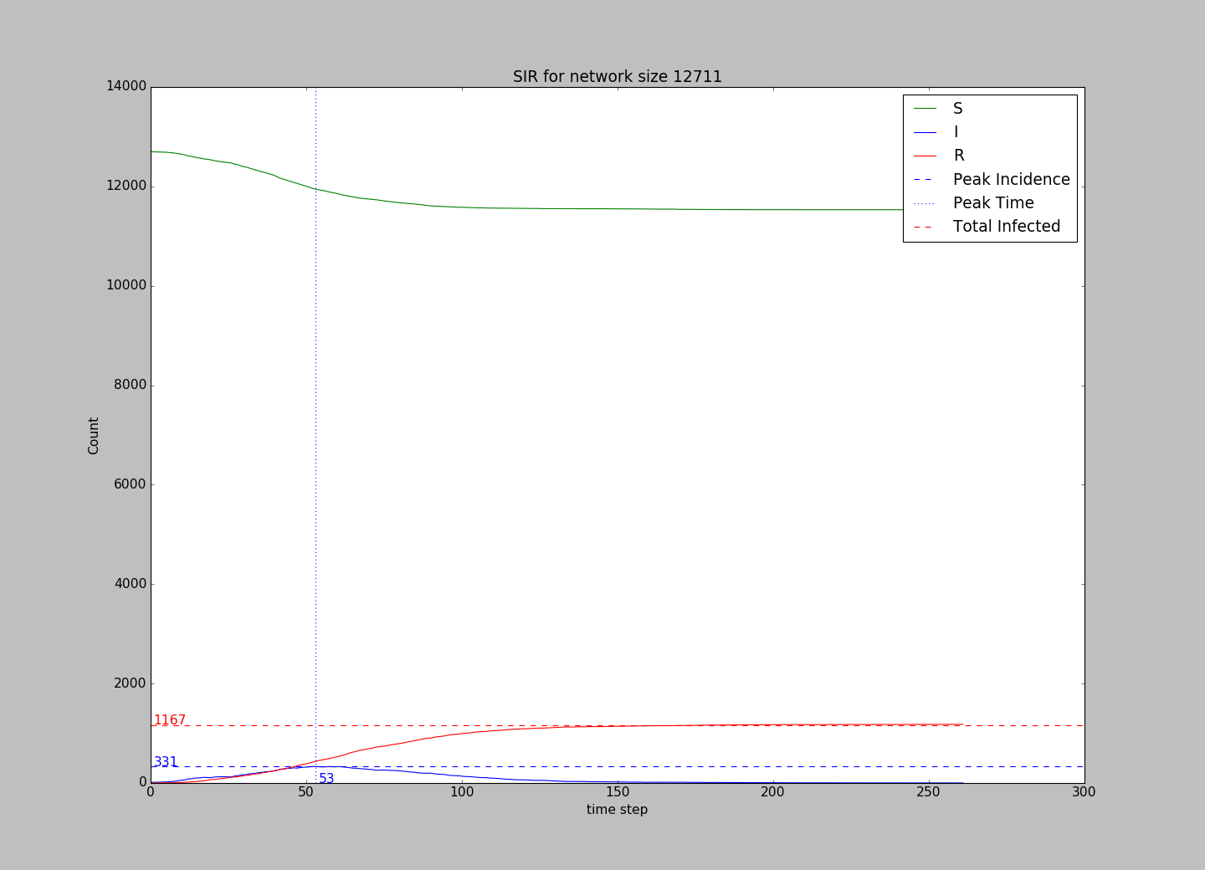
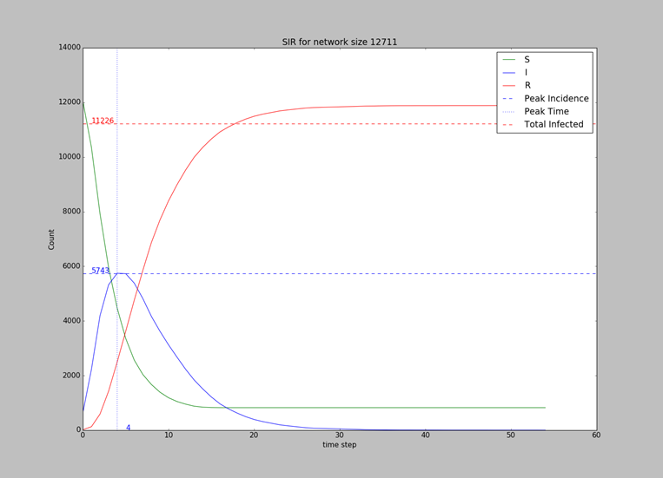
Propagation model

Slide 17

Thank you!

