Slide 1
Rutgers bootcamp extract-Transform-Load project 2021
Stephen Domke
Jess Hunter
Shawntell Manning
Abhusan Karki

Slide 2
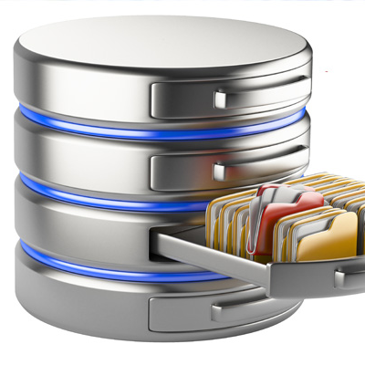
Covid-19 Worldwide Data

Slide 3
Introduction
The impact of Covid-19 has been the most devastating worldwide event in our lifetime
Because of this, we thought it would be a topic with plentiful, up-to-date data that we could explore and construct a database with.
The dataset we used was very extensive, as it included information pertaining to COVID-19 for countries all around the world on every day from 01/01/2020 to 03/10/2021.
Using the ETL process, we were able to extract the data from the CSV into pandas, transform the data by separating certain categorical data into new tables and cleaning the data for our purposes, and then load the data into their respective tables that we created in PostgreSQL.
Some questions that could be used in future analysis are:
what percentage of cases lead to death?
which country had the highest rate of death?
what continents had the most/fewest total cases by a certain date?
how many cases did (country) have on (date)?
what were the top 10 most affected countries?

Slide 4
Extraction
We selected a large dataset called Worldwide_Data.csv, sourced from ourworldindata.org (Coronavirus Source Data) that includes daily data from January 1, 2020 through March 10, 2021. It contains 3 distinct areas of data that were used in our analysis.
https://ourworldindata.org/coronavirus-source-data

Slide 5
Transformation
We created tables out of three categorical aspects of our data which were continent, country and ISO Code
We used .dropna() to remove any null values for each
We used .unique() to obtain the unique categorical values for each, and then created individual dataframes
We used .reset_index() to create an index column which was then renamed to act as the respective ID’s
These ID’s acted as their primary key

Slide 6
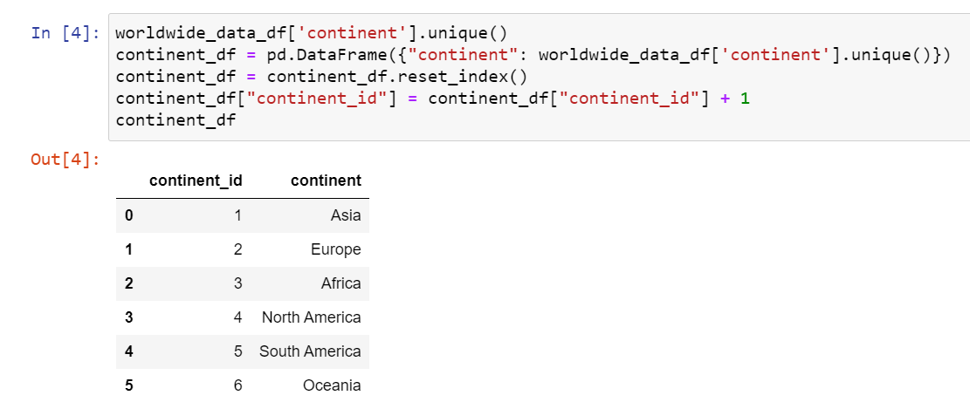
Continents

Slide 7
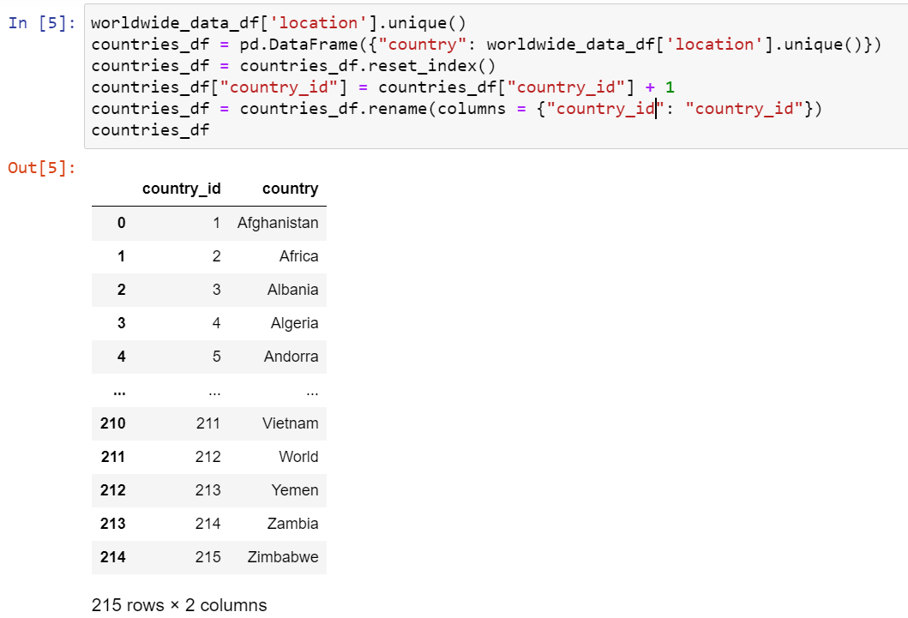
Countries

Slide 8
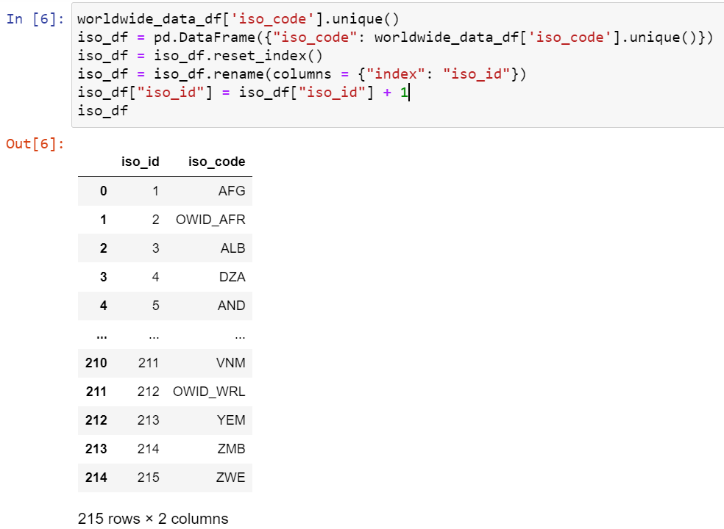
ISO Code

Slide 9
Once we created the tables, we used pd.merge() to join the tables with the original data to include the new ID’s
Excess columns were removed, as they were included in the new tables
These ID’s act as foreign keys in the main data, which relate to the new tables, where they are primary keys

Slide 10
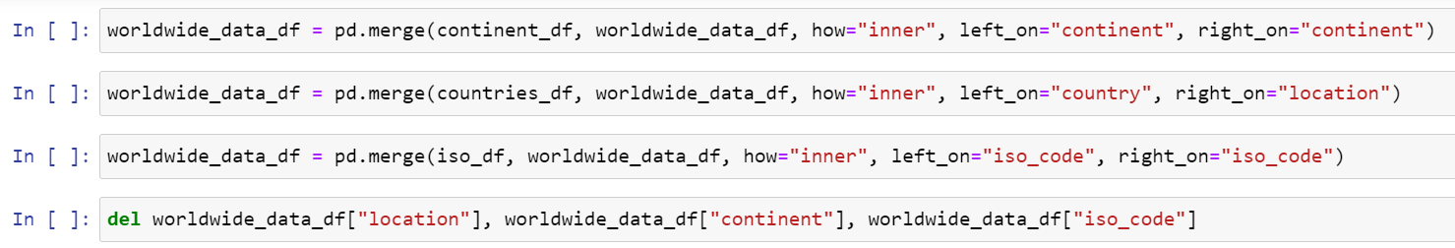
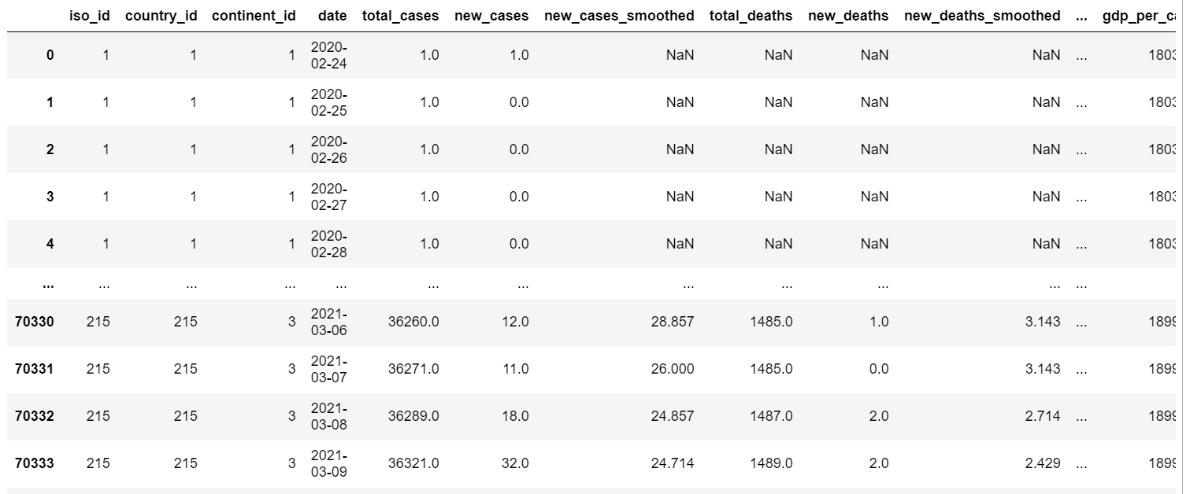

Slide 11
The main data was then cleaned by only including columns of interest and then renaming them appropriately with pd.rename()
Null numerical values were replaced with zero, by using .fillna()
An index column was created using .reset_index() which acted as the primary key for this table

Slide 12
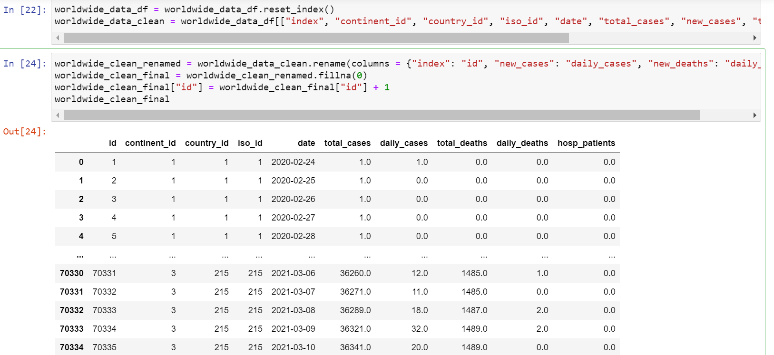

Slide 13
load
We created tables in Postgres that we loaded the data into
A connection and engine were created in Pandas that allowed us to communicate with our Postgres database
We used to_sql to load data into the respective tables
Using pd.read_sql_query, we were able to perform queries on each table

Slide 14
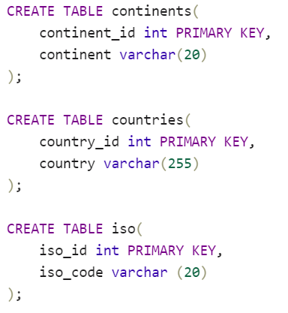
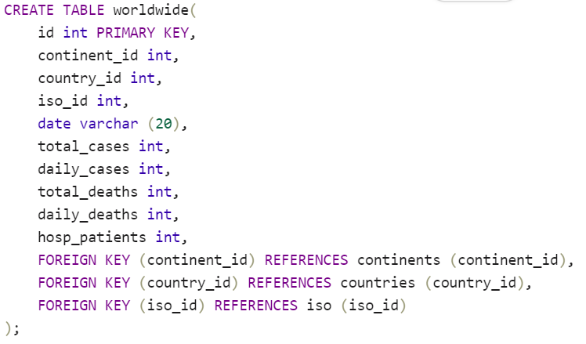
SQL Tables

Slide 15
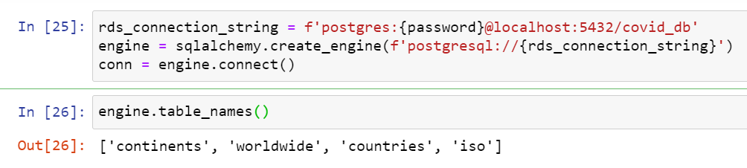
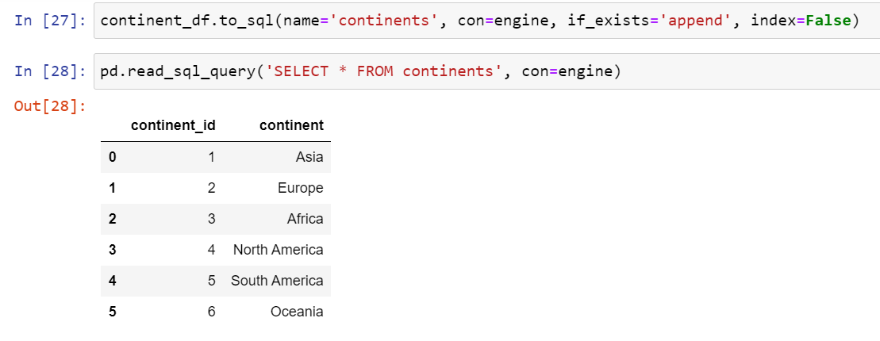
Engine
ISO ID

Slide 16
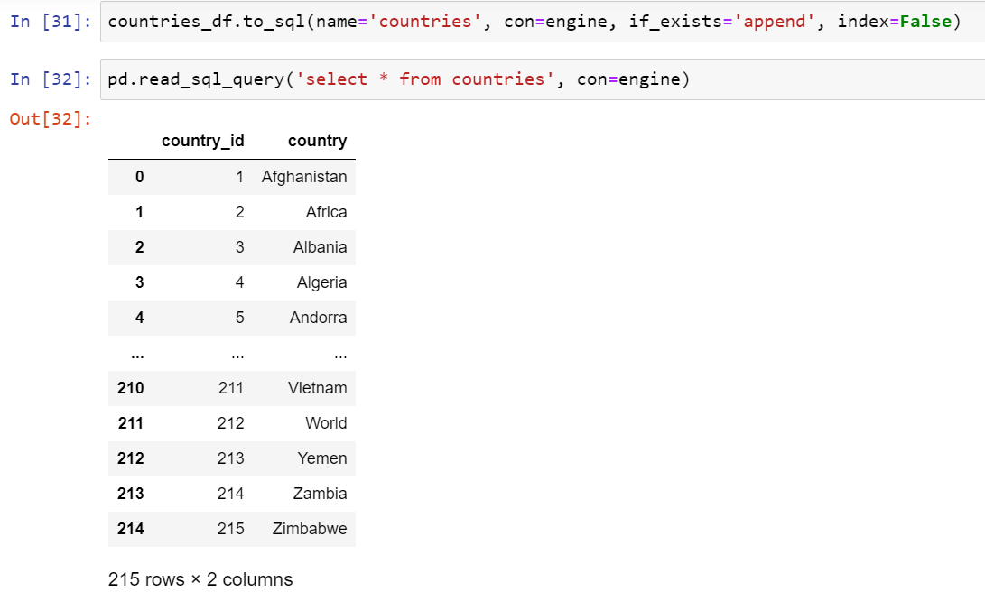
Continents
Countries

Slide 17
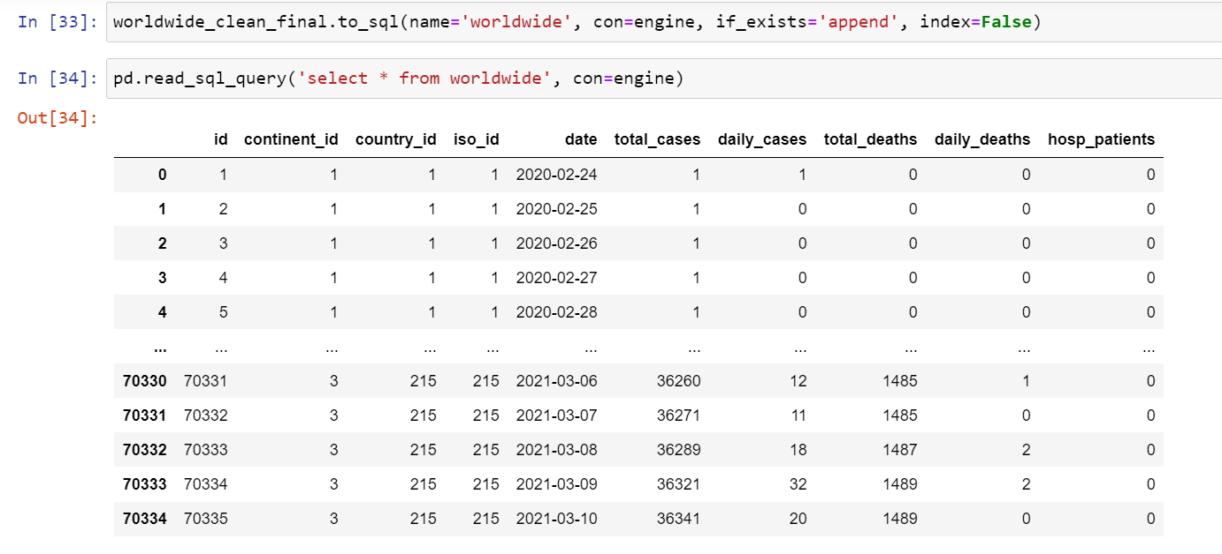
Worldwide

Slide 18
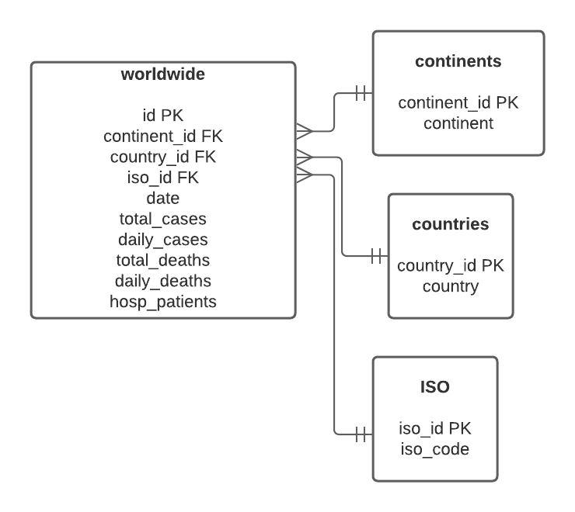
Database Schema

Slide 19




Thank you

