Slide 1
Dupe Finder
Recommender System
Jessica Tran

Slide 2
Problem/Motivation
Beauty products vary wildly in price
Many products have similar ingredients
It can be difficult to find true dupes

Slide 3
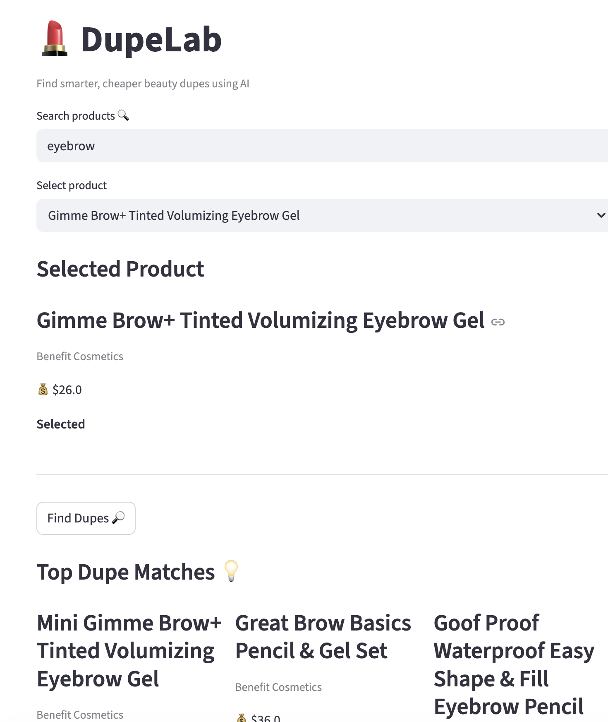
Purpose
Build a content-recommender system
Find similar products
Ensure they are cheaper

Slide 4
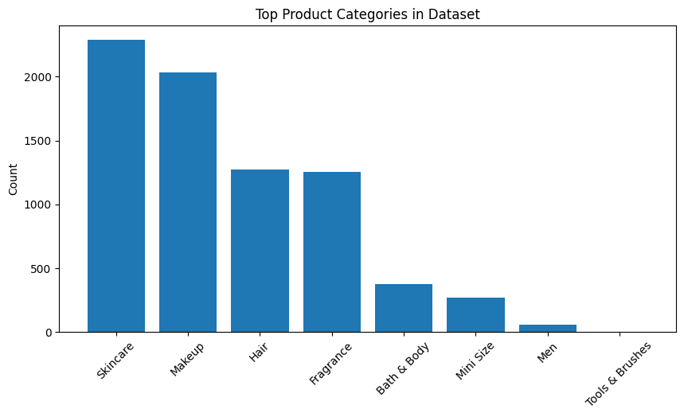
Dataset
Kaggle Dataset: Sephora Products and Skincare Reviews
Collected via Python Scraper in March 2023
Contains: information on over 8000 products including
Names
Ingredients
Price
Ratings
category

Slide 5
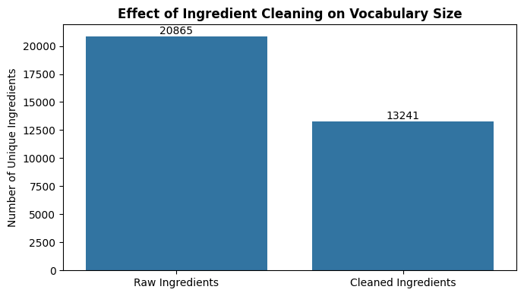
Preprocessing
Raw ingredient text was highly inconsistent.
Changes:
Lowercasing
Removing Noise
Standardizing Ingredients
Filtering Invalid Data

Slide 6
Natural Language Processing
NLP is a field of AI that enables computers to understand, process, and analyze human language
Ingredient lists and product descriptions are unstructured text
NLP transforms text into numerical representations
Enables comparison between products
Without NLP, ingredient text cannot be quantitatively compared or used for recommendation

Slide 7
Similarity Metrics
Keyword Similarity
TF-IDF (0.5)
Semantic Similarity
Sentence-BERT (0.3)
Ingredient Overlap
Jaccard Similarity (0.2)

Slide 8
TF-IDF
Measures importance of words (ingredient) to a specific document (product) compared to the entire dataset
Term-Frequency: how often a word appears in a product
Inverse Document Frequency: reduces the importances of words that appears in many products
Highlights rare but meaningful ingredients in a product
Converts ingredient lists into weighted vectors

Slide 9
Embeddings
Sentence-BERT model
Deep learning model that converts entire pieces of text into dense numerical vectors that represent their meaning
Converts text into vectors
Becomes a point in a high-dimensional space
Captures meaning not just exact matches
Learns semantic relationships between phrases
Can handle synonyms, context, meaning

Slide 10
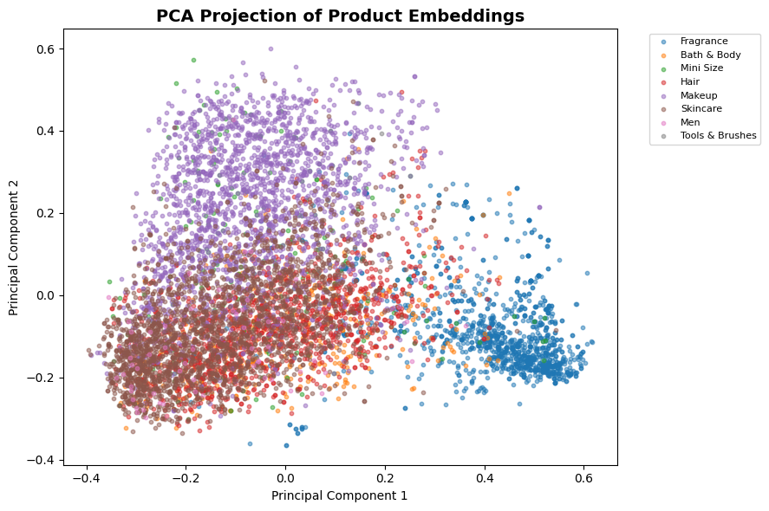
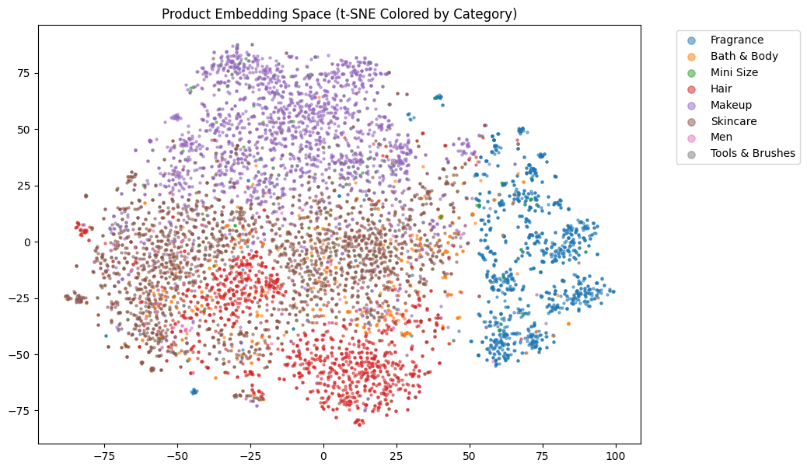

Slide 11
Jaccard Similarity
Measures overlap between sets to measure how similar the sets are
checks how many ingredients two products have in common
It compares the number of shared ingredients to the total number of unique ingredients across both products

Slide 12
Results
Cheaper recommendations with high similarity
A significant percentage (around 83%) of recommendations are cheaper than the original product

Slide 13
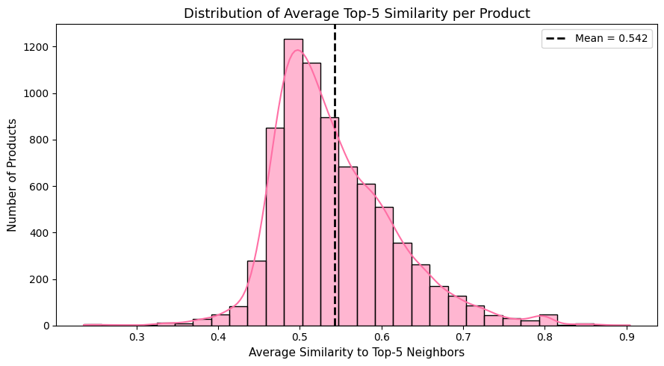
Results:

Slide 14
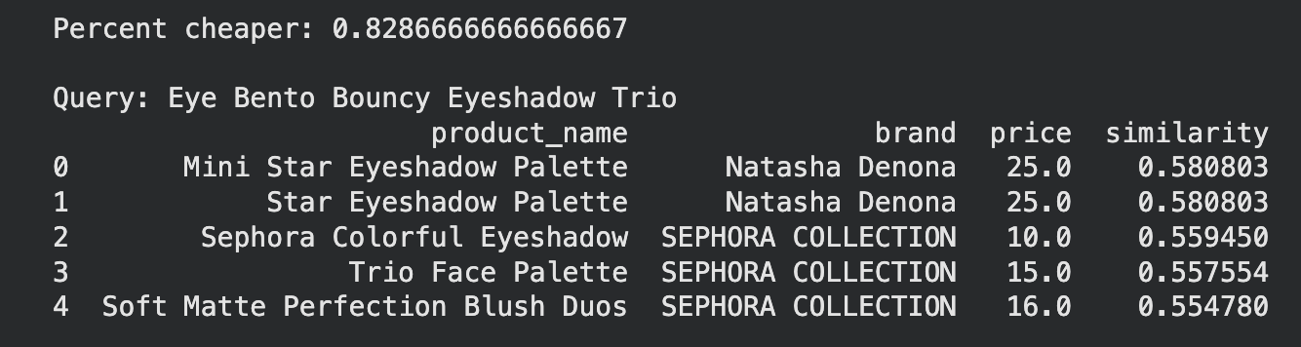
Example:

Slide 15
Limitations
Does not account for ingredient concentration data
Text-only representation (does not include reviews or lab results)
Approximate similarity evaluation using unsupervised model
Limited semantic understanding of niche cosmetic terms
Category-based filtering constraints

Slide 16
Conclusion
The NLP system works well in identifying lower-cost beauty product alternatives with high similarity to original products
The combination of the similarity metrics provides a robust representation of product similarity.
Future improvements: reducing unique ingredients further & include ingredient concentration

Slide 17
Thanks!
Do you have any questions?

