Slide 1
How to use PowerBI!
Jessica Tran

Slide 2
What is Power BI?
Developed by Microsoft
Business Intelligence & Data Visualization Tool
Used for Dashboards, Reporting, and Analytics
Some similar tools include tableau or looker

Slide 3
Power BI Workflow Overview
01
02
03
04
05
Get Data
Transform Data
Model Data
Import or Connect your data source to Power BI
Use Power Query to clean, format, and process data
Use relationships and DAX build models
Create Visuals
Publish & SHare
Use the features to create desired visuals based on your data
Share your dashboard with others!

Slide 4
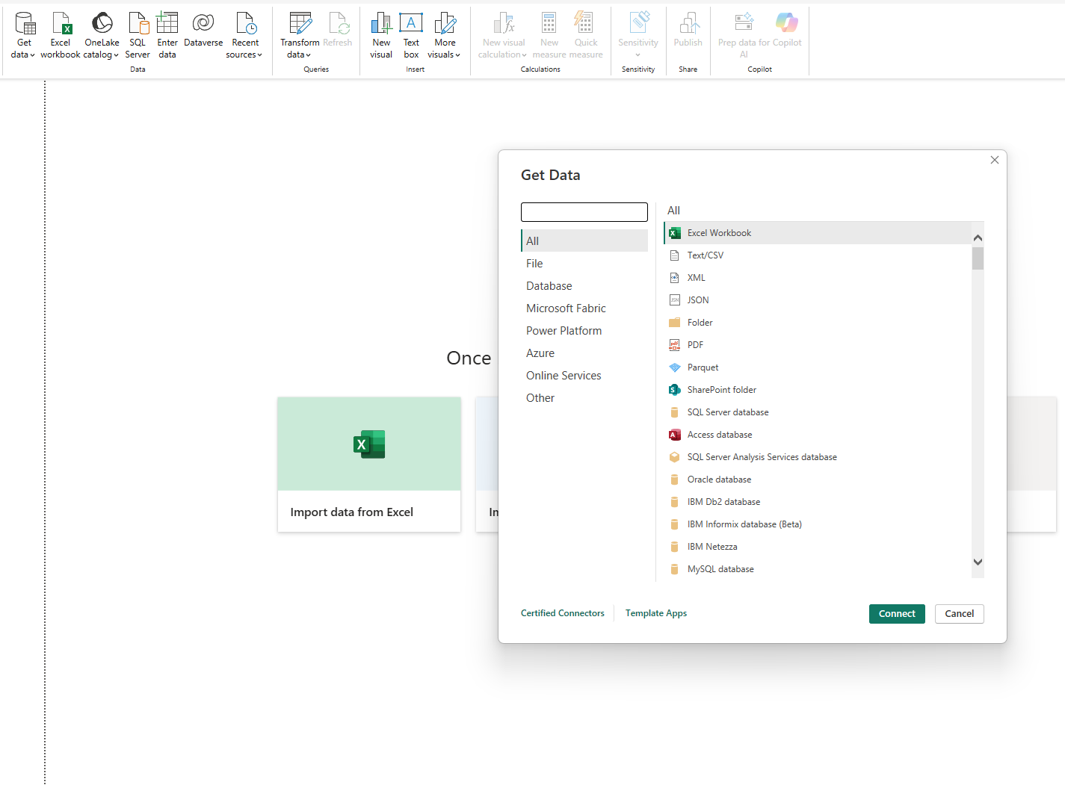
Step 01
Import Data by clicking “Get Data”
Can connect with many different types of data sources such as CSV, XLSX, APIs, cloud sources, etc.

Slide 5
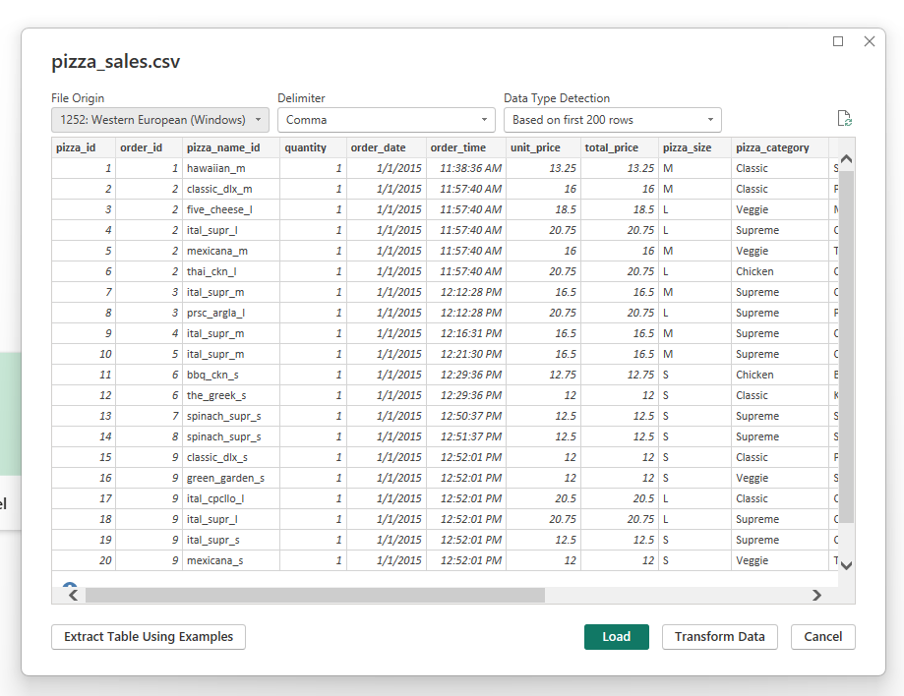
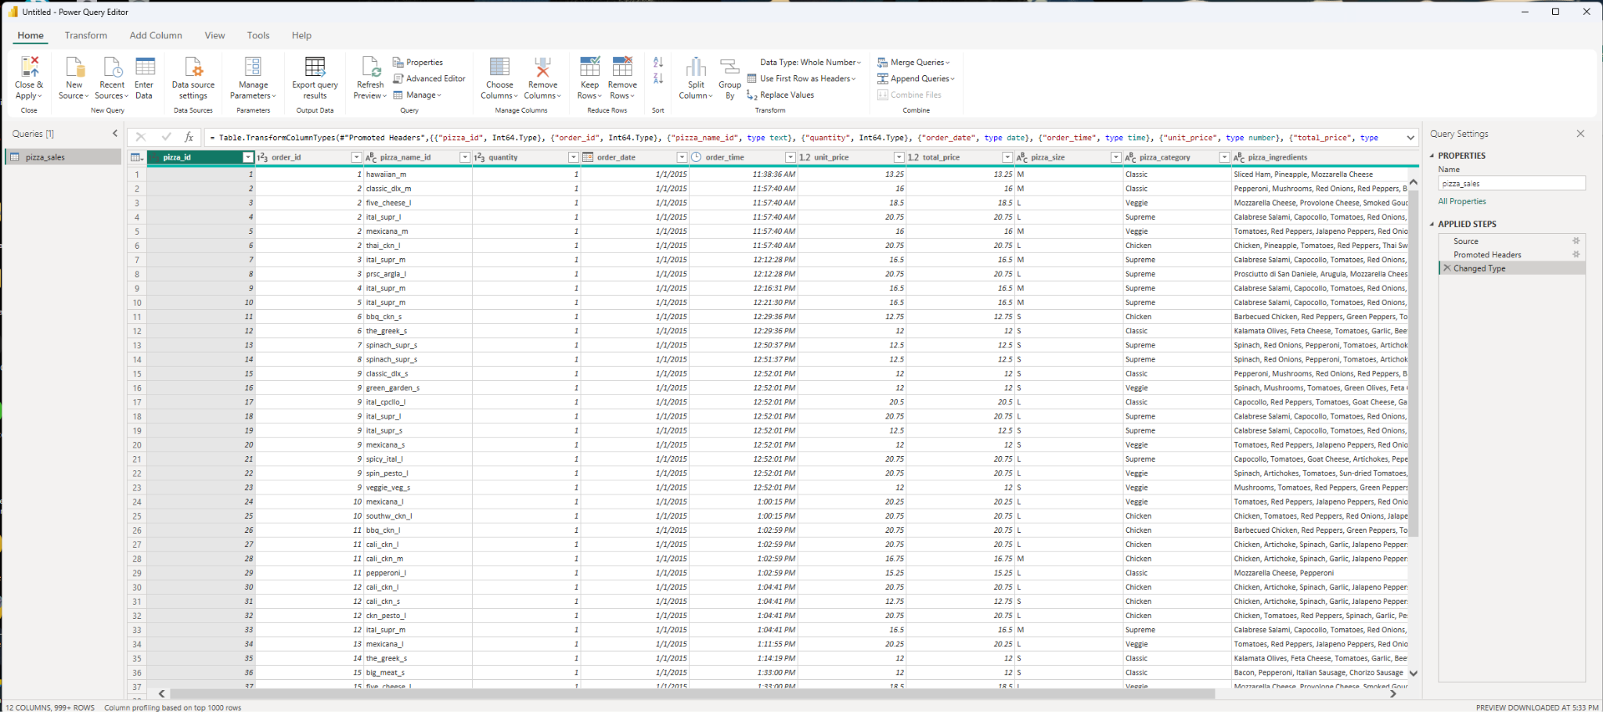
Step 02
Open Transform Data
Processing and cleaning data is done in this window
Power Query Editor

Slide 6
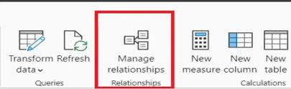
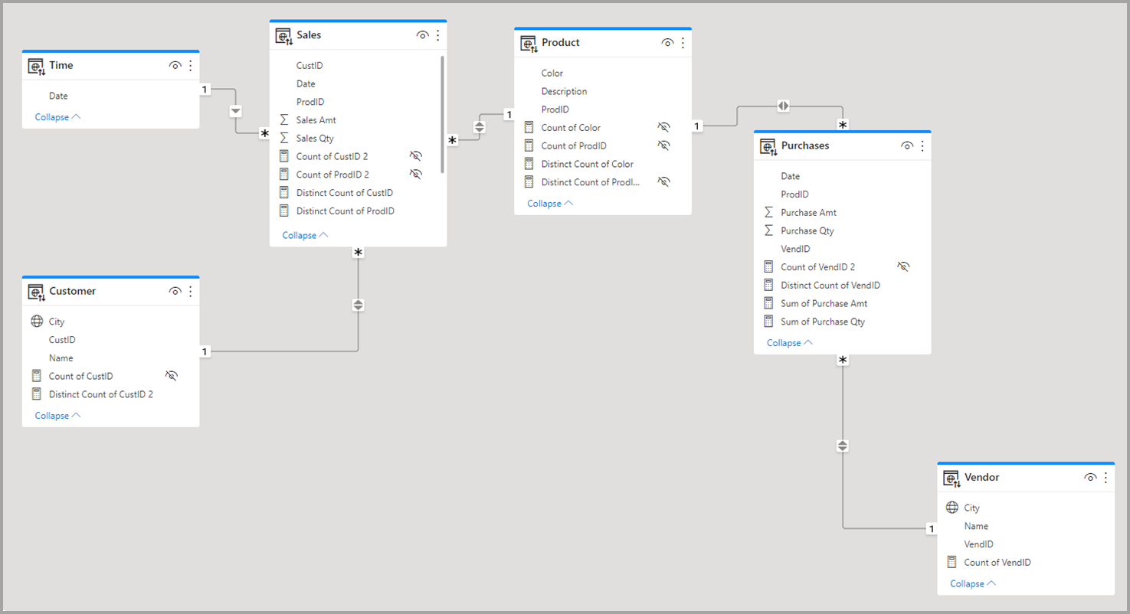
Step 03
Create relationships
DAX Query
Primary/Foreign Keys

Slide 7
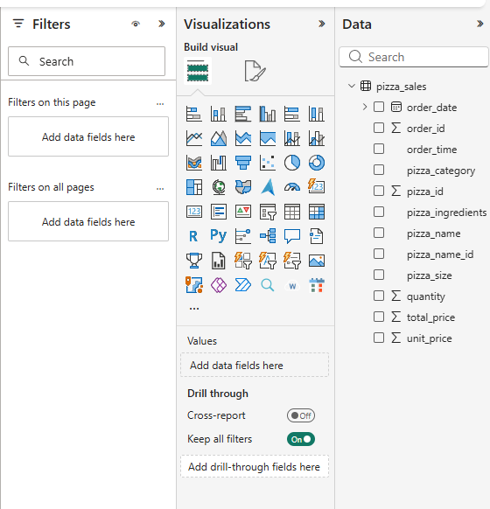
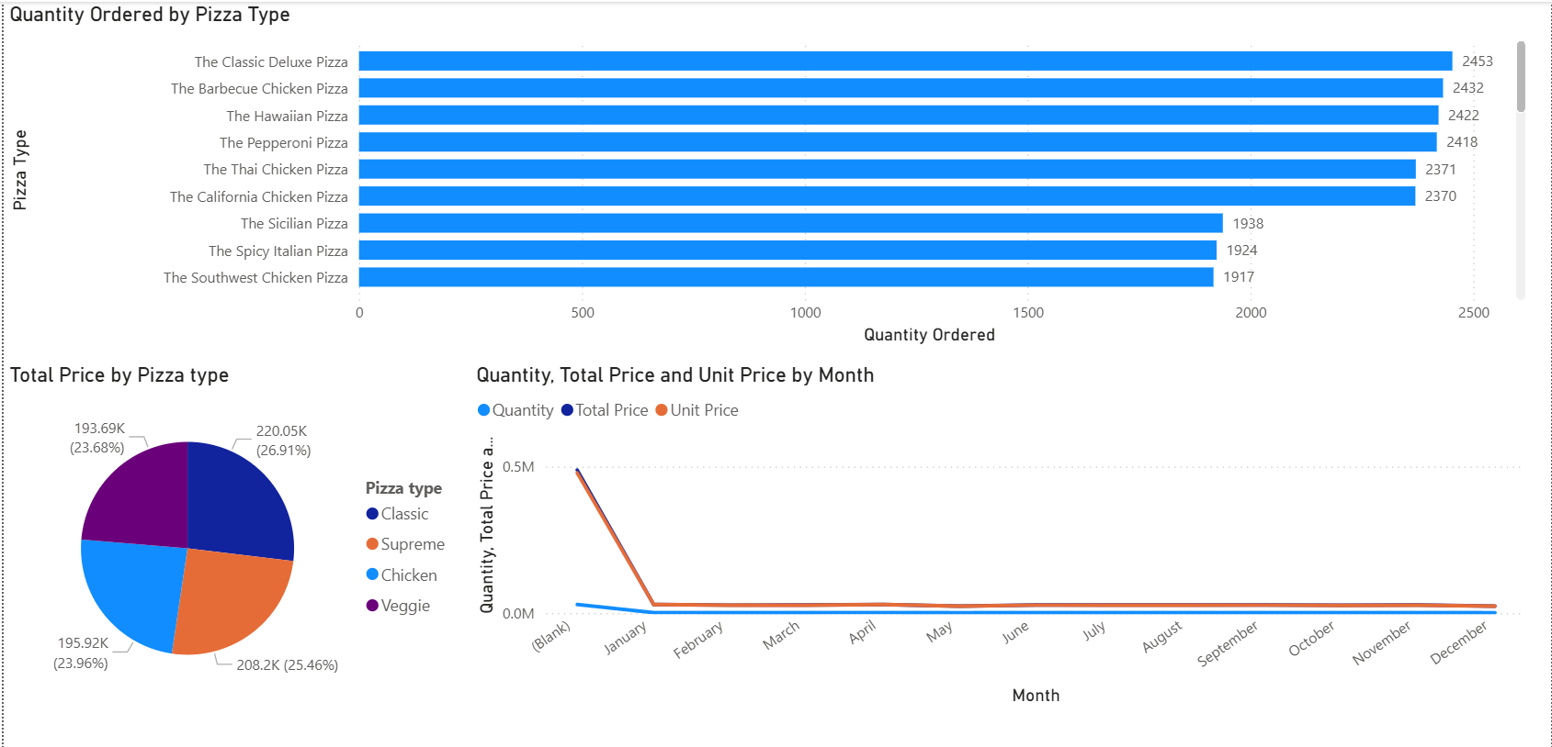
Step 04
Create Visualizations
Charts
Maps
Slicers
Interactive Visuals
Filtering

Slide 8
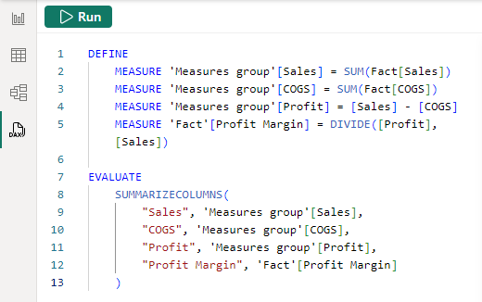
Step 05
Creating a DAX measure
DAX = Data Analysis Expressions
Similar to SQL or pandas

Slide 9
Why it is good to know?
Even if we use: Python, SQL, or Machine learning
We still need to:
  Present results
  Build dashboards
  Communicate insights
Power BI is a communication tool, not just visualization.
ALSO:
  It integrates with Azure
  Can connect to SQL databases
  Can embed ML outputs

Slide 10
Used In
Finance Dashboards
Sales Analytics
Healthcare Reporting
Marketing Performance

Slide 11
THANKS
Do you have any questions?

