Slide 2
Rshiny workshop

Slide 3
Agenda:
Structure of Shiny apps
Example 1 -
Hands-on experience
Example 2 -
Hands-on experience

Slide 4
The structure of Shiny apps
Shiny apps have 2 main components:
UI object
Controls the layout and appearance of your app
Server function
Controls the logic of the app and it contains a set of instructions to get the desired output based on the input given

Slide 6
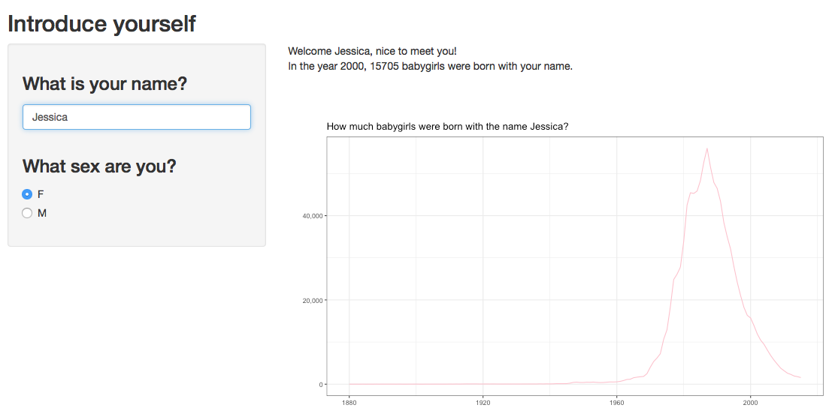
Reactivity
In every Shiny app, we’re working with input and output objects
output
input
For a more detailed overview of reactivity in Shiny, visit this website: https://shiny.rstudio.com/articles/reactivity-overview.html
Notes:
In every Shiny app, we’re working with input and output objects. These could be independent of each other, but the great thing about Shiny apps is that we can make them reactive. That is, if the user gives a certain input, such as entering their name, the output can respond to that. This is the example Shiny app that we’ll be working with in this section. You can see that there are two inputs; the user name and the user sex. There are also two outputs; a bunch of text and a graph. There is a very clear distinction in the code between inputs and outputs, which makes it easy to use. Let’s have a look at the code!

Slide 7
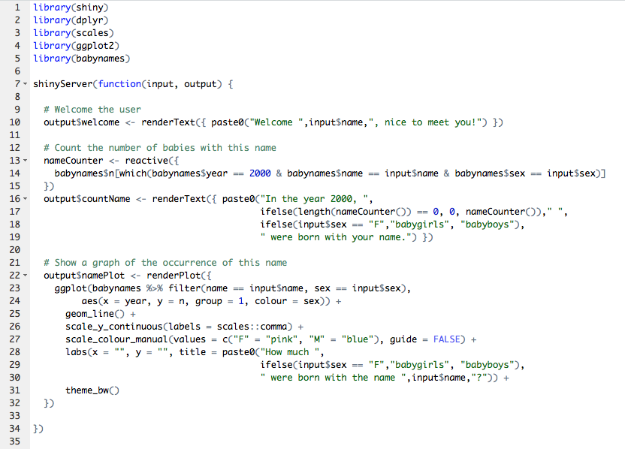
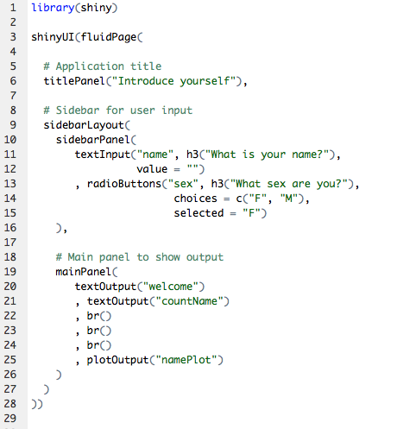
Reactivity
In every Shiny app, we’re working with input and output objects
For a more detailed overview of reactivity in Shiny, visit this website: https://shiny.rstudio.com/articles/reactivity-overview.html
Notes:
Every input object is stored in a list called ‘input’, output object is stored in a list called ‘output’. This can be any type of input or output; text, graphs, an image, or even an extra UI element! Here you see the UI object and the Server function behind the example app. First, let’s see where the input and output objects are.
In the UI object, we explain Shiny where each element should go. We usually show input objects in the side panel, and output objects in the main panel. For this app, we have two input objects: one textInput that we call “name” [click], and the selection that the user makes from the set of radio buttons, which we call “sex” [click]. The names are important, because you’ll refer to these in your Server function. So make them descriptive and unique. In addition to the input objects, we have a few output objects. We have two textOutputs, which we call “welcome” and “countName” [click]. We also have the plotOutput, this is the graph and we call it “namePlot” [click].
In the Server function, you’ll create the output objects. Remember, these are elements of a list, so we refer to them as shown here [click]. The text output that we named ”welcome” is created as an element of the list ”output”. Similarly, we create the second text output called “countName” [click], and the plot output called “namePlot” [click]. In doing so, we want to make use of the input that the user gave us! We do so by calling the relevant element of the “input” vector, like so [click]. Here, we use the name that the user gave us in order to create a personalised welcome text for the user. Similarly, we use input objects in other places in the Server function, such as here [click] and here [click].

