Slide 2
Rshiny workshop

Slide 3
Agenda:
Structure of Shiny apps
Example 1 -
Hands-on experience
Example 2 -
Hands-on experience

Slide 4
The structure of Shiny apps
Shiny apps have 2 main components:
UI object
Controls the layout and appearance of your app
Server function
Controls the logic of the app and it contains a set of instructions to get the desired output based on the input given

Slide 6
Agenda:
Structure of Shiny apps
Example 1: Basic app, UI elements management, Widgets
Hands-on experience
Example 2: Server function
Hands-on experience
Example 3: Reactivity
Hands-on experience

Slide 7
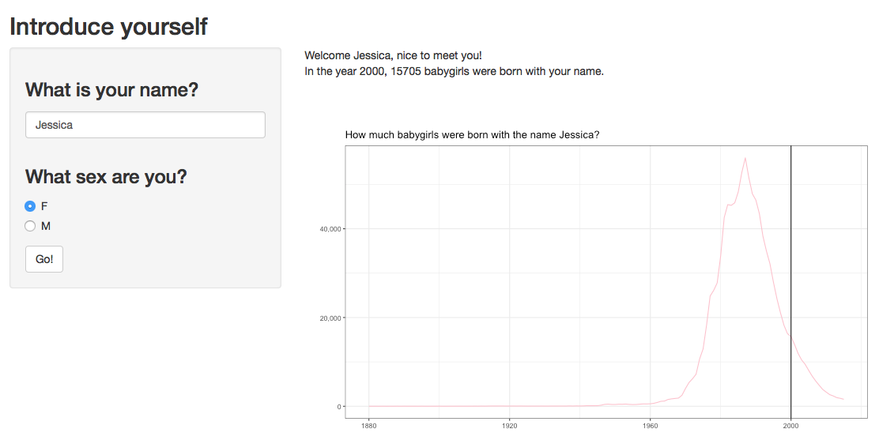
Reactivity
In every Shiny app, we’re working with input and output objects
output
input
For a more detailed overview of reactivity in Shiny, visit this website: https://shiny.rstudio.com/articles/reactivity-overview.html
Notes:
In every Shiny app, we’re working with input and output objects, as you’ve seen in the previous example. These could be independent of each other, which is what you’ve seen so far, but the great thing about Shiny apps is that we can make them reactive. That is, if the user gives a certain input, such as entering their name, the output can respond to that.
This is the example Shiny app that we’ll be working with in this section. You can see that there are three inputs; the user name, the user sex, and a button [click]. There are two outputs; a bunch of text and a graph [click]. There is a very clear distinction in the code between inputs and outputs, which makes it easy to use. Let’s have a look at the code!

Slide 8
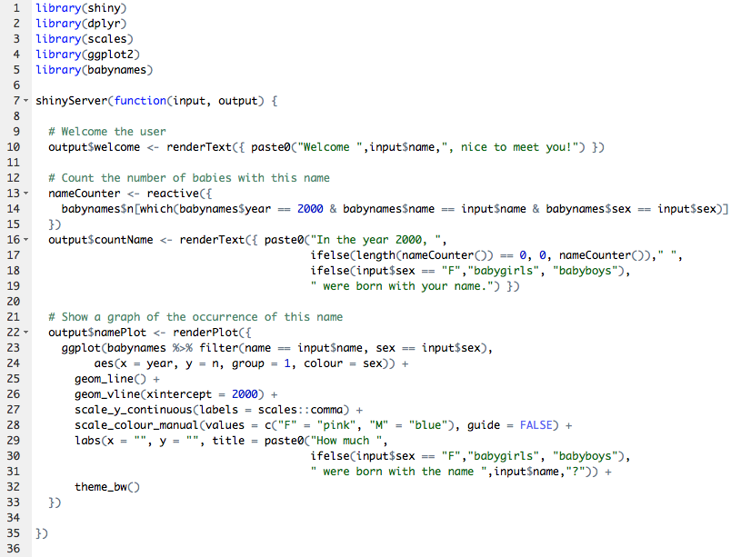
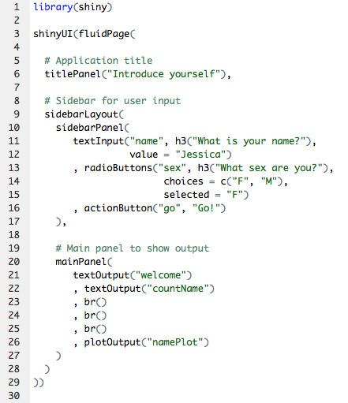
Reactivity
In every Shiny app, we’re working with input and output objects
For a more detailed overview of reactivity in Shiny, visit this website: https://shiny.rstudio.com/articles/reactivity-overview.html
Notes:
Every input object is stored in a list called ‘input’, output object is stored in a list called ‘output’. This can be any type of input or output; text, graphs, an image, or even an extra UI element! Here you see the UI object and the Server function behind the example app. First, let’s see where the input and output objects are.
In the UI object, we explain Shiny where each element should go. We usually show input objects in the side panel, and output objects in the main panel. For this app, we have two input objects: one textInput that we call “name” [click], and the selection that the user makes from the set of radio buttons, which we call “sex” [click]. The names are important, because you’ll refer to these in your Server function. So make them descriptive and unique. In addition to the input objects, we have a few output objects. We have two textOutputs, which we call “welcome” and “countName” [click]. We also have the plotOutput, this is the graph and we call it “namePlot” [click].
In the Server function, you’ll create the output objects. Remember, these are elements of a list, so we refer to them as shown here [click]. The text output that we named ”welcome” is created as an element of the list ”output”. Similarly, we create the second text output called “countName” [click], and the plot output called “namePlot” [click]. In doing so, we want to make use of the input that the user gave us! We do so by calling the relevant element of the “input” vector, like so [click]. Here, we use the name that the user gave us in order to create a personalised welcome text for the user. Similarly, we use input objects in other places in the Server function, such as here [click] and here [click].

Slide 9
Reactivity
When output objects depend on input objects, they need to be placed in a reactive context
For a more detailed overview of reactivity in Shiny, visit this website: https://shiny.rstudio.com/articles/reactivity-overview.html
Notes:
In order to use input objects in your Server function, you need to put them in a reactive context. You might have not realised, but you’ve already worked with some types of reactive context, such as renderText [click][click], renderPlot [click], and the other render functions that Aylin showed you. Every output object needs to be created in a reactive context for it to work. However, there are also other types of reactive contexts, such as this one [click], where we assign a value to the variable nameCounter which is dependent on the input values “name” and “sex”.

Slide 10



Reactivity
Responds directly to a change in input objects
Reactive environment, evaluates code
Creates a reactive object
observe({expr})
reactive({expr})
Responds only to a certain event (e.g. button click)
observeEvent(event,{expr})
eventReactive(event,{expr})
For a more detailed overview of reactivity in Shiny, visit this website: https://shiny.rstudio.com/articles/reactivity-overview.html
Notes:
As you’ve already worked a bit with the render functions, I want to focus now on a different type of reactive context. I will explain the four functions that I think are most important, after which we can try some exercises. These four functions are observe [click], reactive [click], observeEvent [click], and eventReactive [click]. In the first row, we see functions that do not contain the word ‘event’. These are functions that respond directly to a change in input objects [click]. Remember where we saw this function in the names app [click]? As soon as you change the name or sex in the sidepanel, the nameCounter variable would change, and it would reflect the number of babies born in 2000 with that name and sex. In this app, that works fine. But what if you want to do more expensive computations? Or have a lot of inputs that the user can change? You wouldn’t want to recompute everything as soon as the user changes one input value.
In that case, you could use the ’event’ functions [click]. These are functions that only respond when a specific event happens. These functions are very often used with actionButtons, such as the one we saw in the example app [click]. As soon as the user clicks the button, some action will be performed by the Server function, probably updating the output as a result.
We can also classify these four functions according to the columns. In the left column [click], you see the observe functions. These functions create a reactive environment, in which you can run any type of code you want. In the right column [click], are the reactive functions, which don’t create a reactive environment but a reactive object. A reactive object is similar to a function, in that it’s value changes as a result of input values. We therefore call these objects like a function if we want to use them in other parts of our code, like so [click]. In general, you’ll use reactive functions more often than observe functions. This is because observe functions are only useful for ‘under the hood’ calculations that don’t change the output directly.

Slide 11
Agenda:
Structure of Shiny apps
Example 1: Basic app, UI elements management, Widgets
Hands-on experience
Example 2: Server function
Hands-on experience
Example 3: Reactivity
Hands-on experience
Notes:
I understand that reactivity is quite a difficult concept to grasp, especially when you’ve just started working with Shiny. I would advise you to play around with the code of the example app, try changing some values and see how it impacts the output. Both Aylin and I are happy to clarify and answer any questions if necessary!
Once you feel like you are ready to try some exercises related to reactivity, I’ve set up two exercises. The answers are also included in the GitHub repo, and highlighted on slides at the end of this presentation, if you want to try the exercises at home.

Slide 12
Reactivity
Exercise 1: Use the action button
Change outputs (text and graph) only when button is clicked
For a more detailed overview of reactivity in Shiny, visit this website: https://shiny.rstudio.com/articles/reactivity-overview.html
Notes:
Remember that actionButton that we mentioned a few times? After playing with the app a little bit, you might have noticed that it doesn’t actually do anything... At the moment it is just a UI element that is not used in the Server function. What I would like you to try, is make this button work. That is, the output in the main panel of the app (the text and the graph) remain unchanged until the user clicks the button. For this exercise, remember the ‘event’ functions that we talked about: observeEvent() and eventReactive(). Which one should you use here? And which to which event should your function respond?

Slide 13
Reactivity
Exercise 2: Create a third input field
Create an input field in which you can set the year you want to focus on
For a more detailed overview of reactivity in Shiny, visit this website: https://shiny.rstudio.com/articles/reactivity-overview.html
Notes:
In this second example, I want you to go a little bit further, and create another input field on which the output depends. Specifically, we want to make the focus year dependant on user input. Think about the widgets Aylin told you about, which one would be suitable for this purpose? Give it a good name so you can use the input in your Server function. How should we then change the code of this function?

Slide 14
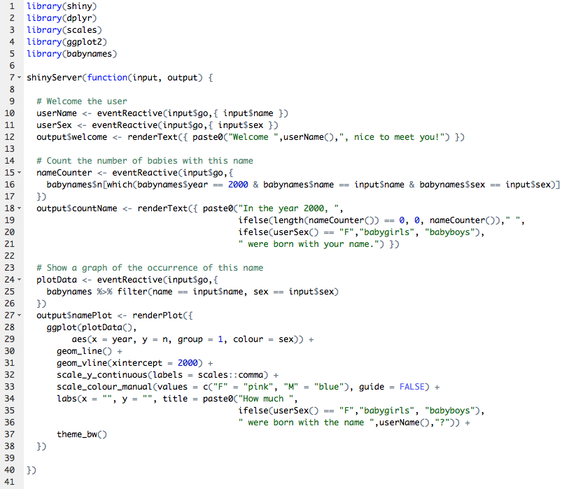
Reactivity
Exercise 1 - solved: Use the action button
Create reactive objects where necessary
Call reactive objects like you would functions
Replace reactive() function by eventReactive() function
For a more detailed overview of reactivity in Shiny, visit this website: https://shiny.rstudio.com/articles/reactivity-overview.html
Notes:
For this exercise, we want to replace any reactive() functions by eventReactive() functions. Also, wherever input objects are used to create output, we need to transform these into reactive objects. Finally, remember that a reactive object is like a function, so that’s how we should call them.

Slide 15
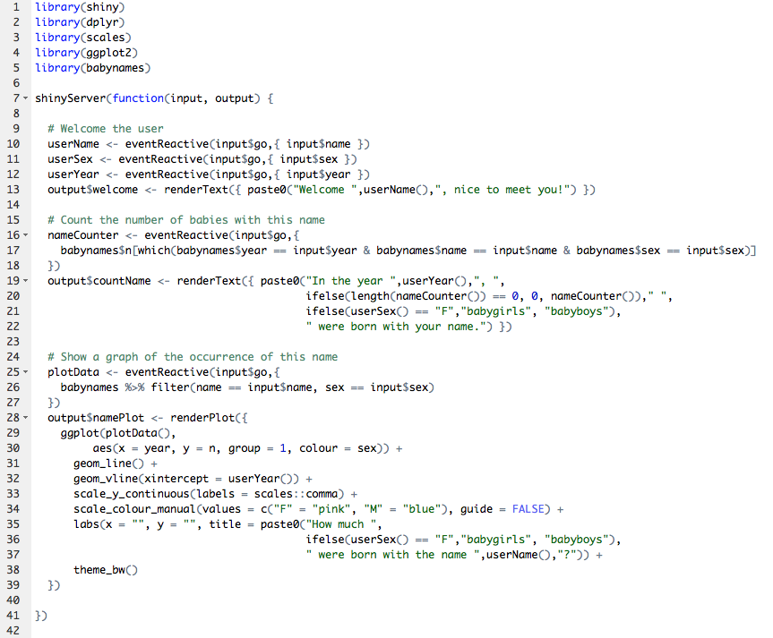
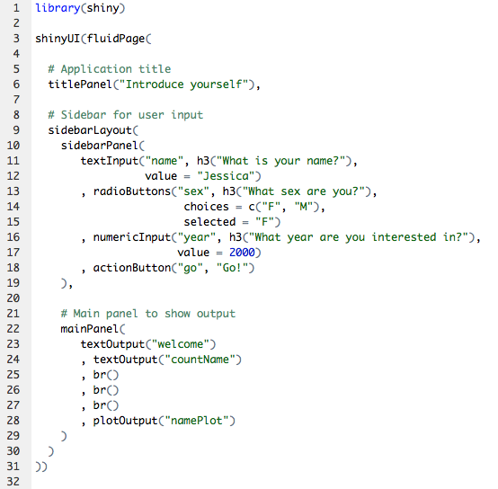
Reactivity
Exercise 2 - solved: Create a third input field
For a more detailed overview of reactivity in Shiny, visit this website: https://shiny.rstudio.com/articles/reactivity-overview.html
Notes:
In the UI object, you add another widget. I’ve called the input corresponding to this widget “year”. I’ve chosen to use a numericInput widget, but another option is to use sliderInput.
In the Server function, I created a new reactive object corresponding to the year that the user inputted, called userYear. Then, I call this object (like a function), wherever we make reference to the year.

