Slide 1
Bay Area dominant species trait data set
Objective: Collect basic leaf trait data for plant species that are dominant in major Bay Area vegetation types, with sampling (where possible) across climatic gradients occupied by the species
Scope of data set:
688 observations
Traits: Average leaf size, SLA, plant height, (leaf dry matter content??)
33 Species, ranging from 1 to 52 observations per species
Collections in 9 BA counties (not Santa Cruz) across climate gradients
Collected by Katie Fitzgerald, under supervision by W. Cornwell, summer 2010

Slide 2
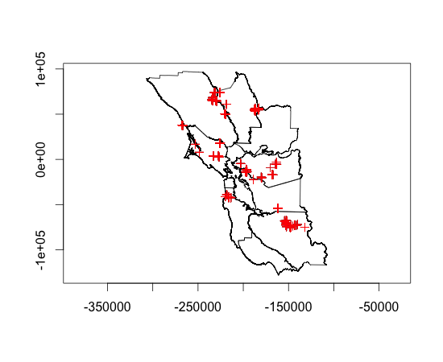
Locations of sample collections

Slide 3
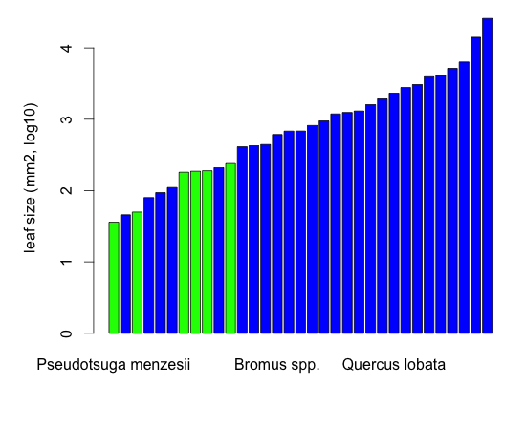
Mean leaf area (mm2, log10)
Platanus racemosa

Slide 4
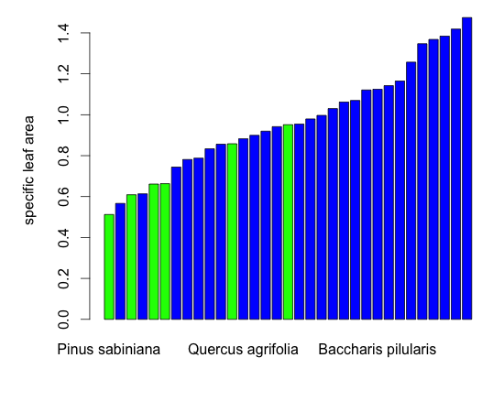
Mean specific leaf area (units?)

Slide 5
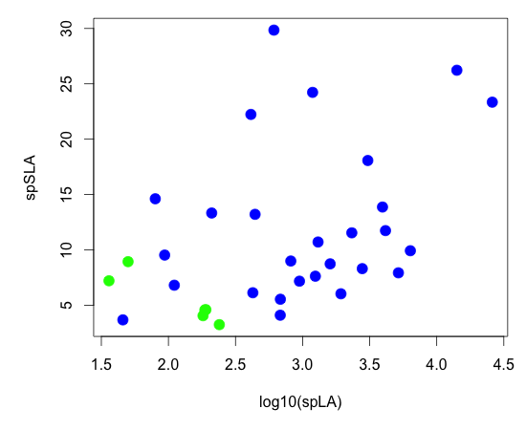
leaf size vs. SLA
R = 0.42
R = 0.31 (angios)

Slide 6
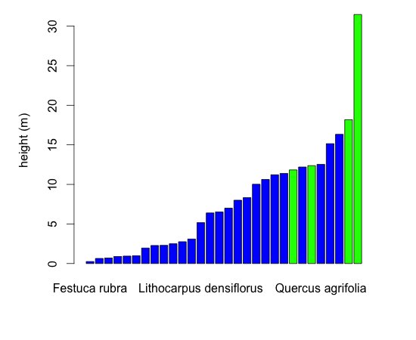
Mean height (m)

