Slide 1




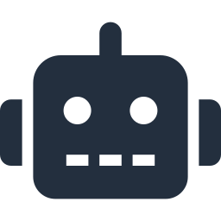

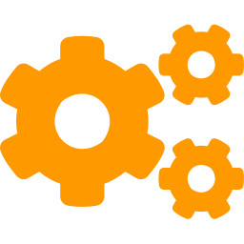


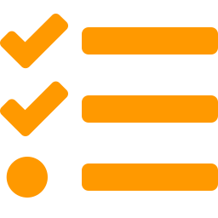





AWS-IQ — Architecture & Workflow
Serverless · event-driven · multi-agent — a request's journey end to end on AWS.
1
Web Dashboard
Profile · org chart · live progress · AI chat · FAQ
2
Amazon API Gateway
Auth (OAuth/JWT) · routing · rate limiting · TLS 1.3
HTTPS
3
Orchestrator Agent · Amazon Bedrock Multi-Agent Collaboration (supervisor pattern) — routes, aggregates, tracks state
4
Profile
Setup
Knowledge
Communication
Daily Task
Profile & org chart
Provision IT access
RAG Q&A + citations
Emails · Teams · cal
Tasks & incidents
DynamoDB
Lambda jobs
Bedrock KB
Amazon SES
DynamoDB
5
DATA & INTEGRATION SERVICES
DynamoDB
Amazon S3
Bedrock KB
Amazon SES
EventBridge
↩ Step 6: Agent responses are aggregated by the orchestrator and streamed back to the dashboard in real time (WebSocket).

