Slide 1
prediction of insurance premium
By: Ms. JESSY ALEXANDER

Slide 2
Problem statement
Project introduction
Insurance premium is an amount of money a person / business pays for an insurance policy that covers health, vehicle, home, life insurances etc.
Insurance is a policy that eliminates or decreases loss costs occurred by various risks. Machine learning (ML) for the insurance industry sector can make the wording of insurance policies more efficient.
Premiums are paid either quarterly, half-yearly or yearly depending upon the terms and conditions.
Our goal is to predict premium charges using different models of regression forecast insurance cost.
Identify which features are necessary for doing prediction.

Slide 3
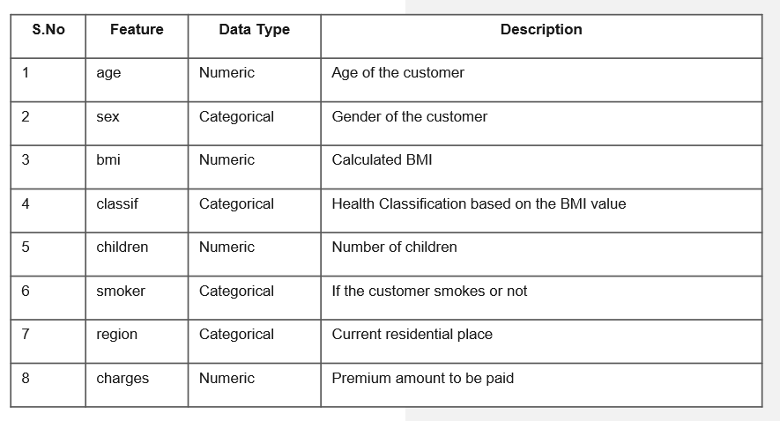
Project data source/ description of data-set
Data sets are provided by NIIT resource.
Consist of 1338 samples and 8 features.
It consist of Independent and Dependent
variables.

Slide 4
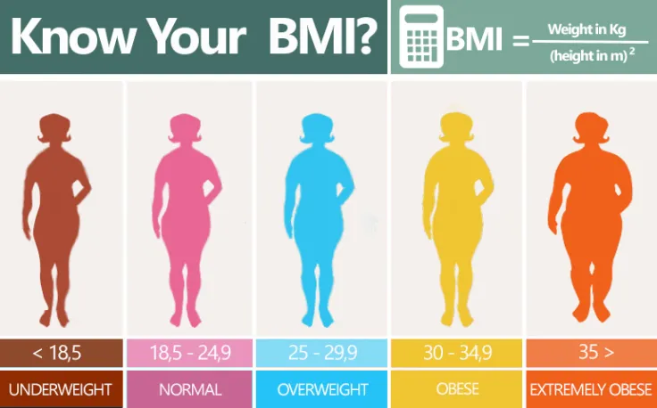
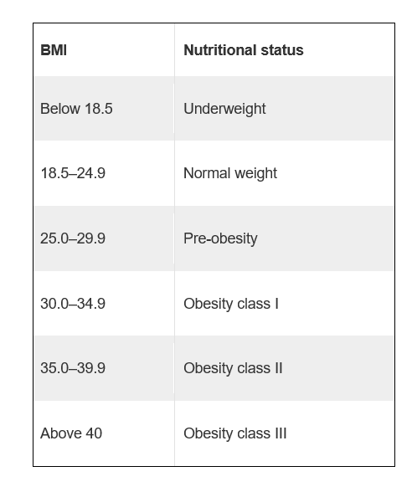
Health Classification based on the BMI value

Slide 5
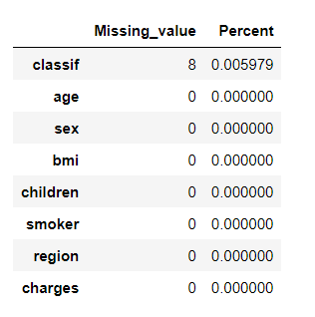
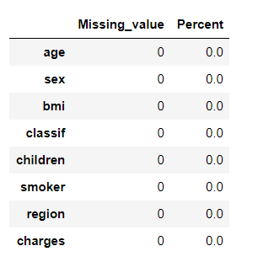
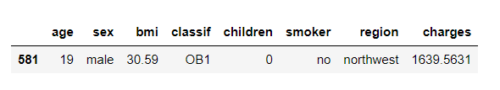
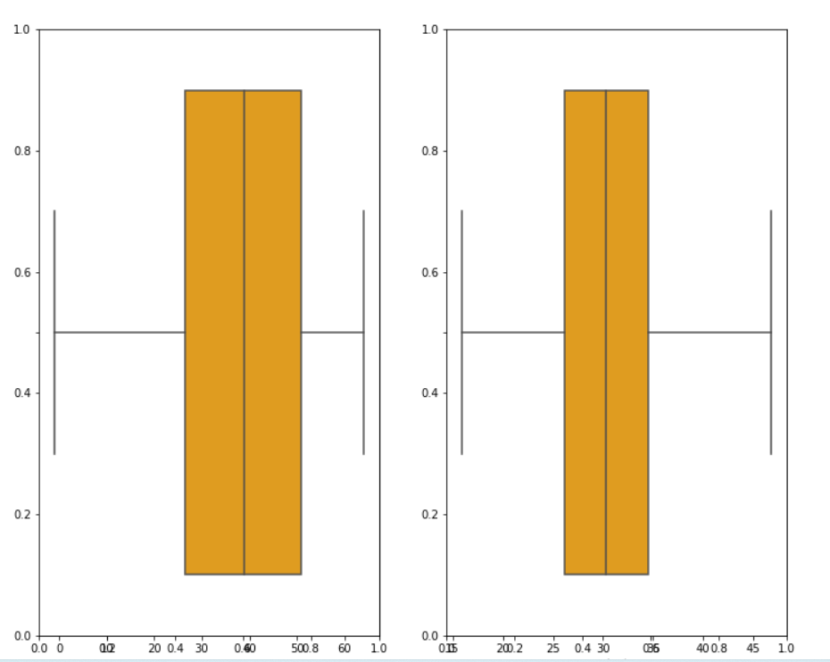
Treatment of data-set
Checking Missing Values Treating Missing Values Duplicate values
Outlier Treatment

Slide 6
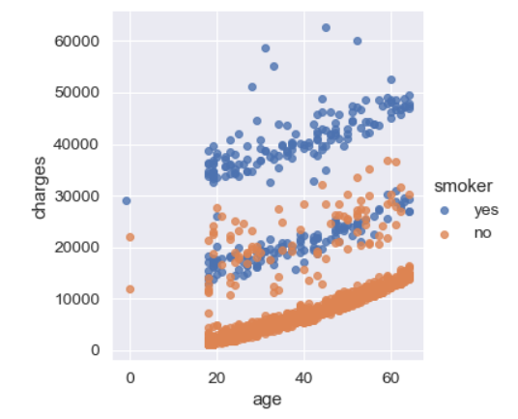
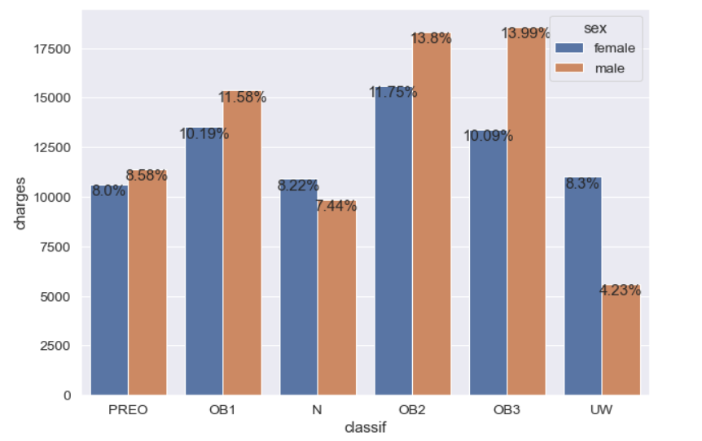
Exploratory Data Analysis (EDA)
OB2 and OB3 are having high premium rates and chance of getting heart diseases are quite high
As age increases it directly impacts the premium charges and also we can observe that smoker are paying high premium amt.

Slide 7
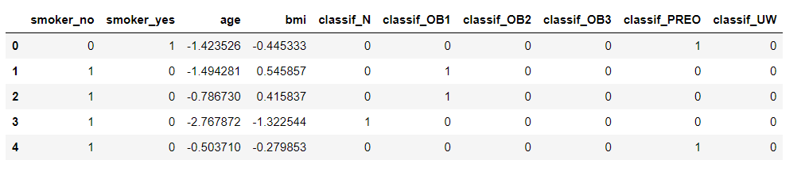
Feature selection
Forward Feature selection are used here.
Each variable is compared with target and high accuracy is taken.
Age, BMI, smoker and classification are taken.

Slide 8
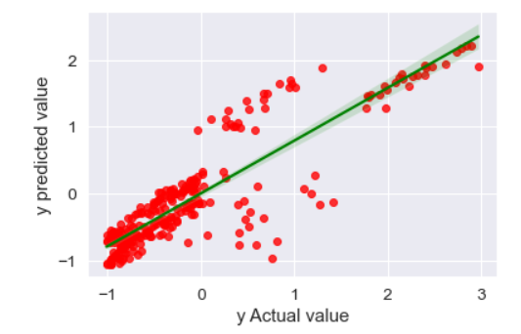
Linear regression model
Scaling the data
Splitting testing and training data set.
Feature Selection
Training 25 linear regression models.

Slide 9
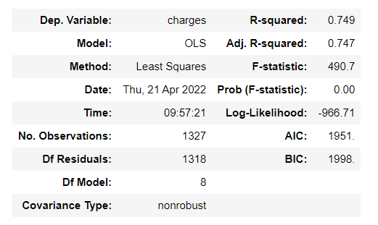
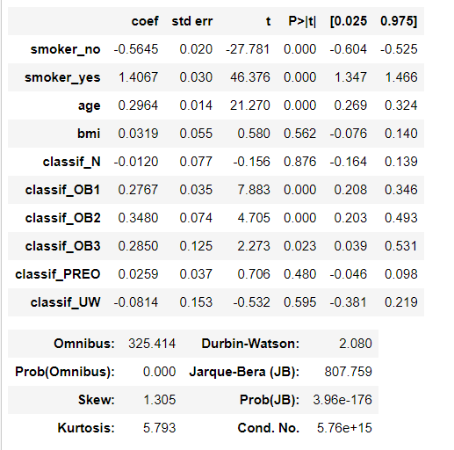
Summary of linear regression
R2 is 0.75 which is quit good so this model as good.
MSE value is 0.264

Slide 10
Modelling using different algorithms
Ridge Regression MSE = 0.195441 R-square = 0.774170
Lasso Regression MSE = 0.196324 R-square = 0.773149
Random Forest MSE = 0.165508 R-square = 0.837146
Decision Tree MSE = 0.223723 R-square = 0.808757
KNN Regression MSE = 0.242087 R-square = 0.899072

Slide 11
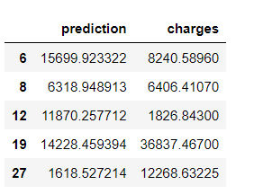
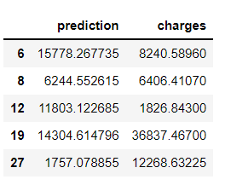
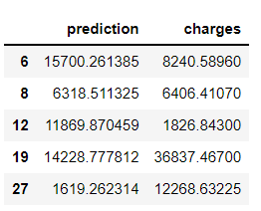
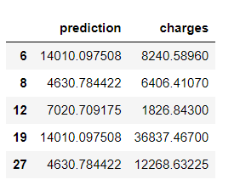
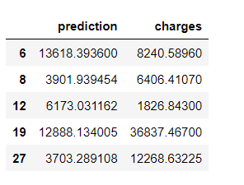
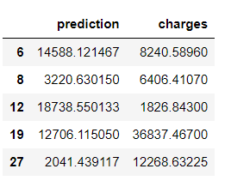
conclusion
Linear Regression
Ridge Regression
Lasso Regression
Decision Tree
Random Forest
KNN
Random forest Regression Model is best when compared to all other models since it error value is low and is Best Model.

Slide 12

Thank you

