Slide 1

Prediction of Bank Churn
By:
Ms. JESSY ALEXANDER

Slide 2
Project Introduction
One of the greatest challenges faced by service companies is to retain its customers.
More customers means more business and revenue to the company.
The cost involved in targeting new customers is a lot more than the effort to retain the existing ones. Keeping this in mind, companies (that also includes banks) try to get some insights into the customer data to identify those customers who are likely to leave (churn).
Project Statement
To determine which customers are likely to churn (leave the bank)
To determine the probabilities of churn for each customer.

Slide 3
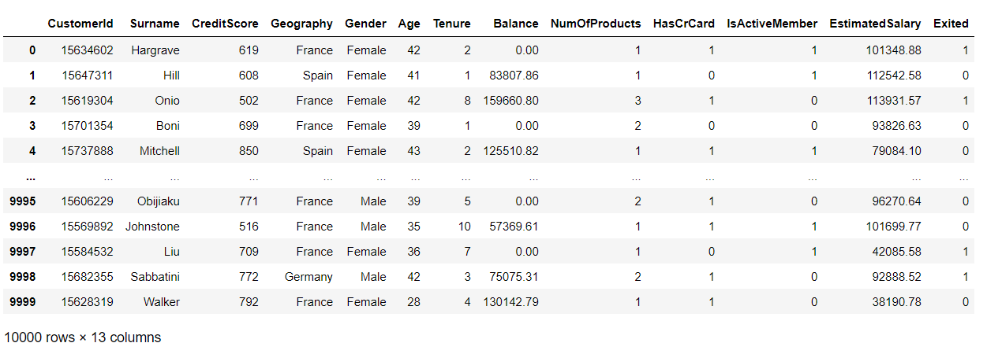
Project data source/ Description of Data-set
Data sets are provided by NIIT resource.
Consist of 10000 samples and 13 features.
It consist of Independent and Dependent variables.

Slide 4
Treatment of Data-set
Checking Null values.
Checking for duplicates.
Outliers treatment
Encoding categorical values
Scaling Data.

Slide 5
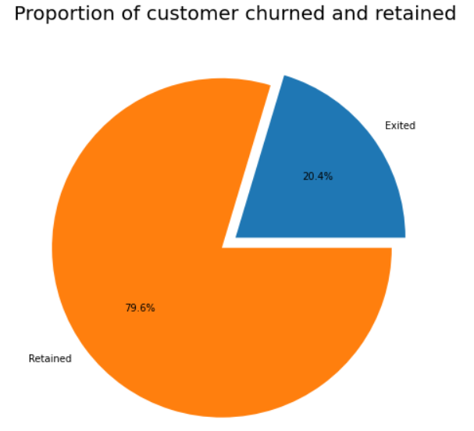
Exploratory Data Analysis (EDA) Univariate
20% of customers have churned out of the bank.

Slide 6
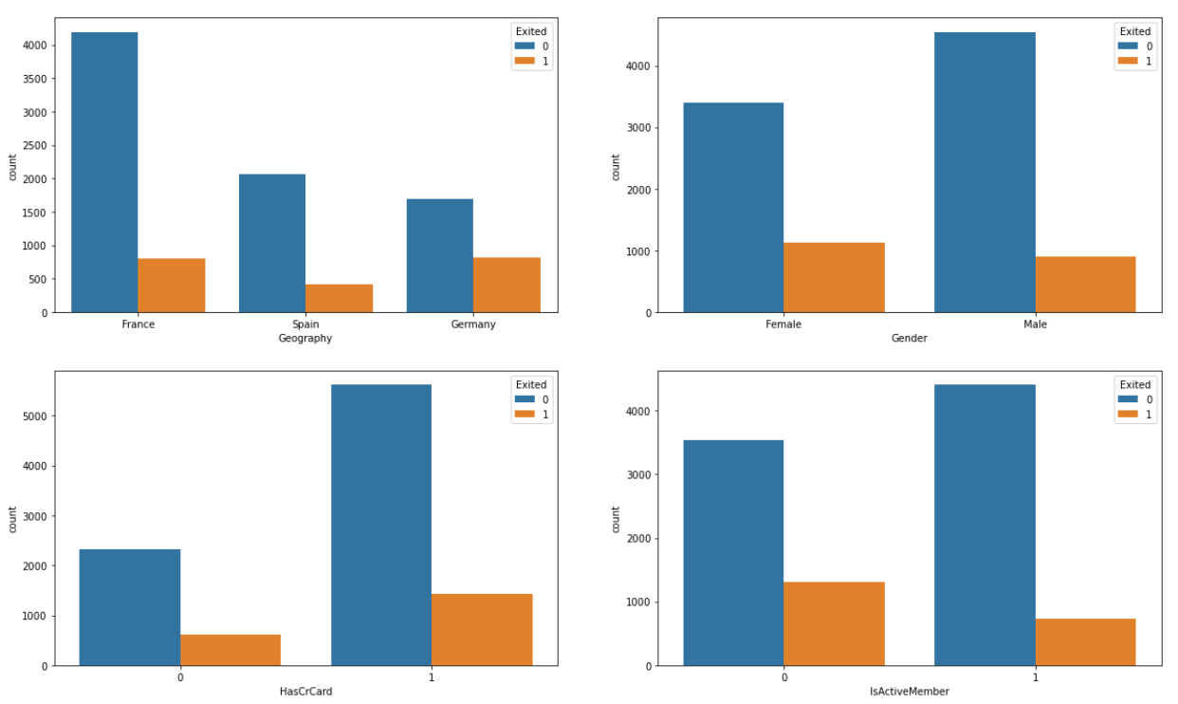
Bivariate Analysis
Most of customers leaving the bank is from France and Germany.
Female customers are leaving the bank more than of Male customers.
Those who are having Credit card are leaving the bank.
The Active members are likely leaving the bank.

Slide 7
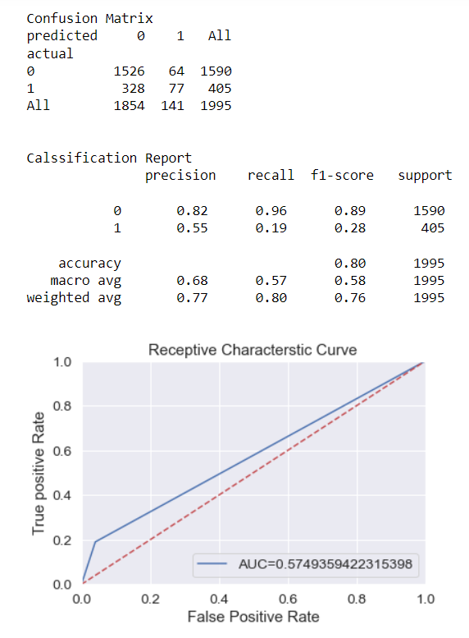
Different Algorithms
LR - Logistic Regression

Slide 8
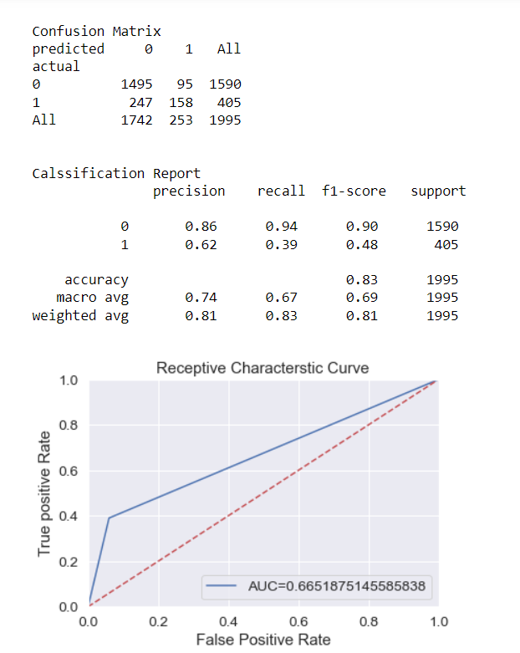
K-NN

Slide 9
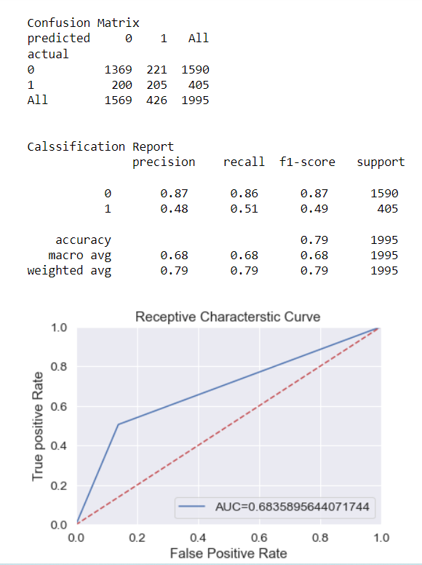
Decision Tree

Slide 10
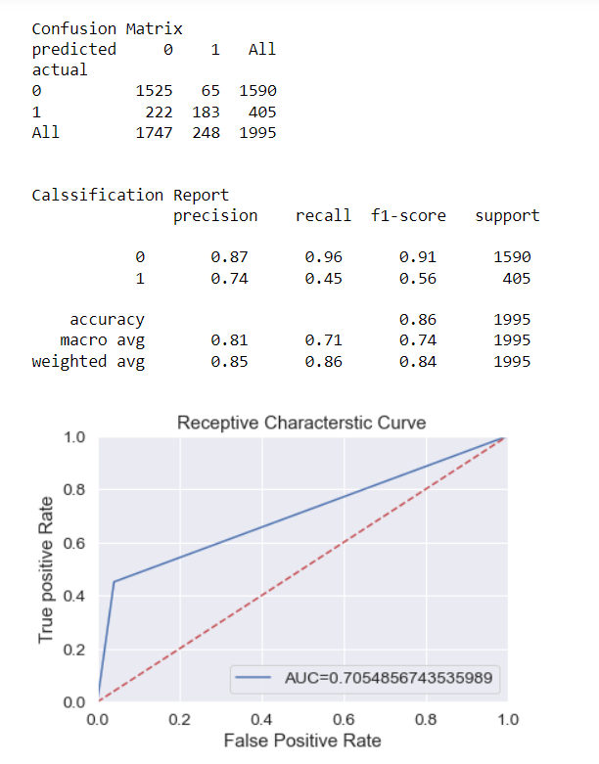
Random Forest

Slide 11
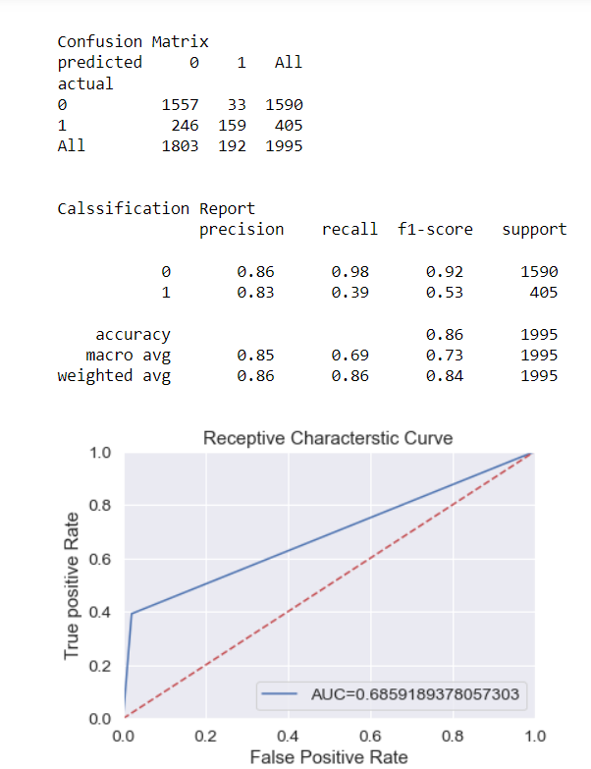
SVM

Slide 12
COMPARISON OF All ALGORITHMS
Model Name | Accuracy Score
LR | 0.803509
KNN | 0.828571
CART | 0.788972
RF | 0.856140
SVM | 0.860150

Slide 13
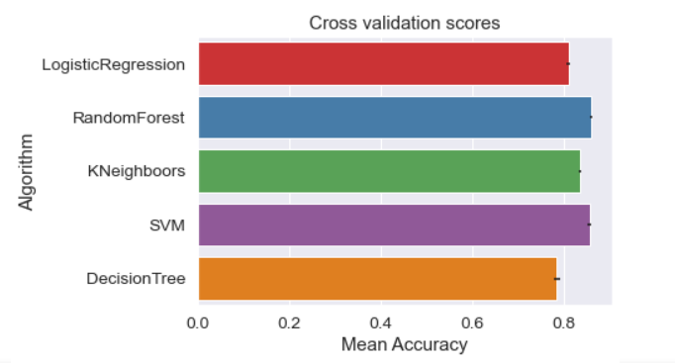
Cross Validation Results
Cross Val Mean | Cross Val Error | Algorithms
0.810831 | 0.003991 | Logistic Regression
0.858969 | 0.002859 | Random Forest
0.835025 | 0.003341 | K-NN
0.856838 | 0.003634 | SVM
0.785509 | 0.005744 | Decision Tree

Slide 14
Conclusion
Random forest is the best Algorithm because it gives best results compare to others classification algorithms.

Slide 15
Thank You

