Slide 1
FURNITURE SALES FORECAST
Presented By :
JESSY ALEXANDER

Slide 2
INTRODUCTION
To estimate the future trends – in terms of sales, profits, gains etc.
To do this analysis, the owner first has to segregate the data by category and analyze each entity separately.
For each entity, a forecast can be estimated based on the past sales of that entity.
The idea behind this is to find out the popularity of a certain product and how its sales can impact the business.
Business Objective
Build a forecast model to predict the Furniture sales of a certain store

Slide 3
TECHNICAL GOALS
Understand the data very well. Do all transformations / data engineering / etc. wherever applicable
Perform Exploratory Data Analysis (EDA)
Carry out all the Data mining tasks
Identify the salient features that will determine the best results
Perform the model evaluation to select the appropriate algorithms

Slide 4
Project Data Source/ Description of Data-Set
Data sets are provided by NIIT resource.
Consist of 9994 samples and 21 features.
S. No | Feature | Data Type | Description
1 | Row ID | Numeric | Unique row identifier
2 | Order ID | Alphanumeric | Order ID
3 | Order Date | Date | Date when the order was made
4 | Ship Date | Date | Date when the order was shipped
5 | Customer ID | Alphanumeric | Customer ID for which the order has been placed
6 | Customer Name | Character | Customer name
7 | Segment | Categorical | Type of Business (Consumer / Corporate / Home Office)
8 | Country | Character | Customer’s Country of origin

Slide 5
S. No | Feature | Data Type | Description
9 | City | Character | Customer’s city
10 | State | Character | Customer’s state
11 | Postal Code | Numeric | Address Zip code
12 | Region | Categorical | Geographical location of the state within the country
13 | Product ID | Alphanumeric | Product identification code
14 | Category | Categorical | Product category
15 | Sub Category | Character | Specific product belonging to a given product category
16 | Product Name | Character | Product name
17 | Sales | Numeric | Sales amount for the given order
18 | Quantity | Numeric | Number of item(s) purchased against the order
19 | Discount | Numeric | Discount offered on the selected product
20 | Profit | Numeric | Overall profit made
21 | Ship Mode | Categorical | Mode of Shipping

Slide 6
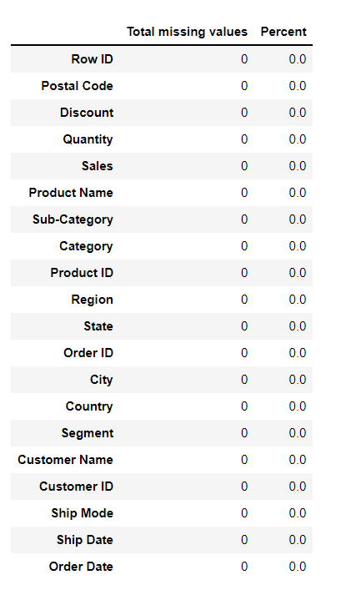
Treatment of Data Set
Checking Missing Values
Checking Duplicates

Slide 7
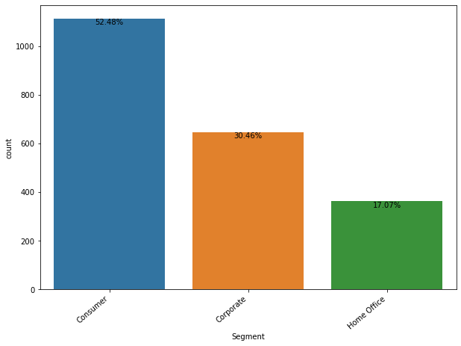
Exploratory Data Analysis (EDA)
Consumer has highest rate compared to other segments

Slide 8
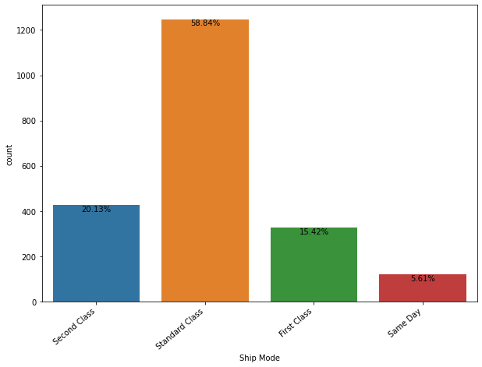
Standard Class has highest rate of count

Slide 9
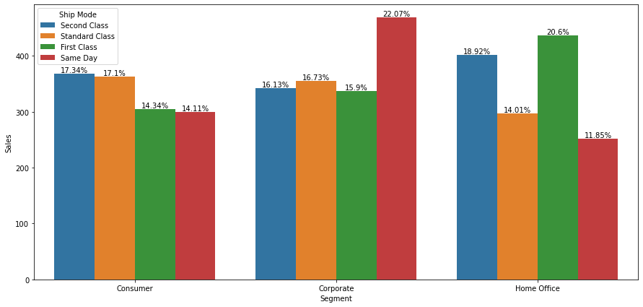
Customers in Corporate purchase more when compared to Consumers and Home Office.

Slide 10
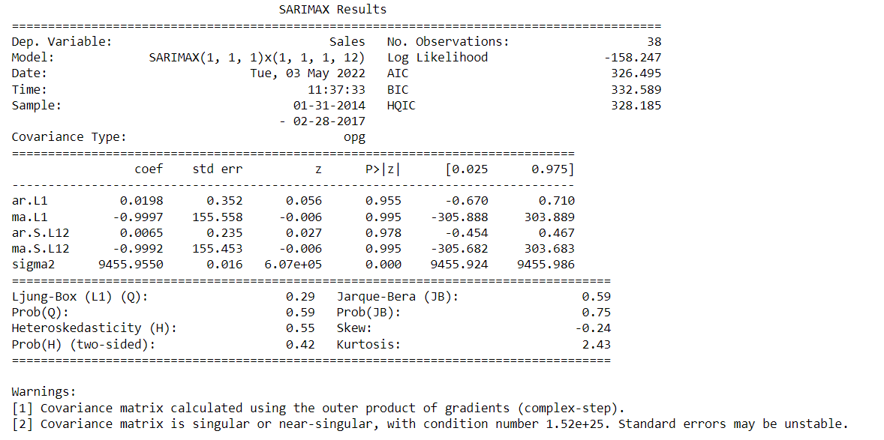
SARIMA
Seasonal Autoregressive Integrated Moving Average- method for time series forecasting with univariate data containing trends and seasonality.

Slide 11
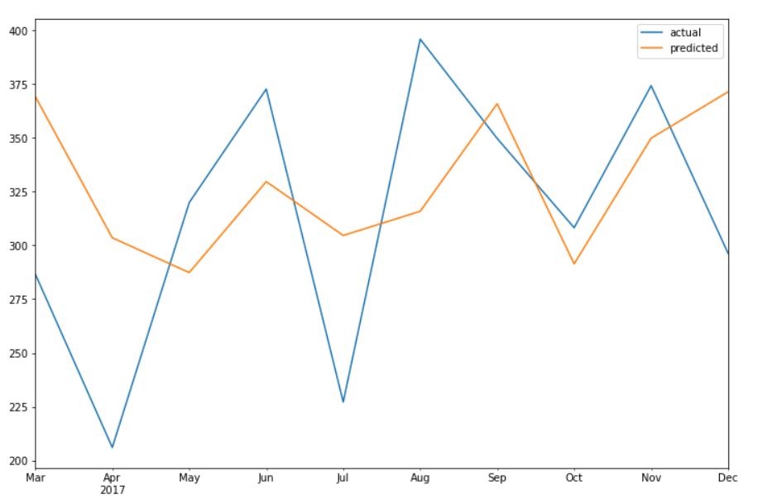
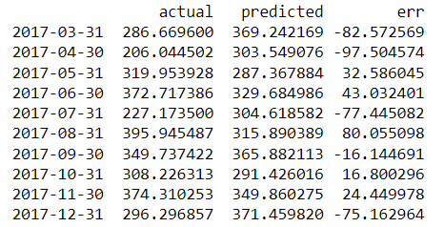
Actual vs Predicted Output
MSE = 3843.57
RMSE = 61.996565950152714

Slide 12
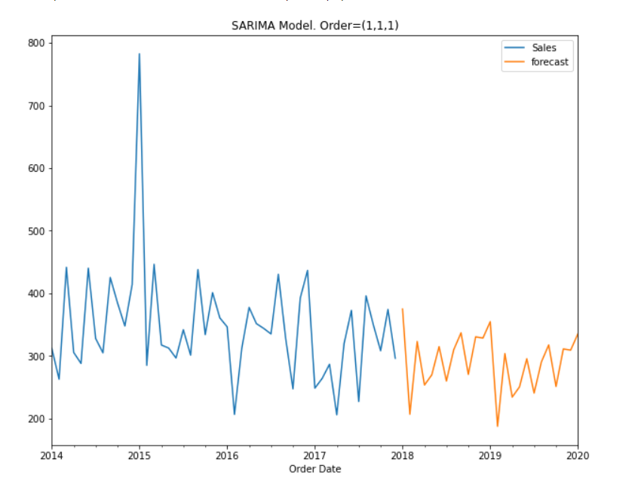
Forecast the future data using the model

Slide 13
Comparison With Other Algorithms
 | ARMA | ARIMA | SARIMA
AIC | 460.331 | 451.194 | 326.495
BIC | 466.881 | 456.027 | 332.589
MSE | 5424.78 | 5285.84 | 3843.57
RMSE | 73.65 | 72.70 | 61.99
ARMA - ARMA is a model of forecasting in which the methods of autoregression (AR) analysis and moving average (MA) are both applied to time-series data.
ARIMA - An autoregressive integrated moving average, or ARIMA, is a statistical analysis model that uses time series data to either better understand the data set or to predict future trends.

Slide 14
Conclusion
SARIMA Model is best model when compared to other algorithms.
Analyzing and forming growth strategies
#1: Product development
One way to grow is by developing a current or new product in order to meet or exceed customer expectations. If our customers love our product, they’ll stay with us, and tell their friends about it.
#2: Market penetration
To penetrate a market with something unique. The unique feature about the product or offering could be accomplished through price differentiation — where we can lower our prices more than our competitors to grab their market share or where we raise our prices higher than your competitors to capture a completely new segment of a market.

Slide 15

THANK YOU

