Slide 1
MALL CUSTOMERS SEGMENTATION
Presented By
JESSY ALEXANDER

Slide 2
INTRODUCTION
Customers who come for shopping in a mall can be grouped in a number of ways.
Shopping pattern, spending pattern, shopping score, salary etc are some of the factors that can be used to divide the customers into different categories.
The reason for these clusters is to help identify those customers who would be interested in certain products, offers and services.
The store may strategize its offerings in such a way that it targets only right customers for specific products.
This helps in creating a win-win situation for both the store (in terms of revenue and more customers through customer recommendation) and the customer (discounts, offers, reward points, gifts, etc.).

Slide 3
TECHNICAL GOALS
Understand the data very well. Do all transformations / data engineering / etc. wherever applicable
Perform Exploratory Data Analysis (EDA)
Carry out all the Data mining tasks
Identify the salient features that will determine the best results
Perform the model evaluation to select the appropriate algorithms

Slide 4
DATASET OVERVIEW
The customer dataset consist of Customer ID, age, genre, annual income and spending score.
BUSSINESS GOALS
To create Customer cluster to identify the different types of customers.

Slide 5
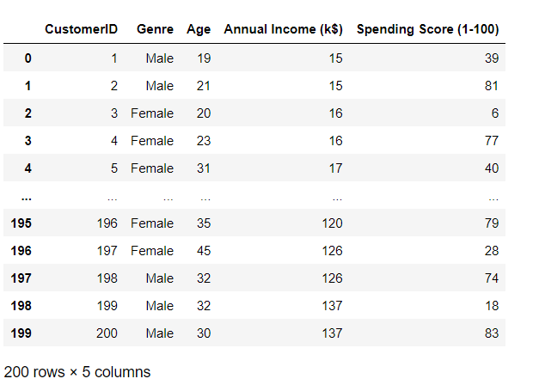
Project Data Source/ Description of Data-Set
Data sets are provided by NIIT resource.
Consist of 200 samples and 5 features.

Slide 6
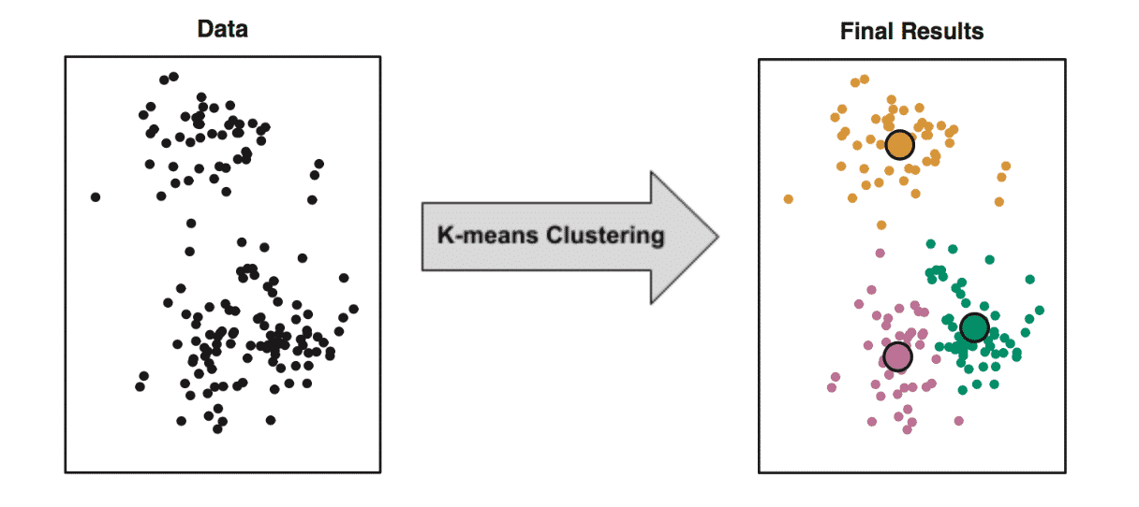
What is Clustering?
Clustering is the task of dividing the population or data points into a number of groups such that data points in the same groups are more similar to other data points in the same group and dissimilar to the data points in other groups. It is basically a collection of objects on the basis of similarity and dissimilarity between them.

Slide 7
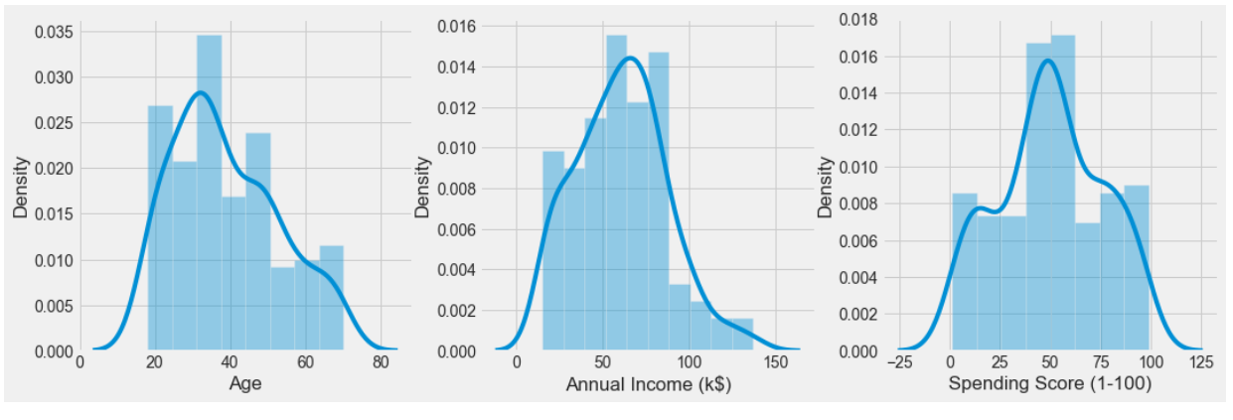
Exploratory Data Analysis (EDA)
In Age columns most people belong to 18 to 50 Age.
Maximum Annual Income 45k to 90k.
Maximum Spending Sore is 50

Slide 8
Clustering Techniques
K- Means
Agglomerative
Clustering
DBSCAN
HDBSCAN

Slide 9
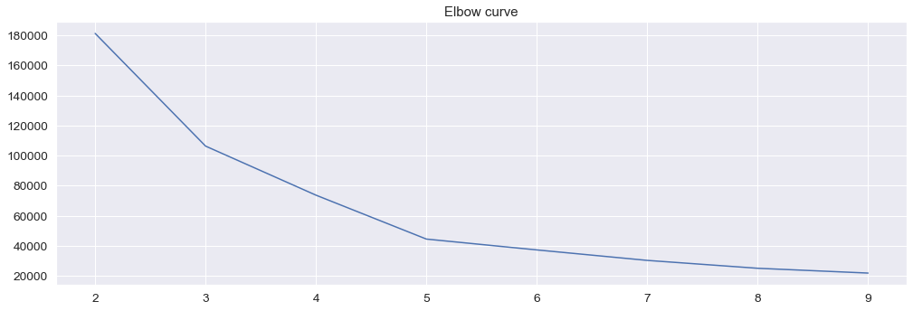
Model Building: Clustering using K- means
From graph, we have 2 sharp edges i.e. k=3 and k=5, we can see significant difference in values so we will go with k=5.
The elbow method is used to determine the optimal number of clusters in k-means clustering. The elbow method plots the value of the cost function produced by different values of k.

Slide 10
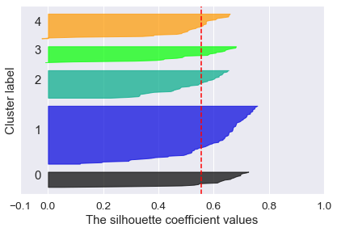
Silhouette Score
The silhouette score of 1 means that the clusters are very dense and nicely separated. The score of 0 means that clusters are overlapping. The score less than 0 means that data belonging to clusters may be wrong / incorrect.
For n_clusters = 2
0.2968969162503008
For n_clusters = 3
0.46761358158775435
For n_clusters = 4
0.4931963109249047
For n_clusters = 5
0.553931997444648
For n_clusters = 6
0.5376203956398481

Slide 11
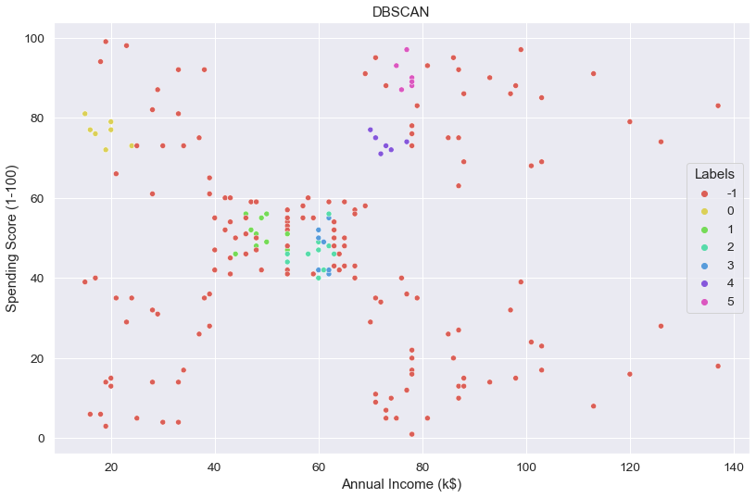
DBSCAN
DBSCAN stands for Density-Based Spatial Clustering for Applications with Noise is an unsupervised clustering algorithm which is used to find high-density base samples to extend the clusters.

Slide 12
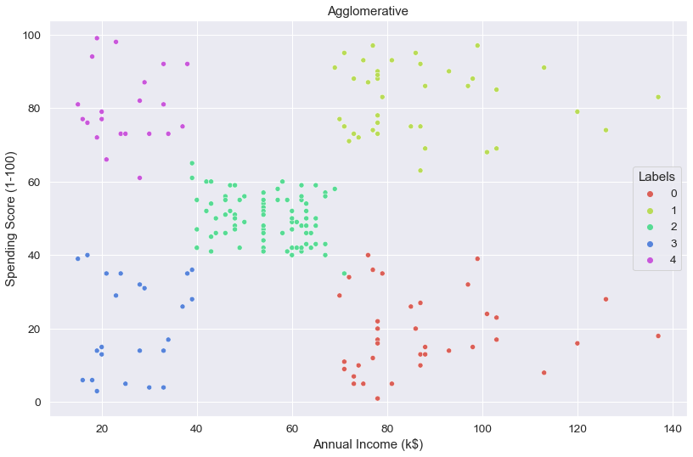
Agglomerative
Agglomerative clustering is based on hierarchical clustering which is used to form a hierarchy of clusters. It works in a “bottom-up” manner.

Slide 13
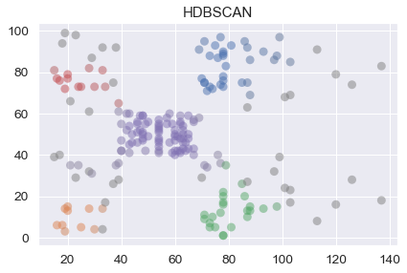
HDBSCAN
HDBSCAN is a density-based clustering algorithm that constructs a cluster hierarchy tree and then uses a specific stability measure to extract flat clusters from the tree.

Slide 14
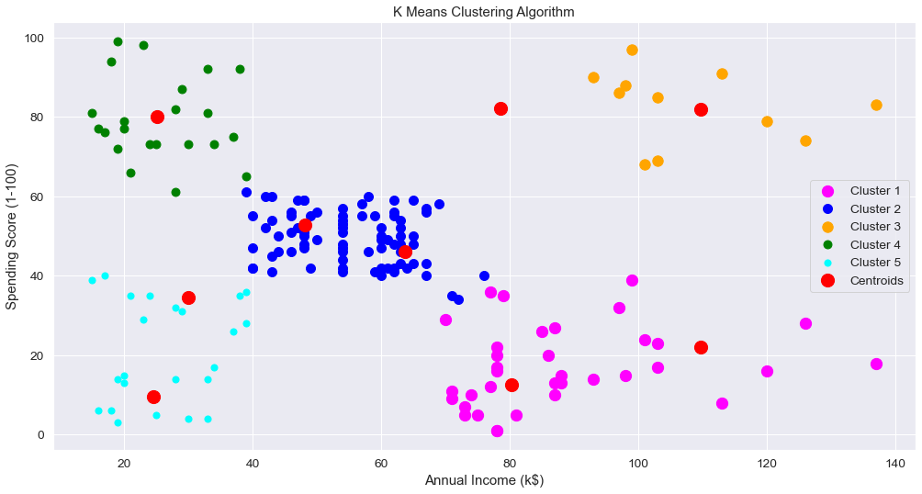
K-Means Clustering Algorithm
Conclusion
Cluster 1 -> earning high but spending more -> Miser
Cluster 2 -> average in terms of earning and spending -> General
Cluster 3 -> earning high and also spending high -> Target
Cluster 4 -> earning less but spending more -> Spend Theft
Cluster 5 -> Earning less , spending less -> Careful
Centroid
K-Means with 5 clusters gives balanced observation when compared to other clusters.

Slide 15

THANK YOU

