Slide 1


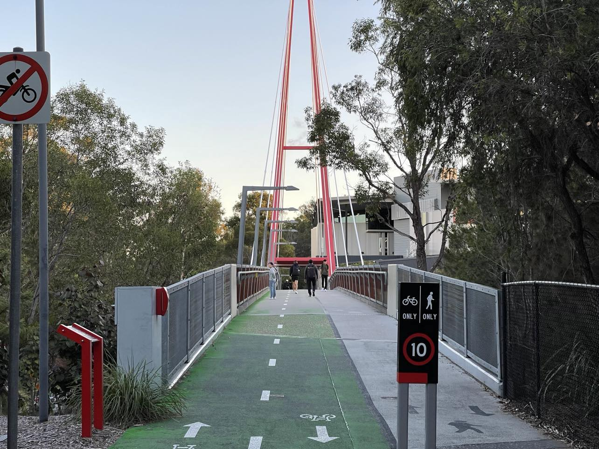
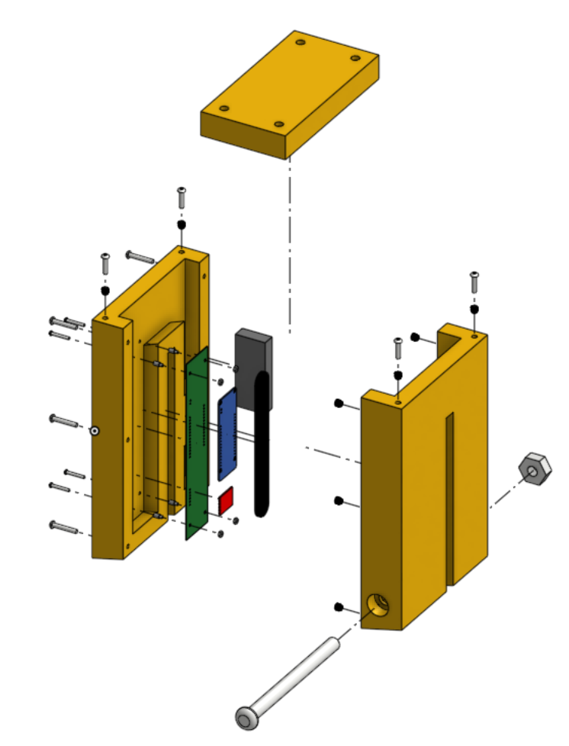
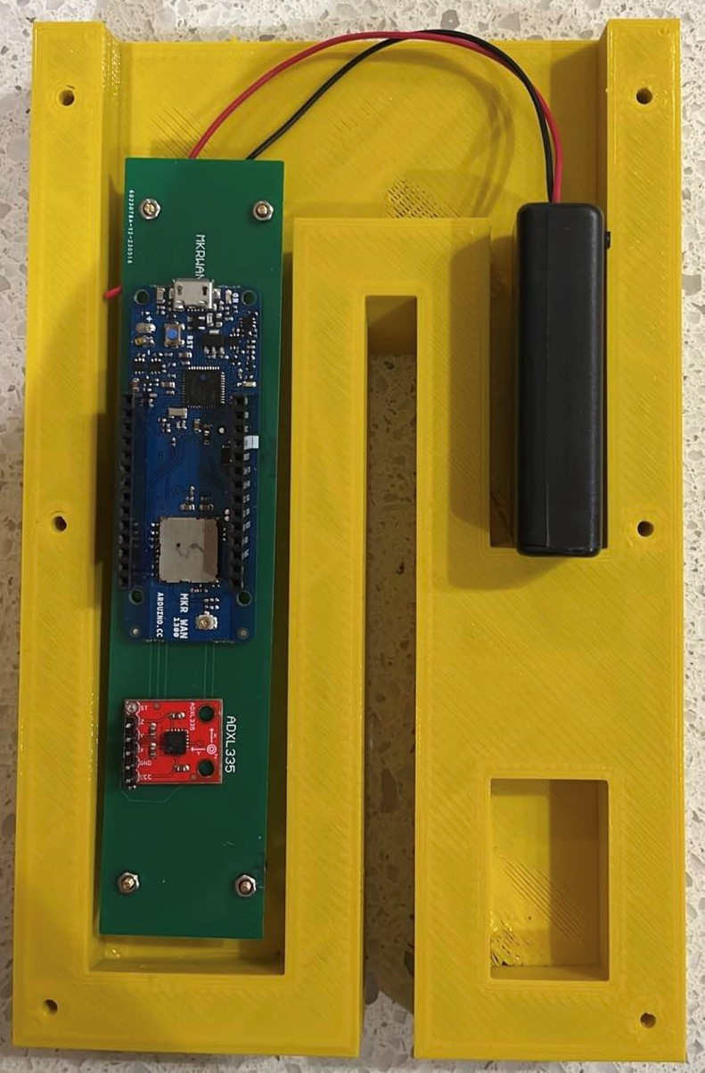
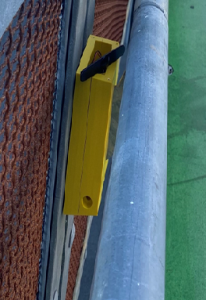
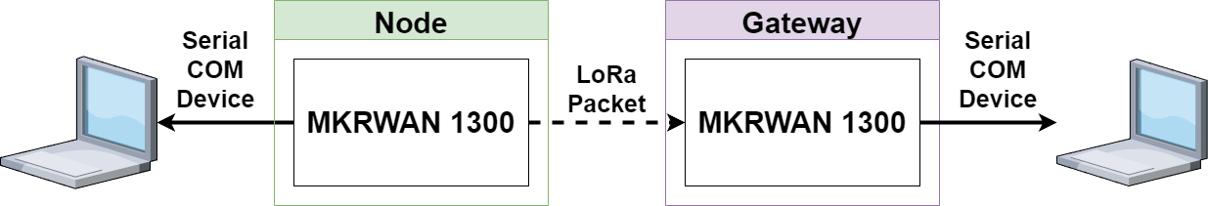
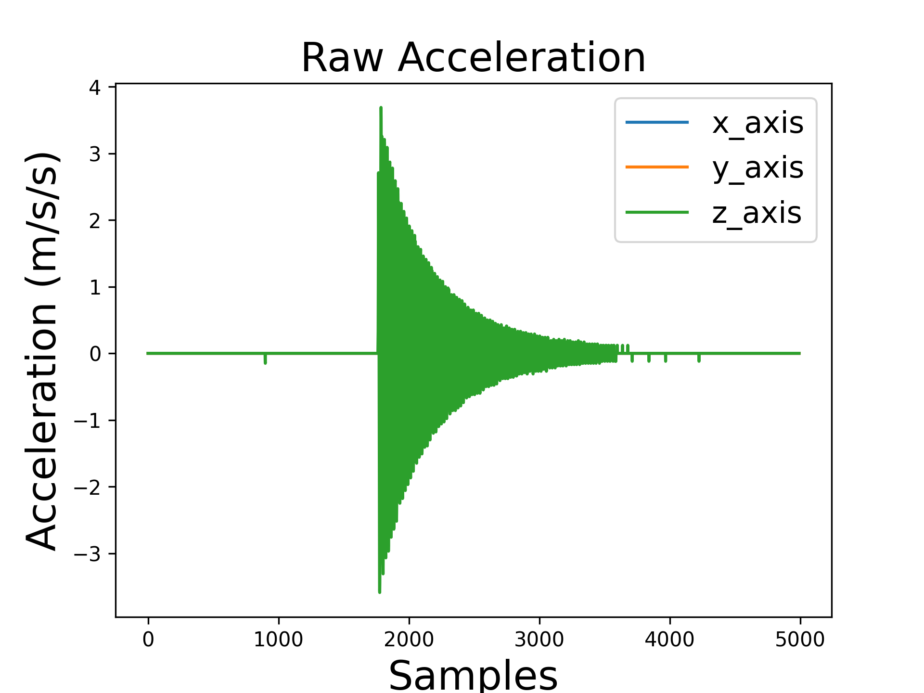
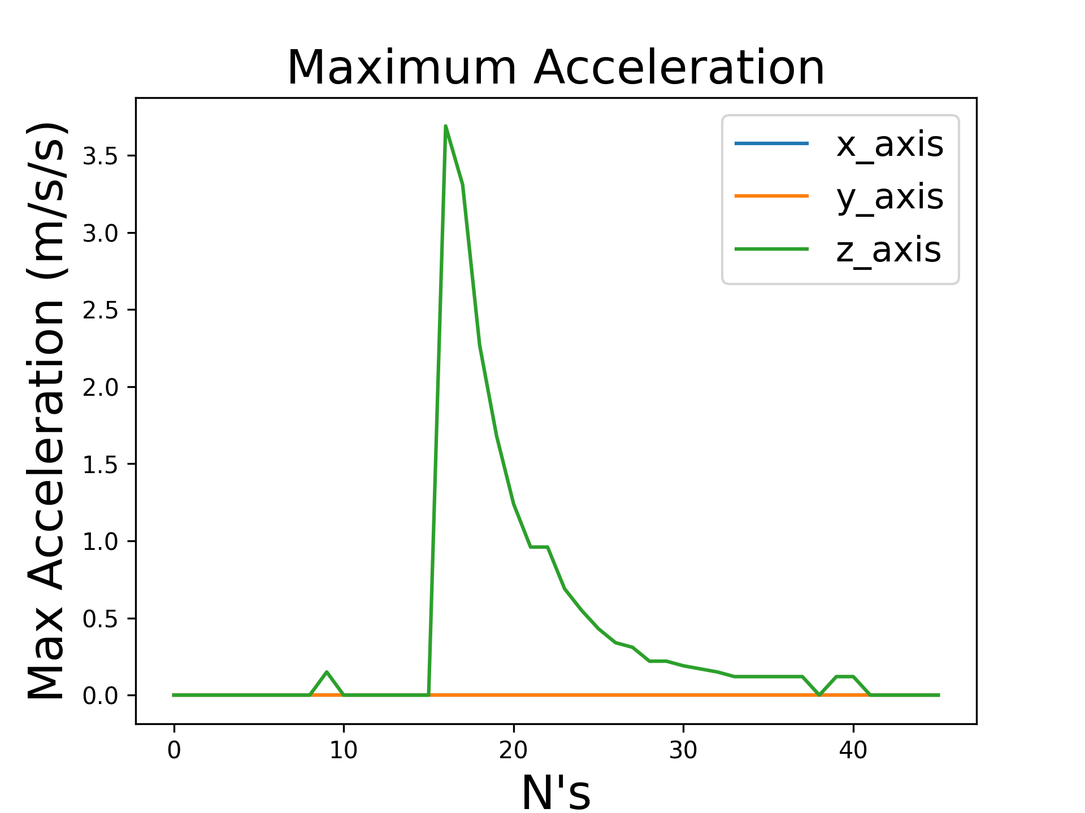
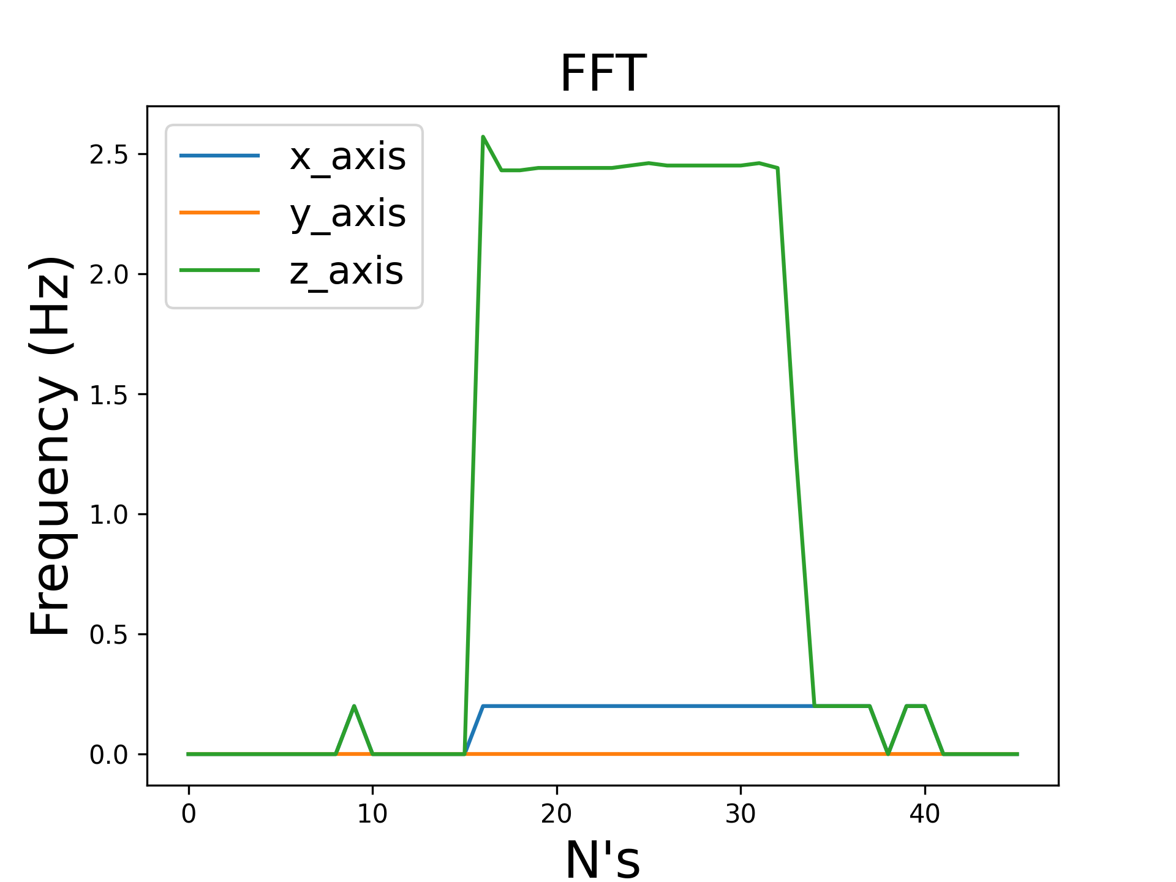
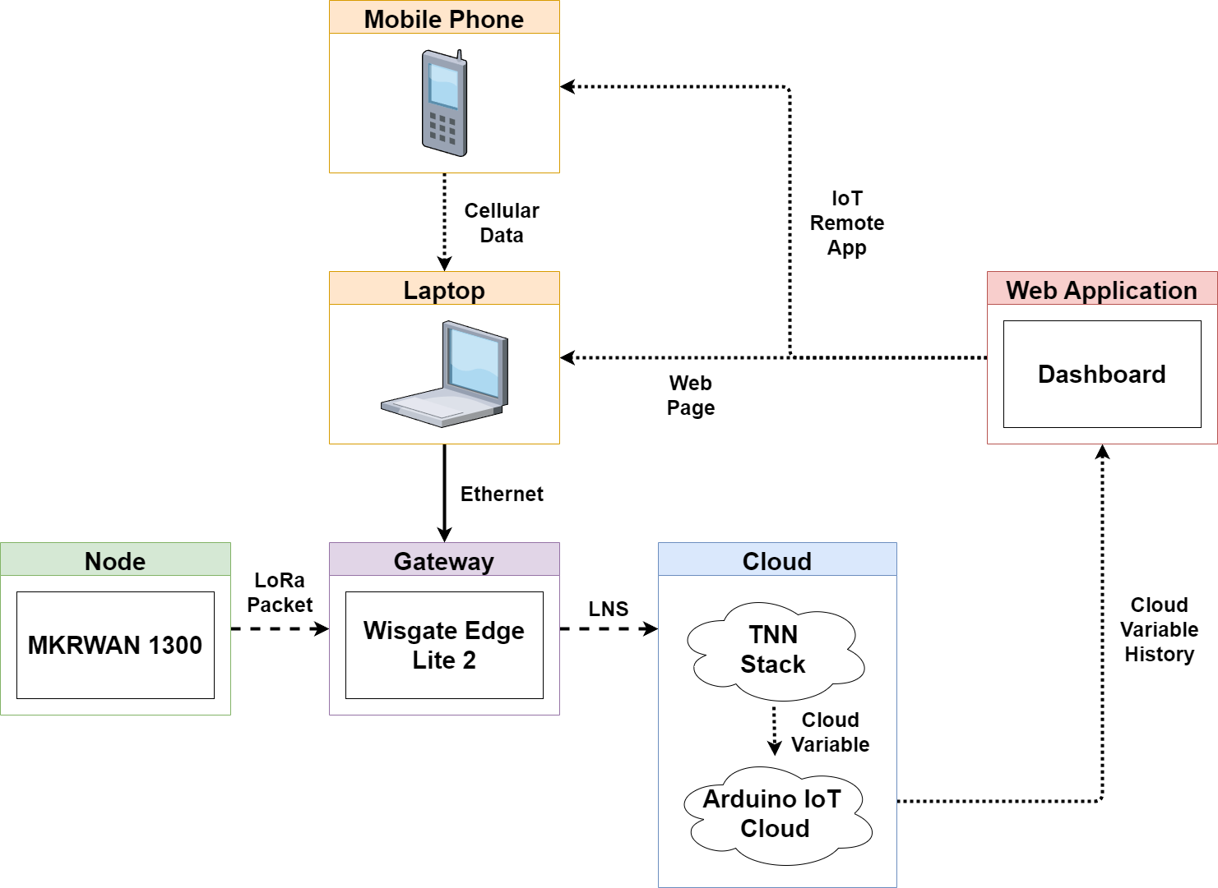
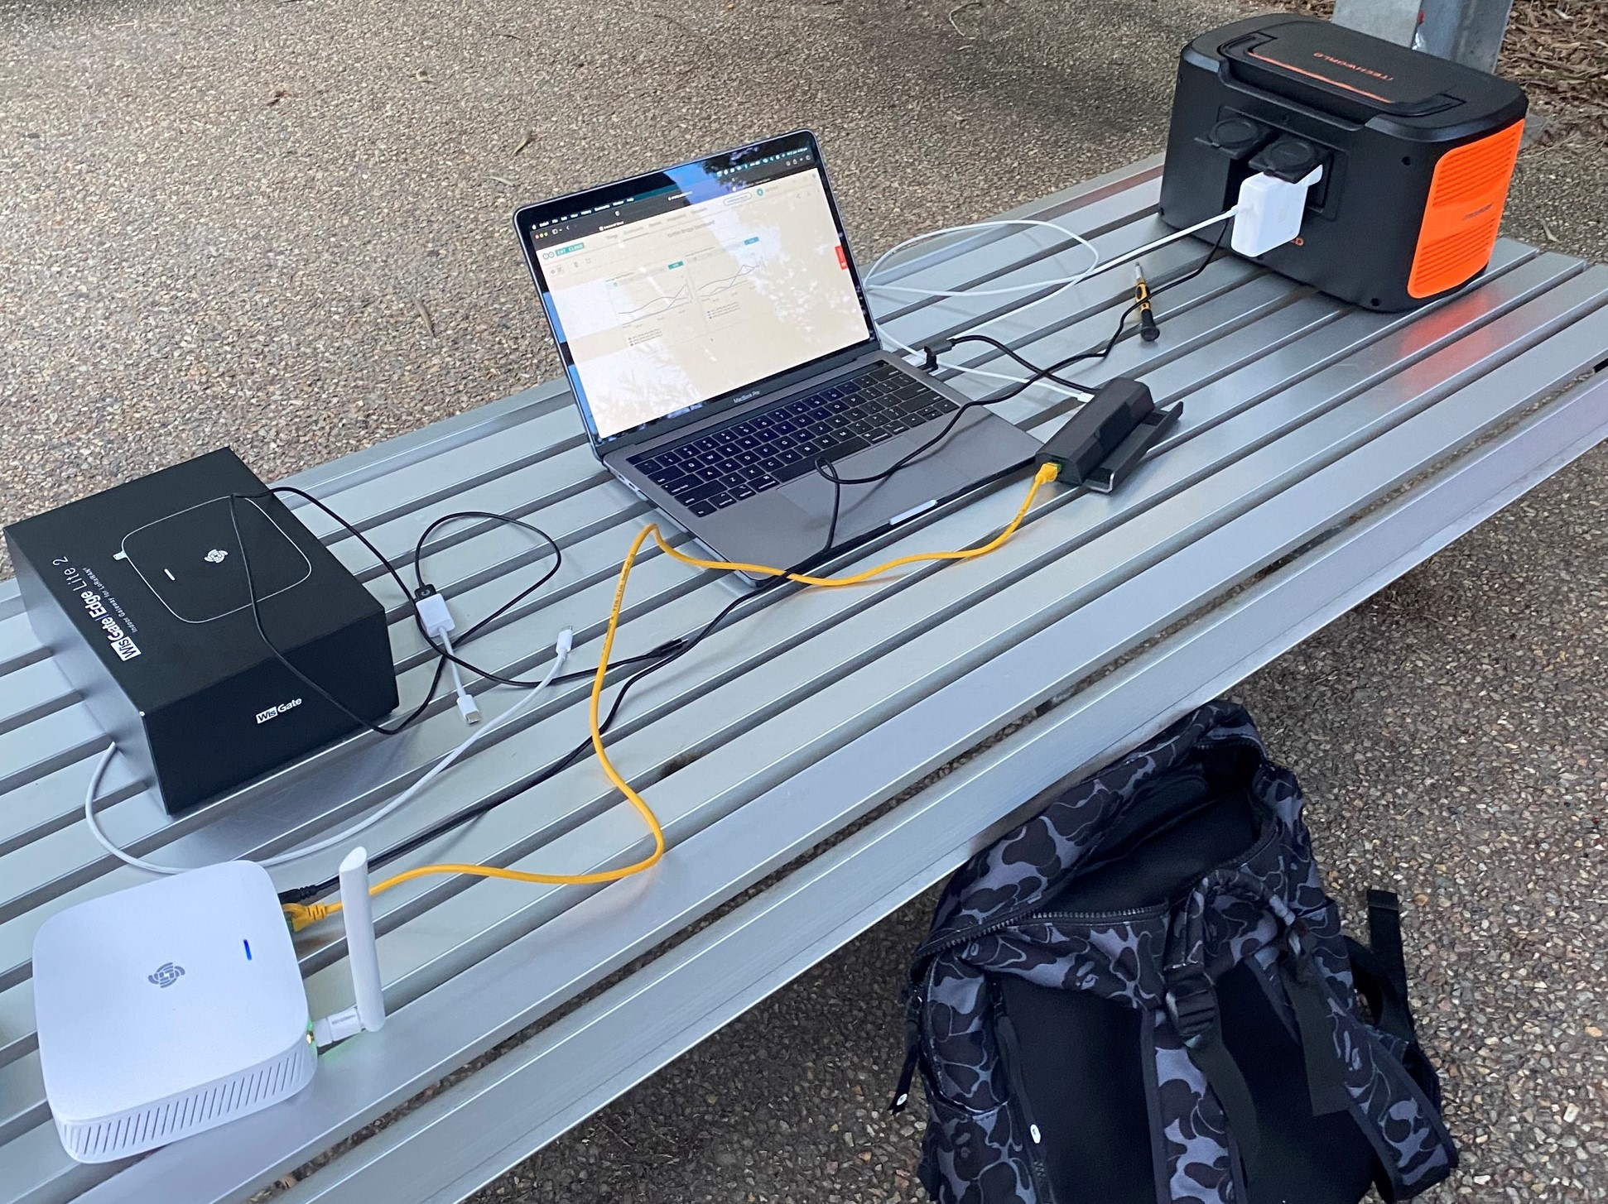

9
Structural Health Monitoring of the Griffith Footbridge
Using LoRaWAN Technology
Jessy Barber
Bachelor of Electrical & Electronics Engineering (honours)
School of Engineering and Built Environment
Introduction
Enclosure Design
LoRaWAN is an emerging technology providing a low-power, long-range communication protocol operating on the ISM radio band.
This project uses the AU915 Frequency sub band 2 (916.8MHz – 918.2MHz), OTAA and the LNS secure sub protocol.
The main objective is to deploy a full LoRaWAN IoT architecture to monitor the maximum acceleration and maximum frequency of the Griffith footbridge over time.
Approved PETG 3D Filament
Designed to sit behind handrail
Size: 20.5 cm x 13.6 cm x 7.1 cm
2 x AAA batteries: 3.0 V, 1250 mAh
Current draw: 23.8 mA -> 52.5 h
System Design
Prototype 1
Results
Prototype 2
Beam Test
Bridge Test
Conclusion
Reproduced FE simulation first mode frequency in beam experiment
Validated documented first mode flexural frequency in bridge test
Successfully demonstrated a full LoRaWAN IoT implementation
Discovered areas of improvement for future IoT deployment
Identified through SNR and RSSI that the antenna was too weak for long-range communication
Demonstrated LoRa as an effective communication protocol for structural health monitoring of the Griffith footbridge
PCB Design
Carrier board for MKRWAN1300 & ADXL335
Size: 147.6 mm x 31 mm x 0.4 mm
4 x enclosure mounting holes
Trace width: 0.254mm

