Slide 1
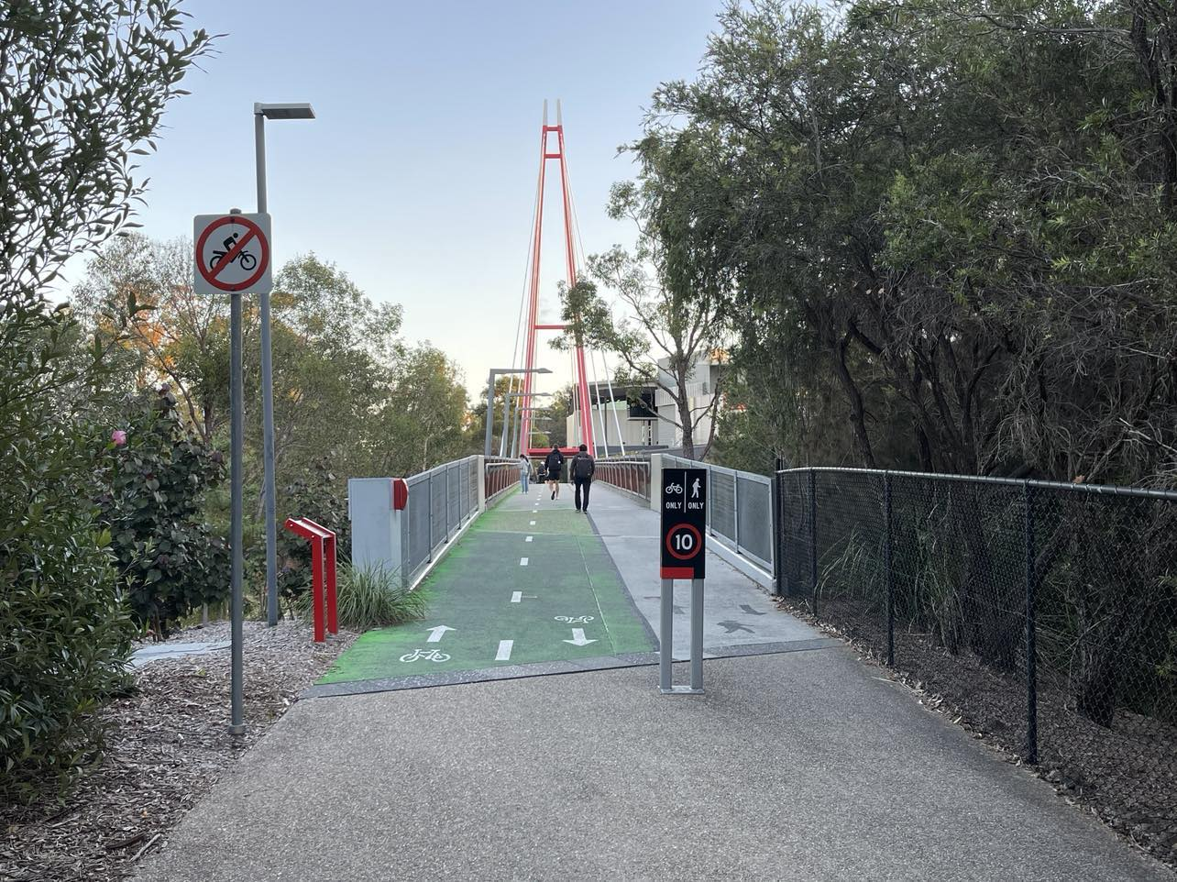
Structural Health Monitoring of the Griffith Footbridge using LoRaWAN Technology
LoRaWAN
What is LoRaWAN Technology?
IoT Architecture
Demonstration of a full IoT implementation
Design and testing of two functional prototypes
Two Prototypes

Slide 2
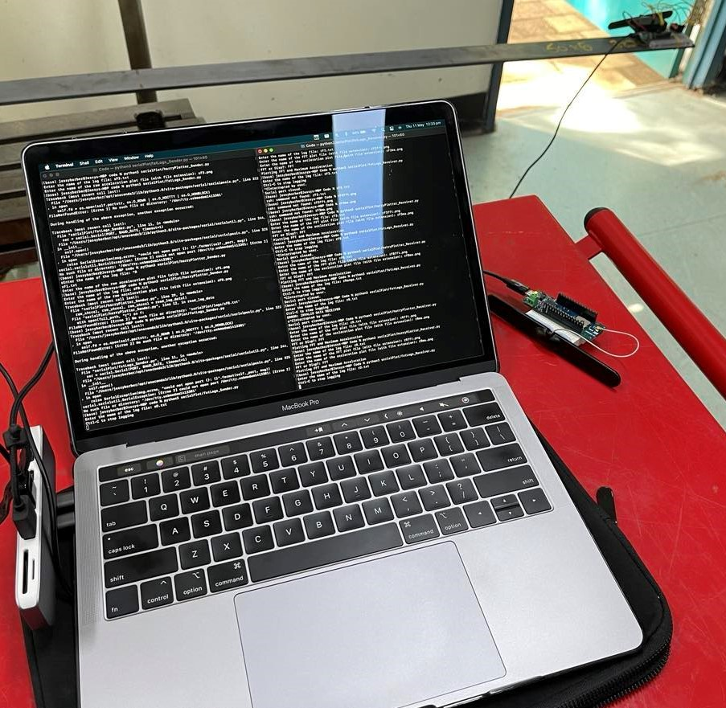

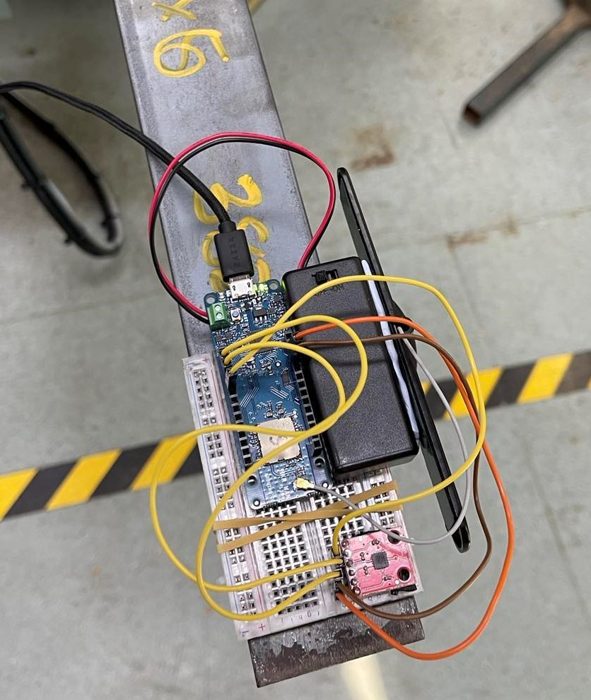
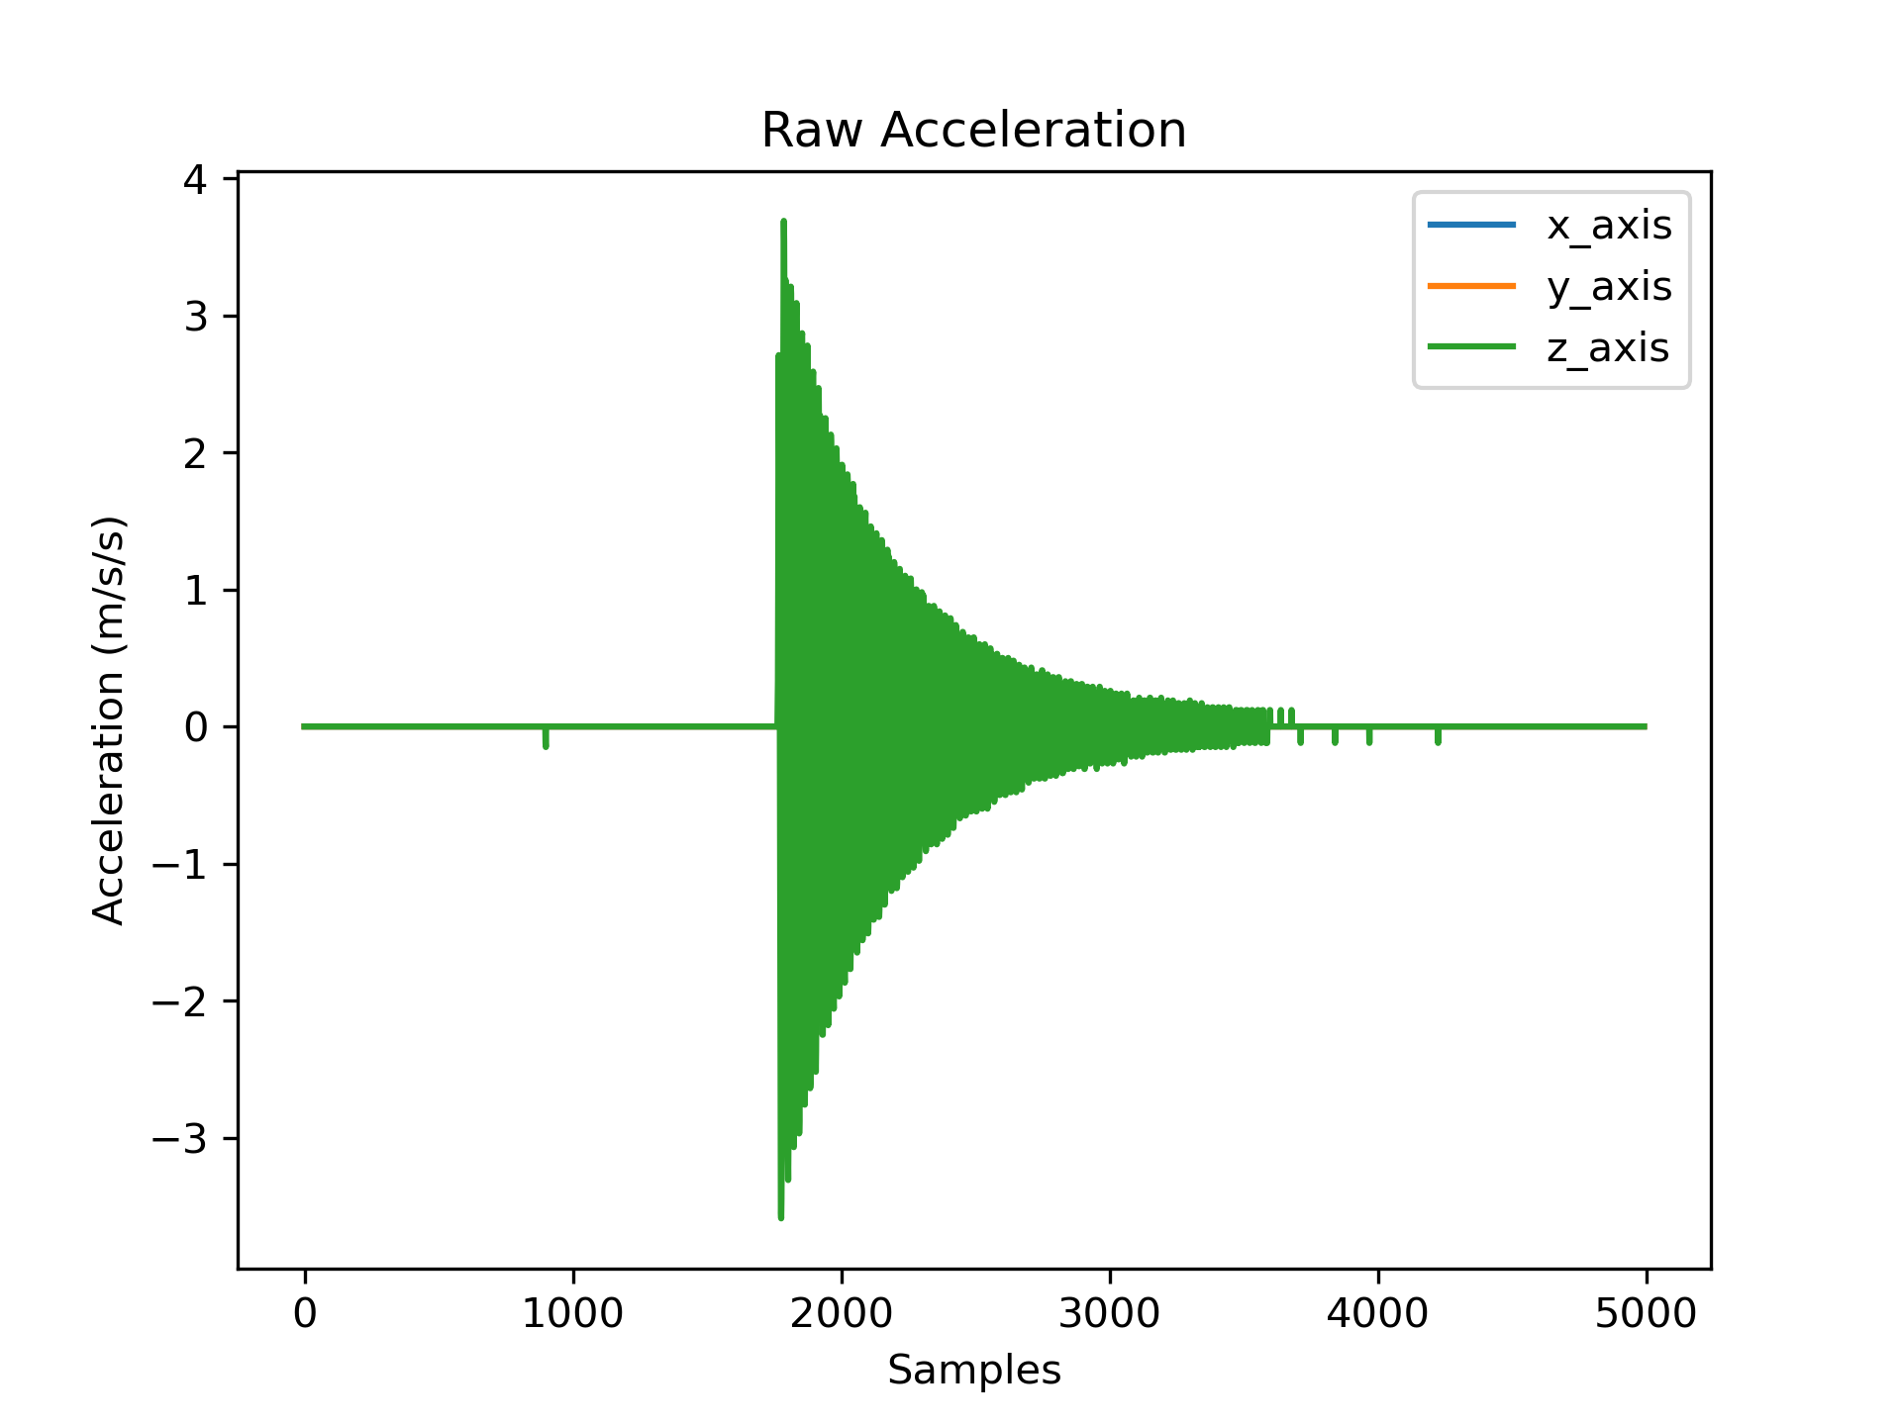
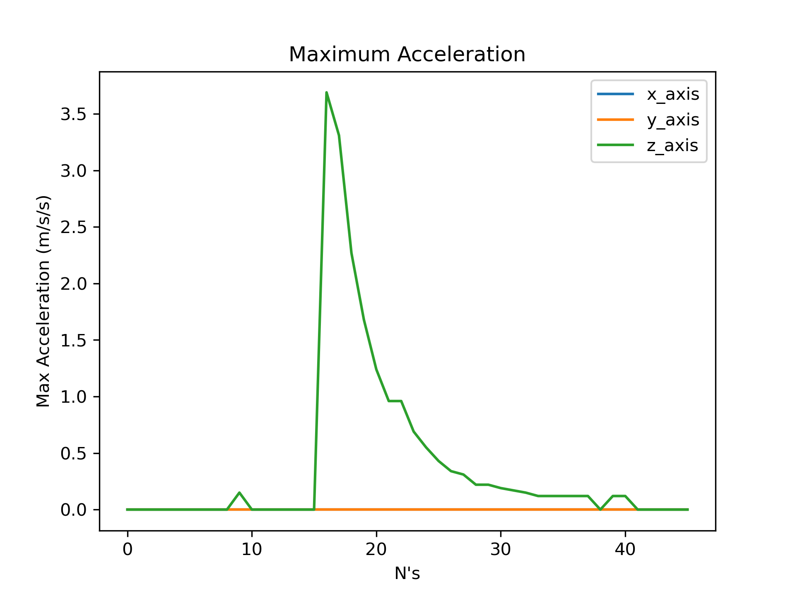
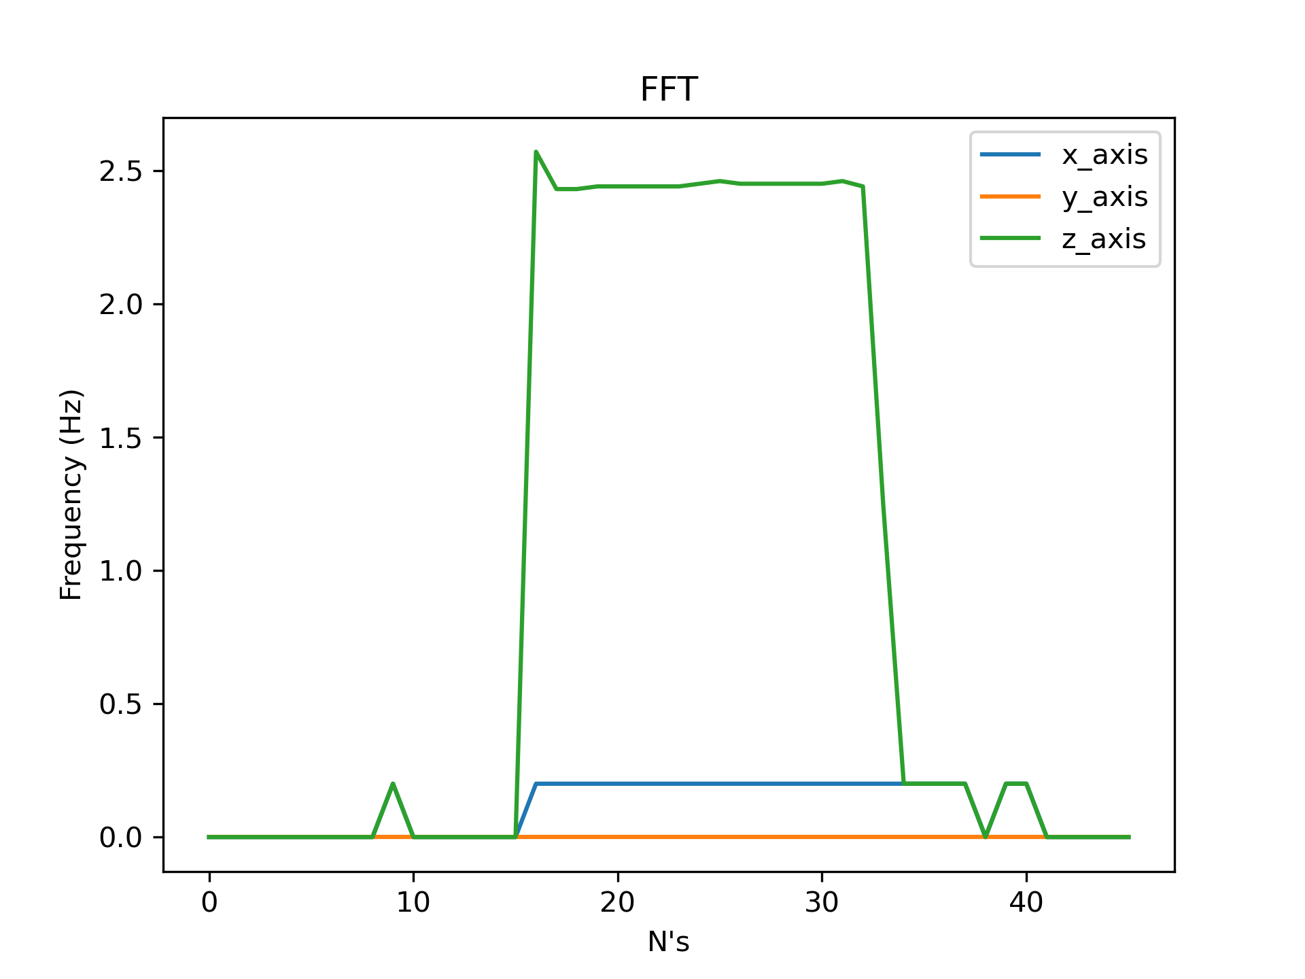
Node to node LoRa communication
Serial communication for raw acceleration
Node to node communication range: 200m
9

Slide 3
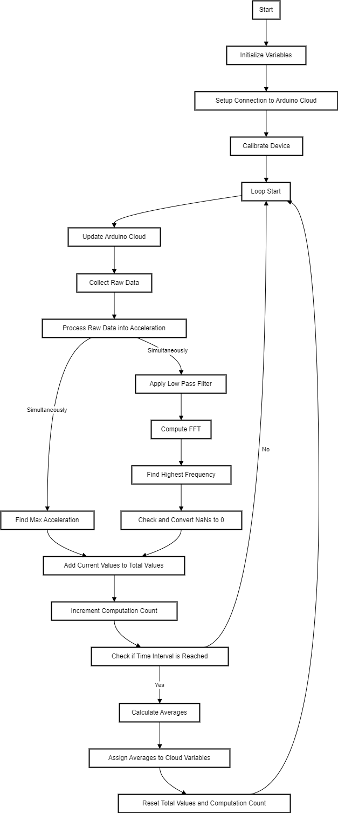
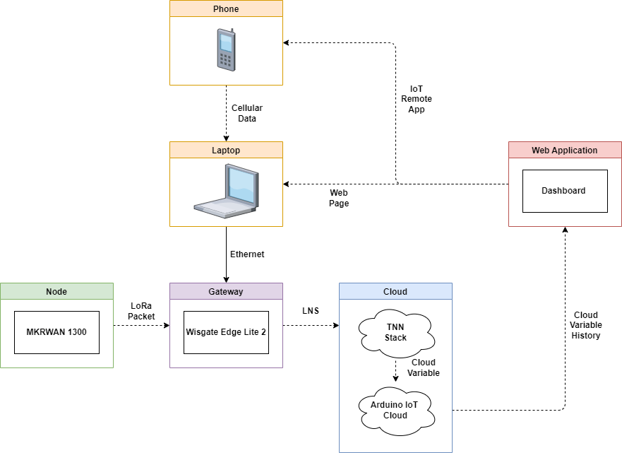

Slide 4

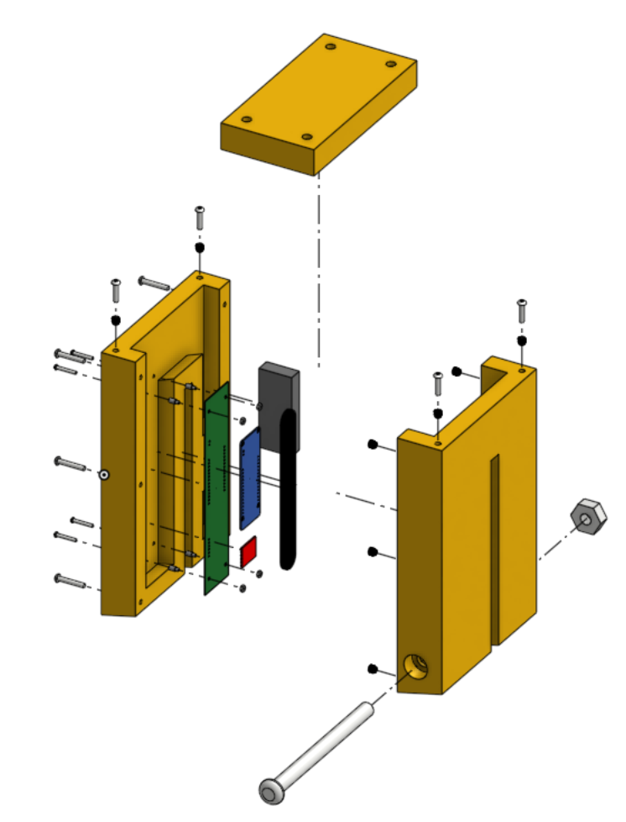
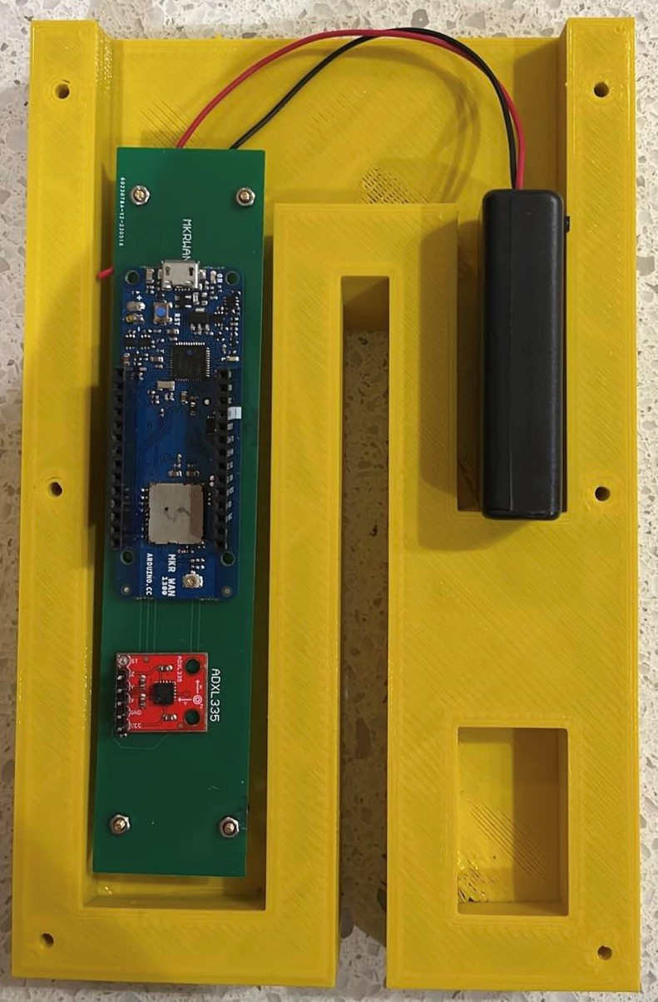

Slide 5
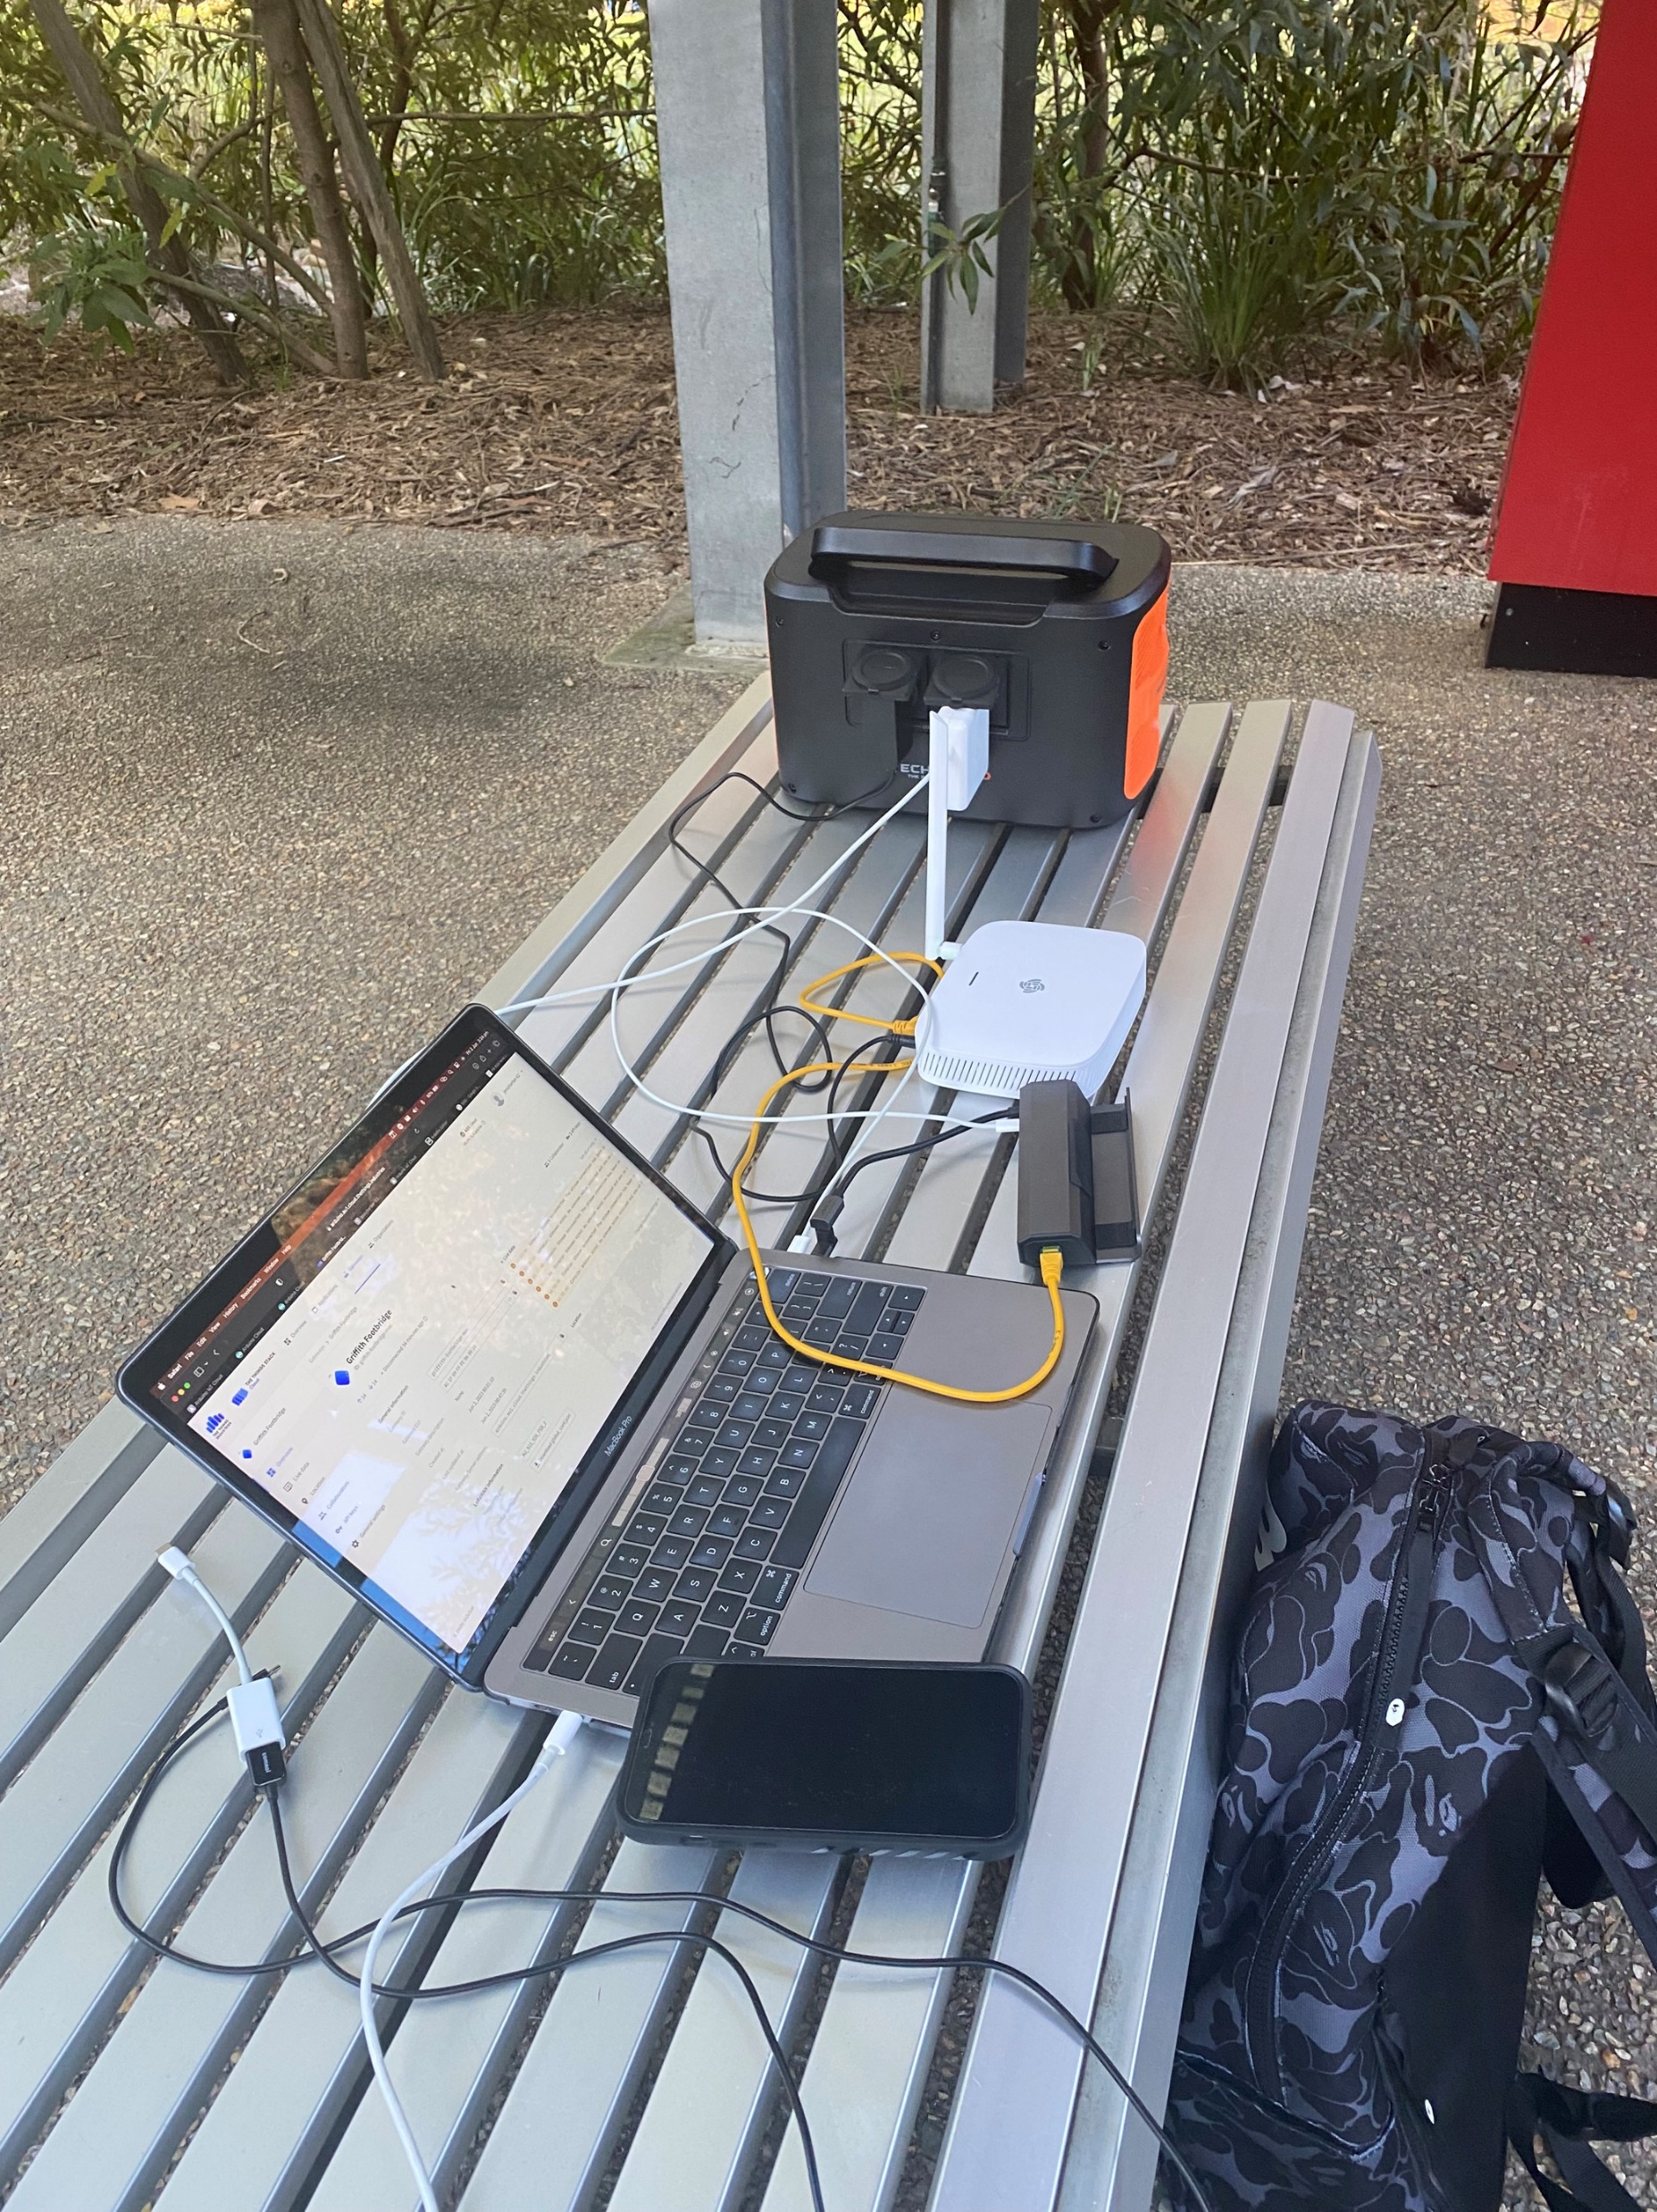
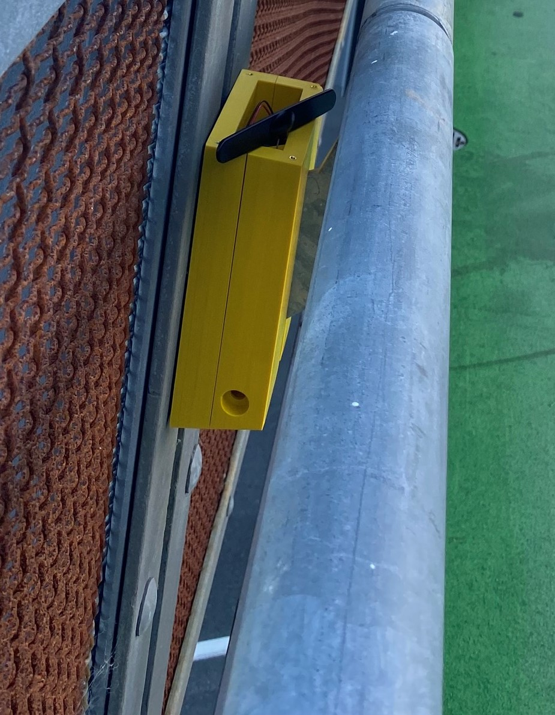
Average first mode flexural frequency:
2.5 Hz
Test range: 25m

Slide 6
Conclusion

